Slide 1


Slide 2
Raise a Halleujah
[Verse 1] I raise a hallelujah,
in the presence of my enemies I raise a hallelujah, louder than the unbelief I raise a hallelujah, my weapon is a melody I raise a hallelujah,
heaven comes to fight for me

Slide 3
[Chorus] I'm gonna sing, in the middle of the storm Louder and louder,
you're gonna hear my praises roar Up from the ashes, hope will arise Death is defeated, the King is alive!

Slide 4
[Verse 2] I raise a hallelujah, with everything inside of me I raise a hallelujah, I will watch the darkness flee I raise a hallelujah, in the middle of the mystery I raise a hallelujah, fear you lost your hold on me!

Slide 5
I'm gonna sing, in the middle of the storm Louder and louder, you're gonna hear my praises roar Up from the ashes, hope will arise Death is defeated, the King is alive!

Slide 6
////Sing a little louder
( Sing a little Louder)////

Slide 7
Sing a little louder
(In the presence of my enemies) Sing a little louder (Louder than the unbelief) Sing a little louder (My weapon is a melody) Sing a little louder (Heaven comes to fight for me) Sing a little louder
(In the presence of my enemies) Sing a little louder (Louder than the unbelief) Sing a little louder (My weapon is a melody) Sing a little louder
(Heaven comes to fight for me) Sing a little louder!

Slide 8
Glorious Day
I was buried beneath my shame Who could carry that kind of weight It was my tomb Till I met You I was breathing, but not alive All my failures I tried to hide It was my tomb, yeah Till I met You

Slide 9
You called my name And I ran out of that grave Out of the darkness Into Your glorious day
You called my name And I ran out of that grave Out of the darkness Into Your glorious day

Slide 10
I needed rescue My sin was heavy But chains break at the weight of Your glory I needed shelter I was an orphan Now You call me a citizen of heaven When I was broken You were my healing Now Your love is the air that I'm breathing I have a future
My eyes are open

Slide 11
Cause when You called my name (Shout it) I ran out of that grave Out of the darkness Into Your glorious day
You called my name And I ran out of that grave Out of the darkness Into Your glorious day

Slide 12
10000 Reasons
Bless the Lord O my soul O my soul Worship His Holy name Sing like never before O my soul I’ll worship Your Holy name
The sun comes up It’s a new day dawning It’s time to sing Your song again Whatever may pass And whatever lies before me Let me be singing When the evening comes

Slide 13
You’re rich in love And You’re slow to anger Your name is great And Your heart is kind For all Your goodness I will keep on singing
Ten thousand reasons For my heart to find

Slide 14
[Bridge 1] Bless the Lord O my soul O my soul Worship His Holy name Sing like never before O my soul I’ll worship Your Holy name

Slide 15
[Bridge 1] And on that day When my strength is failing The end draws near And my time has come Still my soul will Sing Your praise unending
Ten thousand years And then forevermore

Slide 16
Bless the Lord O my soul O my soul Worship His Holy name Sing like never before O my soul I’ll worship Your Holy name

Slide 17
Waymaker You are here, moving in our midst I worship You I worship You You are here, working in this place I worship You I worship You

Slide 18
You are Way maker, miracle worker, promise keeper Light in the darkness My God, that is who You are
You are Way maker, miracle worker, promise keeper Light in the darkness My God, that is who You are

Slide 19
You are here, touching every heart I worship You I worship You You are here, healing every heart Healing every heart Oh, I worship You

Slide 20
You are here, oh, turning lives around I worship You I worship You You mended every heart
You are here, and You are mending every heart I worship You, I worship You

Slide 21
You are Way maker, miracle worker, promise keeper Light in the darkness My God, that is who You are You are
Way maker, miracle worker, promise keeper Light in the darkness My God, that is who You are
4X

Slide 22
//That is who You are That is who You are
That is who You are That is who You are//

Slide 23
You are Way maker, miracle worker, promise keeper Light in the darkness My God, that is who You are
You are Way maker, miracle worker, promise keeper Light in the darkness My God, that is who You are

Slide 24
////Even when I don't see it, You're working Even when I don't feel it, You're working You never stop, You never stop working You never stop, You never stop working////
4x

Slide 25
You are Way maker, miracle worker, promise keeper Light in the darkness My God, that is who You are
You are Way maker, miracle worker, promise keeper Light in the darkness My God, that is who You are

Slide 26
Anthem By His stripes, we are healed By His nail-pierced hands, we're free By His blood, we're washed clean Now we have the victory
The power of sin is broken Jesus overcame it all He has won our freedom Jesus has won it all

Slide 27
Hallelujah, You have won the victory Hallelujah, You have won it all for me Death could not hold You down,
You are the risen King Seated in majesty, You are the risen King

Slide 28
By His stripes, we are healed By His nail-pierced hands, we're free By His blood, we're washed clean Now we have the victory
The power of sin is broken Jesus overcame it all He has won our freedom Jesus has won it all

Slide 29
Hallelujah, You have won the victory Hallelujah, You have won it all for me Death could not hold You down,
You are the risen King Seated in majesty, You are the risen King

Slide 30
//Our God is risen, He is alive He won the victory, He reigns on high Our God is risen, He is alive He won the victory, He reigns on high//

Slide 31
Hallelujah, You have won the victory Hallelujah, You have won it all for me Death could not hold You down,
You are the risen King Seated in majesty, You are the risen King

Slide 33


Slide 34
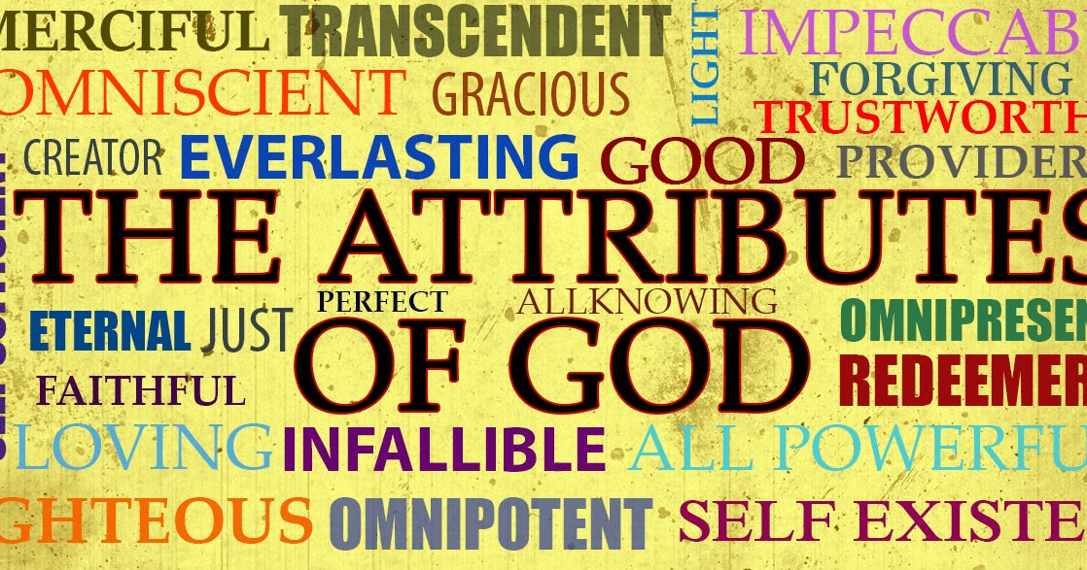

God’s Greatest Attributes to Mankind
by Pastor Fee Soliven
Exodus 34:5-9
Sunday Morning
February 7, 2021

Slide 35
Exodus 34:5-9
5 Now the LORD descended in the cloud and stood with him there, and proclaimed the name of the LORD. 6 And the LORD passed before him and proclaimed, "The LORD, the LORD God, merciful and gracious, longsuffering, and abounding in goodness and truth,

Slide 36
7 keeping mercy for thousands, forgiving iniquity and transgression and sin, by no means clearing the guilty, visiting the iniquity of the fathers upon the children and the children's children to the third and the fourth generation." 8 So Moses made haste and bowed his head toward the earth, and worshiped.

Slide 37
9 Then he said, "If now I have found grace in Your sight, O Lord, let my Lord, I pray, go among us, even though we are a stiff-necked people; and pardon our iniquity and our sin, and take us as Your inheritance."

Slide 38
1. God Revealed Himself as Merciful
2. God Revealed Himself as Gracious
3. God Revealed Himself as Patient
4. God Revealed Himself as Good
5. God Revealed Himself as True

Slide 39
1. God Revealed Himself as Merciful

Slide 40
The Hebrew word for mercy, rachuwm, simply means “compassionate.”

Slide 41
Romans 3:23
“for all have sinned and fall short of the glory of God”

Slide 42
Ephesians 2:4-7
4 But God, who is rich in mercy, because of His great love with which He loved us, 5 even when we were dead in trespasses, made us alive together with Christ (by grace you have been saved), 6 and raised us up together, and made us sit together in the heavenly places in Christ Jesus, 7 that in the ages to come He might show the exceeding riches of His grace in His kindness toward us in Christ Jesus.

Slide 43
2. God Revealed Himself as Gracious

Slide 44
The Hebrew root word for “gracious” is chanan, which simply means “to bend or stoop in kindness to an inferior.”

Slide 45
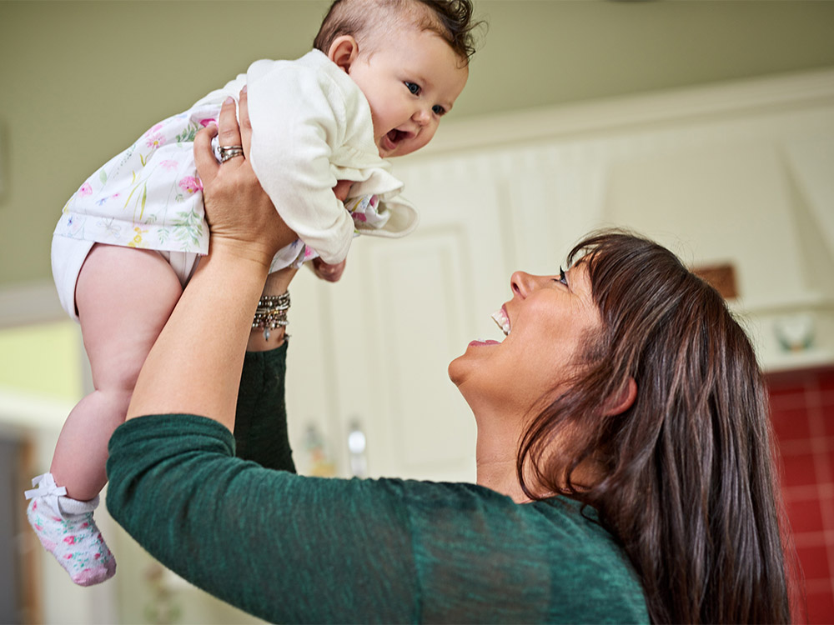

Slide 46
1 Peter 5:10-11
10 But may the God of all grace, who called us to His eternal glory by Christ Jesus, after you have suffered a while, perfect, establish, strengthen, and settle you. 11 To Him be the glory and the dominion forever and ever. Amen.

Slide 47
Hebrews 4:14-16
14 Seeing then that we have a great High Priest who has passed through the heavens, Jesus the Son of God, let us hold fast our confession. 15 For we do not have a High Priest who cannot sympathize with our weaknesses, but was in all points tempted as we are, yet without sin. 16 Let us therefore come boldly to the throne of grace, that we may obtain mercy and find grace to help in time of need.

Slide 48
3. God Revealed Himself as Patient

Slide 49
Psalm 145:8-9
8 The LORD is gracious and full of compassion, Slow to anger and great in mercy. 9 The LORD is good to all, And His tender mercies are over all His works.

Slide 50
Revelation 1:8
I am the Alpha and the Omega, the Beginning and the End," says the Lord, "who is and who was and who is to come, the Almighty."

Slide 51
Luke 4:17-18
17 And He was handed the book of the prophet Isaiah. And when He had opened the book, He found the place where it was written: 18 "The Spirit of the LORD is upon Me, Because He has anointed Me To preach the gospel to the poor; He has sent Me to heal the brokenhearted, To proclaim liberty to the captives And recovery of sight to the blind, To set at liberty those who are oppressed;

Slide 52
4. God Revealed Himself as Good

Slide 53
Matthew 19:17
“So He said to him, "Why do you call Me good? No one is good but One, that is, God. But if you want to enter into life, keep the commandments."

Slide 54
Romans 2:4
“Or do you despise the riches of His goodness, forbearance, and longsuffering, not knowing that the goodness of God leads you to repentance?”

Slide 55
Psalm 34:8
“Oh, taste and see that the LORD is good; Blessed is the man who trusts in Him!”

Slide 56
Romans 15:13
“Now may the God of hope fill you with all joy and peace in believing, that you may abound in hope by the power of the Holy Spirit.”

Slide 57
5. God Revealed Himself as True

Slide 58
The Hebrew word for truth is “emeth” and has many nuances of meaning: establishment, faithfulness, sureness, right, verity
(certainty, reality)

Slide 59
Exodus 34:5-8
6 And the LORD passed before him and proclaimed, "The LORD, the LORD God, merciful and gracious, longsuffering, and abounding in goodness and truth, 7 keeping mercy for thousands, forgiving iniquity and transgression and sin, by no means clearing the guilty, visiting the iniquity of the fathers upon the children and the children's children to the third and the fourth generation."

Slide 60
John 14:6
“Jesus said to him, "I am the way, the truth, and the life. No one comes to the Father except through Me.”

Slide 61
Revelation 15:3
“They sing the song of Moses, the servant of God, and the song of the Lamb, saying: "Great and marvelous are Your works, Lord God Almighty! Just and true are Your ways, O King of the saints!

Slide 62
John 17:15-19
17 Sanctify them by Your truth. Your word is truth. 18 As You sent Me into the world, I also have sent them into the world. 19 And for their sakes I sanctify Myself, that they also may be sanctified by the truth.

Slide 63
3 John 2-4
2 Beloved, I pray that you may prosper in all things and be in health, just as your soul prospers. 3 For I rejoiced greatly when brethren came and testified of the truth that is in you, just as you walk in the truth. 4 I have no greater joy than to hear that my children walk in truth.

Slide 64
1 Thessalonians 4:13-18
13 But I do not want you to be ignorant, brethren, concerning those who have fallen asleep, lest you sorrow as others who have no hope. 14 For if we believe that Jesus died and rose again, even so God will bring with Him those who sleep in Jesus.

Slide 65
15 For this we say to you by the word of the Lord, that we who are alive and remain until the coming of the Lord will by no means precede those who are asleep. 16 For the Lord Himself will descend from heaven with a shout, with the voice of an archangel, and with the trumpet of God. And the dead in Christ will rise first.

Slide 66
17 Then we who are alive and remain shall be caught up together with them in the clouds to meet the Lord in the air. And thus we shall always be with the Lord. 18 Therefore comfort one another with these words.

Slide 67
1 Corinthians 15:50-54
50 Now this I say, brethren, that flesh and blood cannot inherit the kingdom of God; nor does corruption inherit incorruption. 51 Behold, I tell you a mystery: We shall not all sleep, but we shall all be changed-- 52 in a moment, in the twinkling of an eye, at the last trumpet. For the trumpet will sound, and the dead will be raised incorruptible, and we shall be changed.

Slide 68
53 For this corruptible must put on incorruption, and this mortal must put on immortality. 54 So when this corruptible has put on incorruption, and this mortal has put on immortality, then shall be brought to pass the saying that is written: "Death is swallowed up in victory."

Slide 69
Acts 2:38-39
38 Then Peter said to them, "Repent, and let every one of you be baptized in the name of Jesus Christ for the remission of sins; and you shall receive the gift of the Holy Spirit. 39 For the promise is to you and to your children, and to all who are afar off, as many as the Lord our God will call."

