Slide 1


Slide 2
Everlasting God
[Verse 1] Strength will rise as we wait upon the Lord We will wait upon the Lord We will wait upon the Lord

Slide 3
[Chorus][x2] Our God, You reign forever Our hope, our Strong Deliverer You are the everlasting God The everlasting God You do not faint You won't grow weary

Slide 4
[Verse 2] You're the defender of the weak You comfort those in need You lift us up on wings like eagles

Slide 5
Your Love Never Fails
Nothing can separate Even if I ran away Your love never fails
I know I still make mistakes But You have new mercies for me everyday Your love never fails

Slide 6
Chorus
You stay the same through the ages Your love never changes And may be pain in the night But joy comes in the morning And when the oceans rage I don't have to be afraid Because I know that You love me Your love never fails

Slide 7
The wind is strong and the water's deep I'm not alone in these open seas 'Cause Your love never fails
The chasm is far too wide I never thought I'd reach the other side 'Cause Your love never fails

Slide 8
Chorus
You stay the same through the ages Your love never changes And may be pain in the night But joy comes in the morning And when the oceans rage I don't have to be afraid Because I know that You love me Your love never fails

Slide 9
Cause You make all things work together for my good You make all things work together for my good You make all things work together for my good You make all things work together for my good You make all things work together for my good You make all things work together for my good

Slide 10
Chorus
You stay the same through the ages Your love never changes And may be pain in the night But joy comes in the morning And when the oceans rage I don't have to be afraid Because I know that You love me Your love never fails

Slide 11
Break Every Chain
[Chorus] There is power in the name of Jesus There is power in the name of Jesus There is power in the name of Jesus To break every chain, break every chain,
break every chain To break every chain, break every chain,
break every chain

Slide 12
There is power in the name of Jesus Oh there is power in the name of Jesus There is power in the name of Jesus To break every chain, break every chain,
break every chain Break every chain, to break every chain,
break every chain

Slide 13
There is power in the name of Jesus There is power in the name of Jesus There is power in the name of Jesus To break every chain, break every chain, break every chain To break every chain, break every chain, break every chain

Slide 14
[Bridge 1] There's an army rising up There's an army rising up There's an army rising up To break every chain, break every chain,
break every chain To break every chain, break every chain,
break every chain

Slide 15
[Chorus] There is power in the name of Jesus There is power in the name of Jesus There is power in the name of Jesus To break every chain, break every chain,
break every chain To break every chain, break every chain,
break every chain

Slide 16
[Bridge 1] There's an army rising up There's an army rising up There's an army rising up To break every chain, break every chain,
break every chain To break every chain, break every chain,
break every chain

Slide 17
[Bridge 2] I hear the chains falling I hear the chains falling I hear the chains falling I hear the chains falling I hear the chains falling I hear the chains falling I hear the chains falling I hear the chains falling

Slide 18
[Interlude] [Outro] I hear the chains falling I hear the chains falling I hear the chains falling I hear the chains falling I hear the chains falling I hear the chains falling I hear the chains falling...

Slide 19
How He Loves Me [Verse] He is jealous for me Loves like a hurricane I am a tree bending beneath The weight of His wind and mercy When all of a sudden I am unaware of these afflictions eclipsed by glory And I realize just how beautiful You are And how great Your affections are for me

Slide 20
[Chorus] And oh how He loves us Oh, oh how He loves us How He loves us all

Slide 21
[Verse] And He is jealous for me Loves like a hurricane I am a tree bending beneath The weight of His wind and mercy When all of a sudden I am unaware of these afflictions eclipsed by glory And I realize just how beautiful You are And how great Your affections are for me

Slide 22
[Chorus] And oh how He loves us Oh, oh how He loves us How He loves us all

Slide 23
[Post-Chorus] Yeah, He loves us Oh, how He loves us Oh, how He loves us Oh, how He loves

Slide 24
[Bridge] And we are His portion And He is our prize Drawn to redemption by the grace in His eyes If His grace is an ocean, we're all sinking When heaven meets earth like an unforeseen kiss And my heart turns violently inside of my chest I don't have time to maintain these regrets When I think about the way that He loves us

Slide 25
[Chorus] And oh how He loves us Oh, oh how He loves us How He loves us all And oh how He loves us Oh, oh how He loves us How He loves us all And oh how He loves us Oh, oh how He loves us How He loves us all

Slide 27


Slide 28
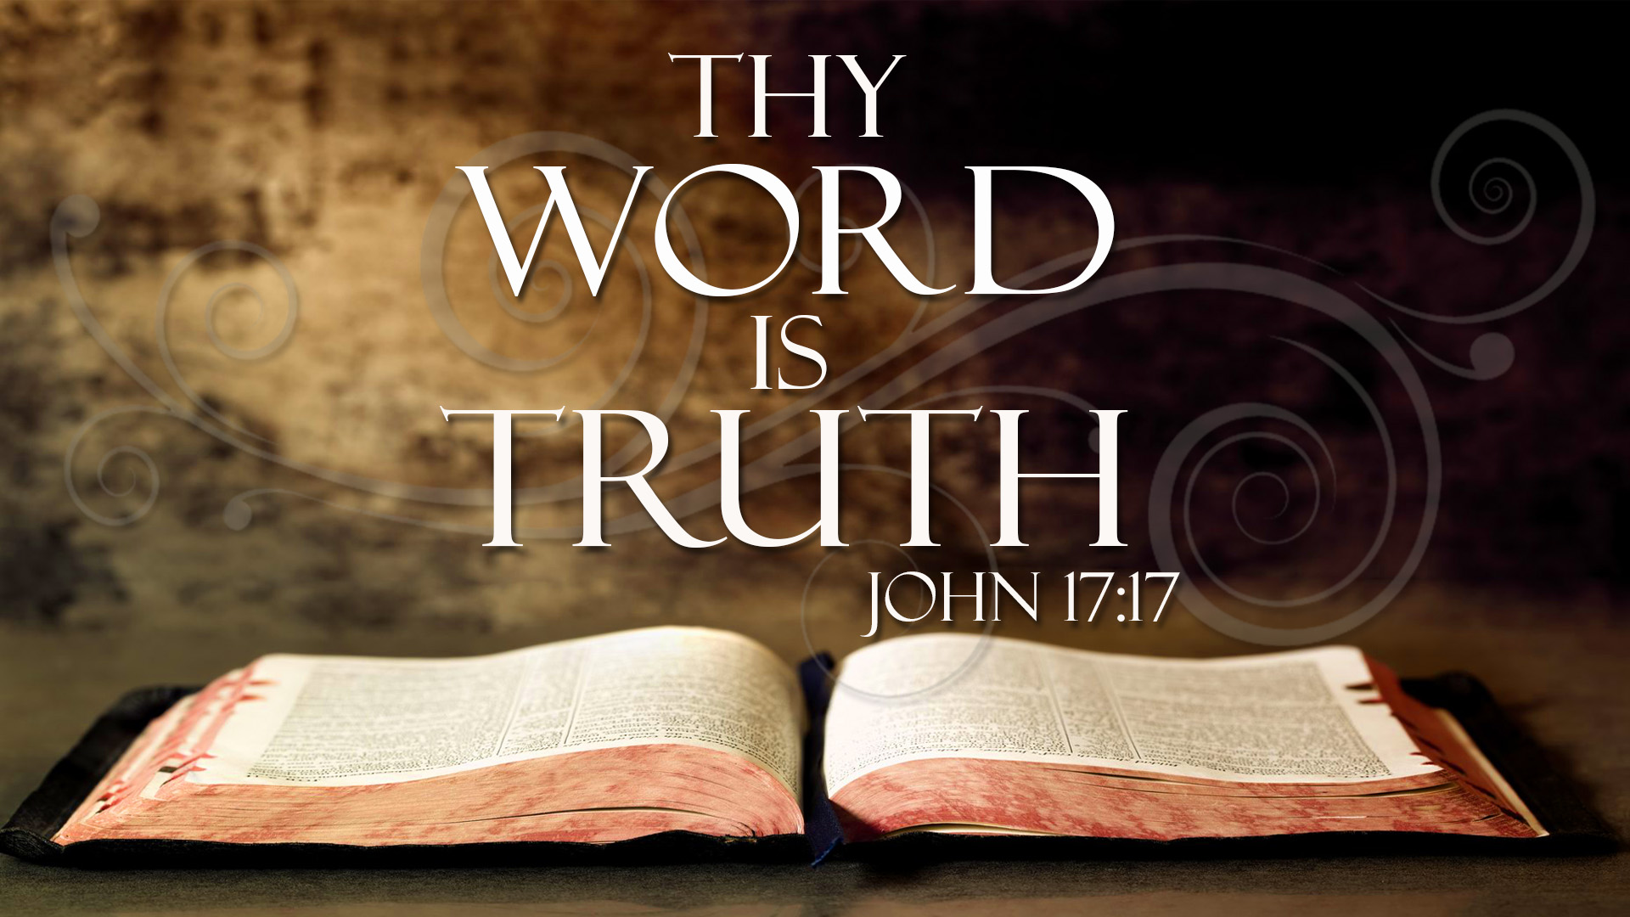

Help Us to Embrace Thy Word
By Pastor Fee Soliven
Isaiah 66:1-2
Sunday Morning
January 31, 2021

Slide 29
Isaiah 66:1-2
1 Thus says the LORD: "Heaven is My throne, And earth is My footstool. Where is the house that you will build Me? And where is the place of My rest? 2 For all those things My hand has made, And all those things exist," Says the LORD. "But on this one will I look: On him who is poor and of a contrite spirit, And who trembles at My word.

Slide 30
What we believe about the Bible is Absolutely Crucial!

Slide 31
John 17:17
“Sanctify them through thy truth: thy Word is Truth”

Slide 32
John 14:6
“Jesus said to him, "I am the way, the truth, and the life. No one comes to the Father except through Me”

Slide 33
Webster Dictionary: Conviction
1. A fixed or firm belief: 2. No clever argument, no persuasive fact or theory could make a dent in his conviction in the rightness of his position.

Slide 34
Isaiah 66:1-2
1 Thus says the LORD: "Heaven is My throne, And earth is My footstool. Where is the house that you will build Me? And where is the place of My rest? 2 For all those things My hand has made, And all those things exist," Says the LORD. "But on this one will I look: On him who is poor and of a contrite spirit, And who trembles at My word.

Slide 35
1. To Reveal the One True God

Slide 36
2 Peter 1:1
Simon Peter, a bondservant and apostle of Jesus Christ, To those who have obtained like precious faith with us by the righteousness of our God and Savior Jesus Christ…

Slide 37
2. To Explain how to Be Saved

Slide 38
Acts 2:38-39
38 Then Peter said to them, "Repent, and let every one of you be baptized in the name of Jesus Christ for the remission of sins; and you shall receive the gift of the Holy Spirit. 39 For the promise is to you and to your children, and to all who are afar off, as many as the Lord our God will call."

Slide 39
Acts 3:19-21
19 Repent therefore and be converted, that your sins may be blotted out, so that times of refreshing may come from the presence of the Lord, 20 and that He may send Jesus Christ, who was preached to you before, 21 whom heaven must receive until the times of restoration of all things, which God has spoken by the mouth of all His holy prophets since the world began.

Slide 40
3. To Teach us how to live a Godly Life

Slide 41
Romans 12:1-2
1 I beseech you therefore, brethren, by the mercies of God, that you present your bodies a living sacrifice, holy, acceptable to God, which is your reasonable service. 2 And do not be conformed to this world, but be transformed by the renewing of your mind, that you may prove what is that good and acceptable and perfect will of God.

Slide 42
4. To Equip us to Serve the Lord

Slide 43
Ephesians 4:11-12
11 And He Himself gave some to be apostles, some prophets, some evangelists, and some pastors and teachers, 12 for the equipping of the saints for the work of ministry, for the edifying of the body of Christ…

Slide 44
We can trust that the Bible is the absolute Word of God

Slide 45
1. It’s Timeless

Slide 46
Psalm 119:89
“Forever, O LORD, Your word is settled in heaven”

Slide 47
2. It’s Infallible

Slide 48
Psalm19:7-8
7 The law of the LORD is perfect, converting the soul; The testimony of the LORD is sure, making wise the simple; 8 The statutes of the LORD are right, rejoicing the heart; The commandment of the LORD is pure, enlightening the eyes…

Slide 49
3. The Word is the Revelation of the one True God

Slide 50
1 Timothy 3:16
“And without controversy great is the mystery of godliness: God was manifested in the flesh, Justified in the Spirit, Seen by angels, Preached among the Gentiles, Believed on in the world,
Received up in glory”

Slide 51
4. The Bible Exposes Man’s Sinful, Hopeless Condition

Slide 52
Isaiah 64:6
“But we are all like an unclean thing, And all our righteousnesses are like filthy rags; We all fade as a leaf, And our iniquities, like the wind, Have taken us away”

Slide 53
Jeremiah 17:9-10
9 "The heart is deceitful above all things, And desperately wicked; Who can know it? 10 I, the LORD, search the heart, I test the mind, Even to give every man according to his ways, According to the fruit of his doings.

Slide 54
Romans 14:12
“So then each of us shall give account of himself to God”

Slide 55
5. Scripture is a Trustworthy
Guide for Daily Life

Slide 56
Luke 21:33
“Heaven and earth will pass away, but My words will by no means pass away”

Slide 57
6. It Shows us the Consequences of Sin

Slide 58
Romans 6:23
“For the wages of sin is death, but the free gift of God is eternal life in Christ Jesus our Lord”

Slide 59
Ephesians 4:18–19
18 They are darkened in their understanding, alienated from the life of God because of the ignorance that is in them, due to their hardness of heart. 19 They have become callous and have given themselves up to sensuality, greedy to practice every kind of impurity.

Slide 60
7. God’s Word Reveals His Unconditional
love for His Children

Slide 61
Romans 8:37-39
37 Yet in all these things we are more than conquerors through Him who loved us. 38 For I am persuaded that neither death nor life, nor angels nor principalities nor powers, nor things present nor things to come, 39 nor height nor depth, nor any other created thing, shall be able to separate us from the love of God which is in Christ Jesus our Lord.

Slide 62
8. God’s Word Reveals the 5 Fundamentals of The Christian Faith!

Slide 63
1. The Deity of Christ (Jesus is God)

Slide 64
2. The Virgin Birth
“The Immaculate Conception”

Slide 65
3. The Crucifixion of Jesus
(His Atoning Blood)

Slide 66
4. The Resurrection of
Our Lord Jesus Christ

Slide 67
5. The 2nd Coming of Our Lord and Savior Jesus Christ!

Slide 68
Scripture tells us how to handle temptation

Slide 69
1 Corinthians 10:13
God “will not allow you to be tempted beyond what you are able, but with the temptation will provide the way of escape also, so that you will be able to endure it.”

Slide 70
God’s Word assures us of Christ’s Return and our Future Reward

Slide 71
John 14:1-3
1 "Let not your heart be troubled; you believe in God, believe also in Me. 2 In My Father's house are many mansions; if it were not so, I would have told you. I go to prepare a place for you. 3 And if I go and prepare a place for you, I will come again and receive you to Myself; that where I am, there you may be also.

Slide 72
Matthew 16:27
“For the Son of Man will come in the glory of His Father with His angels, and then He will reward each according to his works”

Slide 73
Jesus in the Bible also warns us of Coming Judgment

Slide 74
Hebrews 9:27
“It is appointed for men to die once and after this comes judgment”.

Slide 75
Revelation 21:6-8
6 And He said to me, "It is done! I am the Alpha and the Omega, the Beginning and the End. I will give of the fountain of the water of life freely to him who thirsts. 7 He who overcomes shall inherit all things, and I will be his God and he shall be My son.

Slide 76
8 But the cowardly, unbelieving, abominable, murderers, sexually immoral, sorcerers, idolaters, and all liars shall have their part in the lake which burns with fire and brimstone, which is the second death."

Slide 77
Scripture reveals all Future
Events with Accuracy

Slide 78
The Bible is the Indestructible
Word of the living God

Slide 79
Isaiah 40:8
“The grass withers, the flower fades, But the word of our God stands forever."

Slide 80
1 Peter 1:23-25
23 having been born again, not of corruptible seed but incorruptible, through the word of God which lives and abides forever, 24 because "All flesh is as grass, And all the glory of man as the flower of the grass. The grass withers, And its flower falls away, 25 But the word of the LORD endures forever." Now this is the word which by the gospel was preached to you.

Slide 81
It is to be Believed, Valued, and Obeyed

Slide 82
1. Are you thoroughly convinced that the Bible is the infallible Word of God?

Slide 83
2. If so, how is it impacting and transforming your life?

Slide 84
3. If not, what areas do you struggle to believe and why?

Slide 85
15 For this we say to you by the word of the Lord, that we who are alive and remain until the coming of the Lord will by no means precede those who are asleep. 16 For the Lord Himself will descend from heaven with a shout, with the voice of an archangel, and with the trumpet of God. And the dead in Christ will rise first.

Slide 86
17 Then we who are alive and remain shall be caught up together with them in the clouds to meet the Lord in the air. And thus we shall always be with the Lord. 18 Therefore comfort one another with these words.

Slide 87
1 Corinthians 15:50-54
50 Now this I say, brethren, that flesh and blood cannot inherit the kingdom of God; nor does corruption inherit incorruption. 51 Behold, I tell you a mystery: We shall not all sleep, but we shall all be changed-- 52 in a moment, in the twinkling of an eye, at the last trumpet. For the trumpet will sound, and the dead will be raised incorruptible, and we shall be changed.

Slide 88
53 For this corruptible must put on incorruption, and this mortal must put on immortality. 54 So when this corruptible has put on incorruption, and this mortal has put on immortality, then shall be brought to pass the saying that is written: "Death is swallowed up in victory."

Slide 89

20 Again, when a righteous man turns from his righteousness and commits iniquity, and I lay a stumbling block before him, he shall die; because you did not give him warning, he shall die in his sin, and his righteousness which he has done shall not be remembered; but his blood I will require at your hand.

Slide 90
Acts 2:38-39
38 Then Peter said to them, "Repent, and let every one of you be baptized in the name of Jesus Christ for the remission of sins; and you shall receive the gift of the Holy Spirit. 39 For the promise is to you and to your children, and to all who are afar off, as many as the Lord our God will call."

