Slide 1


Slide 2
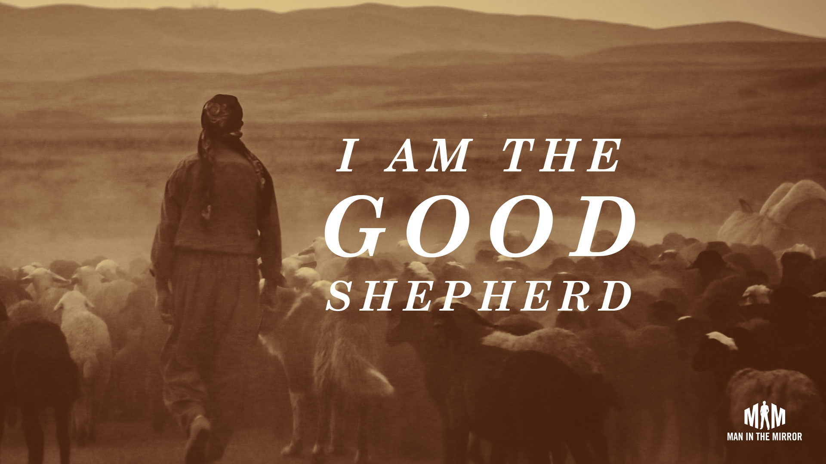

Jesus Our Great Shepherd
by Pastor Fee Soliven
John 10:11-16
Sunday Morning
February 21, 2021

Slide 3
John 10:11-16
11 I am the good shepherd. The good shepherd gives His life for the sheep. 12 But a hireling, he who is not the shepherd, one who does not own the sheep, sees the wolf coming and leaves the sheep and flees; and the wolf catches the sheep and scatters them. 13 The hireling flees because he is a hireling and does not care about the sheep.

Slide 4
14 I am the good shepherd; and I know My sheep, and am known by My own. 15 As the Father knows Me, even so I know the Father; and I lay down My life for the sheep. 16 And other sheep I have which are not of this fold; them also I must bring, and they will hear My voice; and there will be one flock and one shepherd.

Slide 5
King David Understood What
A Good Shepherd Does

Slide 6
Psalm 23:1-6
The LORD is my shepherd; I shall not want. 2 He makes me to lie own in green pastures; He leads me beside the still waters. 3 He restores my soul; He leads me in the paths of righteousness For His name's sake. 4 Yea, though I walk through the valley of the shadow of death, I will fear no evil; For You are with me; Your rod and Your staff, they comfort me.

Slide 7
5 You prepare a table before me in the presence of my enemies; You anoint my head with oil; My cup runs over. 6 Surely goodness and mercy shall follow me All the days of my life; And I will dwell in the house of the LORD Forever.

Slide 8
King David perceived the shepherd about whom he wrote as One who could meet all his needs as demonstrated in the compound names of Jehovah

Slide 9
Jehovah Jireh (The Lord Is My Provider)
Jehovah Nissi (The Lord My Banner)
Jehovah Raah (The Lord My Shepherd)
Jehovah Rapha (The Lord That Heals)
Jehovah Shammah (The Lord Is There)
Jehovah Shalom (The Lord Is My Peace)
Jehovah Tsidkenu
(The Lord Our Righteousness)

Slide 10
The Lord Is My Shepherd—Jehovah-Roi

Slide 11
Jesus Is the Good Shepherd

Slide 12
John 10:14-16
14 I am the good shepherd; and I know My sheep, and am known by My own. 15 As the Father knows Me, even so I know the Father; and I lay down My life for the sheep. 16 And other sheep I have which are not of this fold; them also I must bring, and they will hear My voice; and there will be one flock and one shepherd.

Slide 13
Jesus Is the Chief Shepherd

Slide 14
1 Peter 5:4
“and when the Chief Shepherd appears, you will receive the crown of glory that does not fade away”

Slide 15
The Shepherd Will Provide
Jehovah - Jireh

Slide 16
He Supplies All Our Needs

Slide 17
Psalm 37:25
“I have been young, and now am old; Yet I have not seen the righteous forsaken, Nor his descendants begging bread”

Slide 18
Philippians 4:19
“And my God shall supply all your need according to His riches in glory by Christ Jesus”

Slide 19
The Shepherd Leads Beside Still Waters

Slide 20
Judges 6:23-24
23 Then the LORD said to him, "Peace be with you; do not fear, you shall not die." 24 So Gideon built an altar there to the LORD, and called it The-LORD-Is-Peace. To this day it is still in Ophrah of the Abiezrites.

Slide 21
Jesus Is Our Peace

Slide 22
Jehovah-Shalom – The Lord Is My Peace

Slide 23
2 Timothy 1:7
“For God has not given us a spirit of fear, but of power and of love and of a sound mind”

Slide 24
John 14:27
“Peace I leave with you, My peace I give to you; not as the world gives do I give to you. Let not your heart be troubled, neither let it be afraid”

Slide 25
The Shepherd Restores

Slide 26
Jehovah-Rapha The Lord Our Healer

Slide 27
Isaiah 53:5
“But He was wounded for our transgressions, He was bruised for our iniquities; The chastisement for our peace was upon Him, And by His stripes we are healed”

Slide 28
1 Peter 2:24
“who Himself bore our sins in His own body on the tree, that we, having died to sins, might live for righteousness--by whose stripes you were healed”

Slide 29
James 5:16
“Confess your trespasses to one another, and pray for one another, that you may be healed. The effective, fervent prayer of a righteous man avails much”

Slide 30
Psalm 103:2-3
2 “Bless the LORD, O my soul, and forget not all his benefits: 3 who forgives all your iniquities; who heals all of your diseases”

Slide 31
Matthew 4:23
“And Jesus went about all Galilee, teaching in their synagogues, and preaching the gospel of the kingdom, and healing all manner of sickness and all manner of disease among the people”

Slide 32
Jesus Our Shepherd Leads in
Paths of Righteousness

Slide 33
Jesus Is - Jehovah-Tsidkenu
Our Righteousness

Slide 34
Jeremiah 23:5-6
5 "Behold, the days are coming," says the LORD, "That I will raise to David a Branch of righteousness; A King shall reign and prosper, And execute judgment and righteousness in the earth. 6 In His days Judah will be saved, And Israel will dwell safely; Now this is His name by which He will be called: THE LORD OUR RIGHTEOUSNESS.

Slide 35
Romans 3:21-22
“But now the righteousness of God apart from the law is revealed, being witnessed by the Law and the Prophets, 22 even the righteousness of God, through faith in Jesus Christ, to all and on all who believe. For there is no difference”

Slide 36
The Shepherd Is Always Present

Slide 37
Jesus Is - Jehovah-Shammah
The Lord Is There

Slide 38
Hebrews 13:5
“Let your conversation be without covetousness; and be content with such things as ye have: for he hath said, I will never leave you, nor forsake you”

Slide 39
Jesus Blesses Us in the Midst of Trials

Slide 40
The Shepherd Will Fight Our Battles

Slide 41
Jesus Is - Jehovah-Nissi
The LORD Our Banner

Slide 42
Romans 8:31
“What then shall we say to these things? If God is for us, who can be against us?”

Slide 43
Isaiah 59:19
“So shall they fear the name of the LORD from the west, and his glory from the rising of the sun. When the enemy shall come in like a flood, the Spirit of the LORD shall lift up a standard against him”

Slide 44
Philippians 4:13
“I can do all things through Christ who strengthens me”

Slide 45
The Good Shepherd

Slide 46
John 10:11-18
11 I am the good shepherd. The good shepherd gives His life for the sheep. 12 But a hireling, he who is not the shepherd, one who does not own the sheep, sees the wolf coming and leaves the sheep and flees; and the wolf catches the sheep and scatters them.

Slide 47
13 The hireling flees because he is a hireling and does not care about the sheep. 14 I am the good shepherd; and I know My sheep, and am known by My own. 15 As the Father knows Me, even so I know the Father; and I lay down My life for the sheep. 16 And other sheep I have which are not of this fold; them also I must bring, and they will hear My voice; and there will be one flock and one shepherd.

Slide 48
17 Therefore My Father loves Me, because I lay down My life that I may take it again. 18 No one takes it from Me, but I lay it down of Myself. I have power to lay it down, and I have power to take it again. This command I have received from My Father."

Slide 49
1 Thessalonians 4:13-18
13 But I do not want you to be ignorant, brethren, concerning those who have fallen asleep, lest you sorrow as others who have no hope. 14 For if we believe that Jesus died and rose again, even so God will bring with Him those who sleep in Jesus.

Slide 50
15 For this we say to you by the word of the Lord, that we who are alive and remain until the coming of the Lord will by no means precede those who are asleep. 16 For the Lord Himself will descend from heaven with a shout, with the voice of an archangel, and with the trumpet of God. And the dead in Christ will rise first.

Slide 51
17 Then we who are alive and remain shall be caught up together with them in the clouds to meet the Lord in the air. And thus we shall always be with the Lord. 18 Therefore comfort one another with these words.

Slide 52
1 Corinthians 15:50-54
50 Now this I say, brethren, that flesh and blood cannot inherit the kingdom of God; nor does corruption inherit incorruption. 51 Behold, I tell you a mystery: We shall not all sleep, but we shall all be changed-- 52 in a moment, in the twinkling of an eye, at the last trumpet. For the trumpet will sound, and the dead will be raised incorruptible, and we shall be changed.

Slide 53
53 For this corruptible must put on incorruption, and this mortal must put on immortality. 54 So when this corruptible has put on incorruption, and this mortal has put on immortality, then shall be brought to pass the saying that is written: "Death is swallowed up in victory."

Slide 54

20 Again, when a righteous man turns from his righteousness and commits iniquity, and I lay a stumbling block before him, he shall die; because you did not give him warning, he shall die in his sin, and his righteousness which he has done shall not be remembered; but his blood I will require at your hand.

Slide 55
Acts 2:38-39
38 Then Peter said to them, "Repent, and let every one of you be baptized in the name of Jesus Christ for the remission of sins; and you shall receive the gift of the Holy Spirit. 39 For the promise is to you and to your children, and to all who are afar off, as many as the Lord our God will call."

