Slide 1
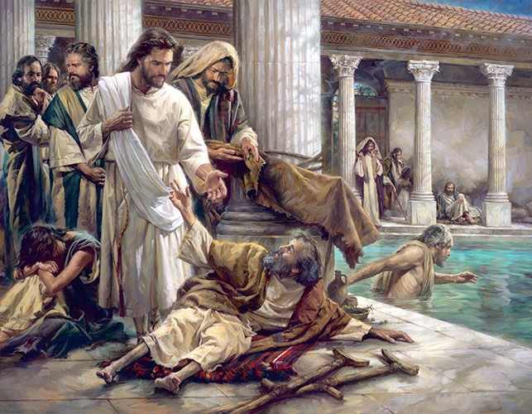

Jesus The God of All Comfort
By Pastor Fee Soliven
Luke 24:47-49
Wednesday Evening
February 3, 2021

Slide 2
Luke 24:44-49
44 Then He said to them, "These are the words which I spoke to you while I was still with you, that all things must be fulfilled which were written in the Law of Moses and the Prophets and the Psalms concerning Me." 45 And He opened their understanding, that they might comprehend the Scriptures.

Slide 3
46 Then He said to them, "Thus it is written, and thus it was necessary for the Christ to suffer and to rise from the dead the third day, 47 and that repentance and remission of sins should be preached in His name to all nations, beginning at Jerusalem. 48 And you are witnesses of these things. 49 Behold, I send the Promise of My Father upon you; but tarry in the city of Jerusalem until you are endued with power from on high."

Slide 4
Even as Christians, it’s possible for us to be unaware of one of God’s most awesome blessings.

Slide 5
1. Who is the Holy Spirit?

Slide 6
Romans 1:20
“For since the creation of the world His invisible attributes are clearly seen, being understood by the things that are made, even His eternal power and Godhead, so that they are without excuse…”

Slide 7
John 14:16-18
16 And I will pray the Father, and He will give you another Helper, that He may abide with you forever-- 17 the Spirit of truth, whom the world cannot receive, because it neither sees Him nor knows Him; but you know Him, for He dwells with you and will be in you. 18 I will not leave you orphans; I will come to you.

Slide 8
2. Why did the Father send the
Holy Spirit?

Slide 9
Luke 24:47-49
47 and that repentance and remission of sins should be preached in His name to all nations, beginning at Jerusalem. 48 And you are witnesses of these things. 49 Behold, I send the Promise of My Father upon you; but tarry in the city of Jerusalem until you are endued with power from on high."

Slide 10
Acts 2:1-6
1 Now when the Day of Pentecost had fully come, they were all with one accord in one place. 2 And suddenly there came a sound from heaven, as of a rushing mighty wind, and it filled the whole house where they were sitting. 3 Then there appeared to them divided tongues, as of fire, and one sat upon each of them.

Slide 11
4 And they were all filled with the Holy Spirit and began to speak with other tongues, as the Spirit gave them utterance. 5 And there were dwelling in Jerusalem Jews, devout men, from every nation under heaven. 6 And when this sound occurred, the multitude came together, and were confused, because everyone heard them speak in his own language.

Slide 12
3. When does the Holy Spirit come?

Slide 13
Ephesians 1:13-14
13 In Him you also trusted, after you heard the word of truth, the gospel of your salvation; in whom also, having believed, you were sealed with the Holy Spirit of promise, 14 who is the guarantee of our inheritance until the redemption of the purchased possession, to the praise of His glory.

Slide 14
Here is the evidence of the Holy Spirit operating in a person’s life!

Slide 15
Galatians 5:22-24
22 But the fruit of the Spirit is love, joy, peace, longsuffering, kindness, goodness, faithfulness, 23 gentleness, self-control. Against such there is no law. 24 And those who are Christ's have crucified the flesh with its passions and desires.

Slide 16
4. What does the Holy Spirit do?

Slide 17
He convicts us of Sin
John 16:8
“And when He has come, He will convict the world of sin, and of righteousness, and of judgment…”

Slide 18
He Permanently Indwells Us
John 14:16
16 And I will pray the Father, and He will give you another Helper, that He may abide with you forever-- 17 the Spirit of truth, whom the world cannot receive, because it neither sees Him nor knows Him; but you know Him, for He dwells with you and will be in you.

Slide 19
He Seals Us
Ephesians 1:13
“In Him you also trusted, after you heard the word of truth, the gospel of your salvation; in whom also, having believed, you were sealed with the Holy Spirit of promise…”

Slide 20
He Teaches Us and Reminds Us of God’s Word
John 14:26
“But the Helper, the Holy Spirit, whom the Father will send in My name, He will teach you all things, and bring to your remembrance all things that I said to you”

Slide 21
He guides us into all Truth
John 16:13
“However, when He, the Spirit of truth, has come, He will guide you into all truth; for He will not speak on His own authority, but whatever He hears He will speak; and He will tell you things to come”

Slide 22
He Bears Fruit through Us
Galatians 5:22-23
22 But the fruit of the Spirit is love, joy, peace, longsuffering, kindness, goodness, faithfulness, 23 gentleness, self-control. Against such there is no law.

Slide 23
He Comforts Us
John 16:7
“Nevertheless I tell you the truth; It is expedient for you that I go away: for if I go not away, the Comforter will not come unto you; but if I depart, I will send him unto you”

Slide 24
He Equips us with Spiritual Gifts
1 Corinthians 12:4-7
4 There are diversities of gifts, but the same Spirit. 5 There are differences of ministries, but the same Lord. 6 And there are diversities of activities, but it is the same God who works all in all. 7 But the manifestation of the Spirit is given to each one for the profit of all…

Slide 25
He Fills Us
Ephesians 5:18
“And do not be drunk with wine, in which is dissipation; but be filled with the Spirit…

Slide 26
He Empowers Us
Acts 1:8
“But you shall receive power when the Holy Spirit has come upon you; and you shall be witnesses to Me in Jerusalem, and in all Judea and Samaria, and to the end of the earth."

Slide 27
1 John 1:9-10
9 If we confess our sins, He is faithful and just to forgive us our sins and to cleanse us from all unrighteousness. 10 If we say that we have not sinned, we make Him a liar, and His word is not in us.

Slide 28
5. The Holy Spirit is our
Source of Power

Slide 29
Luke 24:49
“Behold, I send the Promise of My Father upon you; but tarry in the city of Jerusalem until you are endued with power from on high."

Slide 30
Galatians 5:16-17
16 I say then: Walk in the Spirit, and you shall not fulfill the lust of the flesh. 17 For the flesh lusts against the Spirit, and the Spirit against the flesh; and these are contrary to one another, so that you do not do the things that you wish.

Slide 31
As a result, we experience the following benefits:

Slide 32
“We may get tired, but we won’t burn out”

Slide 33
“We won’t get discouraged by obstacles, knowing the Spirit within us will enable us to do whatever He’s called us to accomplish”

Slide 34
“We’ll trust God rather than trying to manipulate our circumstances”

Slide 35
“We may experience distress, but we won’t become desperate”

Slide 36
What does it mean to be filled with the Spirit?

Slide 37
1. What role does the Holy Spirit play in your life?

Slide 38
2. Are you yielding to Him?

Slide 39
3. What do you think a fully surrendered life would require of you?

Slide 40
4. What would you have to relinquish or change?

Slide 41
5. Have you ever tried to live the Christian life in your own power? What was the outcome?

Slide 42
6. As you examine your life, is the fruit of the Spirit displayed in all you do?

Slide 43
7. How can you remind yourself to respond to others based on the Spirit’s promptings rather than your own emotions?

Slide 44
1 Thessalonians 4:13-18
13 But I do not want you to be ignorant, brethren, concerning those who have fallen asleep, lest you sorrow as others who have no hope. 14 For if we believe that Jesus died and rose again, even so God will bring with Him those who sleep in Jesus.

Slide 45
15 For this we say to you by the word of the Lord, that we who are alive and remain until the coming of the Lord will by no means precede those who are asleep. 16 For the Lord Himself will descend from heaven with a shout, with the voice of an archangel, and with the trumpet of God. And the dead in Christ will rise first.

Slide 46
17 Then we who are alive and remain shall be caught up together with them in the clouds to meet the Lord in the air. And thus we shall always be with the Lord. 18 Therefore comfort one another with these words.

Slide 47
1 Corinthians 15:50-54
50 Now this I say, brethren, that flesh and blood cannot inherit the kingdom of God; nor does corruption inherit incorruption. 51 Behold, I tell you a mystery: We shall not all sleep, but we shall all be changed-- 52 in a moment, in the twinkling of an eye, at the last trumpet. For the trumpet will sound, and the dead will be raised incorruptible, and we shall be changed.

Slide 48
53 For this corruptible must put on incorruption, and this mortal must put on immortality. 54 So when this corruptible has put on incorruption, and this mortal has put on immortality, then shall be brought to pass the saying that is written: "Death is swallowed up in victory."

Slide 49

20 Again, when a righteous man turns from his righteousness and commits iniquity, and I lay a stumbling block before him, he shall die; because you did not give him warning, he shall die in his sin, and his righteousness which he has done shall not be remembered; but his blood I will require at your hand.

Slide 50
Acts 2:38-39
38 Then Peter said to them, "Repent, and let every one of you be baptized in the name of Jesus Christ for the remission of sins; and you shall receive the gift of the Holy Spirit. 39 For the promise is to you and to your children, and to all who are afar off, as many as the Lord our God will call."

