Slide 1
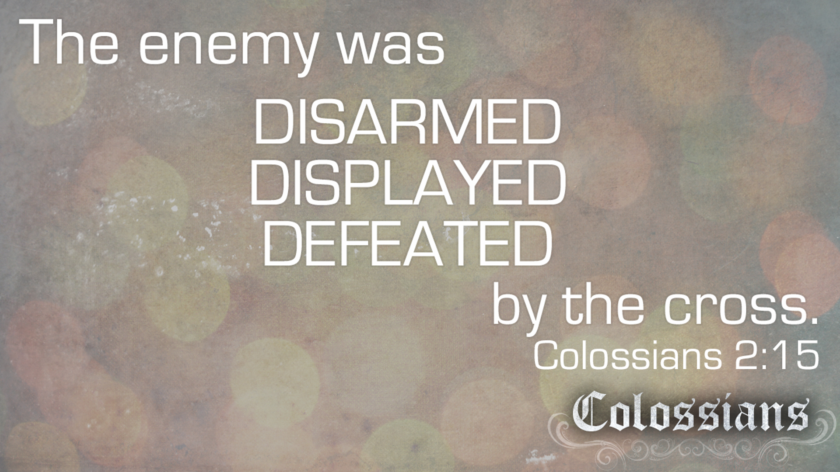

Our Enemy is Defeated
by Pastor Fee Soliven
Revelation 2:12-17
Wednesday Evening
February 10, 2021

Slide 2
Revelation 2:12-17
12 "And to the angel of the church in Pergamos write, 'These things says He who has the sharp two-edged sword: 13 "I know your works, and where you dwell, where Satan's throne is. And you hold fast to My name, and did not deny My faith even in the days in which Antipas was My faithful martyr, who was killed among you, where Satan dwells.

Slide 3
14 But I have a few things against you, because you have there those who hold the doctrine of Balaam, who taught Balak to put a stumbling block before the children of Israel, to eat things sacrificed to idols, and to commit sexual immorality. 15 Thus you also have those who hold the doctrine of the Nicolaitans, which thing I hate. 16 Repent, or else I will come to you quickly and will fight against them with the sword of My mouth.

Slide 4
17 He who has an ear, let him hear what the Spirit says to the churches. To him who overcomes I will give some of the hidden manna to eat. And I will give him a white stone, and on the stone a new name written which no one knows except him who receives it." '

Slide 5
Genesis 3:1-5
1 Now the serpent was more cunning than any beast of the field which the LORD God had made. And he said to the woman, "Has God indeed said, 'You shall not eat of every tree of the garden'?" 2 And the woman said to the serpent, "We may eat the fruit of the trees of the garden;

Slide 6
3 but of the fruit of the tree which is in the midst of the garden, God has said, 'You shall not eat it, nor shall you touch it, lest you die.' " 4 Then the serpent said to the woman, "You will not surely die. 5 For God knows that in the day you eat of it your eyes will be opened, and you will be like God, knowing good and evil."

Slide 7
Isaiah 14:12-17
12 "How you are fallen from heaven, O Lucifer, son of the morning! How you are cut down to the ground, You who weakened the nations! 13 For you have said in your heart: 'I will ascend into heaven, I will exalt my throne above the stars of God; I will also sit on the mount of the congregation On the farthest sides of the north;

Slide 8
14 I will ascend above the heights of the clouds, I will be like the Most High.' 15 Yet you shall be brought down to Sheol, To the lowest depths of the Pit. 16 "Those who see you will gaze at you, And consider you, saying: 'Is this the man who made the earth tremble, Who shook kingdoms, 17 Who made the world as a wilderness And destroyed its cities, Who did not open the house of his prisoners?'

Slide 9
Satan's deep hatred is against God, God's highest creation man, God's covenant people the Jewish Nation and the Born-Again Church that is washed in the Blood of Jesus!

Slide 10
When Satan was cast down where was his thrown here on earth?

Slide 11
Revelation 2:12-17
12 "And to the angel of the church in Pergamos write, 'These things says He who has the sharp two-edged sword: 13 "I know your works, and where you dwell, where Satan's throne is...

Slide 12
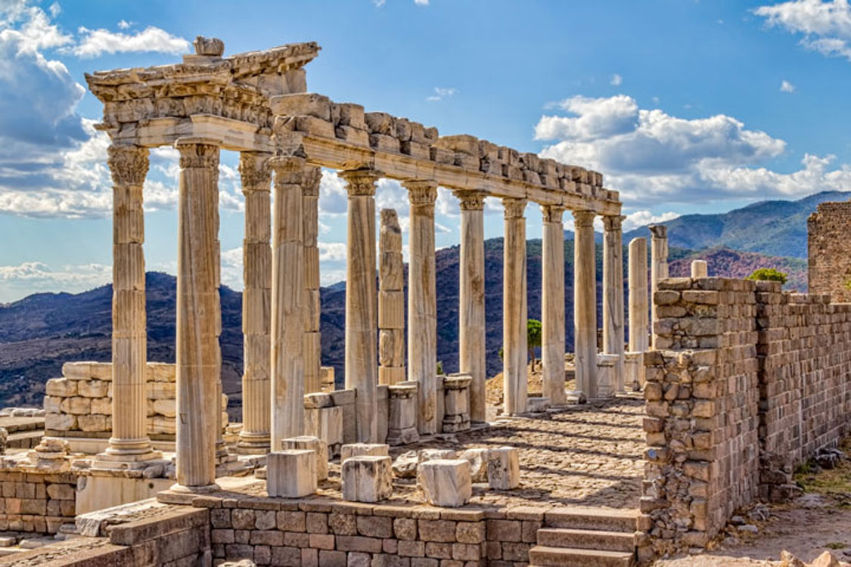
Ephesians 6:18
"praying always with all prayer and supplication in the Spirit, being watchful to this end with all perseverance and supplication for all the saints..."

Slide 13
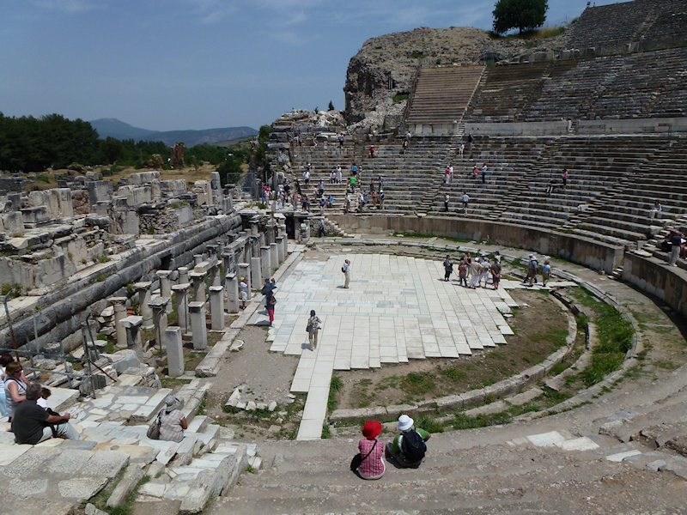
Does your prayer life reflect the kind of relationship you have with God through the blood of His Son?

Slide 14
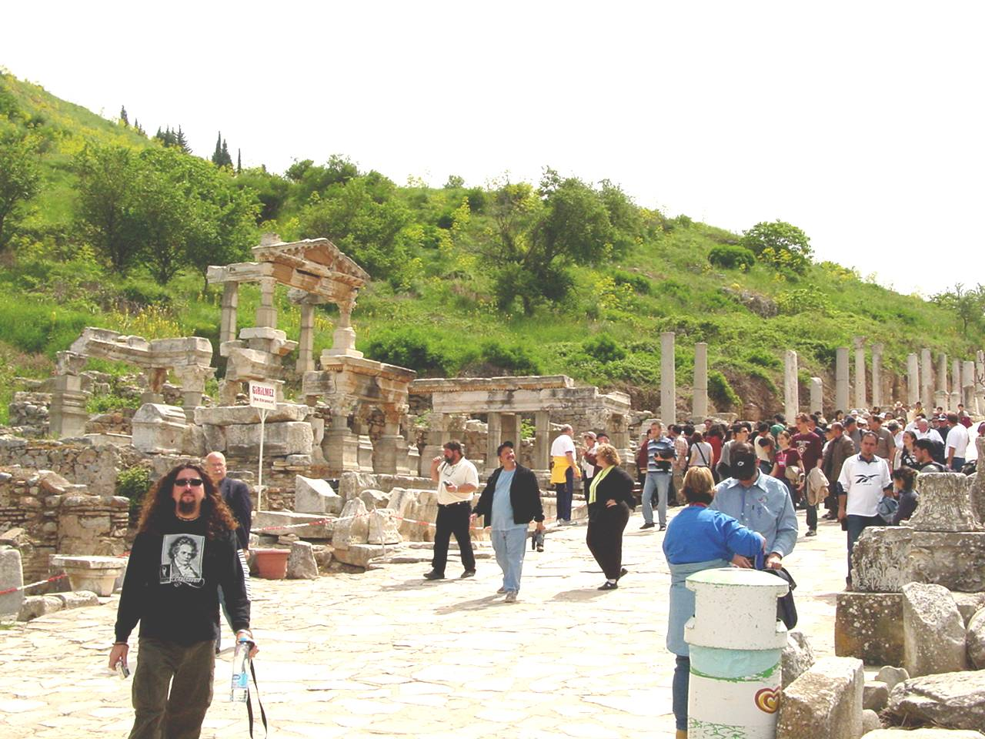
2. Forgiveness of Sin

Slide 15
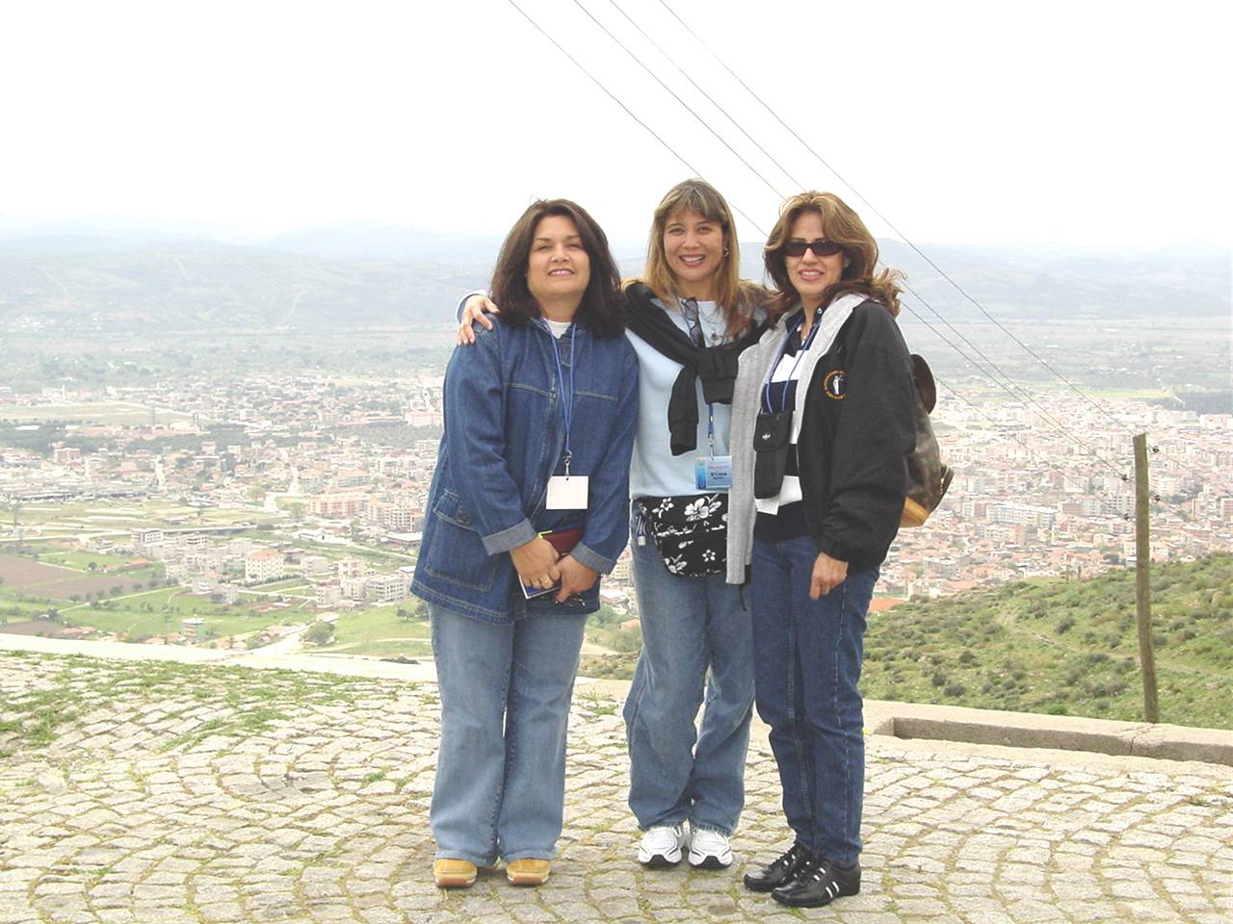
Ephesians 1:7-9
7 In Him we have redemption through His blood, the forgiveness of sins, according to the riches of His grace 8 which He made to abound toward us in all wisdom and prudence, 9 having made known to us the mystery of His will, according to His good pleasure which He purposed in Himself...

Slide 16
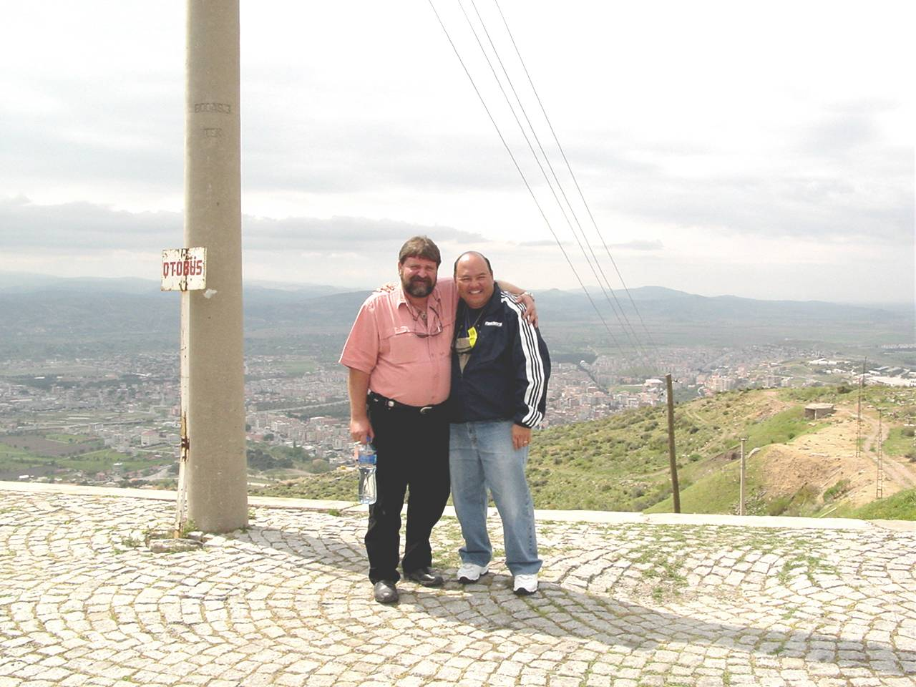
Matthew 26:28
"For this is My blood of the new covenant, which is shed for many for the remission (forgiveness) of sins."

Slide 17
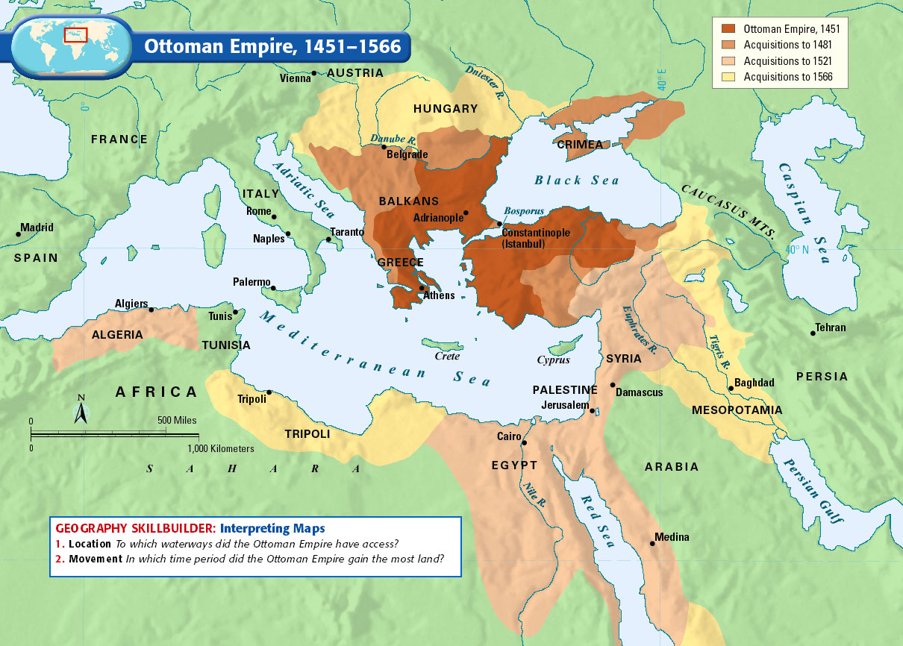
30 Then the sign of the Son of Man will appear in heaven, and then all the tribes of the earth will mourn, and they will see the Son of Man coming on the clouds of heaven with power and great glory. 31 And He will send His angels with a great sound of a trumpet, and they will gather together His elect from the four winds, from one end of heaven to the other.

Slide 18
Daniel 11:31-32
31 And forces shall be mustered by him, and they shall defile the sanctuary fortress; then they shall take away the daily sacrifices, and place there the abomination of desolation. 32 Those who do wickedly against the covenant he shall corrupt with flattery; but the people who know their God shall be strong, and carry out great exploits.

Slide 19
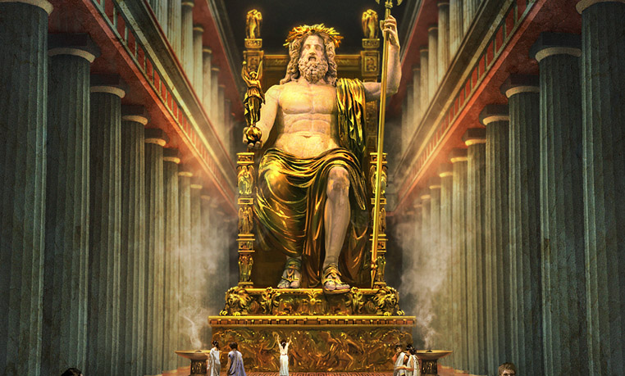
3. Consciences Cleansed

Slide 20
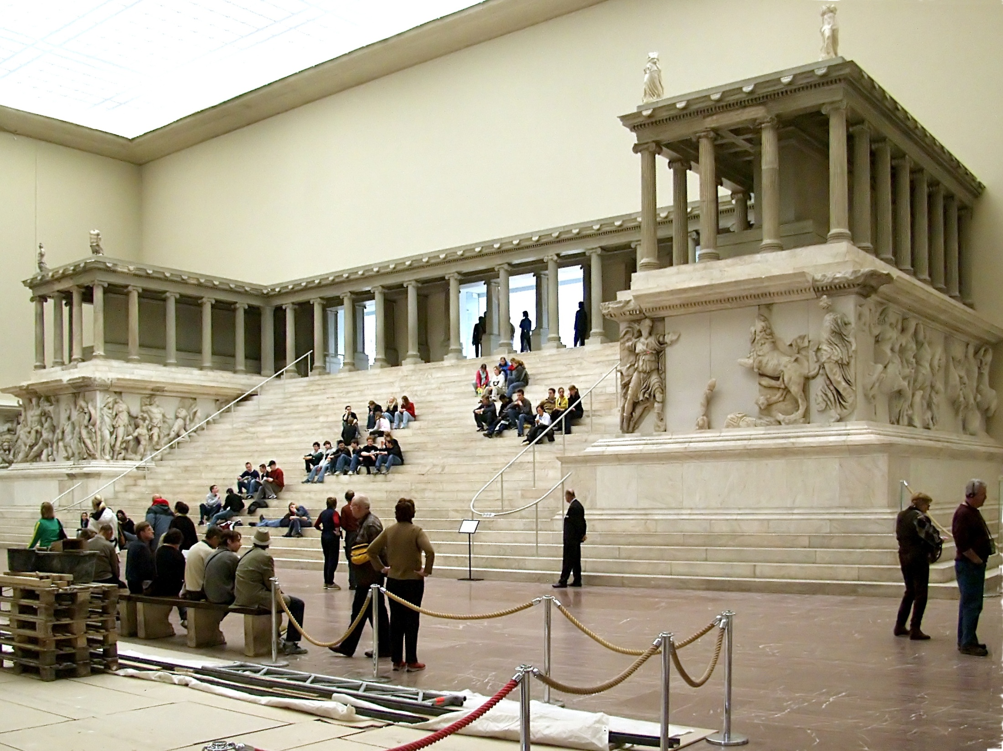
Hebrews 9:14-15
14 how much more shall the blood of Christ, who through the eternal Spirit offered Himself without spot to God, cleanse your conscience from dead works to serve the living God?
The Great Altar of Pergamon,
on display in the Pergamon museum in Berlin, Germany

Slide 21
In 1871 this same temple was dug up and sent to Germany in pieces and the following year anti-Semitism sprung up throughout Germany's country.

Slide 22
In 1889 Germany completed the restoration of Altar of Zeus in the same year Adolf Hitler was born! April 20, 1889

Slide 23
Startling day in Jewish history. Hitler was born on the Hebrew calendar on Nissan 19, 5649 This day was 4 days after Passover which is always Nissan 15

Slide 24
Exodus 14:21-25
21 Then Moses stretched out his hand over the sea; and the LORD caused the sea to go back by a strong east wind all that night, and made the sea into dry land, and the waters were divided. 22 So the children of Israel went into the midst of the sea on the dry ground, and the waters were a wall to them on their right hand and on their left.

Slide 25
23 And the Egyptians pursued and went after them into the midst of the sea, all Pharaoh's horses, his chariots, and his horsemen. 24 Now it came to pass, in the morning watch, that the LORD looked down upon the army of the Egyptians through the pillar of fire and cloud, and He troubled the army of the Egyptians.

Slide 26
25 And He took off their chariot wheels, so that they drove them with difficulty; and the Egyptians said, "Let us flee from the face of Israel, for the LORD fights for them against the Egyptians."

Slide 27
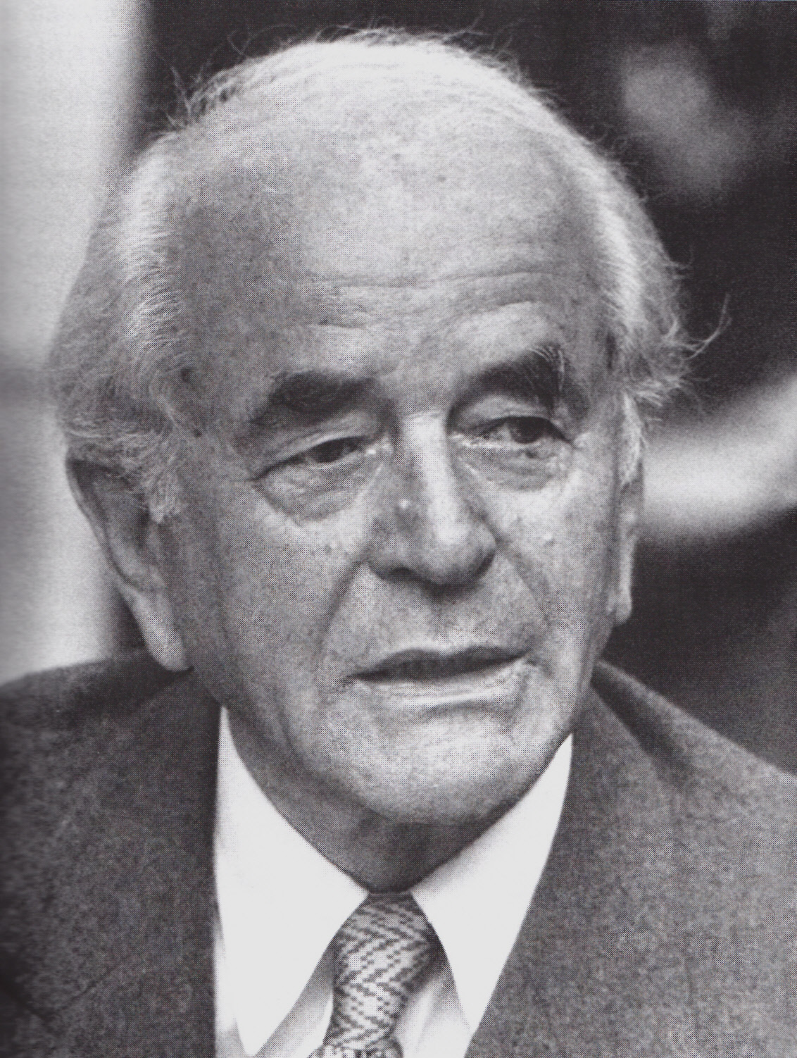
Revelation 12:11
"And they overcame him by the blood of the Lamb and by the word of their testimony, and they did not love their lives to the death."

Slide 28
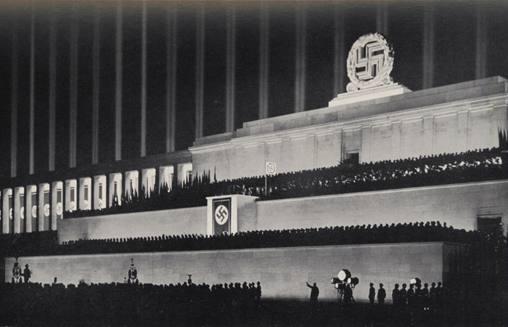
Isaiah 64:6
"But we are all like an unclean thing, And all our righteousnesses are like filthy rags; We all fade as a leaf, And our iniquities, like the wind, Have taken us away."

Slide 29
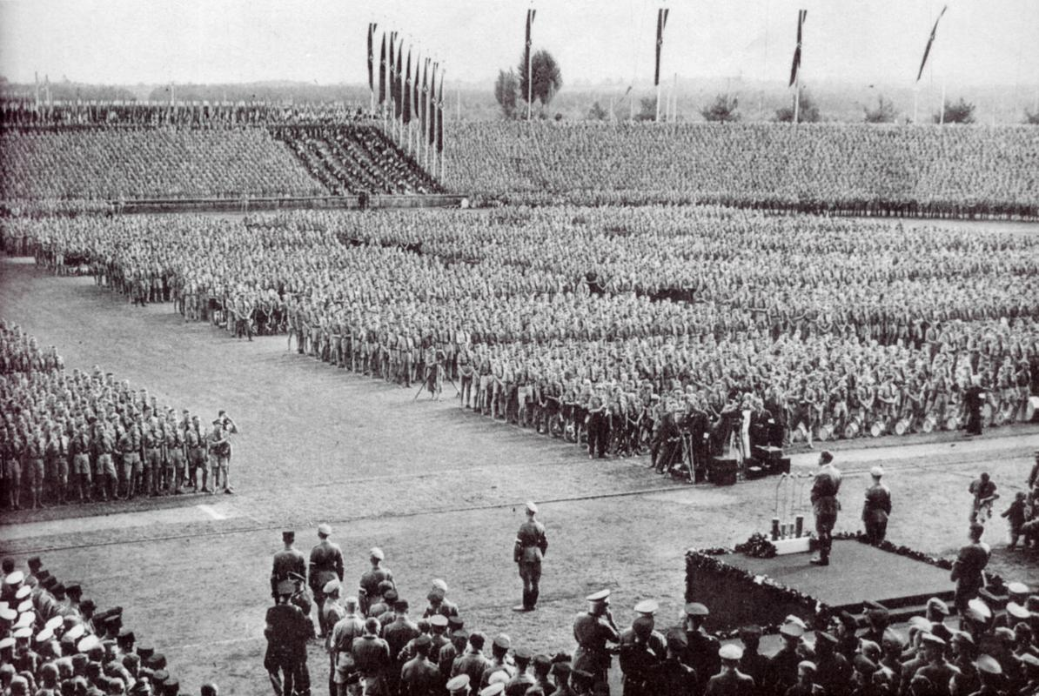
6. Rescued Out of a Sinful Way of Life

Slide 30
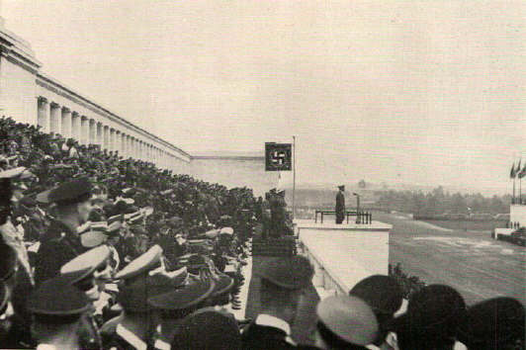
1 Peter 1:18-21
(Revised Standard Version)
18 You know that you were ransomed from the futile ways inherited from your fathers, not with perishable things such as silver or gold, 19 but with the precious blood of Christ, like that of a lamb without blemish or spot.

Slide 31
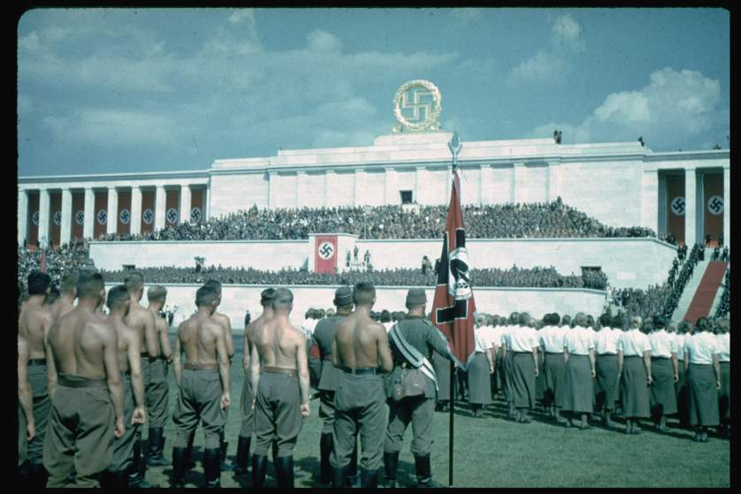
20 He was destined before the foundation of the world but was made manifest at the end of the times for your sake. 21 Through him you have confidence in God, who raised him from the dead and gave him glory, so that your faith and hope are in God.

Slide 32
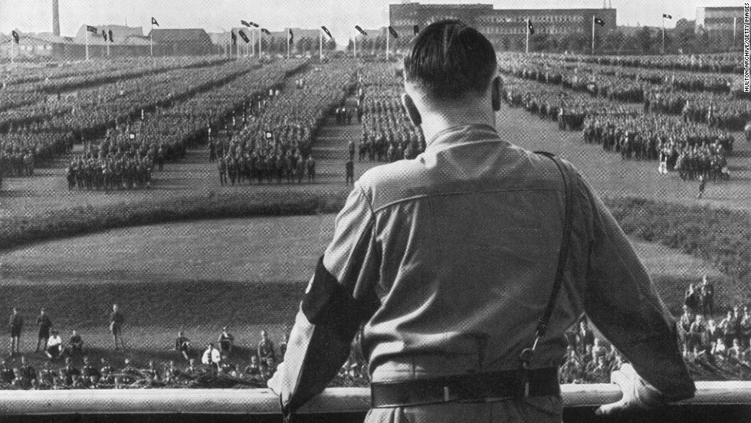
20 He was destined before the foundation of the world but was made manifest at the end of the times for your sake. 21 Through him you have confidence in God, who raised him from the dead and gave him glory, so that your faith and hope are in God.

Slide 33
Webster Dictionary defines an Altar as:
"an elevated place or structure, as a mound or platform, at which religious rites are performed or on which blood sacrifices are offered to gods, ancestors, etc."

Slide 34
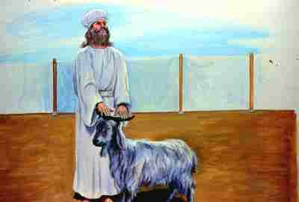
20 He was destined before the foundation of the world but was made manifest at the end of the times for your sake. 21 Through him you have confidence in God, who raised him from the dead and gave him glory, so that your faith and hope are in God.

Slide 35
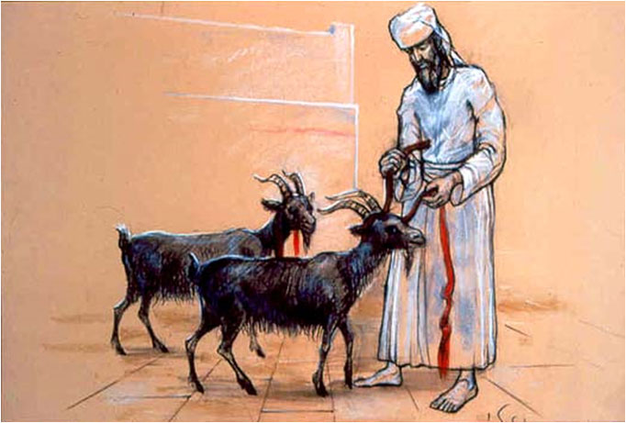
20 He was destined before the foundation of the world but was made manifest at the end of the times for your sake. 21 Through him you have confidence in God, who raised him from the dead and gave him glory, so that your faith and hope are in God.

Slide 36
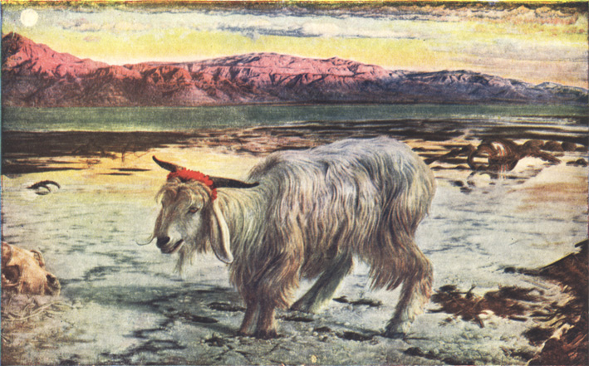
20 He was destined before the foundation of the world but was made manifest at the end of the times for your sake. 21 Through him you have confidence in God, who raised him from the dead and gave him glory, so that your faith and hope are in God.

Slide 37
Hitler possessed by Satan gathered all the Jews in cattle trains and red tagged all of their passports to lead them to the ovens for Satan's sacrifice! They were led as lambs for the slaughter.

Slide 38
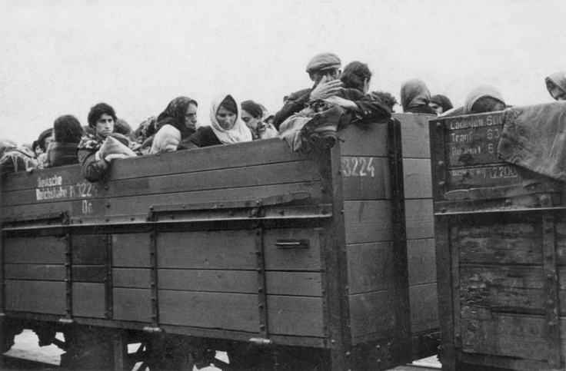
Hitler possessed by Satan gathered all the Jews in cattle trains and red tagged all of their passports to lead them to the ovens for Satan's sacrifice!

Slide 39
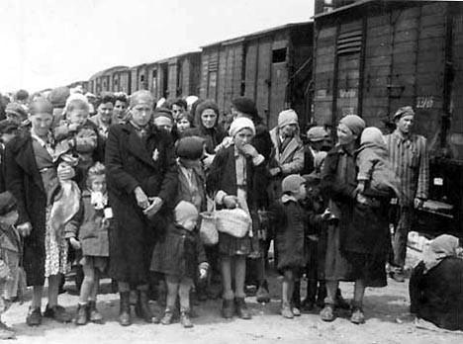
20 He was destined before the foundation of the world but was made manifest at the end of the times for your sake. 21 Through him you have confidence in God, who raised him from the dead and gave him glory, so that your faith and hope are in God.

Slide 40
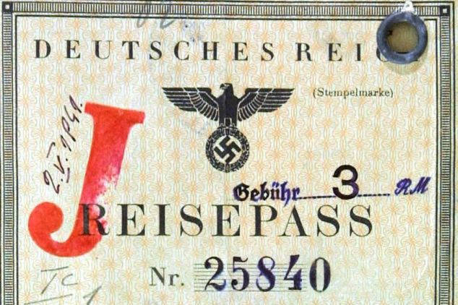
20 He was destined before the foundation of the world but was made manifest at the end of the times for your sake. 21 Through him you have confidence in God, who raised him from the dead and gave him glory, so that your faith and hope are in God.

Slide 41
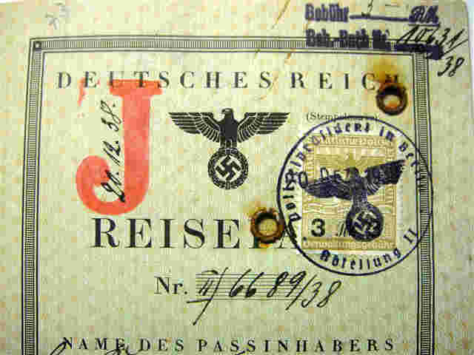
20 He was destined before the foundation of the world but was made manifest at the end of the times for your sake. 21 Through him you have confidence in God, who raised him from the dead and gave him glory, so that your faith and hope are in God.

Slide 42
Their final destination were the
Ovens in Auschwitz

Slide 43
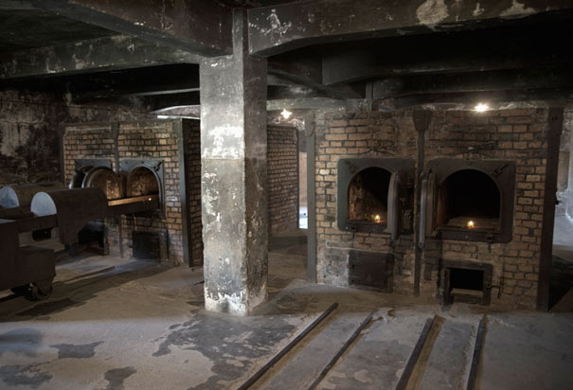
20 He was destined before the foundation of the world but was made manifest at the end of the times for your sake. 21 Through him you have confidence in God, who raised him from the dead and gave him glory, so that your faith and hope are in God.

Slide 44
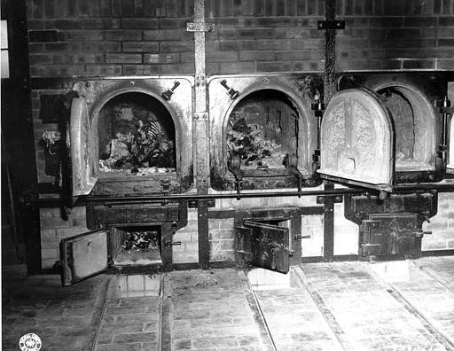
20 He was destined before the foundation of the world but was made manifest at the end of the times for your sake. 21 Through him you have confidence in God, who raised him from the dead and gave him glory, so that your faith and hope are in God.

Slide 45
It was Hitler's burnt offerings to Satan. Satan perverted the Holiest day for the Jews which was Yom Kippur.

Slide 46
Hitler offered up his tithe of 10% to Satan. 6 Million Jews were murdered by him. During World War 2 approx. 60 Million people died.

Slide 47
The Altar of Zeus in Greek means: Caustos or Burnt and a complete or whole burnt offering meant Holos. The word in Greek spells out Holos Caustos now known as "Holocaust" it was the Altar of Holocaust!

Slide 48
Jeremiah 2:1-3
1 Moreover the word of the LORD came to me, saying, 2 "Go and cry in the hearing of Jerusalem, saying, 'Thus says the LORD: "I remember you, The kindness of your youth, The love of your betrothal, When you went after Me in the wilderness, In a land not sown. 3 Israel was holiness to the LORD, The firstfruits of His increase. All that devour him will offend; Disaster will come upon them," says the LORD.' "

Slide 49
John 16:33
"These things I have spoken to you, that in Me you may have peace. In the world you will have tribulation; but be of good cheer, I have overcome the world."

Slide 50
1 Thessalonians 4:13-18
13 But I do not want you to be ignorant, brethren, concerning those who have fallen asleep, lest you sorrow as others who have no hope. 14 For if we believe that Jesus died and rose again, even so God will bring with Him those who sleep in Jesus.

Slide 51
15 For this we say to you by the word of the Lord, that we who are alive and remain until the coming of the Lord will by no means precede those who are asleep. 16 For the Lord Himself will descend from heaven with a shout, with the voice of an archangel, and with the trumpet of God. And the dead in Christ will rise first.

Slide 52
17 Then we who are alive and remain shall be caught up together with them in the clouds to meet the Lord in the air. And thus we shall always be with the Lord. 18 Therefore comfort one another with these words.

Slide 53
1 Corinthians 15:50-54
50 Now this I say, brethren, that flesh and blood cannot inherit the kingdom of God; nor does corruption inherit incorruption. 51 Behold, I tell you a mystery: We shall not all sleep, but we shall all be changed-- 52 in a moment, in the twinkling of an eye, at the last trumpet. For the trumpet will sound, and the dead will be raised incorruptible, and we shall be changed.

Slide 54
53 For this corruptible must put on incorruption, and this mortal must put on immortality. 54 So when this corruptible has put on incorruption, and this mortal has put on immortality, then shall be brought to pass the saying that is written: "Death is swallowed up in victory."

Slide 55

20 Again, when a righteous man turns from his righteousness and commits iniquity, and I lay a stumbling block before him, he shall die; because you did not give him warning, he shall die in his sin, and his righteousness which he has done shall not be remembered; but his blood I will require at your hand.

Slide 56
Acts 2:38-39
38 Then Peter said to them, "Repent, and let every one of you be baptized in the name of Jesus Christ for the remission of sins; and you shall receive the gift of the Holy Spirit. 39 For the promise is to you and to your children, and to all who are afar off, as many as the Lord our God will call."

Slide 57


