Slide 1
“God So Loved”
(We The Kingdom)

Slide 2
Come all you weary. Come all you thirsty. Come to the well. That never runs dry. Drink of the water.

Slide 3
Come and thirst no more. Come all you sinners. Come find his mercy. Come to the table he will

Slide 4
Satisfy. Taste of his goodness. Find what you’re looking for. For God so loved the world that he gave

Slide 5
us. His one and only Son to save us. Whoever believes in him. Will live forever. Bring all your

Slide 6
failures. Bring your addictions. Come lay them down at the foot of the cross. Jesus is waiting there with

Slide 7
Open arms. For god so loved the world that he gave us. His one and only Son to save us. Whoever

Slide 8
Believes in him will live forever. The power of Hell forever defeated. Now it is well. I’m walking in

Slide 9
freedom. For god so loved. God so loved the world. Praise God, Praise God. From whom all blessings

Slide 10
flow. Praise him, Praise Him,. For the wonder of his love. His amazing love. For God so loved the world

Slide 11
that he gave us. His one and only son to save. For God so loved. The world that he gave us. His one

Slide 12
and only Son to save us. Whoever believes in him. Will live forever. The power of Hell forever defeated.

Slide 13
Now it is well. Im walking in freedom. For God so loved. God so loved the world. Bring all your failures

Slide 14
Bring your addictions. Come lay them down at the foot of the cross. Jesus is waiting. God

Slide 15
loved the world.

Slide 16
I saw satan fall like lightning. I saw darkness run for cover. But the miracle that I just can’t get over.

Slide 17
My name is registered in heaven. I believe in signs and wonders. I have resurrection power. Still the

Slide 18
miracle that I just cant get over. My name is registered in heaven. My praise belongs to you

Slide 19
forever. This is my testimony from death to life.Cause grace rewrote my story, I’ll testify. By

Slide 20
Jesus Christ the righteous. I’m justified. Tis is my testimony. This is my testimony. Come together

Slide 21
sons and daughters.Bought with blood and washed in water. Sing the praises of the spirit, son, and

Slide 22
Father. Our God will finish what he started. Our God will finish what he started. If I’m not dead then your

Slide 23
not done. Greater things are still to come. Oh I believe. If I’m not dead your not done greater things

Slide 24
are still to come. Oh I believe. If I’m not dead your not done greater things are still to come. Oh I

Slide 25
Believe. This is my testimony from death to life.Cause grace rewrote my story. I’ll testify. By

Slide 26
Jesus Christ the righteous. I’m justified. This is my testimony. This is my testimony. This is my testimony

Slide 27
from death to life. Cause grace rewrote my story., I’ll testify. By Jesus Christ the righteous. I’m justified.

Slide 28
this is my testimony. This is my testimony.

Slide 29
“Reckless Love”
(Cory Ashbury)

Slide 30
Before I spoke a word. You were singing over me. You have been so, so good to me. Before I took

Slide 31
A breath you breathed your life in me.You have been so so kind to me. Oh the overwhelming,

Slide 32
Never-ending, reckless love of God. Oh, it chases me down fights til im found leaves the 99. And I

Slide 33
couldn’t earn it. I don’t deserve it. Still you give yourself away. Oh, the overwhelming, never-ending

Slide 34
reckless love of God. When I was your foe, still your love fought for me. You have been so,so good to me

Slide 35
When I felt no worth, you paid it all for me. You have been so,so kind to me. Oh the overwhelming never

Slide 36
never-ending reckless love of God. Oh it chases me down, fights til im found leave the 99. And I couldnt

Slide 37
earn it. I don’t deserve it. Still you give yourself away. Oh, the overwhelming, never-ending reckless love of

Slide 38
God. There’s no shadow you wont light up. Mountain you wont climb up. Coming after me. There’s no wall.

Slide 39
you wont kick down. Lie you wont tear down. Coming after me. There’s no shadow you wont light

Slide 40
up. Mountain you wont climb up. Coming after me. There’s no wall you wont kick down. Lie you wont

Slide 41
tear down coming after me. There’s no shadow you wont light up. Mountain you wont climb up coming

Slide 42
after me. There’s no wall you wont kick down. Lie you wont tear down. Coming after me.

Slide 43
Oh, the overwhelming, never-ending reckless love of God. Oh’ ot chases me down, fights til I’m found

Slide 44
leaves the 99. I couldn’t earn it. I don’t deserve it. Still you give yourself away. Oh, the overwhelming,

Slide 45
Never-ending reckless love of God.

Slide 46
“Holy Spirit”
(Kim Walker)

Slide 47
There’s nothing worth more. That could ever come close. No thing can compare. You’re our living hope

Slide 48
Your Presence, Lord. Ive tasted and seen. Of the sweetest of loves. Where my heart becomes free

Slide 49
and my shame is undone.Your presence, Lord. Holy spirit you are welcomed here. Come flood this place

Slide 50
and fill the atmosphere. Your glory, God, is what our hearts long for to be overcome by your presence

Slide 51
Lord. There’s nothing worth more. That could ever come close. No thing can compare. You’re our

Slide 52
living hope. Your presence Lord. I’ve tasted and seen. Of the sweetest of loves. Where my heart

Slide 53
becomes free and my shame is undone. Your presence, Lord. Holy spirit you are welcome here

Slide 54
come flood this place an fill the atmosphere. Your glory, God, is what our hearts long for. To be

Slide 55
overcome by your presence, Lord. Your presence, Lord. Holy spirit you are welcome here

Slide 56
come flood this place an fill the atmosphere. Your glory, God, is what our hearts long for. To be

Slide 57
overcome by your presence, Lord. Let us become more aware of your presence. Let us experience

Slide 58
the glory of your goodness. Let us become more aware of your presence. Let us experience the

Slide 59
the glory of your goodness. Let us become more aware of your presence. Let us experience the

Slide 60
glory of your goodness. Let us become more aware of your presence. Let us experience the glory of your

Slide 61
goodness. Holy spirit, You are welcome here. Come flod this place and fill the atmosphere. Your glory

Slide 62
God, is what our hearts long for. To be over come by your presence, Lord.

Slide 63
Cornerstone

Slide 64
My hope is built on nothing less. Than Jesus blood and righteousness. I dare not trust the sweetest

Slide 65
frame. But wholly trust in Jesus name. My hope is built on nothing less. Than Jesus blood and

Slide 66
righteousness. I dare not trust the sweetest frame Burt wholly trust in Jesus name. Christ alone,

Slide 67
Cornerstone weak made strong in the Savior’s love. Through the storm, He is Lord. Lord of all. When

Slide 68
Darkness seems to hide his face. I rest on his unchanging grace. In every high and stormy gale my

Slide 69
anchor holds within the Veil. My anchor holds within the veil. Christ alone Cornerstone.Weak made strong

Slide 70
in the Savior’s love. Through the storm, He is Lord. Lord of all. He is Lord, Lord of all. Christ alone

Slide 71
Cornerstone, weak made strong in the Savior’s love. Through the storm, He is Lord. Lord of all. When he

Slide 72
Shall come with trumpet sound. Oh may I then in him be found. Dressed in His righteousness alone.

Slide 73
Faultless stand before the throne. Christ alone, Cornerstone. Weak made stong in the Savior’s love.

Slide 74
Through the storm, He is Lord lord of all.

Slide 75
Christ alone cornerstone.Weak made strong. In the Savior’s love. Through the storm. He is Lord lord of

Slide 76
All. Christ alone. Cornerstone weak made strong in saviors love. Through the storm. He is Lord

Slide 77
Lord of all.

Slide 78


Slide 79
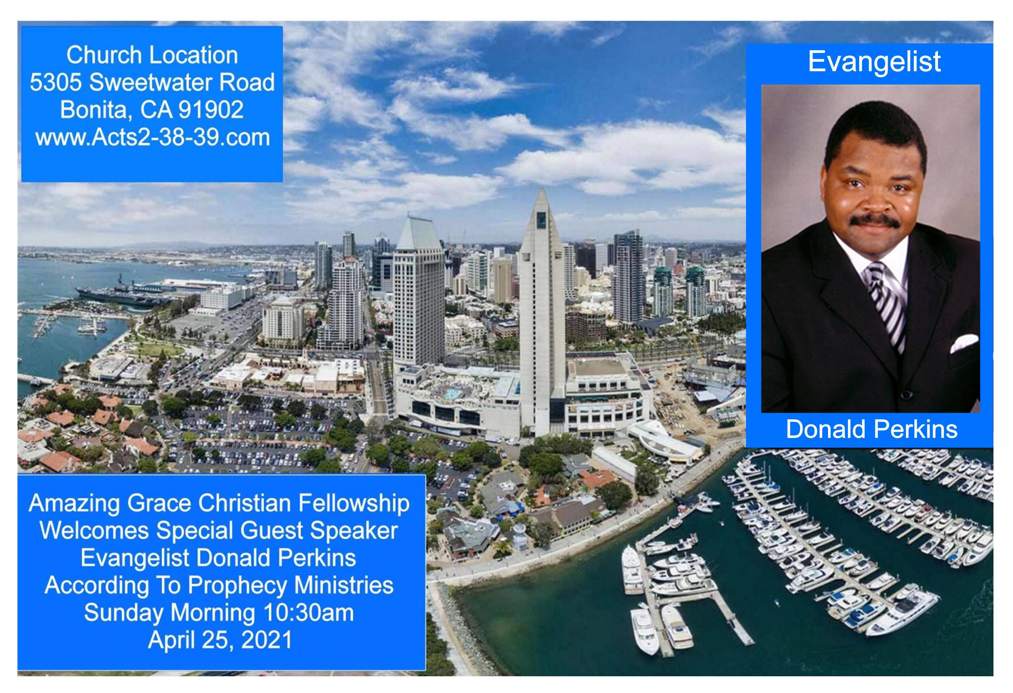

Slide 80


Help Me Be Faithful Like Jesus
by Pastor Fee Soliven
1 Thessalonians 5:16-24
Sunday Morning
March 28, 2021

Slide 81
1 Thessalonians 5:16-24
16 Rejoice always, 17 pray without ceasing, 18 in everything give thanks; for this is the will of God in Christ Jesus for you. 19 Do not quench the Spirit. 20 Do not despise prophecies. 21 Test all things; hold fast what is good. 22 Abstain from every form of evil.

Slide 82
23 Now may the God of peace Himself sanctify you completely; and may your whole spirit, soul, and body be preserved blameless at the coming of our Lord Jesus Christ. 24 He who calls you is faithful, who also will do it.

Slide 83
Faithfulness is one of the most important qualities in a Person’s Life

Slide 84
Genesis 32:9-10
9 Then Jacob said, "O God of my father Abraham and God of my father Isaac, the LORD who said to me, 'Return to your country and to your family, and I will deal well with you': 10 I am not worthy of the least of all the mercies and of all the truth which You have shown Your servant…

Slide 85
Scripture affirms God’s Faithfulness

Slide 86
Deuteronomy 7:9
“Know therefore that the Lord your God, He is God, the faithful God, who keeps His covenant and His faithfulness to a thousand generations for those who love Him and keep His commandments.”

Slide 87
Psalm 33:4
”For the word of the Lord is right, And all His work is done in faithfulness.”

Slide 88
Psalm 36:5
“Your mercy, Lord, extends to the heavens, Your faithfulness reaches to the skies.”

Slide 89
Psalm 119:90
“Your faithfulness continues throughout generations.”

Slide 90
Lamentations 3:22-23
“The Lord’s acts of mercy indeed do not end, for His compassions do not fail. They are new every morning; great is Your faithfulness.”

Slide 91
2 Timothy 2:13
“If we are faithless, He remains faithful, for He cannot deny Himself.”

Slide 92
Hebrews 13:5
“I will never desert you, nor will I ever abandon you,”

Slide 93
Luke 24:49
“clothed with power from on high”

Slide 94
Ephesians 1:12-14
12 that we who first trusted in Christ should be to the praise of His glory. 13 In Him you also trusted, after you heard the word of truth, the gospel of your salvation; in whom also, having believed, you were sealed with the Holy Spirit of promise, 14 who is the guarantee of our inheritance until the redemption of the purchased possession, to the praise of His glory.

Slide 95
Ephesians 4:30-32
30 And do not grieve the Holy Spirit of God, by whom you were sealed for the day of redemption. 31 Let all bitterness, wrath, anger, clamor, and evil speaking be put away from you, with all malice. 32 And be kind to one another, tenderhearted, forgiving one another, just as God in Christ forgave you.

Slide 96
God has promised to be Faithful to Us

Slide 97
1. He will always forgive us!

Slide 98
1 John 1:9
“If we confess our sins, He is faithful and righteous, so that He will forgive us our sins and cleanse us from all unrighteousness”

Slide 99
2. God’s Faithfulness limits the
Power of our Temptation!

Slide 100
1 Corinthians 10:13
“No temptation has overtaken you except something common to mankind; and God is faithful, so He will not allow you to be tempted beyond what you are able, but with the temptation will provide the way of escape also, so that you will be able to endure it”

Slide 101
3. We can have the Peace of God!

Slide 102
Philippians 4:7
“And the peace of God, which surpasses all comprehension, will guard your hearts and minds in Christ Jesus”

Slide 103
4. The Holy Spirit limits the power of Satan in our lives!

Slide 104
2 Thessalonians 3:3
“But the Lord is faithful, and He will strengthen and protect you from the evil one”

Slide 105
1 Corinthians 1:7-9
7 so that you come short in no gift, eagerly waiting for the revelation of our Lord Jesus Christ, 8 who will also confirm you to the end, that you may be blameless in the day of our Lord Jesus Christ. 9 God is faithful, by whom you were called into the fellowship of His Son, Jesus Christ our Lord.

Slide 106
Galatians 5:22-24
22 But the fruit of the Spirit is love, joy, peace, longsuffering, kindness, goodness, faithfulness, 23 gentleness, self-control. Against such there is no law. 24 And those who are Christ's have crucified the flesh with its passions and desires.

Slide 107
When we walk in the Spirit, we’ll have the following characteristics:

Slide 108
Devoted to God
He will be the only One we follow.

Slide 109
Loyal to God
We will be someone others can count on to do what we say we will.

Slide 110
Unwavering
Our reliability won’t vary from day to day.

Slide 111
Steadfast
We’ll be steady in our commitments and unshaken by changing circumstances.

Slide 112
Trustworthy
Others can believe us because we will always speak truth.

Slide 113
Dependable
People can rely on us to show up on time and accomplish what we undertake.

Slide 114
Obedient
Although we won’t do it perfectly, our desire and aim will be to obey God.

Slide 115
Fruitful
Our lives will have a positive influence on others.

Slide 116
Faithful
We will be faithful to God and to others.

Slide 117
1. How confident are you that you can trust the Lord in every circumstance?

Slide 118
2. In what ways has He demonstrated His faithfulness in your life?

Slide 119
3. How faithful are you to other people in your life?

Slide 120
4. How faithful are you to the Lord?

Slide 121
1 Thessalonians 4:13-18
13 But I do not want you to be ignorant, brethren, concerning those who have fallen asleep, lest you sorrow as others who have no hope. 14 For if we believe that Jesus died and rose again, even so God will bring with Him those who sleep in Jesus.

Slide 122
15 For this we say to you by the word of the Lord, that we who are alive and remain until the coming of the Lord will by no means precede those who are asleep. 16 For the Lord Himself will descend from heaven with a shout, with the voice of an archangel, and with the trumpet of God. And the dead in Christ will rise first.

Slide 123
17 Then we who are alive and remain shall be caught up together with them in the clouds to meet the Lord in the air. And thus we shall always be with the Lord. 18 Therefore comfort one another with these words.

Slide 124
1 Corinthians 15:50-54
50 Now this I say, brethren, that flesh and blood cannot inherit the kingdom of God; nor does corruption inherit incorruption. 51 Behold, I tell you a mystery: We shall not all sleep, but we shall all be changed-- 52 in a moment, in the twinkling of an eye, at the last trumpet. For the trumpet will sound, and the dead will be raised incorruptible, and we shall be changed.

Slide 125
53 For this corruptible must put on incorruption, and this mortal must put on immortality. 54 So when this corruptible has put on incorruption, and this mortal has put on immortality, then shall be brought to pass the saying that is written: "Death is swallowed up in victory."

Slide 126

20 Again, when a righteous man turns from his righteousness and commits iniquity, and I lay a stumbling block before him, he shall die; because you did not give him warning, he shall die in his sin, and his righteousness which he has done shall not be remembered; but his blood I will require at your hand.

Slide 127
Acts 2:38-39
38 Then Peter said to them, "Repent, and let every one of you be baptized in the name of Jesus Christ for the remission of sins; and you shall receive the gift of the Holy Spirit. 39 For the promise is to you and to your children, and to all who are afar off, as many as the Lord our God will call."

Slide 128


