Slide 1
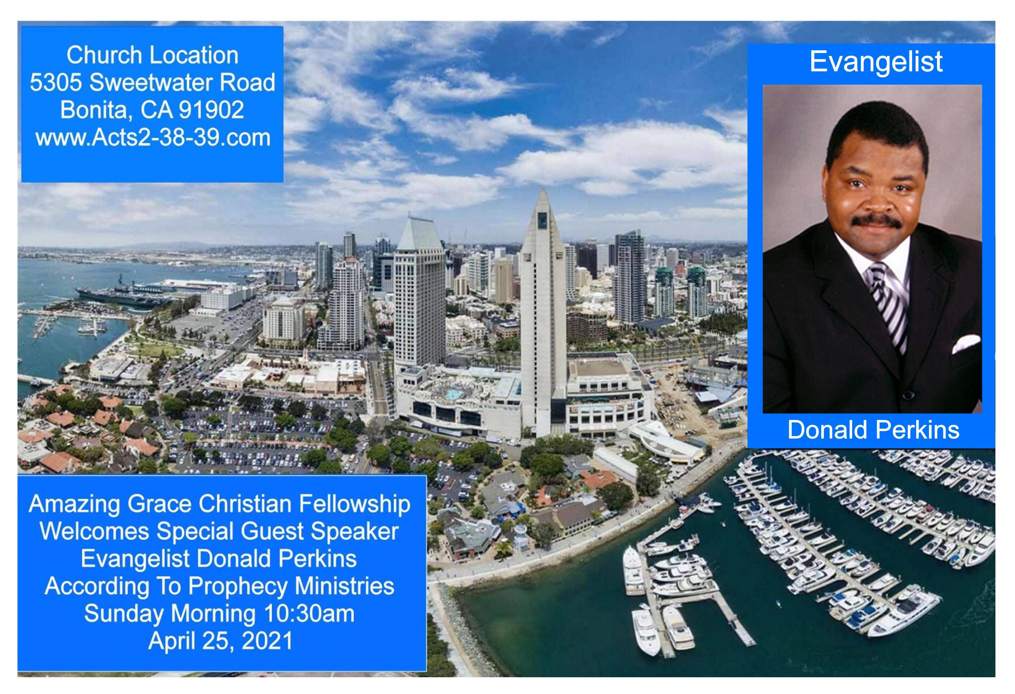

Slide 2
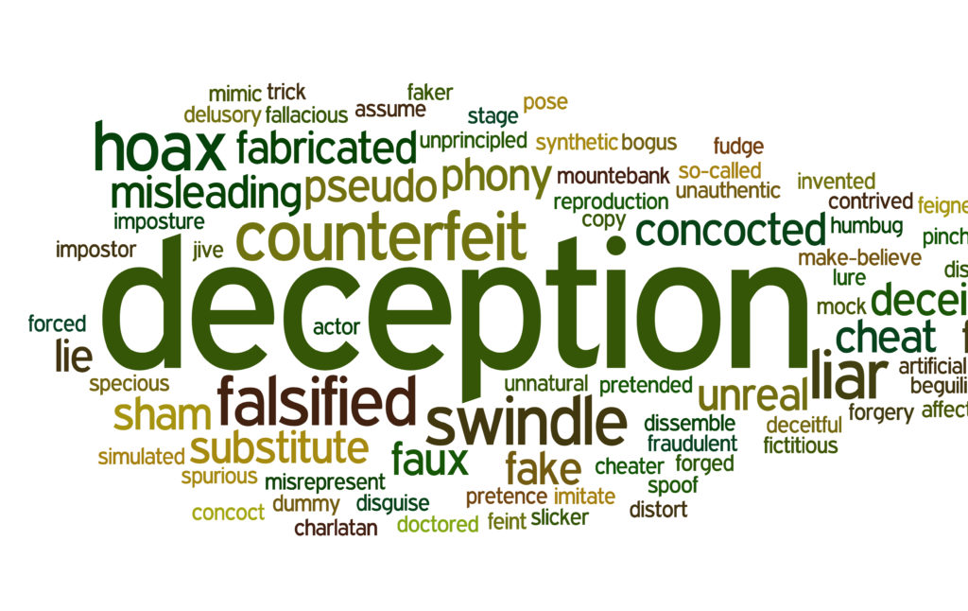

The Age of Deception
By Pastor Fee Soliven
James 1:12-16
Wednesday Evening
March 24, 2021

Slide 3
James 1:12-16
12 Blessed is the man who endures temptation; for when he has been approved, he will receive the crown of life which the Lord has promised to those who love Him. 13 Let no one say when he is tempted, "I am tempted by God"; for God cannot be tempted by evil, nor does He Himself tempt anyone.

Slide 4
14 But each one is tempted when he is drawn away by his own desires and enticed. 15 Then, when desire has conceived, it gives birth to sin; and sin, when it is full-grown, brings forth death. 16 Do not be deceived, my beloved brethren.

Slide 5
12 Blessed is the man who endures temptation; for when he has been approved, he will receive the crown of life which the Lord has promised to those who love Him.

Slide 6
Job 5:17-19
17 "Behold, happy is the man whom God corrects; Therefore do not despise the chastening of the Almighty. 18 For He bruises, but He binds up; He wounds, but His hands make whole. 19 He shall deliver you in six troubles,

Slide 7
Psalm 11:5-6
5 The LORD tests the righteous, But the wicked and the one who loves violence His soul hates. 6 Upon the wicked He will rain coals; Fire and brimstone and a burning wind Shall be the portion of their cup.

Slide 8
2 Timothy 4:7-8
7 I have fought the good fight, I have finished the race, I have kept the faith. 8 Finally, there is laid up for me the crown of righteousness, which the Lord, the righteous Judge, will give to me on that Day, and not to me only but also to all who have loved His appearing.

Slide 9
13 Let no one say when he is tempted, "I am tempted by God"; for God cannot be tempted by evil, nor does He Himself tempt anyone.

Slide 10
Matthew 4:1-4
1 Then Jesus was led up by the Spirit into the wilderness to be tempted by the devil. 2 And when He had fasted forty days and forty nights, afterward He was hungry. 3 Now when the tempter came to Him, he said, "If You are the Son of God, command that these stones become bread."

Slide 11
4 But He answered and said, "It is written, 'Man shall not live by bread alone, but by every word that proceeds from the mouth of God.' "
Matthew 4:7
"Jesus said to him, "It is written again, 'You shall not tempt the LORD your God.' "

Slide 12
Matthew 4:7
"Jesus said to him, "It is written again, 'You shall not tempt the LORD your God.' "

Slide 13
14 But each one is tempted when he is drawn away by his own desires and enticed.

Slide 14
Jeremiah 17:9-10
9 "The heart is deceitful above all things, And desperately wicked; Who can know it? 10 I, the LORD, search the heart, I test the mind, Even to give every man according to his ways, According to the fruit of his doings.

Slide 15
Romans 7:18-21
18 For I know that in me (that is, in my flesh) nothing good dwells; for to will is present with me, but how to perform what is good I do not find. 19 For the good that I will to do, I do not do; but the evil I will not to do, that I practice.

Slide 16
20 Now if I do what I will not to do, it is no longer I who do it, but sin that dwells in me. 21 I find then a law, that evil is present with me, the one who wills to do good.

Slide 17
1 Corinthians 10:13
3 No temptation has overtaken you except such as is common to man; but God is faithful, who will not allow you to be tempted beyond what you are able, but with the temptation will also make the way of escape, that you may be able to bear it.

Slide 18
2 Timothy 2:22
"Flee also youthful lusts; but pursue righteousness, faith, love, peace with those who call on the Lord out of a pure heart."

Slide 19
15 Then, when desire has conceived, it gives birth to sin; and sin, when it is full-grown, brings forth death.

Slide 20
Romans 6:15-23
15 What then? Shall we sin because we are not under law but under grace? Certainly not! 16 Do you not know that to whom you present yourselves slaves to obey, you are that one's slaves whom you obey, whether of sin leading to death, or of obedience leading to righteousness?

Slide 21
17 But God be thanked that though you were slaves of sin, yet you obeyed from the heart that form of doctrine to which you were delivered. 18 And having been set free from sin, you became slaves of righteousness.

Slide 22
19 I speak in human terms because of the weakness of your flesh. For just as you presented your members as slaves of uncleanness, and of lawlessness leading to more lawlessness, so now present your members as slaves of righteousness for holiness. 20 For when you were slaves of sin, you were free in regard to righteousness.

Slide 23
21 What fruit did you have then in the things of which you are now ashamed? For the end of those things is death. 22 But now having been set free from sin, and having become slaves of God, you have your fruit to holiness, and the end, everlasting life. 23 For the wages of sin is death, but the gift of God is eternal life in Christ Jesus our Lord.

Slide 24
16 Do not be deceived,
my beloved brethren.

Slide 25
Matthew 24:1-5
1 Then Jesus went out and departed from the temple, and His disciples came up to show Him the buildings of the temple. 2 And Jesus said to them, "Do you not see all these things? Assuredly, I say to you, not one stone shall be left here upon another, that shall not be thrown down."

Slide 26
3 Now as He sat on the Mount of Olives, the disciples came to Him privately, saying, "Tell us, when will these things be? And what will be the sign of Your coming, and of the end of the age?" 4 And Jesus answered and said to them: "Take heed that no one deceives you. 5 For many will come in My name, saying, 'I am the Christ,' and will deceive many.

Slide 27
1 Corinthians 6:9-11
9 Do you not know that the unrighteous will not inherit the kingdom of God? Do not be deceived. Neither fornicators, nor idolaters, nor adulterers, nor homosexuals, nor sodomites,

Slide 28
10 nor thieves, nor covetous, nor drunkards, nor revilers, nor extortioners will inherit the kingdom of God. 11 And such were some of you. But you were washed, but you were sanctified, but you were justified in the name of the Lord Jesus and by the Spirit of our God.

Slide 29
Jeremiah 17:7-8
7 "Blessed is the man who trusts in the LORD, And whose hope is the LORD. 8 For he shall be like a tree planted by the waters, Which spreads out its roots by the river, And will not fear when heat comes; But its leaf will be green, And will not be anxious in the year of drought, Nor will cease from yielding fruit.

Slide 30
1 Thessalonians 4:13-18
13 But I do not want you to be ignorant, brethren, concerning those who have fallen asleep, lest you sorrow as others who have no hope. 14 For if we believe that Jesus died and rose again, even so God will bring with Him those who sleep in Jesus.

Slide 31
15 For this we say to you by the word of the Lord, that we who are alive and remain until the coming of the Lord will by no means precede those who are asleep. 16 For the Lord Himself will descend from heaven with a shout, with the voice of an archangel, and with the trumpet of God. And the dead in Christ will rise first.

Slide 32
17 Then we who are alive and remain shall be caught up together with them in the clouds to meet the Lord in the air. And thus we shall always be with the Lord. 18 Therefore comfort one another with these words.

Slide 33
1 Corinthians 15:50-54
50 Now this I say, brethren, that flesh and blood cannot inherit the kingdom of God; nor does corruption inherit incorruption. 51 Behold, I tell you a mystery: We shall not all sleep, but we shall all be changed-- 52 in a moment, in the twinkling of an eye, at the last trumpet. For the trumpet will sound, and the dead will be raised incorruptible, and we shall be changed.

Slide 34
53 For this corruptible must put on incorruption, and this mortal must put on immortality. 54 So when this corruptible has put on incorruption, and this mortal has put on immortality, then shall be brought to pass the saying that is written: "Death is swallowed up in victory."

Slide 35

20 Again, when a righteous man turns from his righteousness and commits iniquity, and I lay a stumbling block before him, he shall die; because you did not give him warning, he shall die in his sin, and his righteousness which he has done shall not be remembered; but his blood I will require at your hand.

Slide 36
Acts 2:38-39
38 Then Peter said to them, "Repent, and let every one of you be baptized in the name of Jesus Christ for the remission of sins; and you shall receive the gift of the Holy Spirit. 39 For the promise is to you and to your children, and to all who are afar off, as many as the Lord our God will call."

Slide 37


