Slide 1


Slide 2


The Prophecy of Enoch
by Pastor Fee Soliven
Jude 14-17
Wednesday Evening
May 4, 2022

Slide 3
Jude 14-17
14 Now Enoch, the seventh from Adam, prophesied about these men also, saying, "Behold, the Lord comes with ten thousands of His saints, 15 to execute judgment on all, to convict all who are ungodly among them of all their ungodly deeds which they have committed in an ungodly way, and of all the harsh things which ungodly sinners have spoken against Him."

Slide 4
16 These are grumblers, complainers, walking according to their own lusts; and they mouth great swelling words, flattering people to gain advantage. 17 But you, beloved, remember the words which were spoken before by the apostles of our Lord Jesus Christ:

Slide 5
14 Now Enoch, the seventh from Adam, prophesied about these men also, saying, "Behold, the Lord comes with ten thousands of His saints, 15 to execute judgment on all, to convict all who are ungodly among them of all their ungodly deeds which they have committed in an ungodly way, and of all the harsh things which ungodly sinners have spoken against Him."

Slide 6
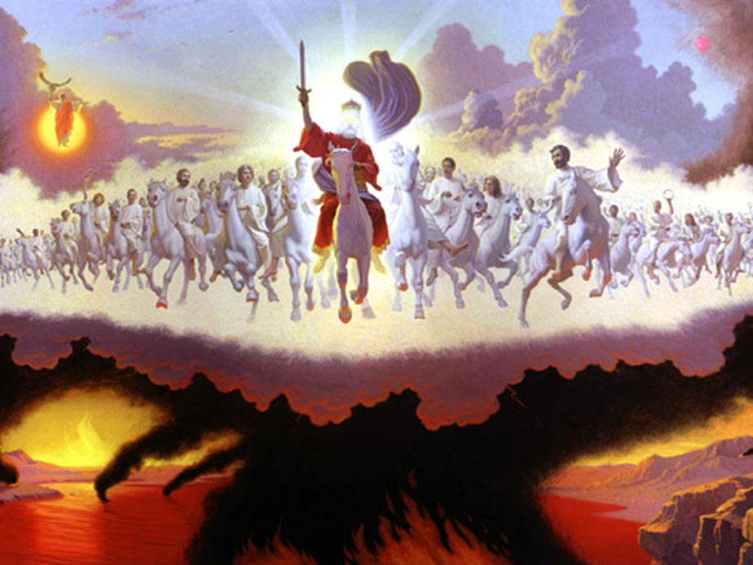
14 Now Enoch, the seventh from Adam, prophesied about these men also, saying, "Behold, the Lord comes with ten thousands of His saints, 15 to execute judgment on all, to convict all who are ungodly among them of all their ungodly deeds which they have committed in an ungodly way, and of all the harsh things which ungodly sinners have spoken against Him."

Slide 7
Genesis 5:21-24
21 Enoch lived sixty-five years, and begot Methuselah. 22 After he begot Methuselah, Enoch walked with God three hundred years, and had sons and daughters. 23 So all the days of Enoch were three hundred and sixty-five years. 24 And Enoch walked with God; and he was not, for God took him.

Slide 8
Luke 3:37
“the son of Methuselah, the son of Enoch, the son of Jared, the son of Mahalalel, the son of Cainan”

Slide 9
Hebrews 11:5
“By faith Enoch was taken away so that he did not see death, "and was not found, because God had taken him"; for before he was taken he had this testimony, that he pleased God”

Slide 10
Zechariah 14:3-5
3 Then the LORD will go forth And fight against those nations, As He fights in the day of battle. 4 And in that day His feet will stand on the Mount of Olives, Which faces Jerusalem on the east. And the Mount of Olives shall be split in two, From east to west, Making a very large valley; Half of the mountain shall move toward the north And half of it toward the south.

Slide 11
5 Then you shall flee through My mountain valley, For the mountain valley shall reach to Azal. Yes, you shall flee As you fled from the earthquake In the days of Uzziah king of Judah. Thus the LORD my God will come, And all the saints with You.

Slide 12
Matthew 16:24-28
24 Then Jesus said to His disciples, "If anyone desires to come after Me, let him deny himself, and take up his cross, and follow Me. 25 For whoever desires to save his life will lose it, but whoever loses his life for My sake will find it. 26 For what profit is it to a man if he gains the whole world, and loses his own soul? Or what will a man give in exchange for his soul?

Slide 13
27 For the Son of Man will come in the glory of His Father with His angels, and then He will reward each according to his works. 28 Assuredly, I say to you, there are some standing here who shall not taste death till they see the Son of Man coming in His kingdom."

Slide 14
16 These are grumblers, complainers, walking according to their own lusts; and they mouth great swelling words, flattering people to gain advantage.

Slide 15
1 Corinthians 10:1-13
1 Moreover, brethren, I do not want you to be unaware that all our fathers were under the cloud, all passed through the sea, 2 all were baptized into Moses in the cloud and in the sea, 3 all ate the same spiritual food, 4 and all drank the same spiritual drink. For they drank of that spiritual Rock that followed them, and that Rock was Christ.

Slide 16
5 But with most of them God was not well pleased, for their bodies were scattered in the wilderness. 6 Now these things became our examples, to the intent that we should not lust after evil things as they also lusted. 7 And do not become idolaters as were some of them. As it is written, "The people sat down to eat and drink, and rose up to play."

Slide 17
8 Nor let us commit sexual immorality, as some of them did, and in one day twenty-three thousand fell; 9 nor let us tempt Christ, as some of them also tempted, and were destroyed by serpents; 10 nor complain, as some of them also complained, and were destroyed by the destroyer. 11 Now all these things happened to them as examples, and they were written for our admonition, on whom the ends of the ages have come.

Slide 18
12 Therefore let him who thinks he stands take heed lest he fall. 13 No temptation has overtaken you except such as is common to man; but God is faithful, who will not allow you to be tempted beyond what you are able, but with the temptation will also make the way of escape, that you may be able to bear it.

Slide 19
17 But you, beloved, remember the words which were spoken before by the apostles of our Lord Jesus Christ: 18 how they told you that there would be mockers in the last time who would walk according to their own ungodly lusts.

Slide 20
“in the last times there would be scoffers whose purpose in life is to enjoy themselves in every evil way imaginable,”

Slide 21
Mark 13:21-23
21 Then if anyone says to you, 'Look, here is the Christ!' or, 'Look, He is there!' do not believe it. 22 For false christs and false prophets will rise and show signs and wonders to deceive, if possible, even the elect. 23 But take heed; see, I have told you all things beforehand.

Slide 22
Acts 20:28-30
28 Therefore take heed to yourselves and to all the flock, among which the Holy Spirit has made you overseers, to shepherd the church of God which He purchased with His own blood. 29 For I know this, that after my departure savage wolves will come in among you, not sparing the flock. 30 Also from among yourselves men will rise up, speaking perverse things, to draw away the disciples after themselves.

Slide 23
1 Timothy 4:1-3
1 Now the Spirit expressly says that in latter times some will depart from the faith, giving heed to deceiving spirits and doctrines of demons, 2 speaking lies in hypocrisy, having their own conscience seared with a hot iron…

Slide 24
2 Timothy 3:1-5
1 But know this, that in the last days perilous times will come: 2 For men will be lovers of themselves, lovers of money, boasters, proud, blasphemers, disobedient to parents, unthankful, unholy, 3 unloving, unforgiving, slanderers, without self-control, brutal, despisers of good,

Slide 25
4 traitors, headstrong, haughty, lovers of pleasure rather than lovers of God, 5 having a form of godliness but denying its power. And from such people turn away!

Slide 26
2 Peter 2:1-3
1 But there were also false prophets among the people, even as there will be false teachers among you, who will secretly bring in destructive heresies, even denying the Lord who bought them, and bring on themselves swift destruction.

Slide 27
2 And many will follow their destructive ways, because of whom the way of truth will be blasphemed. 3 By covetousness they will exploit you with deceptive words; for a long time their judgment has not been idle, and their destruction does not slumber.

Slide 28
1 John 4:1-3
1 Beloved, do not believe every spirit, but test the spirits, whether they are of God; because many false prophets have gone out into the world. 2 By this you know the Spirit of God: Every spirit that confesses that Jesus Christ has come in the flesh is of God,

Slide 29
3 and every spirit that does not confess that Jesus Christ has come in the flesh is not of God. And this is the spirit of the Antichrist, which you have heard was coming, and is now already in the world.

Slide 30
1 Thessalonians 4:13-18
13 But I do not want you to be ignorant, brethren, concerning those who have fallen asleep, lest you sorrow as others who have no hope. 14 For if we believe that Jesus died and rose again, even so God will bring with Him those who sleep in Jesus.

Slide 31
15 For this we say to you by the word of the Lord, that we who are alive and remain until the coming of the Lord will by no means precede those who are asleep. 16 For the Lord Himself will descend from heaven with a shout, with the voice of an archangel, and with the trumpet of God. And the dead in Christ will rise first.

Slide 32
17 Then we who are alive and remain shall be caught up together with them in the clouds to meet the Lord in the air. And thus we shall always be with the Lord. 18 Therefore comfort one another with these words.

Slide 33
1 Corinthians 15:50-54
50 Now this I say, brethren, that flesh and blood cannot inherit the kingdom of God; nor does corruption inherit incorruption. 51 Behold, I tell you a mystery: We shall not all sleep, but we shall all be changed-- 52 in a moment, in the twinkling of an eye, at the last trumpet. For the trumpet will sound, and the dead will be raised incorruptible, and we shall be changed.

Slide 34
53 For this corruptible must put on incorruption, and this mortal must put on immortality. 54 So when this corruptible has put on incorruption, and this mortal has put on immortality, then shall be brought to pass the saying that is written: "Death is swallowed up in victory."

Slide 35

20 Again, when a righteous man turns from his righteousness and commits iniquity, and I lay a stumbling block before him, he shall die; because you did not give him warning, he shall die in his sin, and his righteousness which he has done shall not be remembered; but his blood I will require at your hand.

Slide 36
Acts 2:38-39
38 Then Peter said to them, "Repent, and let every one of you be baptized in the name of Jesus Christ for the remission of sins; and you shall receive the gift of the Holy Spirit. 39 For the promise is to you and to your children, and to all who are afar off, as many as the Lord our God will call."

