Slide 1


Slide 2
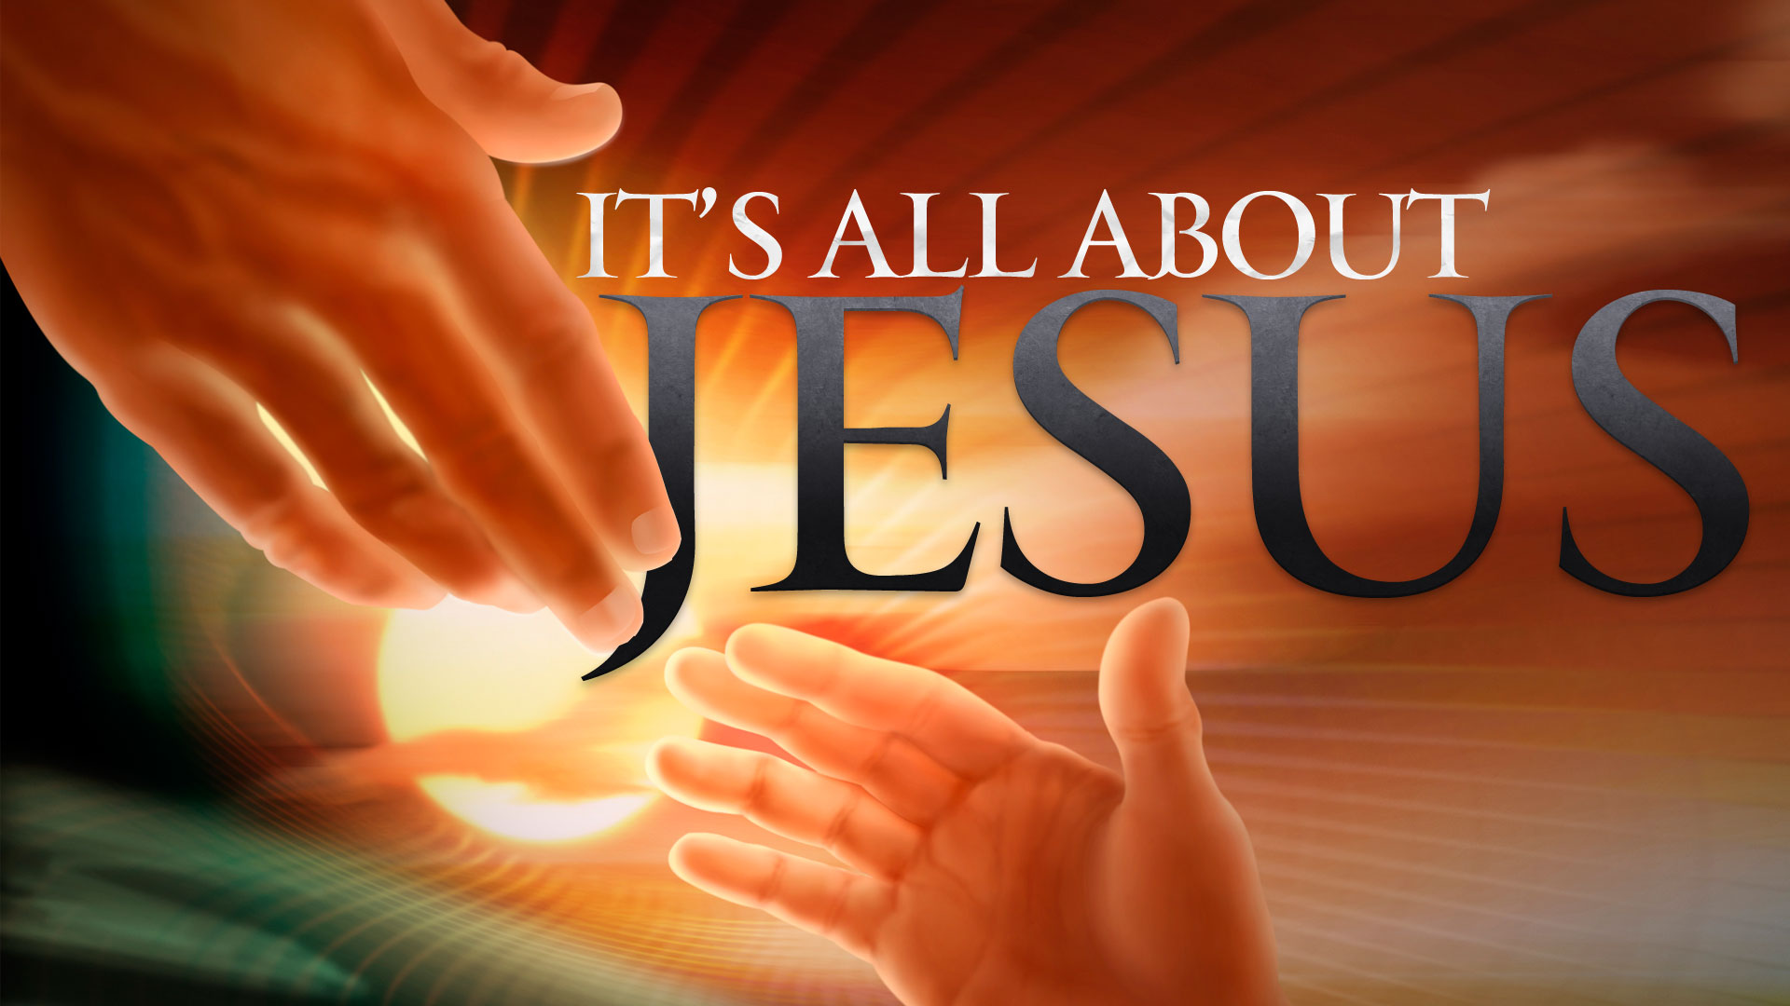

Be an Example in Purity and Love
By Pastor Fee Soliven
1 Timothy 4:10-16
Wednesday Evening
January 24, 2018

Slide 3
10 For to this end we both labor and suffer reproach, because we trust in the living God, who is the Savior of all men, especially of those who believe.

Slide 4
11 These things command and teach.

Slide 5
13 Till I come, give attention to reading, to exhortation, to doctrine.

Slide 6
10 For to this end we both labor and suffer reproach, because we trust in the living God, who is the Savior of all men, especially of those who believe.

Slide 7
Colossians 1:28-29
28 Him we preach, warning every man and teaching every man in all wisdom, that we may present every man perfect in Christ Jesus. 29 To this end I also labor, striving according to His working which works in me mightily.

Slide 8
Titus 1:3
“but has in due time manifested His word through preaching, which was committed to me according to the commandment of God our Savior”

Slide 9
Titus 2:7-10
7 in all things showing yourself to be a pattern of good works; in doctrine showing integrity, reverence, incorruptibility, 8 sound speech that cannot be condemned, that one who is an opponent may be ashamed, having nothing evil to say of you.

Slide 10
9 Exhort bondservants to be obedient to their own masters, to be well pleasing in all things, not answering back, 10 not pilfering, but showing all good fidelity, that they may adorn the doctrine of God our Savior in all things.

Slide 11
Titus 3:4-5
4 But when the kindness and the love of God our Savior toward man appeared, 5 not by works of righteousness which we have done, but according to His mercy He saved us, through the washing of regeneration and renewing of the Holy Spirit…

Slide 12
11 These things command and teach

Slide 13
2 Timothy 3:16
“All Scripture is breathed out by God and profitable for teaching, for reproof, for correction, and for training in righteousness…”

Slide 14
12 Let no one despise your youth, but be an example to the believers in word, in conduct, in love, in spirit, in faith, in purity.

Slide 15
1. What you teach

Slide 16
2. The way you live

Slide 17
3. Love

Slide 18
1 Corinthians 13:1-7
1 Though I speak with the tongues of men and of angels, but have not love, I have become sounding brass or a clanging cymbal. 2 And though I have the gift of prophecy, and understand all mysteries and all knowledge, and though I have all faith, so that I could remove mountains, but have not love, I am nothing.

Slide 19
3 And though I bestow all my goods to feed the poor, and though I give my body to be burned, but have not love, it profits me nothing. 4 Love suffers long and is kind; love does not envy; love does not parade itself, is not puffed up; 5 does not behave rudely, does not seek its own, is not provoked, thinks no evil;

Slide 20
6 does not rejoice in iniquity, but rejoices in the truth; 7 bears all things, believes all things, hopes all things, endures all things. 8 Love never fails.

Slide 21
4. Faith

Slide 22
5. Purity

Slide 23
13 Till I come, give attention to reading, to exhortation, to doctrine.

Slide 24
Exodus 24:7
“Then he took the Book of the Covenant and read in the hearing of the people. And they said, "All that the LORD has said we will do, and be obedient."

Slide 25
Deuteronomy 31:11
“when all Israel comes to appear before the LORD your God in the place which He chooses, you shall read this law before all Israel in their hearing.”

Slide 26
Joshua 8:35
“There was not a word of all that Moses had commanded which Joshua did not read before all the congregation of Israel, with the women, the little ones, and the strangers who were living among them.”

Slide 27
2 Kings 23:2
“The king went up to the house of the LORD with all the men of Judah, and with him all the inhabitants of Jerusalem--the priests and the prophets and all the people, both small and great. And he read in their hearing all the words of the Book of the Covenant which had been found in the house of the LORD.”

Slide 28
Luke 4:16-17
16 So He came to Nazareth, where He had been brought up. And as His custom was, He went into the synagogue on the Sabbath day, and stood up to read. 17 And He was handed the book of the prophet Isaiah. And when He had opened the book, He found the place where it was written…

Slide 29
Acts 15:19-21
19 Therefore I judge that we should not trouble those from among the Gentiles who are turning to God, 20 but that we write to them to abstain from things polluted by idols, from sexual immorality, from things strangled, and from blood. 21 For Moses has had throughout many generations those who preach him in every city, being read in the synagogues every Sabbath."

Slide 30
1 Thessalonians 5:27
“I charge you by the Lord that this epistle be read to all the holy brethren.”

