Slide 3
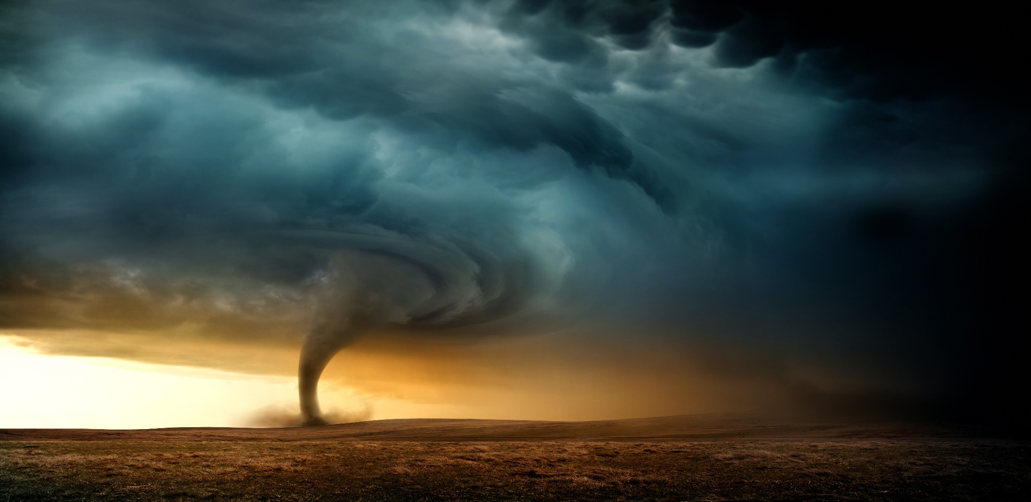
Jesus is in The Midst of Your Storms
By Pastor Fee Soliven
Psalm 107:23-32
Sunday Morning
January 21, 2018

Slide 4
23 Those who go down to the sea in ships, Who do business on great waters, 24 They see the works of the LORD, And His wonders in the deep. 25 For He commands and raises the stormy wind, Which lifts up the waves of the sea.

Slide 5
26 They mount up to the heavens, They go down again to the depths; Their soul melts because of trouble. 27 They reel to and fro, and stagger like a drunken man, And are at their wits' end. 28 Then they cry out to the LORD in their trouble, And He brings them out of their distresses. 29 He calms the storm, So that its waves are still.

Slide 6
30 Then they are glad because they are quiet; So He guides them to their desired haven. 31 Oh, that men would give thanks to the LORD for His goodness, And for His wonderful works to the children of men! 32 Let them exalt Him also in the assembly of the people, And praise Him in the company of the elders.

Slide 7
We all experience storms in our lives, those occasions that bring pain, suffering, or loss.

Slide 8
Where is God?
Why has this happened?
Was it something I did?
Did God cause it?
If so, why?

Slide 9
Psalm 103:19
“The Lord has established His throne in the heavens, and His sovereignty rules over all.”

Slide 10
1 Peter 4:12-13
12 Beloved, do not think it strange concerning the fiery trial which is to try you, as though some strange thing happened to you; 13 but rejoice to the extent that you partake of Christ's sufferings, that when His glory is revealed, you may also be glad with exceeding joy.

Slide 11
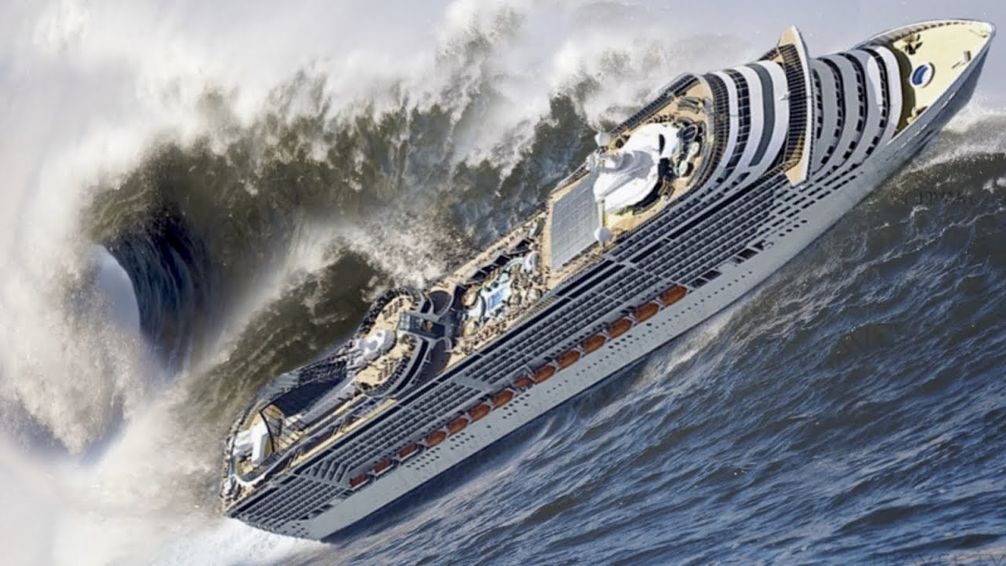
Romans 3:18
“There is no fear of God before their eyes.”

Slide 12
Was God in the storm?

Slide 13
Psalm 107:25
“For He commands and raises the stormy wind, Which lifts up the waves of the sea”

Slide 14
Proverbs 16:1-4
(Living Bible Translation)
1 We can make our plans, but the final outcome is in God's hands. 2 We can always "prove" that we are right, but is the Lord convinced? 3 Commit your work to the Lord, then it will succeed. 4 The Lord has made everything for his own purposes-even the wicked, for punishment.

Slide 15
There are three kinds of storms

Slide 16
1. Natural Storms

Slide 17
2. Emotional Storms

Slide 18
3. Spiritual storms

Slide 19
1. Natural Storms

Slide 20
2. Emotional Storms

Slide 21
Poor Health

Slide 22
Financial Struggles

Slide 23
Relationship Difficulties

Slide 24
3. Spiritual Storms

Slide 25
What are the sources of
our Storms?

Slide 26
1. Ourselves

Slide 27
2. The devil

Slide 28
2 Samuel 11:1-5
1 It happened in the spring of the year, at the time when kings go out to battle, that David sent Joab and his servants with him, and all Israel; and they destroyed the people of Ammon and besieged Rabbah. But David remained at Jerusalem. 2 Then it happened one evening that David arose from his bed and walked on the roof of the king's house. And from the roof he saw a woman bathing, and the woman was very beautiful to behold.

Slide 29
3 So David sent and inquired about the woman. And someone said, "Is this not Bathsheba, the daughter of Eliam, the wife of Uriah the Hittite?" 4 Then David sent messengers, and took her; and she came to him, and he lay with her, for she was cleansed from her impurity; and she returned to her house. 5 And the woman conceived; so she sent and told David, and said, "I am with child."

Slide 30
David was where he shouldn’t have been

Slide 31
He saw what he should
not have seen

Slide 32
His look turned to lust, and he sent for her

Slide 33
His lust gave birth to an act of sin

Slide 34
3. God

Slide 35
Why does God allow storms in our lives?

Slide 36
1. To get our Attention

Slide 37
2. To bring us to Repentance

Slide 38
Why does God allow storms in
our lives?

Slide 39
3. To conform us to Christ’s Image

Slide 40
4. To Equip us for Service

Slide 41
5. To demonstrate His Power in our Lives

Slide 42
6. To reveal Himself to Us

Slide 43
7. To Demonstrate His Love

Slide 44
8. To Remind us who is in Control

Slide 45
1. How do you usually respond to the storms in your life?

Slide 46
2. How does it make you feel knowing that God is in control?

Slide 47
3. As you look back on past storms, what has the Lord taught you about Himself and His ways?

