Slide 1


Slide 2


Slide 3
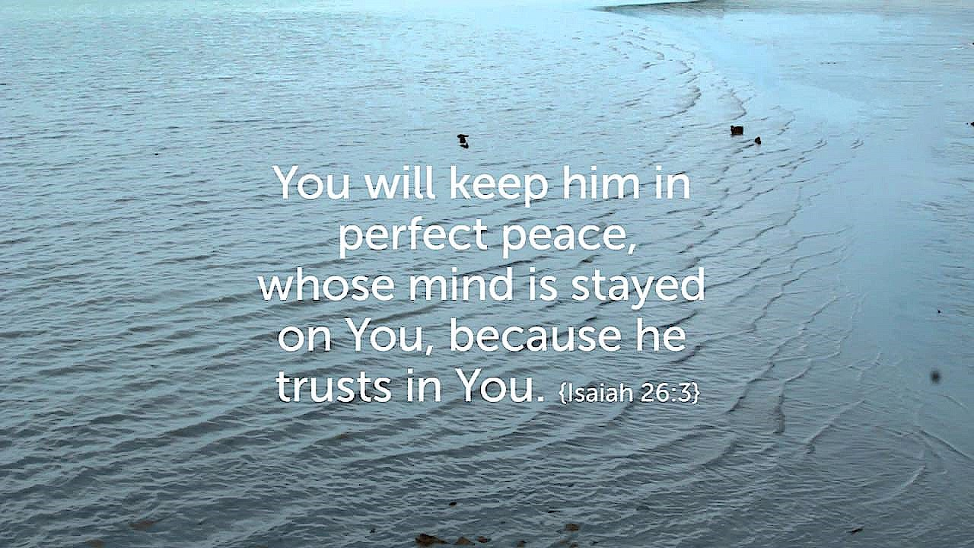

Keep My Mind in Perfect Peace
By Pastor Fee Soliven
Isaiah 26:1-6
Sunday Morning
January 28, 2018

Slide 4
Isaiah 26:1-6
1 In that day this song will be sung in the land of Judah: "We have a strong city; God will appoint salvation for walls and bulwarks. 2 Open the gates, That the righteous nation which keeps the truth may enter in. 3 You will keep him in perfect peace, Whose mind is stayed on You, Because he trusts in You.

Slide 5
4 Trust in the LORD forever, For in YAH, the LORD, is everlasting strength. 5 For He brings down those who dwell on high, The lofty city; He lays it low, He lays it low to the ground, He brings it down to the dust. 6 The foot shall tread it down--The feet of the poor And the steps of the needy."

Slide 6
When confronted with questionable situations or opportunities, can you trust your conscience mind to guide you to make right choices?

Slide 7
God has given every person a conscience mind to guard and guide them.

Slide 8
1 Timothy 1:18-19
18 This charge I commit to you, son Timothy, according to the prophecies previously made concerning you, that by them you may wage the good warfare, 19 having faith and a good conscience, which some having rejected, concerning the faith have suffered shipwreck…

Slide 9
The Conscience Mind is a Universal Gift of God

Slide 10
1. Our conscience mind distinguishes between the morally right and wrong

Slide 11
Acts 24:16
“So I always take pains to have a clear conscience toward both God and man.”

Slide 12
2. Our conscience mind urges us to do that which we recognize to be right.

Slide 13
Hebrews 13:16
“Pray for us: for we trust we have a good conscience, in all things willing to live honestly.”

Slide 14
3. Our conscience mind restrains us from doing what we recognize to be wrong.

Slide 15
Titus 1:15
“To the pure, all things are pure, but to the defiled and unbelieving, nothing is pure; but both their minds and their consciences are defiled.”

Slide 16
4. Our conscience mind passes judgment on our acts and executes that judgment within our souls.

Slide 17
1 Timothy 6:5
“These people always cause trouble. Their minds are corrupt, and they have turned their backs on the truth. To them, a show of godliness is just a way to become wealthy.”

Slide 18
How does the conscience work?

Slide 19
1. It judges a man’s soul in three areas. They are attitude, conduct, and behavior.

Slide 20
2. It’s like spiritual radar sending out signals that danger is near.

Slide 21
3. It acts like a grid system that sends a stop signal whenever something wrong hits it.

Slide 22
The Bible mentions several different types of consciences

Slide 23
1. A Good Conscience

Slide 24
1 Timothy 1:19
“having faith and a good conscience…”

Slide 25
2. A Struggling Conscience

Slide 26
1 Corinthians 8:7-12
7 But not everyone knows this. Some people are still so accustomed to idols that when they eat such food they think of it as having been sacrificed to an idol, and since their conscience is weak, it is defiled. 8 But food does not bring us near to God; we are no worse if we do not eat, and no better if we do. 9 Be careful, however, that the exercise of your freedom does not become a stumbling block to the weak.

Slide 27
10 For if anyone with a weak conscience sees you who have this knowledge eating in an idol's temple, won't he be emboldened to eat what has been sacrificed to idols? 11 So this weak brother, for whom Christ died, is destroyed by your knowledge. 12 When you sin against your brothers in this way and wound their weak conscience, you sin against Christ.

Slide 28
3. A soiled Conscience

Slide 29
Titus 1:15
“To the pure all things are pure, but to those who are defiled and unbelieving nothing is pure; but even their mind and conscience are defiled.”

Slide 30
4. A Seared Conscience

Slide 31
1 Timothy 4:2
“speaking lies in hypocrisy, having their own conscience seared with a hot iron…”

Slide 32
Romans 1:21-24
“21 because, although they knew God, they did not glorify Him as God, nor were thankful, but became futile in their thoughts, and their foolish hearts were darkened. 22 Professing to be wise, they became fools,

Slide 33
23 and changed the glory of the incorruptible God into an image made like corruptible man--and birds and four-footed animals and creeping things. 24 Therefore God also gave them up to uncleanness, in the lusts of their hearts, to dishonor their bodies among themselves…”

Slide 34
When can we trust our conscience to be our guide?

Slide 35
1. We can trust it when we’ve accepted the Word of God as the basis for our conduct.

Slide 36
2. We can trust it if we have programmed our conscience with the teaching of Scripture.

Slide 37
3. We can trust our conscience when we have a strong desire to obey the Lord.

Slide 38
4. We can trust it if we prayerfully consider the decisions we must make.

Slide 39
5. We can trust our conscience when it immediately sounds an alarm when we’re considering a wrong direction in our thoughts or actions.

Slide 40
6. We can trust it when we feel guilty immediately upon disobedience.

Slide 41
1. The conscience is informed by what we know and have learned. How readily do you respond to your conscience?

Slide 42
2. Who has influenced your conscience?

Slide 43
3. What ideas and teachings have shaped your perceptions of right and wrong?

Slide 44
4. How reliable do you think your conscience is? Now consider what a conscience informed by God’s Word would be like.

Slide 45
5. How much more reliable do you think it would be?

Slide 46
6. What practical steps can you take to develop a trustworthy, protective, faithful conscience?

