Slide 1


Slide 2


Slide 3
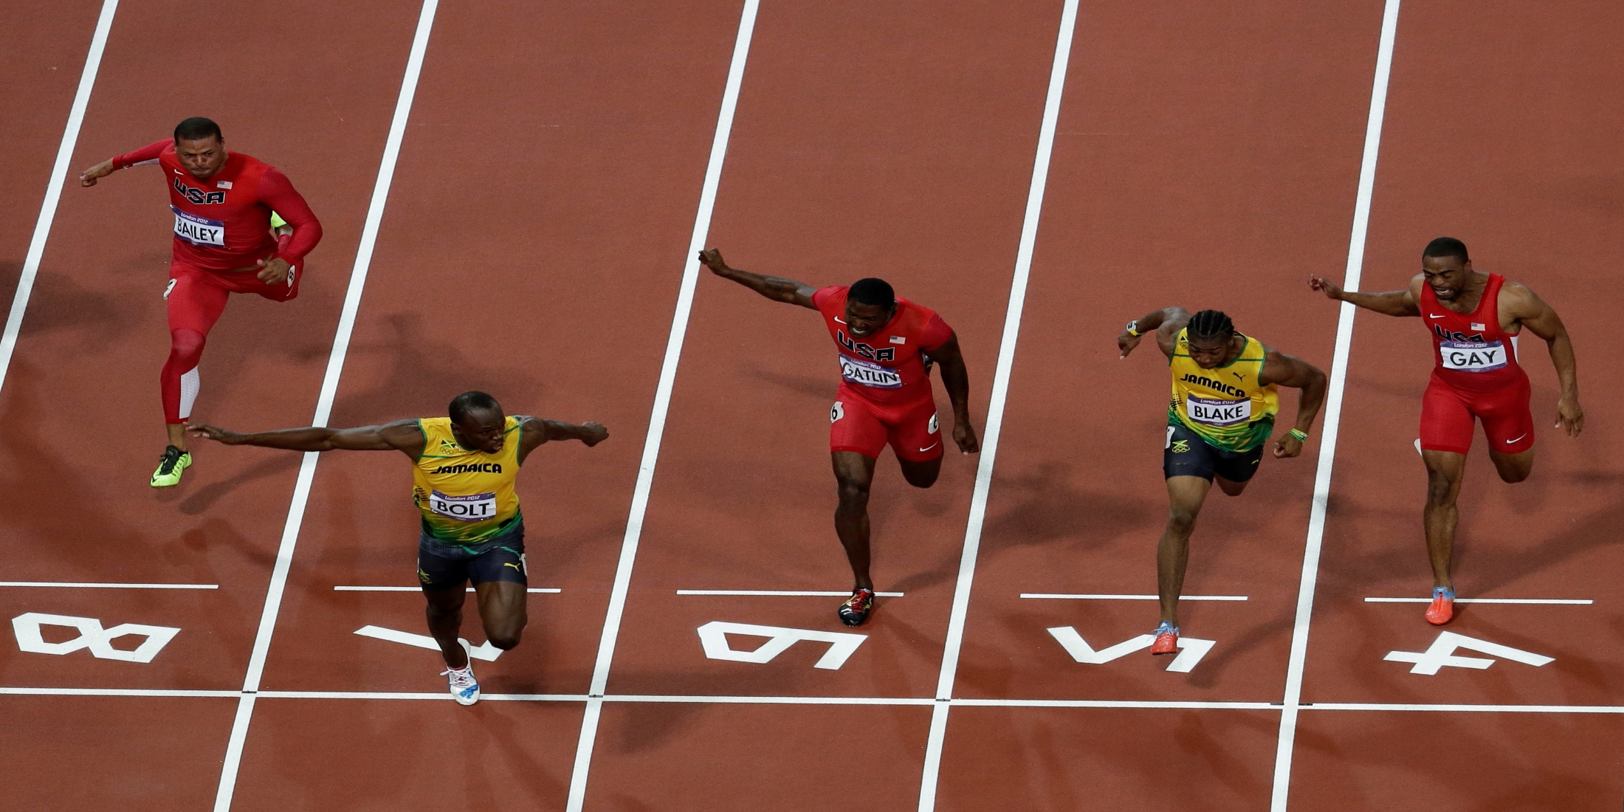

Crossing the Finish Line
By Pastor Fee Soliven
2 Timothy 4:5-8
Sunday Morning
February 11, 2018

Slide 4
2 Timothy 4:5-8
5 But you be watchful in all things, endure afflictions, do the work of an evangelist, fulfill your ministry. 6 For I am already being poured out as a drink offering, and the time of my departure is at hand. 7 I have fought the good fight, I have finished the race, I have kept the faith. 8 Finally, there is laid up for me the crown of righteousness, which the Lord, the righteous Judge, will give to me on that Day, and not to me only but also to all who have loved His appearing.

Slide 5
1. FIGHTING THE GOOD FIGHT

Slide 6
2 Timothy 4:7
“I have fought a good fight, I have finished my course, I have kept the faith”

Slide 7
The Apostle Paul compares Christians as a soldier, husbandman, sufferer, student, vessel, and a servant.

Slide 8
I have fought a good fight:

Slide 9
I have finished my course:

Slide 10
I have kept the faith:

Slide 11
Hebrews 13:5-6
5 Let your conduct be without covetousness; be content with such things as you have. For He Himself has said, "I will never leave you nor forsake you." 6 So we may boldly say: "The LORD is my helper; I will not fear. What can man do to me?"

Slide 12
John 1:1-5
1 In the beginning was the Word, and the Word was with God, and the Word was God. 2 He was in the beginning with God. 3 All things were made through Him, and without Him nothing was made that was made. 4 In Him was life, and the life was the light of men. 5 And the light shines in the darkness, and the darkness did not comprehend it.

Slide 13
The Word of God is:

Slide 14
1. A light unto our path
2. The gate to heaven
3. A guide for the youth
4. Comfort for the aged
5. Food for the hungry
6. Water for the thirsty
7. Rest for the weary
8. Hope for the unbeliever
9. Salvation for the sinner
10. And Grace for the Christian

Slide 15
2. FINISH HIS WORK:

Slide 16
John 4:34
“Jesus said to them, "My food is to do the will of Him who sent Me, and to finish His work.

Slide 17
My meat is to do the will of him:

Slide 18
To finish his work:

Slide 19
The Fivefold use of the Word:

Slide 20
Hold it
Hide it in your heart that we may not sin against God

Slide 21
2. Study it
Minister to yourself through study of the word

Slide 22
3. Apply it
Put it into action

Slide 23
4. Rightly divide it
Don’t let false doctrines come your way

Slide 24
5. Preach it
Take the gospel to the streets, your work place, to our families

Slide 25
3. LAYING ASIDE EVERY WEIGHT:

Slide 26
Hebrews 12:1
Wherefore seeing we also are compassed about with so great a cloud of witnesses, let us lay aside every weight, and the sin which doth so easily beset us, and let us run with patience the race that is set before us…

Slide 27
Lay aside every weight:

Slide 28
Let us run with patience:

Slide 29
1 Corinthians 9:24
“Do you not know that those who run in a race all run, but one receives the prize? Run in such a way that you may obtain it.”

Slide 30
Revelation 22:14
“Blessed are they that do his commandments, that they may have right to the tree of life and may enter in through the gates into the city.”

Slide 31
The race that is set before us:

Slide 32
Hebrews 12:1
(The Living Bible Translation)
“Since we have such a huge crowd of men of faith watching us from the grandstands, let us strip off anything that slows us down or holds us back, and especially those sins that wrap themselves so tightly around our feet and trip us up; and let us run with patience the particular race that God has set”

Slide 33
4. LOOKING UNTO JESUS:

Slide 34
Hebrews 12:2
“Looking unto Jesus the author and finisher of our faith; who for the joy that was set before him endured the cross, despising the shame, and is set down at the right hand of the throne of God.”

Slide 35
Looking unto Jesus:

Slide 36
Finisher of our faith:

Slide 37
Set down at the right hand:

Slide 38
1 Peter 1:3-4
3 Blessed be the God and Father of our Lord Jesus Christ, who according to His abundant mercy has begotten us again to a living hope through the resurrection of Jesus Christ from the dead, 4 to an inheritance incorruptible and undefiled and that does not fade away, reserved in heaven for you…

Slide 39
5. FORGETTING THOSE THINGS:

Slide 40
Philippians 3:13
Brethren, I count not myself to have apprehended: but this one thing I do, forgetting those things which are behind, and reaching forth unto those things which are before,

Slide 41
This one thing I do:

Slide 42
Philippians 1:6
Being confident of this very thing, that he which hath begun a good work in you will perform it until the day of Jesus Christ:

Slide 43
Forgetting those things which are behind:

Slide 44
Romans 8:1
There is therefore now no condemnation to them which are in Christ Jesus, who walk not after the flesh, but after the Spirit.

Slide 45
Reaching forth:

Slide 46
1 Peter 4:16
Yet if any man suffer as a Christian, let him not be ashamed; but let him glorify God on this behalf.

Slide 47
6. PRESSING TOWARDS THE MARK:

Slide 48
Philippians 3:14
I press toward the mark for the prize of the high calling of God in Christ Jesus.

Slide 49
I Press toward the mark:

Slide 50
For the prize of the high calling:

Slide 51
1 Peter 5:4
And when the chief Shepherd shall appear, you shall receive a crown of glory that fades not away.

