Slide 1


Slide 2


Slide 3
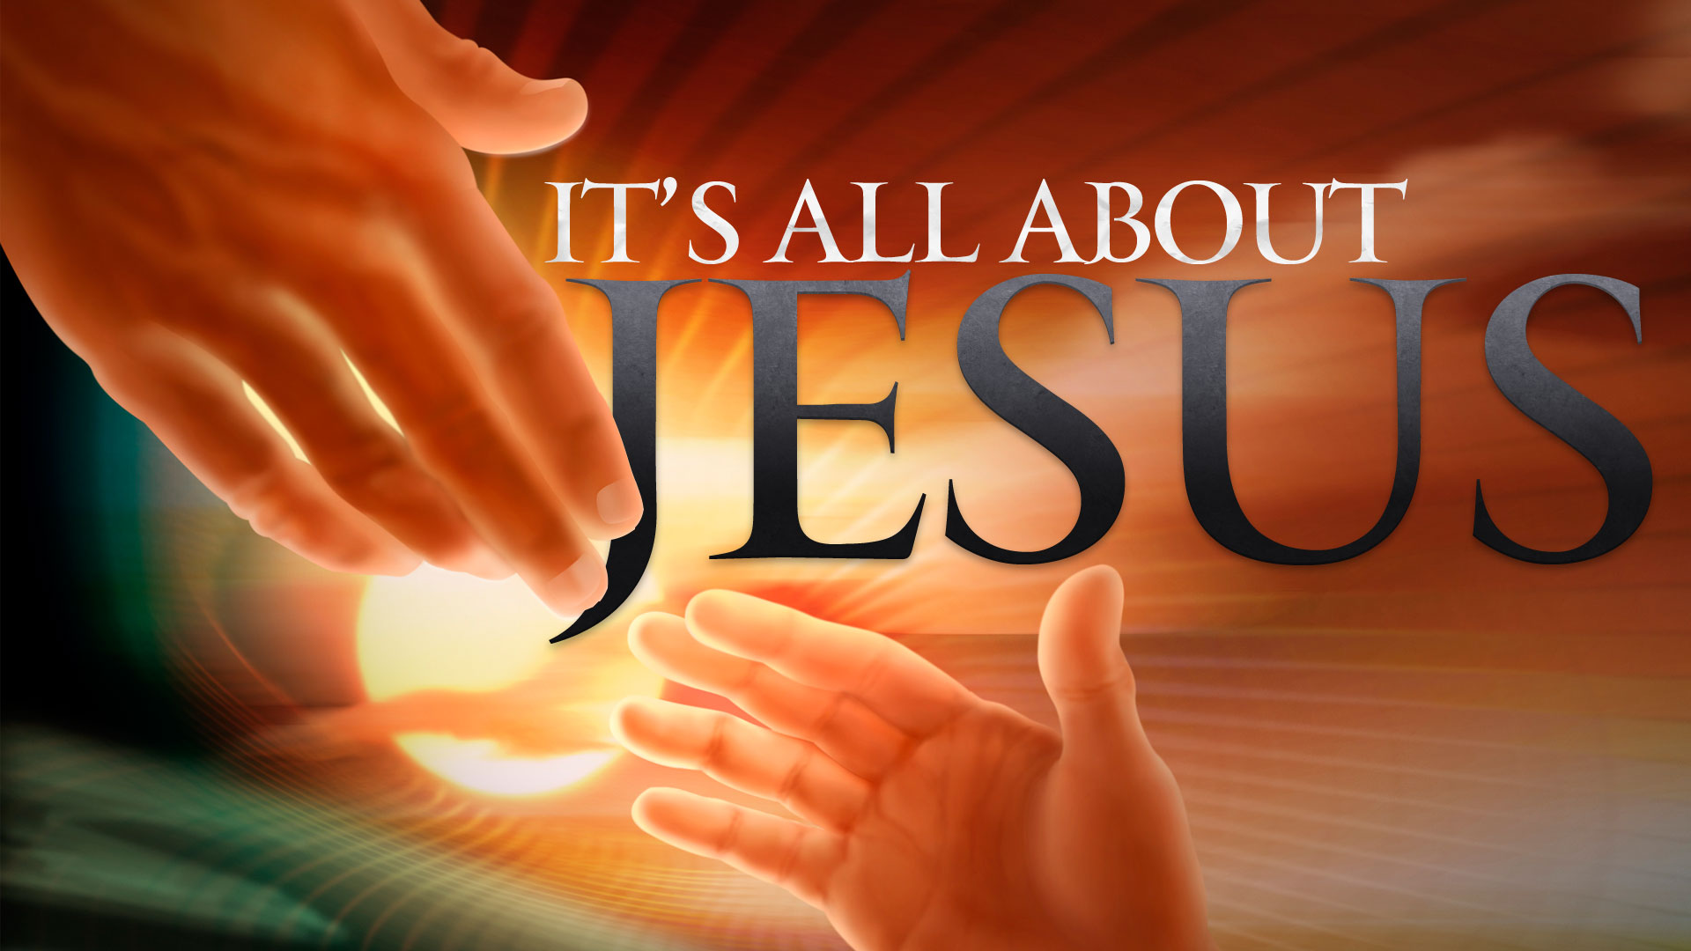

Do Not Neglect Your Gifts
By Pastor Fee Soliven
1 Timothy 4:14-16
Wednesday Evening
January 31, 2018

Slide 4
14 Do not neglect the gift that is in you, which was given to you by prophecy with the laying on of the hands of the eldership.

Slide 5
15 Meditate on these things; give yourself entirely to them, that your progress may be evident to all.

Slide 6
16 Take heed to yourself and to the doctrine. Continue in them, for in doing this you will save both yourself and those who hear you.

Slide 7
14 Do not neglect the gift that is in you, which was given to you by prophecy with the laying on of the hands of the eldership.

Slide 8
Romans 12:3-8
3 For I say, through the grace given to me, to everyone who is among you, not to think of himself more highly than he ought to think, but to think soberly, as God has dealt to each one a measure of faith. 4 For as we have many members in one body, but all the members do not have the same function, 5 so we, being many, are one body in Christ, and individually members of one another.

Slide 9
6 Having then gifts differing according to the grace that is given to us, let us use them: if prophecy, let us prophesy in proportion to our faith; 7 or ministry, let us use it in our ministering; he who teaches, in teaching; 8 he who exhorts, in exhortation; he who gives, with liberality; he who leads, with diligence; he who shows mercy, with cheerfulness.

Slide 10
1 Corinthians 1:4-9
4 I thank my God always concerning you for the grace of God which was given to you by Christ Jesus, 5 that you were enriched in everything by Him in all utterance and all knowledge, 6 even as the testimony of Christ was confirmed in you,

Slide 11
7 so that you come short in no gift, eagerly waiting for the revelation of our Lord Jesus Christ, 8 who will also confirm you to the end, that you may be blameless in the day of our Lord Jesus Christ. 9 God is faithful, by whom you were called into the fellowship of His Son, Jesus Christ our Lord.

Slide 12
1 Corinthians 12:1-11
1 Now concerning spiritual gifts, brethren, I do not want you to be ignorant: 2 You know that you were Gentiles, carried away to these dumb idols, however you were led. 3 Therefore I make known to you that no one speaking by the Spirit of God calls Jesus accursed, and no one can say that Jesus is Lord except by the Holy Spirit.

Slide 13
4 There are diversities of gifts, but the same Spirit. 5 There are differences of ministries, but the same Lord. 6 And there are diversities of activities, but it is the same God who works all in all. 7 But the manifestation of the Spirit is given to each one for the profit of all: 8 for to one is given the word of wisdom through the Spirit, to another the word of knowledge through the same Spirit,

Slide 14
9 to another faith by the same Spirit, to another gifts of healings by the same Spirit, 10 to another the working of miracles, to another prophecy, to another discerning of spirits, to another different kinds of tongues, to another the interpretation of tongues. 11 But one and the same Spirit works all these things, distributing to each one individually as He wills.

Slide 15
1 Corinthians 12:27-31
27 Now you are the body of Christ, and members individually. 28 And God has appointed these in the church: first apostles, second prophets, third teachers, after that miracles, then gifts of healings, helps, administrations, varieties of tongues.

Slide 16
29 Are all apostles? Are all prophets? Are all teachers? Are all workers of miracles? 30 Do all have gifts of healings? Do all speak with tongues? Do all interpret? 31 But earnestly desire the best gifts. And yet I show you a more excellent way.

Slide 17
1 Peter 4:7-11
7 But the end of all things is at hand; therefore be serious and watchful in your prayers. 8 And above all things have fervent love for one another, for "love will cover a multitude of sins." 9 Be hospitable to one another without grumbling. 10 As each one has received a gift, minister it to one another, as good stewards of the manifold grace of God.

Slide 18
11 If anyone speaks, let him speak as the oracles of God. If anyone ministers, let him do it as with the ability which God supplies, that in all things God may be glorified through Jesus Christ, to whom belong the glory and the dominion forever and ever. Amen.

Slide 19
15 Meditate on these things; give yourself entirely to them, that your progress may be evident to all.

Slide 20
Proverbs 23:17-21
17 Do not let your heart envy sinners, But be zealous for the fear of the LORD all the day; 18 For surely there is a hereafter, And your hope will not be cut off. 19 Hear, my son, and be wise; And guide your heart in the way. 20 Do not mix with winebibbers, Or with gluttonous eaters of meat; 21 For the drunkard and the glutton will come to poverty, And drowsiness will clothe a man with rags.

Slide 21
Proverbs 27:23-24
23 Be diligent to know the state of your flocks, And attend to your herds; 24 For riches are not forever, Nor does a crown endure to all generations.

Slide 22
Hebrews 4:11-16
11 Let us therefore be diligent to enter that rest, lest anyone fall according to the same example of disobedience. 12 For the word of God is living and powerful, and sharper than any two-edged sword, piercing even to the division of soul and spirit, and of joints and marrow, and is a discerner of the thoughts and intents of the heart. 13 And there is no creature hidden from His sight, but all things are naked and open to the eyes of Him to whom we must give account.

Slide 23
14 Seeing then that we have a great High Priest who has passed through the heavens, Jesus the Son of God, let us hold fast our confession. 15 For we do not have a High Priest who cannot sympathize with our weaknesses, but was in all points tempted as we are, yet without sin. 16 Let us therefore come boldly to the throne of grace, that we may obtain mercy and find grace to help in time of need.

Slide 24
2 Peter 3:14-18
14 Therefore, beloved, looking forward to these things, be diligent to be found by Him in peace, without spot and blameless; 15 and account that the longsuffering of our Lord is salvation--as also our beloved brother Paul, according to the wisdom given to him, has written to you,

Slide 25
16 as also in all his epistles, speaking in them of these things, in which are some things hard to understand, which untaught and unstable people twist to their own destruction, as they do also the rest of the Scriptures.

Slide 26
17 You therefore, beloved, since you know this beforehand, beware lest you also fall from your own steadfastness, being led away with the error of the wicked; 18 but grow in the grace and knowledge of our Lord and Savior Jesus Christ. To Him be the glory both now and forever. Amen.

Slide 27
16 Take heed to yourself and to the doctrine. Continue in them, for in doing this you will save both yourself and those who hear you.

Slide 28
Philippians 2:12-16
12 Therefore, my beloved, as you have always obeyed, not as in my presence only, but now much more in my absence, work out your own salvation with fear and trembling; 13 for it is God who works in you both to will and to do for His good pleasure.

Slide 29
14 Do all things without complaining and disputing, 15 that you may become blameless and harmless, children of God without fault in the midst of a crooked and perverse generation, among whom you shine as lights in the world, 16 holding fast the word of life, so that I may rejoice in the day of Christ that I have not run in vain or labored in vain.

Slide 30
Proverbs 11:25-26
25 Whoever brings blessing will be enriched, and one who waters will himself be watered. 26 The people curse him who holds back grain, but a blessing is on the head of him who sells it.”

Slide 31
Exodus 23:13
"Now concerning everything which I have said to you, be on your guard; and do not mention the name of other gods, nor let them be heard from your mouth.

Slide 32
Ezekiel 3:19
"Yet if you have warned the wicked and he does not turn from his wickedness or from his wicked way, he shall die in his iniquity; but you have delivered yourself.

Slide 33
Acts 20:28
Keep watch over yourselves and the entire flock of which the Holy Spirit has made you overseers. Be shepherds of the church of God, which He purchased with His own blood.

Slide 34
1 Corinthians 1:21
For since in the wisdom of God, the world through its wisdom did not know Him, God was pleased through the foolishness of what was preached to save those who believe.

