Slide 1


Slide 2


Slide 3
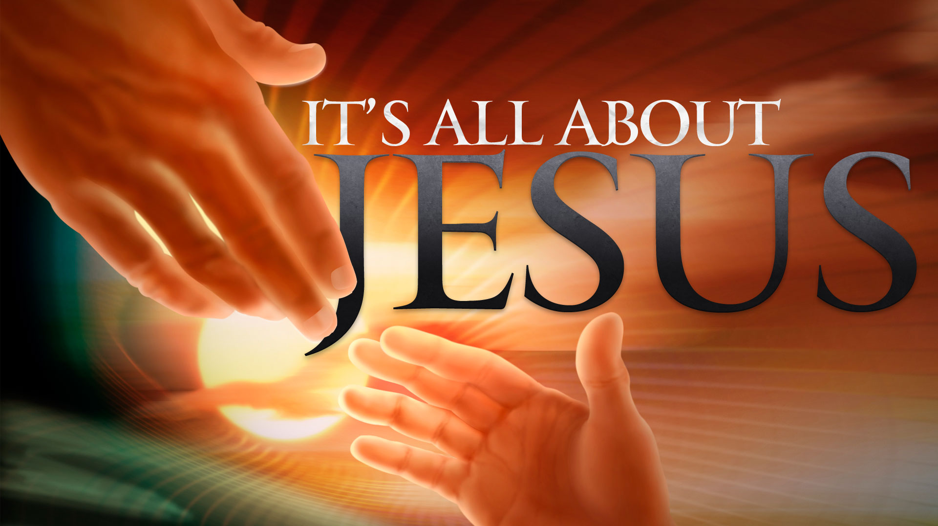

Humble Thyself in Christ
By Pastor Fee Soliven
1 Timothy 6:1-5
Wednesday Evening
February 21, 2018

Slide 4
1 Let as many bondservants as are under the yoke count their own masters worthy of all honor, so that the name of God and His doctrine may not be blasphemed. 2 And those who have believing masters, let them not despise them because they are brethren, but rather serve them because those who are benefited are believers and beloved. Teach and exhort these things.

Slide 5
3 If anyone teaches otherwise and does not consent to wholesome words, even the words of our Lord Jesus Christ, and to the doctrine which accords with godliness,

Slide 6
4 he is proud, knowing nothing, but is obsessed with disputes and arguments over words, from which come envy, strife, reviling, evil suspicions,

Slide 7
5 useless wranglings of men of corrupt minds and destitute of the truth, who suppose that godliness is a means of gain. From such withdraw yourself.

Slide 8
1 Let as many bondservants as are under the yoke count their own masters worthy of all honor, so that the name of God and His doctrine may not be blasphemed. 2 And those who have believing masters, let them not despise them because they are brethren, but rather serve them because those who are benefited are believers and beloved. Teach and exhort these things.

Slide 9
1 Corinthians 7:20-24
20 Let each one remain in the same calling in which he was called. 21 Were you called while a slave? Do not be concerned about it; but if you can be made free, rather use it.

Slide 10
22 For he who is called in the Lord while a slave is the Lord's freedman. Likewise he who is called while free is Christ's slave. 23 You were bought at a price; do not become slaves of men. 24 Brethren, let each one remain with God in that state in which he was called.

Slide 11
Galatians 3:28-29
26 For you are all sons of God through faith in Christ Jesus. 27 For as many of you as were baptized into Christ have put on Christ. 28 There is neither Jew nor Greek, there is neither slave nor free, there is neither male nor female; for you are all one in Christ Jesus. 29 And if you are Christ's, then you are Abraham's seed, and heirs according to the promise.

Slide 12
Ephesians 6:5-9
5 Bondservants, be obedient to those who are your masters according to the flesh, with fear and trembling, in sincerity of heart, as to Christ; 6 not with eyeservice, as men-pleasers, but as bondservants of Christ, doing the will of God from the heart, 7 with good will doing service, as to the Lord, and not to men,

Slide 13
8 knowing that whatever good anyone does, he will receive the same from the Lord, whether he is a slave or free. 9 And you, masters, do the same things to them, giving up threatening, knowing that your own Master also is in heaven, and there is no partiality with Him.

Slide 14
Colossians 3:22-25
22 Bondservants, obey in all things your masters according to the flesh, not with eyeservice, as men-pleasers, but in sincerity of heart, fearing God. 23 And whatever you do, do it heartily, as to the Lord and not to men,

Slide 15
24 knowing that from the Lord you will receive the reward of the inheritance; for you serve the Lord Christ. 25 But he who does wrong will be repaid for what he has done, and there is no partiality.

Slide 16
Titus 2:9-10
9 Exhort bondservants to be obedient to their own masters, to be well pleasing in all things, not answering back, 10 not pilfering, but showing all good fidelity, that they may adorn the doctrine of God our Savior in all things.

Slide 17
1 Peter 2:13-25
13 Therefore submit yourselves to every ordinance of man for the Lord's sake, whether to the king as supreme, 14 or to governors, as to those who are sent by him for the punishment of evildoers and for the praise of those who do good.

Slide 18
15 For this is the will of God, that by doing good you may put to silence the ignorance of foolish men-- 16 as free, yet not using liberty as a cloak for vice, but as bondservants of God. 17 Honor all people. Love the brotherhood. Fear God. Honor the king. 18 Servants, be submissive to your masters with all fear, not only to the good and gentle, but also to the harsh.

Slide 19
19 For this is commendable, if because of conscience toward God one endures grief, suffering wrongfully. 20 For what credit is it if, when you are beaten for your faults, you take it patiently? But when you do good and suffer, if you take it patiently, this is commendable before God.

Slide 20
21 For to this you were called, because Christ also suffered for us, leaving us an example, that you should follow His steps: 22 "Who committed no sin, or was deceit found in His mouth"; 23 who, when He was reviled, did not revile in return; when He suffered, He did not threaten, but committed Himself to Him who judges righteously;

Slide 21
24 who Himself bore our sins in His own body on the tree, that we, having died to sins, might live for righteousness--by whose stripes you were healed. 25 For you were like sheep going astray but have now returned to the Shepherd and Overseer of your souls.

Slide 22
3 If anyone teaches otherwise and does not consent to wholesome words, even the words of our Lord Jesus Christ, and to the doctrine which accords with godliness,

Slide 23
Matthew 23:27-33
27 Woe to you, scribes and Pharisees, hypocrites! For you are like whitewashed tombs which indeed appear beautiful outwardly, but inside are full of dead men's bones and all uncleanness. 28 Even so you also outwardly appear righteous to men, but inside you are full of hypocrisy and lawlessness.

Slide 24
29 Woe to you, scribes and Pharisees, hypocrites! Because you build the tombs of the prophets and adorn the monuments of the righteous, 30 and say, 'If we had lived in the days of our fathers, we would not have been partakers with them in the blood of the prophets.'

Slide 25
31 "Therefore you are witnesses against yourselves that you are sons of those who murdered the prophets. 32 Fill up, then, the measure of your fathers' guilt. 33 Serpents, brood of vipers! How can you escape the condemnation of hell?

Slide 26
4 he is proud, knowing nothing, but is obsessed with disputes and arguments over words, from which come envy, strife, reviling, evil suspicions,

Slide 27
Proverbs 8:13
“The fear of the LORD is to hate evil; Pride and arrogance and the evil way And the perverse mouth I hate.”

Slide 28
Proverbs 6:16-19
16 These six things the LORD hates, Yes, seven are an abomination to Him: 17 A proud look, A lying tongue, Hands that shed innocent blood, 18 A heart that devises wicked plans, Feet that are swift in running to evil, 19 A false witness who speaks lies, And one who sows discord among brethren.

Slide 29
5 useless wranglings of men of corrupt minds and destitute of the truth, who suppose that godliness is a means of gain. From such withdraw yourself.

Slide 30
2 Peter 2:1-14
1 But there were false prophets, too, in those days, just as there will be false teachers among you. They will cleverly tell their lies about God, turning against even their Master who bought them; but theirs will be a swift and terrible end.

Slide 31
2 Many will follow their evil teaching that there is nothing wrong with sexual sin. And because of them Christ and his way will be scoffed at. 3 These teachers in their greed will tell you anything to get hold of your money. But God condemned them long ago and their destruction is on the way.

Slide 32
4 For God did not spare even the angels who sinned, but threw them into hell, chained in gloomy caves and darkness until the judgment day. 5 And he did not spare any of the people who lived in ancient times before the flood except Noah, the one man who spoke up for God, and his family of seven. At that time God completely destroyed the whole world of ungodly men with the vast flood.

Slide 33
6 Later, he turned the cities of Sodom and Gomorrah into heaps of ashes and blotted them off the face of the earth, making them an example for all the ungodly in the future to look back upon and fear. 7 But at the same time the Lord rescued Lot out of Sodom because he was a good man, sick of the terrible wickedness he saw everywhere around him day after day.

Slide 34
9 So also the Lord can rescue you and me from the temptations that surround us, and continue to punish the ungodly until the day of final judgment comes. 10 He is especially hard on those who follow their own evil, lustful thoughts, and those who are proud and willful, daring even to scoff at the Glorious Ones without so much as trembling,

Slide 35
11 although the angels in heaven who stand in the very presence of the Lord, and are far greater in power and strength than these false teachers, never speak out disrespectfully against these evil Mighty Ones. 12 But false teachers are fools-no better than animals. They do whatever they feel like; born only to be caught and killed, they laugh at the terrifying powers of the underworld which they know so little about; and they will be destroyed along with all the demons and powers of hell.

Slide 36
13 That is the pay these teachers will have for their sin. For they live in evil pleasures day after day. They are a disgrace and a stain among you, deceiving you by living in foul sin on the side while they join your love feasts as though they were honest men.

