Slide 1


Slide 2


Slide 3
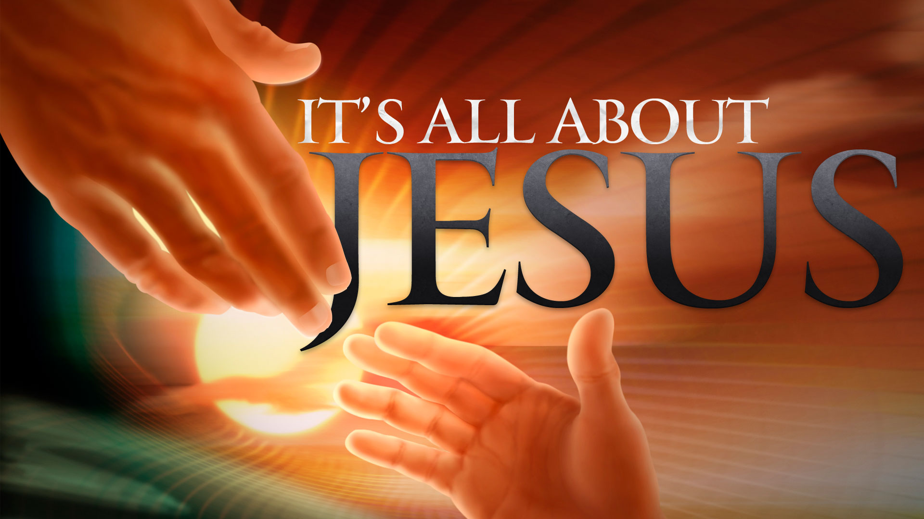

Fight the Good Fight of Faith
By Pastor Fee Soliven
1 Timothy 6:12-16
Wednesday Evening
March 14, 2018

Slide 4
12 Fight the good fight of faith, lay hold on eternal life, to which you were also called and have confessed the good confession in the presence of many witnesses.

Slide 5
13 I urge you in the sight of God who gives life to all things, and before Christ Jesus who witnessed the good confession before Pontius Pilate, 14 that you keep this commandment without spot, blameless until our Lord Jesus Christ's appearing,

Slide 6
15 which He will manifest in His own time, He who is the blessed and only Potentate, the King of kings and Lord of lords,

Slide 7
16 who alone has immortality, dwelling in unapproachable light, whom no man has seen or can see, to whom be honor and everlasting power. Amen.

Slide 8
12 Fight the good fight of faith, lay hold on eternal life, to which you were also called and have confessed the good confession in the presence of many witnesses.

Slide 9
Hebrews 11:6
“But without faith it is impossible to please Him, for he who comes to God must believe that He is, and that He is a rewarder of those who diligently seek Him.”

Slide 10
Philippians 3:12-21
12 Not that I have already attained, or am already perfected; but I press on, that I may lay hold of that for which Christ Jesus has also laid hold of me. 13 Brethren, I do not count myself to have apprehended; but one thing I do, forgetting those things which are behind and reaching forward to those things which are ahead,

Slide 11
14 I press toward the goal for the prize of the upward call of God in Christ Jesus. 15 Therefore let us, as many as are mature, have this mind; and if in anything you think otherwise, God will reveal even this to you. 16 Nevertheless, to the degree that we have already attained, let us walk by the same rule, let us be of the same mind.

Slide 12
17 Brethren, join in following my example, and note those who so walk, as you have us for a pattern. 18 For many walk, of whom I have told you often, and now tell you even weeping, that they are the enemies of the cross of Christ: 19 whose end is destruction, whose god is their belly, and whose glory is in their shame--who set their mind on earthly things.

Slide 13
20 For our citizenship is in heaven, from which we also eagerly wait for the Savior, the Lord Jesus Christ, 21 who will transform our lowly body that it may be conformed to His glorious body, according to the working by which He is able even to subdue all things to Himself.

Slide 14
James 1:12-18
12 Blessed is the man who endures temptation; for when he has been approved, he will receive the crown of life which the Lord has promised to those who love Him. 13 Let no one say when he is tempted, "I am tempted by God"; for God cannot be tempted by evil, nor does He Himself tempt anyone.

Slide 15
14 But each one is tempted when he is drawn away by his own desires and enticed. 15 Then, when desire has conceived, it gives birth to sin; and sin, when it is full-grown, brings forth death. 16 Do not be deceived, my beloved brethren.

Slide 16
17 Every good gift and every perfect gift is from above, and comes down from the Father of lights, with whom there is no variation or shadow of turning. 18 Of His own will He brought us forth by the word of truth, that we might be a kind of firstfruits of His creatures.

Slide 17
John 5:24
"Most assuredly, I say to you, he who hears My word and believes in Him who sent Me has everlasting life, and shall not come into judgment, but has passed from death into life.”

Slide 18
1 John 3:14
“We know that we have passed from death to life, because we love the brethren. He who does not love his brother abides in death.”

Slide 19
1 John 5:13
“These things I have written to you who believe in the name of the Son of God, that you may know that you have eternal life, and that you may continue to believe in the name of the Son of God.”

Slide 20
13 I urge you in the sight of God who gives life to all things, and before Christ Jesus who witnessed the good confession before Pontius Pilate, 14 that you keep this commandment without spot, blameless until our Lord Jesus Christ's appearing,

Slide 21
Matthew 27:11
“Now Jesus stood before the governor. And the governor asked Him, saying, "Are You the King of the Jews?" So Jesus said to him, "It is as you say."

Slide 22
Mark 15:2
Then Pilate asked Him, "Are You the King of the Jews?" And He answered and said to him, "It is as you say."

Slide 23
15 which He will manifest in His own time, He who is the blessed and only Potentate, the King of kings and Lord of lords,

Slide 24
Psalm 136:2-3
2 Oh, give thanks to the God of gods! For His mercy endures forever. 3 Oh, give thanks to the Lord of lords! For His mercy endures forever…

Slide 25
Deuteronomy 10:17
“For the LORD your God is God of gods and Lord of lords, the great God, mighty and awesome, who shows no partiality nor takes a bribe.”

Slide 26
Revelation 17:14
“These will make war with the Lamb, and the Lamb will overcome them, for He is Lord of lords and King of kings; and those who are with Him are called, chosen, and faithful."

Slide 27
Revelation 19:16
“And He has on His robe and on His thigh a name written: KING OF KINGS AND LORD OF LORDS.”

Slide 28
16 who alone has immortality, dwelling in unapproachable light, whom no man has seen or can see, to whom be honor and everlasting power. Amen.

Slide 29
Exodus 33:17-23
17 So the LORD said to Moses, "I will also do this thing that you have spoken; for you have found grace in My sight, and I know you by name." 18 And he said, "Please, show me Your glory."

Slide 30
19 Then He said, "I will make all My goodness pass before you, and I will proclaim the name of the LORD before you. I will be gracious to whom I will be gracious, and I will have compassion on whom I will have compassion." 20 But He said, "You cannot see My face; for no man shall see Me, and live." 21 And the LORD said, "Here is a place by Me, and you shall stand on the rock.

Slide 31
22 So it shall be, while My glory passes by, that I will put you in the cleft of the rock, and will cover you with My hand while I pass by. 23 Then I will take away My hand, and you shall see My back; but My face shall not be seen."

Slide 32
Romans 9:14-29
14 What shall we say then? Is there unrighteousness with God? Certainly not! 15 For He says to Moses, "I will have mercy on whomever I will have mercy, and I will have compassion on whomever I will have compassion." 16 So then it is not of him who wills, nor of him who runs, but of God who shows mercy.

Slide 33
17 For the Scripture says to Pharaoh, "For this very purpose I have raised you up, that I may show My power in you, and that My name may be declared in all the earth." 18 Therefore He has mercy on whom He wills, and whom He wills He hardens. 19 You will say to me then, "Why does He still find fault? For who has resisted His will?"

Slide 34
20 But indeed, O man, who are you to reply against God? Will the thing formed say to him who formed it, "Why have you made me like this?" 21 Does not the potter have power over the clay, from the same lump to make one vessel for honor and another for dishonor? 22 What if God, wanting to show His wrath and to make His power known, endured with much longsuffering the vessels of wrath prepared for destruction,

Slide 35
23 and that He might make known the riches of His glory on the vessels of mercy, which He had prepared beforehand for glory, 24 even us whom He called, not of the Jews only, but also of the Gentiles? 25 As He says also in Hosea: "I will call them My people, who were not My people, And her beloved, who was not beloved."

Slide 36
26 "And it shall come to pass in the place where it was said to them, 'You are not My people,' There they shall be called sons of the living God." 27 Isaiah also cries out concerning Israel: "Though the number of the children of Israel be as the sand of the sea, The remnant will be saved.

Slide 37
28 For He will finish the work and cut it short in righteousness, Because the LORD will make a short work upon the earth." 29 And as Isaiah said before: "Unless the LORD of Sabaoth had left us a seed, We would have become like Sodom, and we would have been made like Gomorrah."

Slide 38
John 1:18
“No one has seen God at any time. The only begotten Son, who is in the bosom of the Father, He has declared Him.”

Slide 39
Romans 1:21
“because, although they knew God, they did not glorify Him as God, nor were thankful, but became futile in their thoughts, and their foolish hearts were darkened.”

