Slide 1


Slide 2


Slide 3
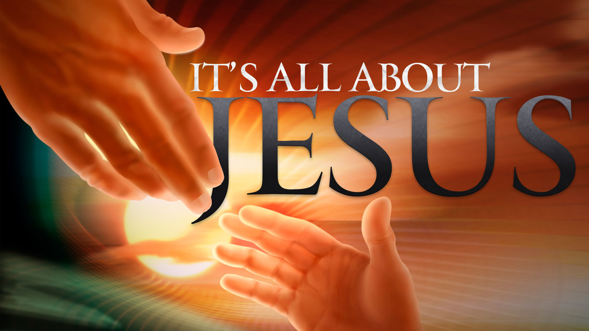

Having a Sound Mind
By Pastor Fee Soliven
2 Timothy 1:1-7
Wednesday Evening
March 28, 2018

Slide 4
1 Paul, an apostle of Jesus Christ by the will of God, according to the promise of life which is in Christ Jesus,

Slide 5
2 To Timothy, a beloved son: Grace, mercy, and peace from God the Father and Christ Jesus our Lord.

Slide 6
3 I thank God, whom I serve with a pure conscience, as my forefathers did, as without ceasing I remember you in my prayers night and day,

Slide 7
4 greatly desiring to see you, being mindful of your tears, that I may be filled with joy,

Slide 8
5 when I call to remembrance the genuine faith that is in you, which dwelt first in your grandmother Lois and your mother Eunice, and I am persuaded is in you also.

Slide 9
6 Therefore I remind you to stir up the gift of God which is in you through the laying on of my hands.

Slide 10
7 For God has not given us a spirit of fear, but of power and of love and of a sound mind.

Slide 11
1 Paul, an apostle of Jesus Christ by the will of God, according to the promise of life which is in Christ Jesus,

Slide 12
Acts 9:1-6
1 Then Saul, still breathing threats and murder against the disciples of the Lord, went to the high priest 2 and asked letters from him to the synagogues of Damascus, so that if he found any who were of the Way, whether men or women, he might bring them bound to Jerusalem.

Slide 13
3 And as he journeyed he came near Damascus, and suddenly a light shone around him from heaven. 4 Then he fell to the ground, and heard a voice saying to him, "Saul, Saul, why are you persecuting Me?" 5 And he said, "Who are You, Lord?" And the Lord said, "I am Jesus, whom you are persecuting. It is hard for you to kick against the goads."

Slide 14
6 So he, trembling and astonished, said, "Lord, what do You want me to do?" And the Lord said to him, "Arise and go into the city, and you will be told what you must do."

Slide 15
Acts 26:12-18
12 "While thus occupied, as I journeyed to Damascus with authority and commission from the chief priests, 13 at midday, O king, along the road I saw a light from heaven, brighter than the sun, shining around me and those who journeyed with me.

Slide 16
14 And when we all had fallen to the ground, I heard a voice speaking to me and saying in the Hebrew language, 'Saul, Saul, why are you persecuting Me? It is hard for you to kick against the goads.' 15 "So I said, 'Who are You, Lord?' And He said, 'I am Jesus, whom you are persecuting.

Slide 17
16 But rise and stand on your feet; for I have appeared to you for this purpose, to make you a minister and a witness both of the things which you have seen and of the things which I will yet reveal to you. 17 I will deliver you from the Jewish people, as well as from the Gentiles, to whom I now send you,

Slide 18
18 to open their eyes, in order to turn them from darkness to light, and from the power of Satan to God, that they may receive forgiveness of sins and an inheritance among those who are sanctified by faith in Me.'

Slide 19
2 To Timothy, a beloved son: Grace, mercy, and peace from God the Father and Christ Jesus our Lord.

Slide 20
3 I thank God, whom I serve with a pure conscience, as my forefathers did, as without ceasing I remember you in my prayers night and day,

Slide 21
Romans 1:8
“First, I thank my God through Jesus Christ for you all, that your faith is spoken of throughout the whole world.”

Slide 22
Philippians 1:3-5
3 I thank my God upon every remembrance of you, 4 always in every prayer of mine making request for you all with joy, 5 for your fellowship in the gospel from the first day until now…

Slide 23
Colossians 1:3
“We give thanks to the God and Father of our Lord Jesus Christ, praying always for you…”

Slide 24
Acts 24:16
“This being so, I myself always strive to have a conscience without offense toward God and men.”

Slide 25
1 Timothy 1:5
“Now the purpose of the commandment is love from a pure heart, from a good conscience, and from sincere faith…”

Slide 26
Romans 1:9
“For God is my witness, whom I serve with my spirit in the gospel of His Son, that without ceasing I make mention of you always in my prayers…”

Slide 27
4 greatly desiring to see you, being mindful of your tears, that I may be filled with joy,

Slide 28
Galatians 5:22-23
22 But the fruit of the Spirit is love, joy, peace, longsuffering, kindness, goodness, faithfulness, 23 gentleness, self-control. Against such there is no law.

Slide 29
Acts 13:47-52
47 For so the Lord has commanded us: 'I have set you as a light to the Gentiles, That you should be for salvation to the ends of the earth.' "

Slide 30
48 Now when the Gentiles heard this, they were glad and glorified the word of the Lord. And as many as had been appointed to eternal life believed. 49 And the word of the Lord was being spread throughout all the region.

Slide 31
50 But the Jews stirred up the devout and prominent women and the chief men of the city, raised up persecution against Paul and Barnabas, and expelled them from their region. 51 But they shook off the dust from their feet against them, and came to Iconium. 52 And the disciples were filled with joy and with the Holy Spirit.

Slide 32
5 when I call to remembrance the genuine faith that is in you, which dwelt first in your grandmother Lois and your mother Eunice, and I am persuaded is in you also.

Slide 33
Acts 16:1
“Then he came to Derbe and Lystra. And behold, a certain disciple was there, named Timothy, the son of a certain Jewish woman who believed, but his father was Greek.”

Slide 34
1. Is your faith halfhearted?

Slide 35
Hebrews 11:6
“But without faith it is impossible to please Him, for he who comes to God must believe that He is, and that He is a rewarder of those who diligently seek Him.”

Slide 36
2. Do you rely on how you feel to determine your faithfulness to God?

Slide 37
Psalm 57:7
“My heart is steadfast, O God, my heart is steadfast; I will sing and give praise.”

Slide 38
Colossians 1:21-23
21 And you, who once were alienated and enemies in your mind by wicked works, yet now He has reconciled 22 in the body of His flesh through death, to present you holy, and blameless, and above reproach in His sight—

Slide 39
23 if indeed you continue in the faith, grounded and steadfast, and are not moved away from the hope of the gospel which you heard, which was preached to every creature under heaven, of which I, Paul, became a minister.

Slide 40
6 Therefore I remind you to stir up the gift of God which is in you through the laying on of my hands.

Slide 41
1 Timothy 4:14
“Do not neglect the gift that is in you, which was given to you by prophecy with the laying on of the hands of the eldership.”

Slide 42
7 For God has not given us a spirit of fear, but of power and of love and of a sound mind.

Slide 43
1. Power—We do not need to have naturally powerful personalities. God gives strength of character and confidence that wins us respect when we face opposition as we speak, preach, and live the truth. God supernaturally replaces any timidity on the servant’s part with boldness. Such power is difficult to discredit.

Slide 44
2. Love—Accompanying the power to speak the truth must be love for the listeners, believers and nonbelievers alike. Love separates Christians from the heathen world around them. Indeed, love separated the minister of Christ from the false teachers. Such love is difficult to dismiss.

Slide 45
3. Self-discipline—This can also be translated “self-control” or “sound mind.” In order to lead others, true ministers must control themselves. To put it another way, a good leader must have a cool head. Such control, such “soundness” is difficult to disclaim.

