Slide 1


Slide 2


Slide 3


Laying Hold on Eternal Life
By Pastor Fee Soliven
1 Timothy 6:17-21
Wednesday Evening
March 21, 2018

Slide 4
17 Command those who are rich in this present age not to be haughty, nor to trust in uncertain riches but in the living God, who gives us richly all things to enjoy.

Slide 5
18 Let them do good, that they be rich in good works, ready to give, willing to share,

Slide 6
19 storing up for themselves a good foundation for the time to come, that they may lay hold on eternal life.

Slide 7
20 O Timothy! Guard what was committed to your trust, avoiding the profane and idle babble and contradictions of what is falsely called knowledge—

Slide 8
21 by professing it some have strayed concerning the faith. Grace be with you. Amen.

Slide 9
17 Command those who are rich in this present age not to be haughty, nor to trust in uncertain riches but in the living God, who gives us richly all things to enjoy.

Slide 10
Psalm 62:8-10
8 O my people, trust him all the time. Pour out your longings before him, for he can help! 9 The greatest of men or the lowest-both alike are nothing in his sight. They weigh less than air on scales.

Slide 11
10 Don't become rich by extortion and robbery; if your riches increase, don't be proud. 11 God has said it many times, that power belongs to him (and also, O Lord, steadfast love belongs to you). He rewards each one of us according to what our works deserve.

Slide 12
Proverbs 11:28
“He who trusts in his riches will fall, But the righteous will flourish like the green leaf.”

Slide 13
Proverbs 23:4-9
4 Do not overwork to be rich; Because of your own understanding, cease! 5 Will you set your eyes on that which is not? For riches certainly make themselves wings; They fly away like an eagle toward heaven.

Slide 14
6 Do not eat the bread of a miser, Nor desire his delicacies; 7 For as he thinks in his heart, so is he. "Eat and drink!" he says to you, But his heart is not with you. 8 The morsel you have eaten, you will vomit up, And waste your pleasant words. 9 Do not speak in the hearing of a fool, For he will despise the wisdom of your words.

Slide 15
Ecclesiastes 2:24
24 “So I decided that there was nothing better for a man to do than to enjoy his food and drink and his job. Then I realized that even this pleasure is from the hand of God. 25 For who can eat or enjoy apart from him? 26 For God gives those who please him wisdom, knowledge, and joy; but if a sinner becomes wealthy, God takes the wealth away from him and gives it to those who please him. So here, too, we see an example of foolishly chasing the wind.

Slide 16
18 Let them do good, that they be rich in good works, ready to give, willing to share,

Slide 17
1. Being rich in good works means practicing “hands-on” giving to others. People are sometimes more effectively helped by personal involvement than by the giving of material objects or money.

Slide 18
2. Giving generously to those in need strikes a blow against the self-centeredness of our times. We learn to do with less so that more may do with some.

Slide 19
3. Being always ready to share with others improves our ability to respond quickly and effectively. Experience can help us to always be ready to share.

Slide 20
19 storing up for themselves a good foundation for the time to come, that they may lay hold on eternal life.

Slide 21
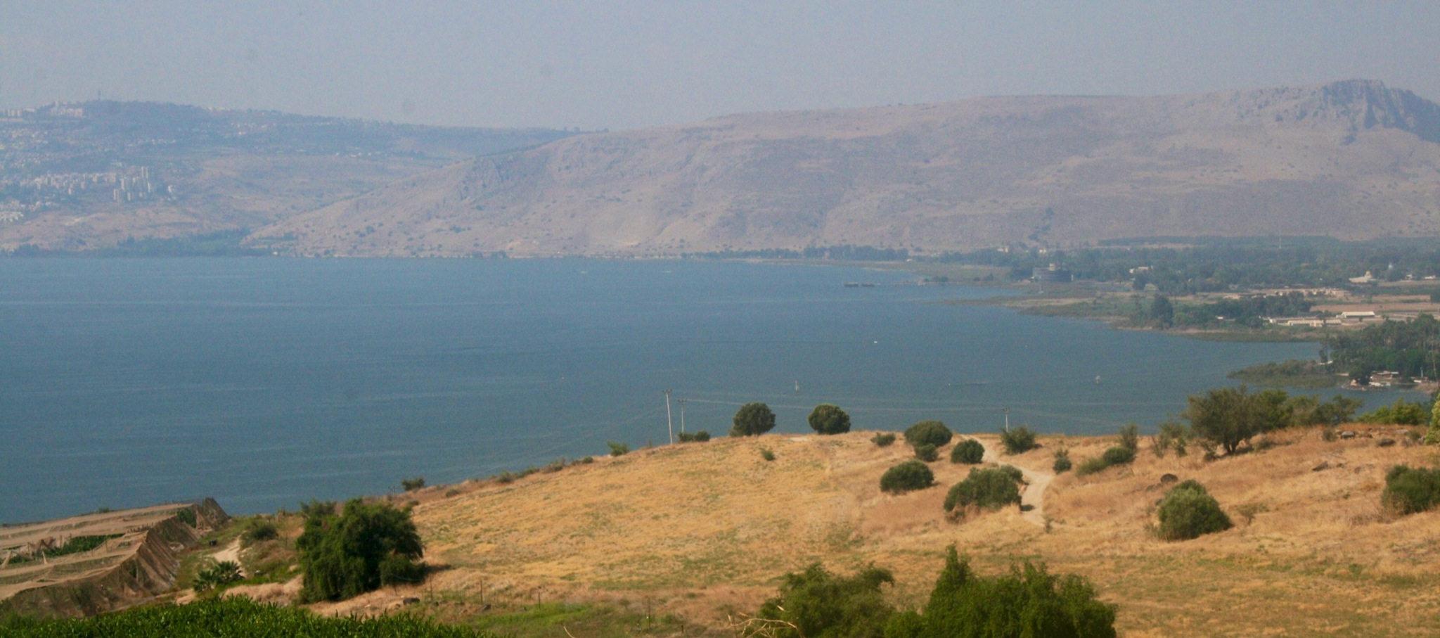
19 storing up for themselves a good foundation for the time to come, that they may lay hold on eternal life.

Slide 22
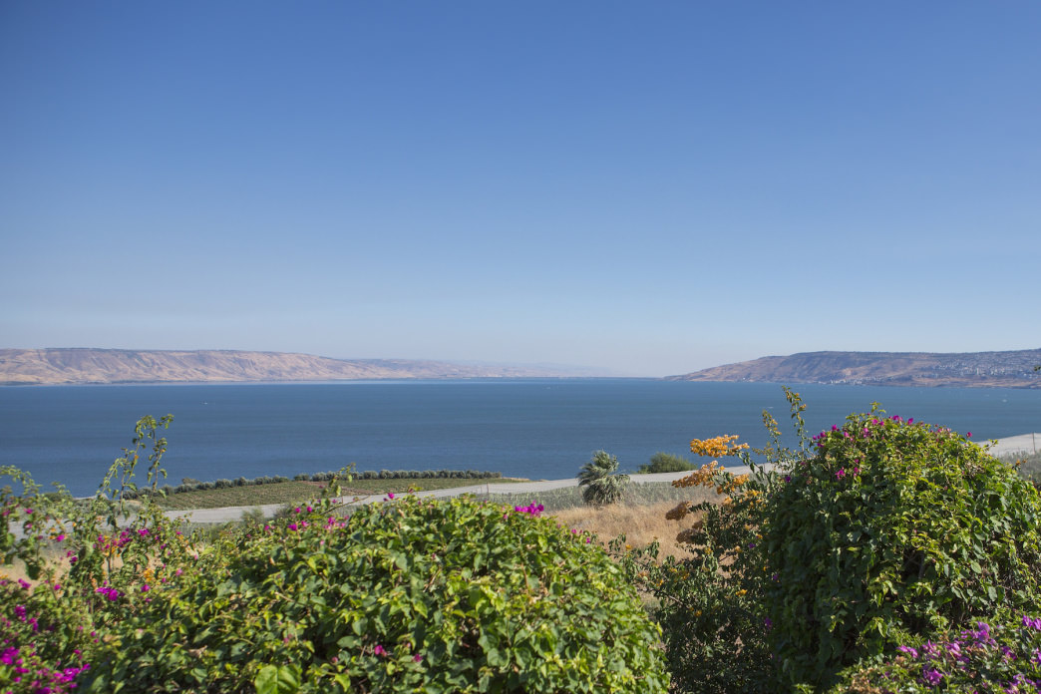
19 storing up for themselves a good foundation for the time to come, that they may lay hold on eternal life.

Slide 23
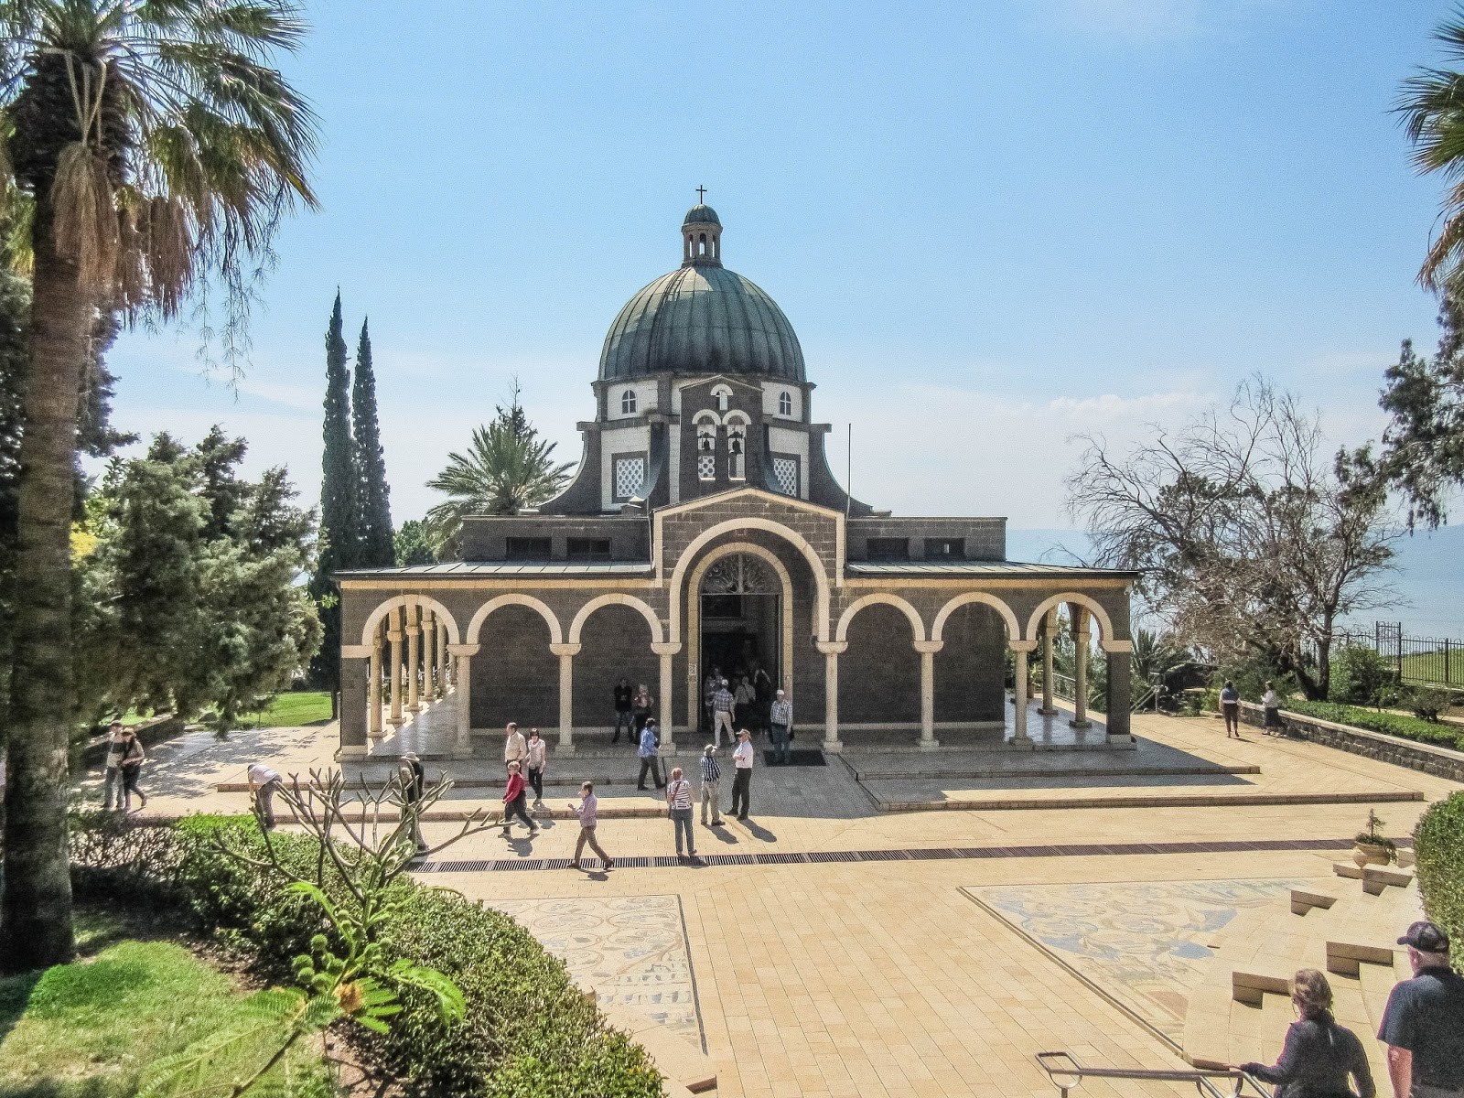
19 storing up for themselves a good foundation for the time to come, that they may lay hold on eternal life.

Slide 24
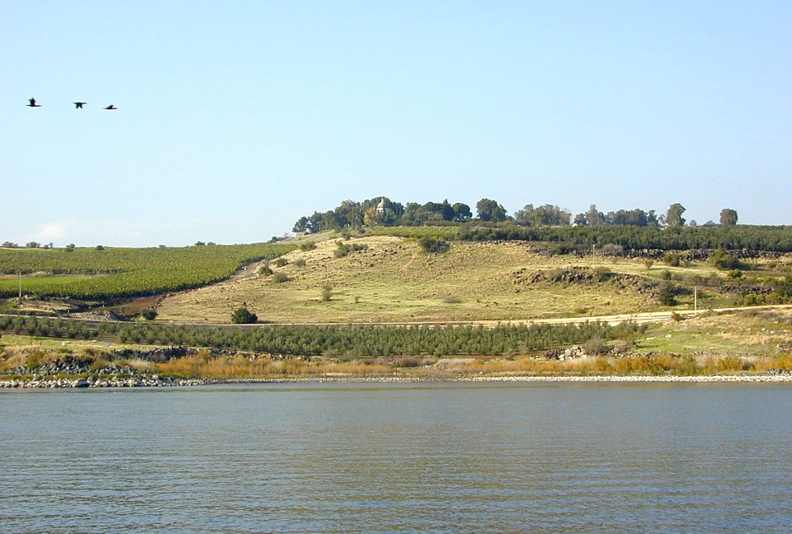
19 storing up for themselves a good foundation for the time to come, that they may lay hold on eternal life.

Slide 25
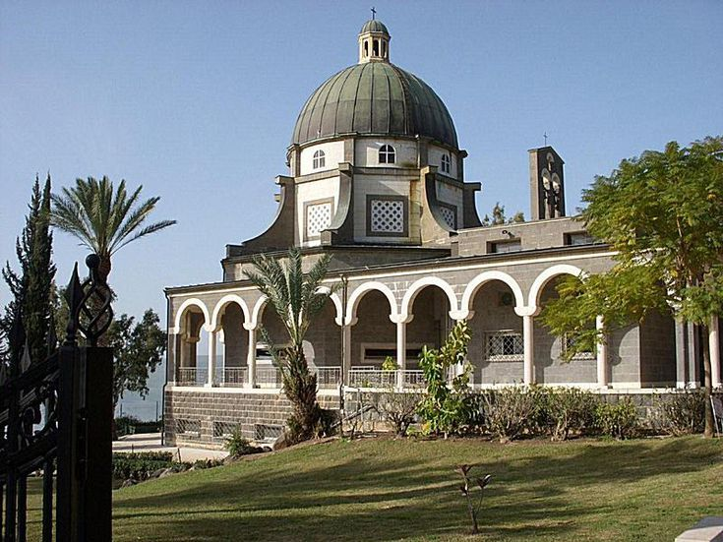
19 storing up for themselves a good foundation for the time to come, that they may lay hold on eternal life.

Slide 26
Matthew 6:19-21
19 "Do not lay up for yourselves treasures on earth, where moth and rust destroy and where thieves break in and steal; 20 but lay up for yourselves treasures in heaven, where neither moth nor rust destroys and where thieves do not break in and steal. 21 For where your treasure is, there your heart will be also.

Slide 27
James 5:1-5
1 Come now, you rich, weep and howl for your miseries that are coming upon you! 2 Your riches are corrupted, and your garments are moth-eaten. 3 Your gold and silver are corroded, and their corrosion will be a witness against you and will eat your flesh like fire. You have heaped up treasure in the last days.

Slide 28
4 Indeed the wages of the laborers who mowed your fields, which you kept back by fraud, cry out; and the cries of the reapers have reached the ears of the Lord of Sabaoth. 5 You have lived on the earth in pleasure and luxury; you have fattened your hearts as in a day of slaughter.

Slide 29
Job 14:13-17
13 "Oh, that You would hide me in the grave, That You would conceal me until Your wrath is past, That You would appoint me a set time, and remember me! 14 If a man dies, shall he live again? All the days of my hard service I will wait, Till my change comes.

Slide 30
15 You shall call, and I will answer You; You shall desire the work of Your hands. 16 For now You number my steps, But do not watch over my sin. 17 My transgression is sealed up in a bag, And You cover my iniquity.

Slide 31
20 O Timothy! Guard what was committed to your trust, avoiding the profane and idle babble and contradictions of what is falsely called knowledge—

Slide 32
Colossians 2:8-10
8 Beware lest anyone cheat you through philosophy and empty deceit, according to the tradition of men, according to the basic principles of the world, and not according to Christ. 9 For in Him dwells all the fullness of the Godhead bodily; 10 and you are complete in Him, who is the head of all principality and power.

Slide 33
Jeremiah 17:11
“Like a partridge that hatches eggs it did not lay is the man who gains riches by unjust means. When his life is half gone, they will desert him, and in the end he will prove to be a fool.”

Slide 34
21 by professing it some have strayed concerning the faith. Grace be with you. Amen.

Slide 35
1 Timothy 1:18-20
18 Timothy, my son, I give you this instruction in keeping with the prophecies once made about you, so that by following them you may fight the good fight, 19 holding on to faith and a good conscience. Some have rejected these and so have shipwrecked their faith. 20 Among them are Hymenaeus and Alexander, whom I have handed over to Satan to be taught not to blaspheme.

