Slide 1


Slide 2


Slide 3


The 14 Stages of The Cross Part 1
By Pastor Fee Soliven
Luke 22:39-43
Sunday Morning
March 11, 2018

Slide 4
Luke 22:39-43
39 Coming out, He went to the Mount of Olives, as He was accustomed, and His disciples also followed Him. 40 When He came to the place, He said to them, "Pray that you may not enter into temptation." 41 And He was withdrawn from them about a stone's throw, and He knelt down and prayed, 42 saying, "Father, if it is Your will, take this cup away from Me; nevertheless not My will, but Yours, be done."

Slide 5
Via Dolorosa

Slide 6
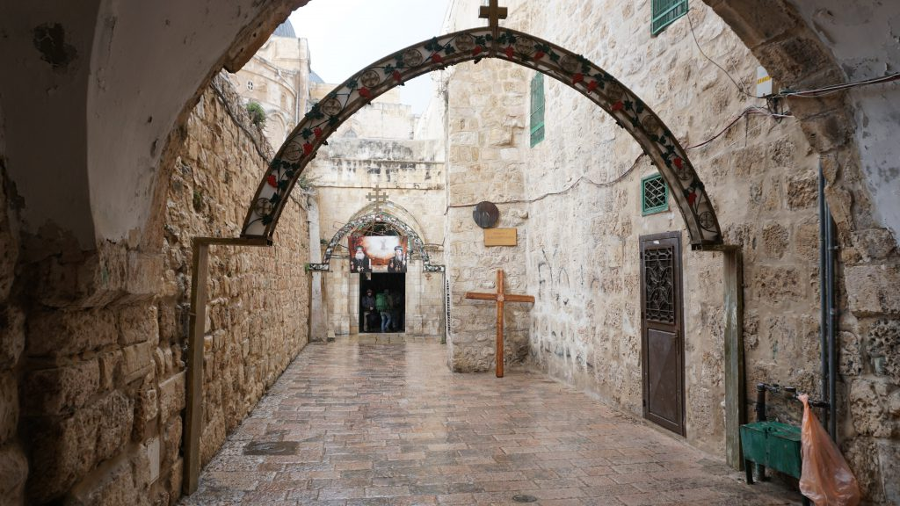
1. Do you remember the last time you felt down or discouraged?

Slide 7
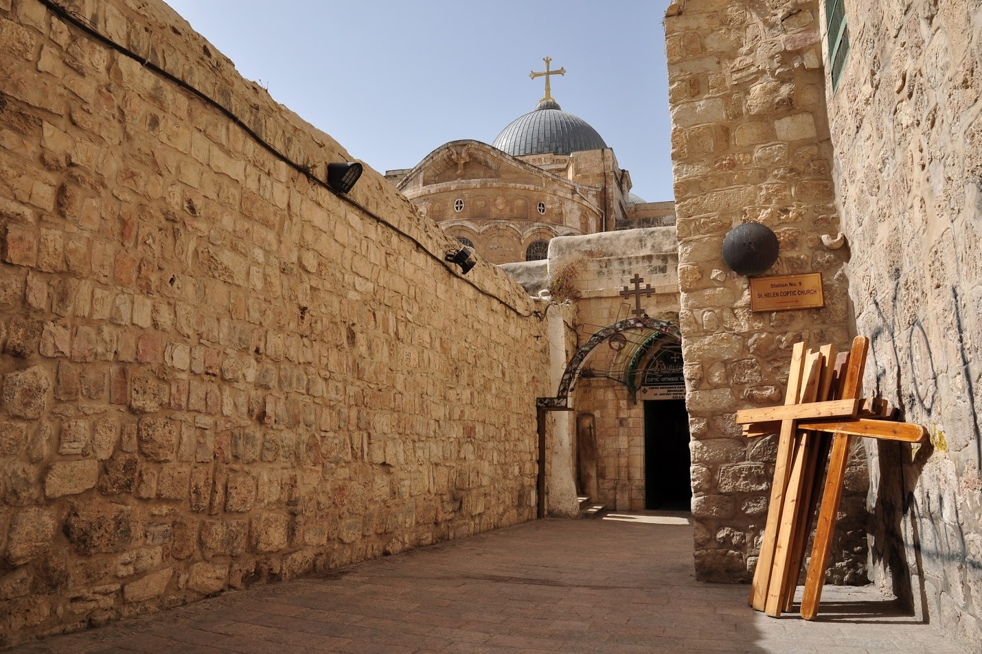
2. What caused you to feel this way?

Slide 8
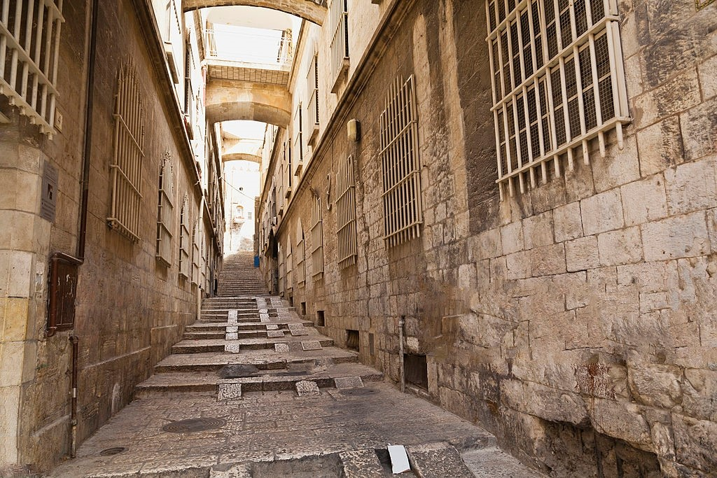
The apostle Paul is an inspiring example of someone who was down but not out.

Slide 9
1st Station of the Cross
Jesus on the Mount of Olives

Slide 10
Luke 22:39-46
39 Coming out, He went to the Mount of Olives, as He was accustomed, and His disciples also followed Him. 40 When He came to the place, He said to them, "Pray that you may not enter into temptation." 41 And He was withdrawn from them about a stone's throw, and He knelt down and prayed, 42 saying, "Father, if it is Your will, take this cup away from Me; nevertheless not My will, but Yours, be done."

Slide 11
43 Then an angel appeared to Him from heaven, strengthening Him. 44 And being in agony, He prayed more earnestly. Then His sweat became like great drops of blood falling down to the ground. 45 When He rose up from prayer, and had come to His disciples, He found them sleeping from sorrow. 46 Then He said to them, "Why do you sleep? Rise and pray, lest you enter into temptation."

Slide 12
2nd Station of the Cross
Jesus is betrayed by
Judas and Arrested

Slide 13
Luke 22:47-48
47 And while He was still speaking, behold, a multitude; and he who was called Judas, one of the twelve, went before them and drew near to Jesus to kiss Him. 48 But Jesus said to him, "Judas, are you betraying the Son of Man with a kiss?"

Slide 14
2 Corinthians 13:5
“Examine yourselves as to whether you are in the faith. Test yourselves. Do you not know yourselves, that Jesus Christ is in you?--unless indeed you are disqualified.”

Slide 15
3rd Station of the Cross
Jesus is condemned
by the Sanhedrin

Slide 16
Luke 22:66-71
66 As soon as it was day, the elders of the people, both chief priests and scribes, came together and led Him into their council, saying, 67 "If You are the Christ, tell us." But He said to them, "If I tell you, you will by no means believe. 68 And if I also ask you, you will by no means answer Me or let Me go.

Slide 17
69 Hereafter the Son of Man will sit on the right hand of the power of God." 70 Then they all said, "Are You then the Son of God?" So He said to them, "You rightly say that I am." 71 And they said, "What further testimony do we need? For we have heard it ourselves from His own mouth."

Slide 18
Luke 6:37-38
37 "Judge not, and you shall not be judged. Condemn not, and you shall not be condemned. Forgive, and you will be forgiven. 38 Give, and it will be given to you: good measure, pressed down, shaken together, and running over will be put into your bosom. For with the same measure that you use, it will be measured back to you."

Slide 19
4th Station of the Cross
Peter denies Jesus

Slide 20
Luke 22:54-62
54 Having arrested Him, they led Him and brought Him into the high priest's house. And Peter followed at a distance. 55 Now when they had kindled a fire in the midst of the courtyard and sat down together, Peter sat among them. 56 And a certain servant girl, seeing him as he sat by the fire, looked intently at him and said, "This man was also with Him."

Slide 21
57 But he denied Him, saying, "Woman, I do not know Him." 58 And after a little while another saw him and said, "You also are of them." But Peter said, "Man, I am not!" 59 Then after about an hour had passed, another confidently affirmed, saying, "Surely this fellow also was with Him, for he is a Galilean."

Slide 22
60 But Peter said, "Man, I do not know what you are saying!" Immediately, while he was still speaking, the rooster crowed. 61 And the Lord turned and looked at Peter. And Peter remembered the word of the Lord, how He had said to him, "Before the rooster crows, you will deny Me three times." 62 So Peter went out and wept bitterly.

Slide 23
Matthew 14:29-33
29 So He said, "Come." And when Peter had come down out of the boat, he walked on the water to go to Jesus. 30 But when he saw that the wind was boisterous, he was afraid; and beginning to sink he cried out, saying, "Lord, save me!"

Slide 24
31 And immediately Jesus stretched out His hand and caught him, and said to him, "O you of little faith, why did you doubt?" 32 And when they got into the boat, the wind ceased. 33 Then those who were in the boat came and worshiped Him, saying, "Truly You are the Son of God."

Slide 25
5th Station of the Cross
Jesus is judged by Pontius Pilate

Slide 26
Luke 23:13-25
13 Then Pilate, when he had called together the chief priests, the rulers, and the people, 14 said to them, "You have brought this Man to me, as one who misleads the people. And indeed, having examined Him in your presence, I have found no fault in this Man concerning those things of which you accuse Him;

Slide 27
15 no, neither did Herod, for I sent you back to him; and indeed nothing deserving of death has been done by Him. 16 I will therefore chastise Him and release Him" 17(for it was necessary for him to release one to them at the feast). 18 And they all cried out at once, saying, "Away with this Man, and release to us Barabbas"—

Slide 28
19 who had been thrown into prison for a certain rebellion made in the city, and for murder. 20 Pilate, therefore, wishing to release Jesus, again called out to them. 21 But they shouted, saying, "Crucify Him, crucify Him!" 22 Then he said to them the third time, "Why, what evil has He done? I have found no reason for death in Him. I will therefore chastise Him and let Him go."

Slide 29
23 But they were insistent, demanding with loud voices that He be crucified. And the voices of these men and of the chief priests prevailed. 24 So Pilate gave sentence that it should be as they requested. 25 And he released to them the one they requested, who for rebellion and murder had been thrown into prison; but he delivered Jesus to their will.

Slide 30
Isaiah 42:8
“I am the LORD, that is My name; And My glory I will not give to another, Nor My praise to graven images. 9 Behold, the former things have come to pass, And new things I declare; Before they spring forth I tell you of them."

Slide 31
6th Station of the Cross
Jesus is Scourged
and Crowned with Thorns

Slide 32
Luke 22:63-65
63 Now the men who held Jesus mocked Him and beat Him. 64 And having blindfolded Him, they struck Him on the face and asked Him, saying, "Prophesy! Who is the one who struck You?" 65 And many other things they blasphemously spoke against Him.

Slide 33
Isaiah 53:3-6
3 He is despised and rejected by men, A Man of sorrows and acquainted with grief. And we hid, as it were, our faces from Him; He was despised, and we did not esteem Him. 4 Surely He has borne our griefs And carried our sorrows; Yet we esteemed Him stricken, Smitten by God, and afflicted.

Slide 34
5 But He was wounded for our transgressions, He was bruised for our iniquities; The chastisement for our peace was upon Him, And by His stripes we are healed. 6 All we like sheep have gone astray; We have turned, every one, to his own way; And the LORD has laid on Him the iniquity of us all.

Slide 35
7th Station of the Cross
Jesus Takes up His Cross

Slide 36
John 19:17
“And He, bearing His cross, went out to a place called the Place of a Skull, which is called in Hebrew, Golgotha…”

Slide 37
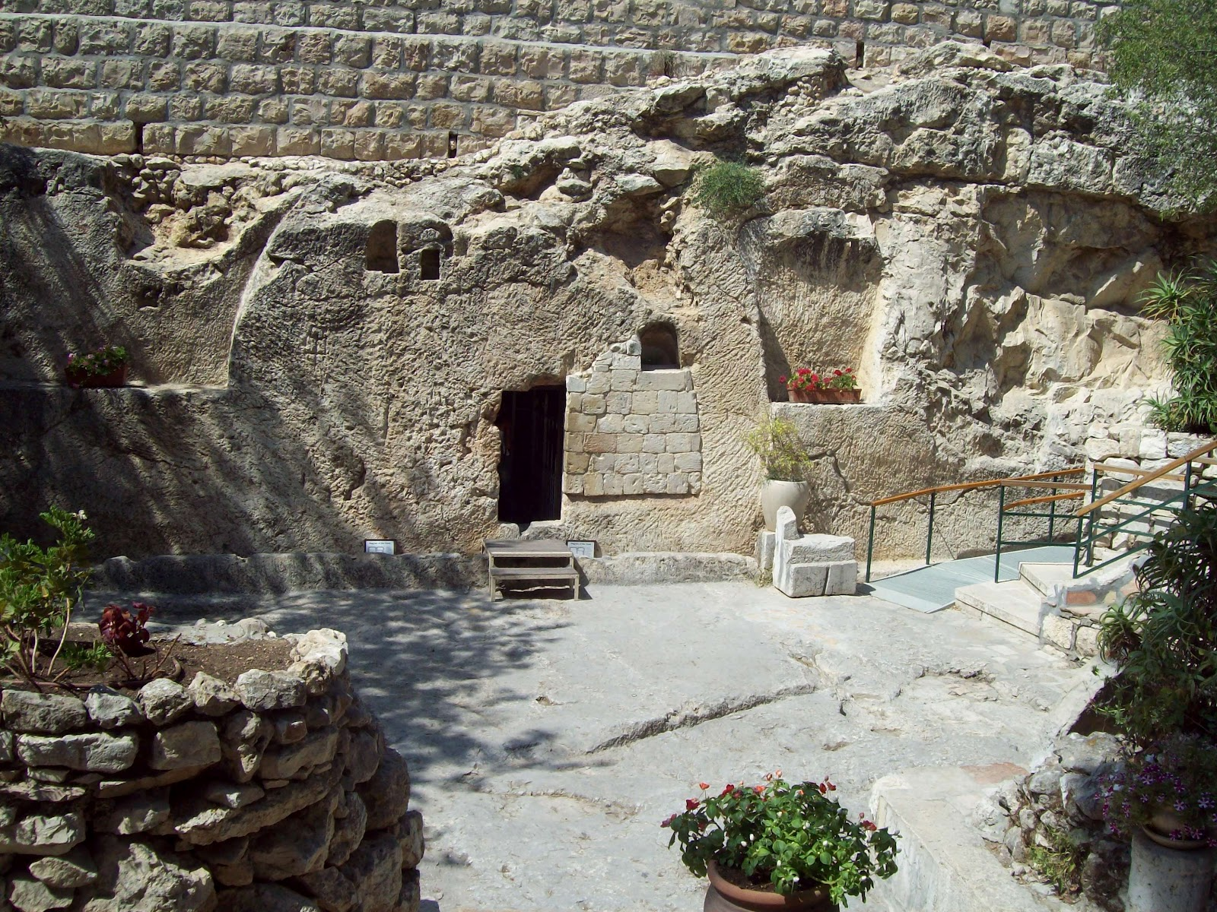
3. When you’re feeling down, where is your focus?

Slide 38
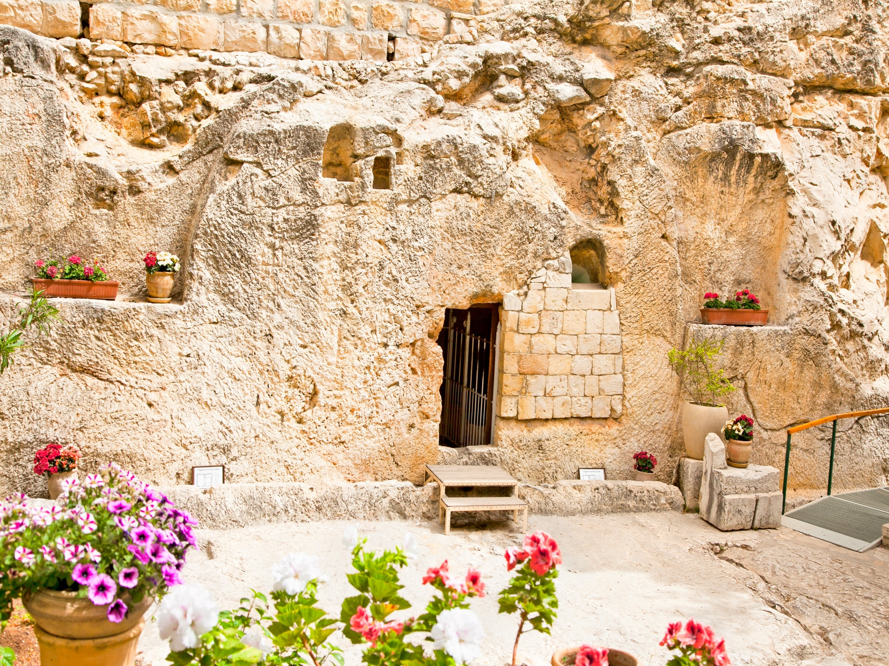
4. How would focusing on the Lord change your response to discouragement?

Slide 39
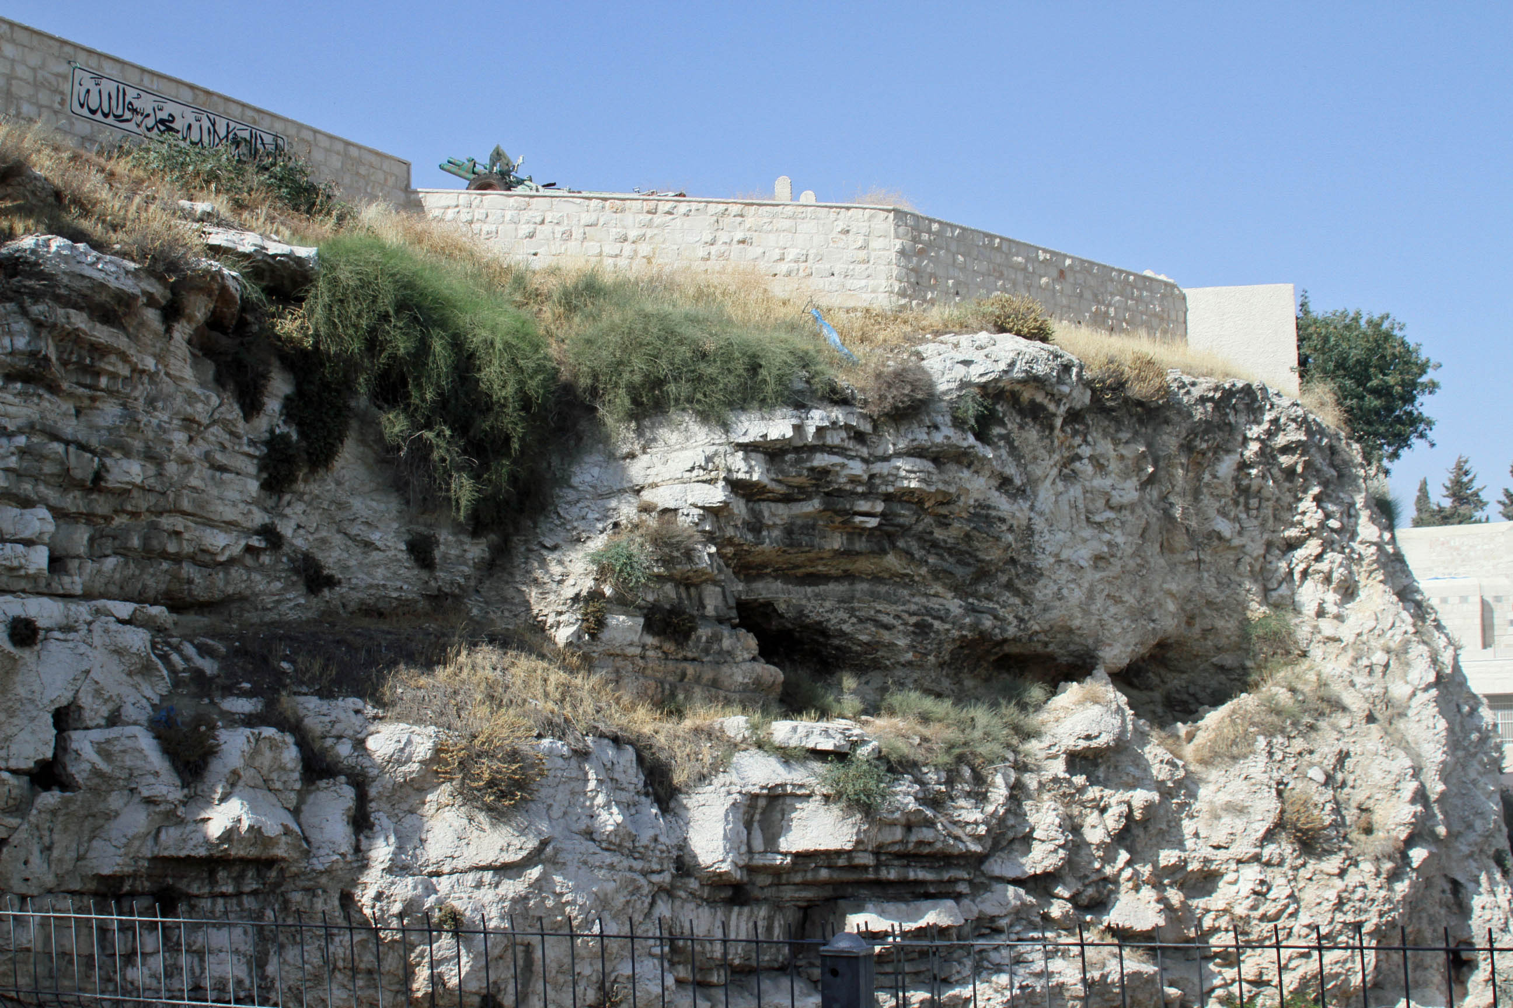
5. Who in your life has been an example of perseverance through hardship? For whom are you setting an example?

Slide 40
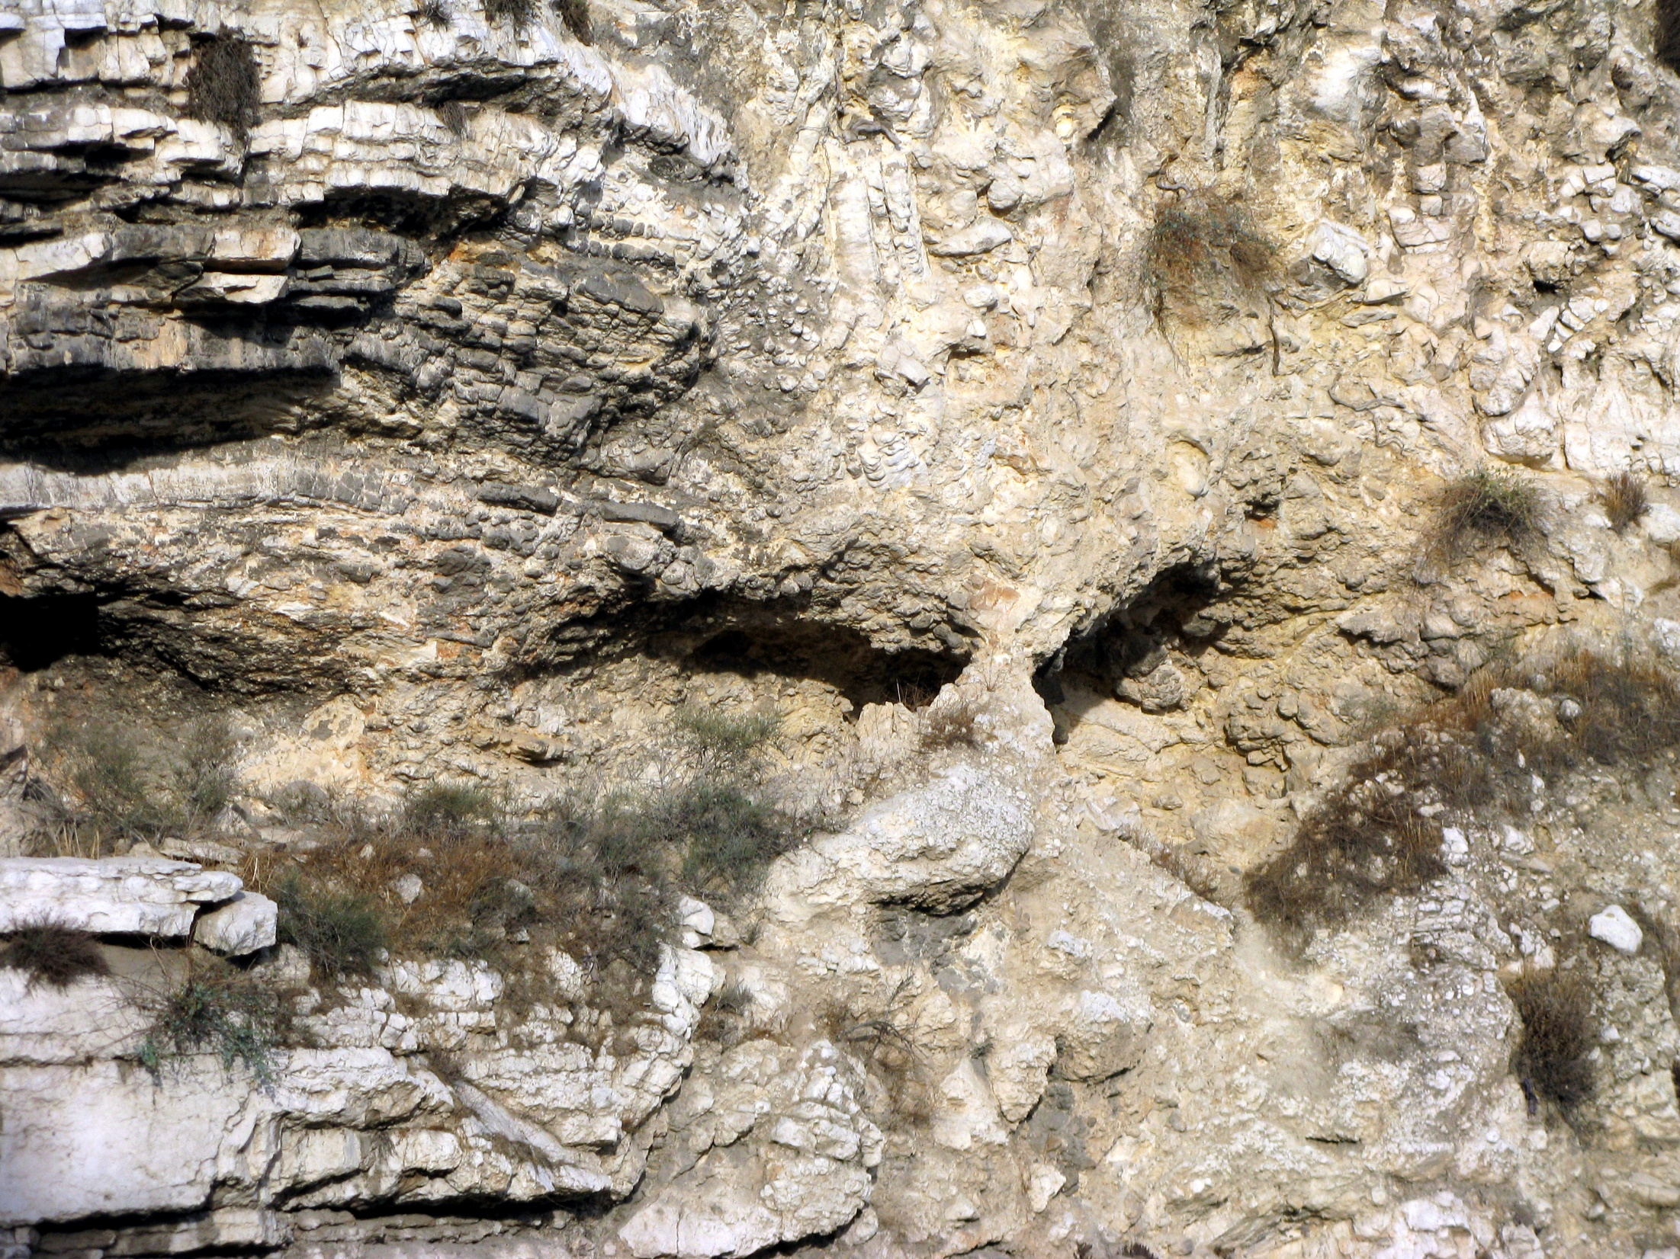
5. Who in your life has been an example of perseverance through hardship? For whom are you setting an example?

Slide 41
Matthew 16:24
"If anyone would come after me, he must deny himself and take up his cross and follow me.”

Slide 42
Matthew 10:38
“…and anyone who does not take his cross and follow me is not worthy of me

Slide 43
2 Corinthians 5:17
“Therefore, if anyone is in Christ, he is a new creation; old things have passed away; behold, all things have become new.”

