Slide 1


Slide 2


Slide 3
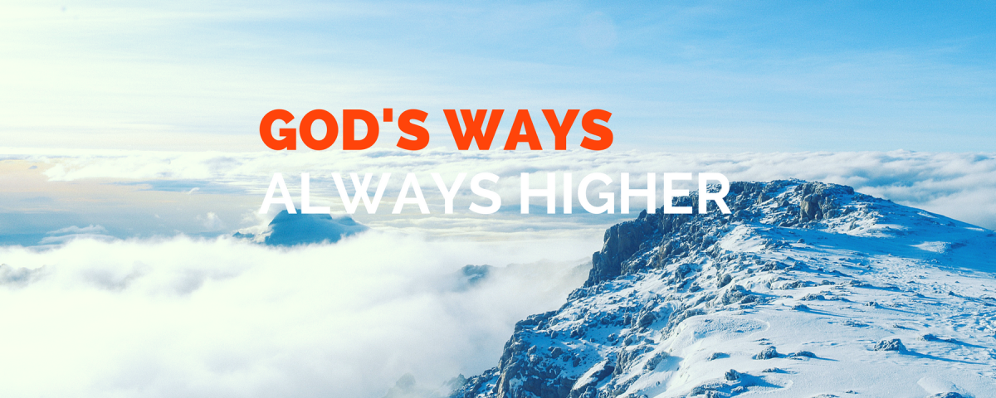

Jesus Your Ways are Higher Than Mine
By Pastor Fee Soliven
Isaiah 55:6-9
Sunday Morning
April 22, 2018

Slide 4
Isaiah 55:6-9
6 Seek the LORD while He may be found, Call upon Him while He is near. 7 Let the wicked forsake his way, And the unrighteous man his thoughts; Let him return to the LORD, And He will have mercy on him; And to our God, For He will abundantly pardon.

Slide 5
8 "For My thoughts are not your thoughts, Nor are your ways My ways," says the LORD. 9 "For as the heavens are higher than the earth, So are My ways higher than your ways, And My thoughts than your thoughts.

Slide 6
Sometimes we might wonder why a plan of ours doesn’t turn out
as we had hoped

Slide 7
Genesis 11:1-9
1 Now the whole earth had one language and one speech. 2 And it came to pass, as they journeyed from the east, that they found a plain in the land of Shinar, and they dwelt there.

Slide 8
3 Then they said to one another, "Come, let us make bricks and bake them thoroughly." They had brick for stone, and they had asphalt for mortar. 4 And they said, "Come, let us build ourselves a city, and a tower whose top is in the heavens; let us make a name for ourselves, lest we be scattered abroad over the face of the whole earth."

Slide 9
5 But the LORD came down to see the city and the tower which the sons of men had built. 6 And the LORD said, "Indeed the people are one and they all have one language, and this is what they begin to do; now nothing that they propose to do will be withheld from them.

Slide 10
7 Come, let Us go down and there confuse their language, that they may not understand one another's speech." 8 So the LORD scattered them abroad from there over the face of all the earth, and they ceased building the city. 9 Therefore its name is called Babel, because there the LORD confused the language of all the earth; and from there the LORD scattered them abroad over the face of all the earth.

Slide 11
Genesis 9:7
“And as for you, be fruitful and multiply; Bring forth abundantly in the earth And multiply in it."

Slide 12
Genesis 11:4
“And they said, "Come, let us build ourselves a city, and a tower whose top is in the heavens; let us make a name for ourselves, lest we be scattered abroad over the face of the whole earth."

Slide 13
Acts 19:11-16
11 Now God worked unusual miracles by the hands of Paul, 12 so that even handkerchiefs or aprons were brought from his body to the sick, and the diseases left them and the evil spirits went out of them.

Slide 14
13 Then some of the itinerant Jewish exorcists took it upon themselves to call the name of the Lord Jesus over those who had evil spirits, saying, "We exorcise you by the Jesus whom Paul preaches." 14 Also there were seven sons of Sceva, a Jewish chief priest, who did so.

Slide 15
15 And the evil spirit answered and said, "Jesus I know, and Paul I know; but who are you?" 16 Then the man in whom the evil spirit was leaped on them, overpowered them, and prevailed against them, so that they fled out of that house naked and wounded.

Slide 16
Proverbs 3:5-8
5 Trust in the LORD with all your heart, And lean not on your own understanding; 6 In all your ways acknowledge Him, And He shall direct your paths. 7 Do not be wise in your own eyes; Fear the LORD and depart from evil. 8 It will be health to your flesh, And strength to your bones.

Slide 17
The Consequences of Leaving God Out of Our Plans

Slide 18
1. We can’t claim God’s promise of provision and protection

Slide 19
Psalm 34:7
“The angel of the Lord encamps around those who fear him, and delivers them.”

Slide 20
Psalm 91:1-4
He who dwells in the secret place of the Most High Shall abide under the shadow of the Almighty. 2 I will say of the LORD, "He is my refuge and my fortress; My God, in Him I will trust." 3 Surely He shall deliver you from the snare of the fowler And from the perilous pestilence. 4 He shall cover you with His feathers, And under His wings you shall take refuge; His truth shall be your shield and buckler.

Slide 21
2. We can’t honestly ask the Lord for His blessing

Slide 22
3. The absence of God in our plans limits the possibilities of whatever we do

Slide 23
2 Timothy 2:22
“So flee youthful passions and pursue righteousness, faith, love, and peace, along with those who call on the Lord from a pure heart.

Slide 24
4. Leaving God out of our plans reveals our pride

Slide 25
Proverbs 16:18-19
18 Pride goes before destruction, And a haughty spirit before a fall. 19 Better to be of a humble spirit with the lowly, Than to divide the spoil with the proud.

Slide 26
Proverbs 29:22-23
22 An angry man stirs up strife, And a furious man abounds in transgression. 23 A man's pride will bring him low, But the humble in spirit will retain honor.

Slide 27
5. If we don’t seek God’s guidance, we may choose less than He would have provided

Slide 28
Results of Disobedience to God

Slide 29
1. Confusion
We’ll start to question our decision and wonder if we made a wrong choice. God’s actions at the Tower of Babel demonstrate how He brings confusion when we make decisions apart from Him. Not only were their plans frustrated, but God accomplished His will despite them, as they scattered over the surface of the earth.

Slide 30
2. Conflict
We’ll experience internal conflict when the Holy Spirit gives us a sense of uneasiness, inadequacy, and doubt over our course of action.

Slide 31
3. Cost
Disobedience is always costly when we don’t do the right thing, in the right time, and in the right way.

Slide 32
4. Loss
We will experience loss at some point in our lives, whether emotionally or physically.

Slide 33
5. Regret
God chooses the best direction, time, and way. Therefore, if we go in an opposite direction, don’t wait for His timing, or do it our way, we will miss His best and suffer deep regret.

Slide 34
6. Pain
We may experience physical pain as the result of our disobedience, but the worst pain is that which is emotional. As we look back at our choices, we’ll be filled with thoughts of “If only I’d done this or not done that.”

Slide 35
7. Disaster
It could come to us financially, emotionally, or in countless other ways, but the result of disobedience is always disastrous because we didn’t follow the Lord.

Slide 36
8. Discipline
If we will not listen and obey God, He’ll discipline us. His goal is that we learn to trust in Him with all our heart instead of leaning on our own understanding. Only then will He make our paths straight.

Slide 37
Proverbs 3:5-6
5 Trust in the LORD with all your heart, And lean not on your own understanding; 6 In all your ways acknowledge Him, And He shall direct your paths.

Slide 38
1. When you are making plans, do you ask the Lord for guidance?

Slide 39
2. What situations cause you to remember to ask Him for direction?

Slide 40
3. Which decisions do you usually make on your own?

Slide 41
4. What hard lessons have you learned from leaving God out of your plans or jumping ahead of Him?

Slide 42
5. What blessings have you enjoyed as a result of seeking His guidance and following Him in obedience?

