Slide 1


Slide 2


Slide 3
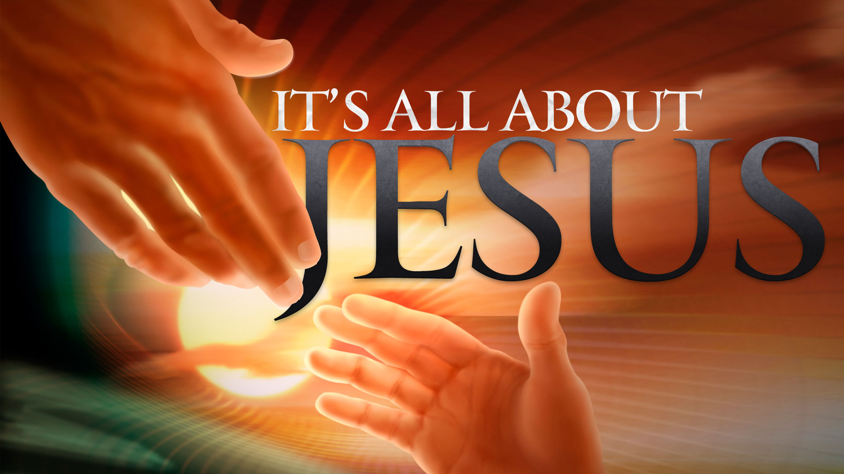

Never Be Ashamed of Jesus our Savior
By Pastor Fee Soliven
2 Timothy 1:8-12
Wednesday Evening
April 4, 2018

Slide 4
8 Therefore do not be ashamed of the testimony of our Lord, nor of me His prisoner, but share with me in the sufferings for the gospel according to the power of God,

Slide 5
9 who has saved us and called us with a holy calling, not according to our works, but according to His own purpose and grace which was given to us in Christ Jesus before time began,

Slide 6
10 but has now been revealed by the appearing of our Savior Jesus Christ, who has abolished death and brought life and immortality to light through the gospel, 11 to which I was appointed a preacher, an apostle, and a teacher of the Gentiles.

Slide 7
12 For this reason I also suffer these things; nevertheless I am not ashamed, for I know whom I have believed and am persuaded that He is able to keep what I have committed to Him until that Day.

Slide 8
8 Therefore do not be ashamed of the testimony of our Lord, nor of me His prisoner, but share with me in the sufferings for the gospel according to the power of God,

Slide 9
Romans 1:16-17
16 For I am not ashamed of the gospel of Christ, for it is the power of God to salvation for everyone who believes, for the Jew first and also for the Greek. 17 For in it the righteousness of God is revealed from faith to faith; as it is written, "The just shall live by faith."

Slide 10
Isaiah 41:10
“So do not fear, for I am with you; do not be dismayed, for I am your God. I will strengthen you and help you; I will uphold you with my righteous right hand.”

Slide 11
Psalm 56:3
“When I am afraid, I put my trust in you.”

Slide 12
John 14:27
“Peace is what I leave with you; it is my own peace that I give you. I do not give it as the world does. Do not be worried and upset; do not be afraid.”

Slide 13
2 Timothy 1:7
“For God has not given us a spirit of fear, but of power and of love and of a sound mind.”

Slide 14
1 John 4:18
“There is no fear in love. But perfect love drives out fear, because fear has to do with punishment. The one who fears is not made perfect in love.”

Slide 15
Hebrews 13:23
“Know that our brother Timothy has been set free, with whom I shall see you if he comes shortly”

Slide 16
9 who has saved us and called us with a holy calling, not according to our works, but according to His own purpose and grace which was given to us in Christ Jesus before time began,

Slide 17
Titus 3:4-7
4 But when the kindness and the love of God our Savior toward man appeared, 5 not by works of righteousness which we have done, but according to His mercy He saved us, through the washing of regeneration and renewing of the Holy Spirit,

Slide 18
6 whom He poured out on us abundantly through Jesus Christ our Savior, 7 that having been justified by His grace we should become heirs according to the hope of eternal life.

Slide 19
John 15:16-19
16 You did not choose Me, but I chose you and appointed you that you should go and bear fruit, and that your fruit should remain, that whatever you ask the Father in My name He may give you. 17 These things I command you, that you love one another.

Slide 20
18 "If the world hates you, you know that it hated Me before it hated you. 19 If you were of the world, the world would love its own. Yet because you are not of the world, but I chose you out of the world, therefore the world hates you.

Slide 21
John 10:27-30
27 My sheep hear My voice, and I know them, and they follow Me. 28 And I give them eternal life, and they shall never perish; neither shall anyone snatch them out of My hand. 29 My Father, who has given them to Me, is greater than all; and no one is able to snatch them out of My Father's hand. 30 I and My Father are one."

Slide 22
Ephesians 1:3-14
3 Blessed be the God and Father of our Lord Jesus Christ, who has blessed us with every spiritual blessing in the heavenly places in Christ, 4 just as He chose us in Him before the foundation of the world, that we should be holy and without blame before Him in love,

Slide 23
5 having predestined us to adoption as sons by Jesus Christ to Himself, according to the good pleasure of His will, 6 to the praise of the glory of His grace, by which He has made us accepted in the Beloved. 7 In Him we have redemption through His blood, the forgiveness of sins, according to the riches of His grace 8 which He made to abound toward us in all wisdom and prudence,

Slide 24
9 having made known to us the mystery of His will, according to His good pleasure which He purposed in Himself, 10 that in the dispensation of the fullness of the times He might gather together in one all things in Christ, both which are in heaven and which are on earth--in Him.

Slide 25
11 In Him also we have obtained an inheritance, being predestined according to the purpose of Him who works all things according to the counsel of His will, 12 that we who first trusted in Christ should be to the praise of His glory.

Slide 26
13 In Him you also trusted, after you heard the word of truth, the gospel of your salvation; in whom also, having believed, you were sealed with the Holy Spirit of promise, 14 who is the guarantee of our inheritance until the redemption of the purchased possession, to the praise of His glory.

Slide 27
10 but has now been revealed by the appearing of our Savior Jesus Christ, who has abolished death and brought life and immortality to light through the gospel, 11 to which I was appointed a preacher, an apostle, and a teacher of the Gentiles.

Slide 28
Romans 16:25-26
25 Now to Him who is able to establish you according to my gospel and the preaching of Jesus Christ, according to the revelation of the mystery kept secret since the world began

Slide 29
26 but now has been made manifest, and by the prophetic Scriptures has been made known to all nations, according to the commandment of the everlasting God, for obedience to the faith…

Slide 30
Titus 2:11-15
11 For the grace of God that brings salvation has appeared to all men, 12 teaching us that, denying ungodliness and worldly lusts, we should live soberly, righteously, and godly in the present age, 13 looking for the blessed hope and glorious appearing of our great God and Savior Jesus Christ,

Slide 31
14 who gave Himself for us, that He might redeem us from every lawless deed and purify for Himself His own special people, zealous for good works. 15 Speak these things, exhort, and rebuke with all authority. Let no one despise you.

Slide 32
12 For this reason I also suffer these things; nevertheless I am not ashamed, for I know whom I have believed and am persuaded that He is able to keep what I have committed to Him until that Day.

Slide 33
1. Paul knew that God would guard the souls of those converted through his preaching

Slide 34
2. Paul trusted God to guard his own soul until Christ’s second coming

Slide 35
3. Paul was confident that, though he was in prison and facing death, God would carry out the gospel ministry and guard the teaching through others such as Timothy.

Slide 36
Titus 3:8
“This saying is trustworthy. And I want you to emphasize these things, so that those who have believed God will take care to devote themselves to good deeds. These things are excellent and profitable for the people.”

