Slide 1


Slide 2


Slide 3
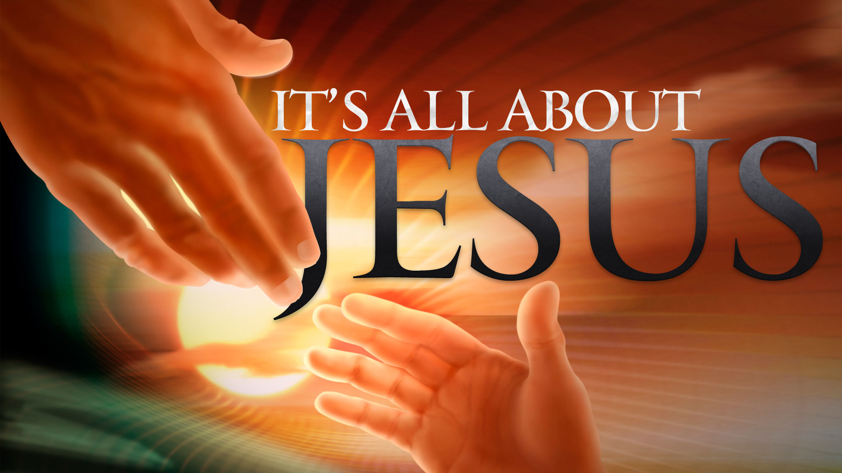

Relationships Do Matter
By Pastor Fee Soliven
2 Timothy 1:13-18
Wednesday Evening
April 11, 2018

Slide 4
13 Hold fast the pattern of sound words which you have heard from me, in faith and love which are in Christ Jesus.

Slide 5
14 That good thing which was committed to you, keep by the Holy Spirit who dwells in us.

Slide 6
15 This you know, that all those in Asia have turned away from me, among whom are Phygellus and Hermogenes.

Slide 7
16 The Lord grant mercy to the household of Onesiphorus, for he often refreshed me, and was not ashamed of my chain;

Slide 8
17 but when he arrived in Rome, he sought me out very zealously and found me.

Slide 9
18 The Lord grant to him that he may find mercy from the Lord in that Day--and you know very well how many ways he ministered to me at Ephesus.

Slide 10
13 Hold fast the pattern of sound words which you have heard from me, in faith and love which are in Christ Jesus.

Slide 11
Hebrews 10:23-25
23 Let us hold fast the confession of our hope without wavering, for He who promised is faithful. 24 And let us consider one another in order to stir up love and good works,

Slide 12
25 not forsaking the assembling of ourselves together, as is the manner of some, but exhorting one another, and so much the more as you see the Day approaching.

Slide 13
1 Thessalonians 5:12-22
12 And we urge you, brethren, to recognize those who labor among you, and are over you in the Lord and admonish you, 13 and to esteem them very highly in love for their work's sake. Be at peace among yourselves.

Slide 14
14 Now we exhort you, brethren, warn those who are unruly, comfort the fainthearted, uphold the weak, be patient with all. 15 See that no one renders evil for evil to anyone, but always pursue what is good both for yourselves and for all. 16 Rejoice always, 17 pray without ceasing,

Slide 15
18 in everything give thanks; for this is the will of God in Christ Jesus for you. 19 Do not quench the Spirit. 20 Do not despise prophecies. 21 Test all things; hold fast what is good. 22 Abstain from every form of evil.

Slide 16
1 Timothy 6:3-5
3 If anyone teaches otherwise and does not consent to wholesome words, even the words of our Lord Jesus Christ, and to the doctrine which accords with godliness, 4 he is proud, knowing nothing, but is obsessed with disputes and arguments over words, from which come envy, strife, reviling, evil suspicions,

Slide 17
5 useless wranglings of men of corrupt minds and destitute of the truth, who suppose that godliness is a means of gain. From such withdraw yourself.

Slide 18
14 That good thing which was committed to you, keep by the Holy Spirit who dwells in us.

Slide 19
Titus 3:1-11
1 Remind them to be subject to rulers and authorities, to obey, to be ready for every good work, 2 to speak evil of no one, to be peaceable, gentle, showing all humility to all men.

Slide 20
3 For we ourselves were also once foolish, disobedient, deceived, serving various lusts and pleasures, living in malice and envy, hateful and hating one another. 4 But when the kindness and the love of God our Savior toward man appeared,

Slide 21
5 not by works of righteousness which we have done, but according to His mercy He saved us, through the washing of regeneration and renewing of the Holy Spirit, 6 whom He poured out on us abundantly through Jesus Christ our Savior, 7 that having been justified by His grace we should become heirs according to the hope of eternal life.

Slide 22
8 This is a faithful saying, and these things I want you to affirm constantly, that those who have believed in God should be careful to maintain good works. These things are good and profitable to men.

Slide 23
9 But avoid foolish disputes, genealogies, contentions, and strivings about the law; for they are unprofitable and useless. 10 Reject a divisive man after the first and second admonition, 11 knowing that such a person is warped and sinning, being self-condemned.

Slide 24
15 This you know, that all those in Asia have turned away from me, among whom are Phygellus and Hermogenes.

Slide 25
John 6:48-71
48 I am the bread of life. 49 Your fathers ate the manna in the wilderness, and are dead. 50 This is the bread which comes down from heaven, that one may eat of it and not die. 51 I am the living bread which came down from heaven. If anyone eats of this bread, he will live forever; and the bread that I shall give is My flesh, which I shall give for the life of the world."

Slide 26
52 The Jews therefore quarreled among themselves, saying, "How can this Man give us His flesh to eat?" 53 Then Jesus said to them, "Most assuredly, I say to you, unless you eat the flesh of the Son of Man and drink His blood, you have no life in you. 54 Whoever eats My flesh and drinks My blood has eternal life, and I will raise him up at the last day.

Slide 27
55 For My flesh is food indeed, and My blood is drink indeed. 56 He who eats My flesh and drinks My blood abides in Me, and I in him. 57 As the living Father sent Me, and I live because of the Father, so he who feeds on Me will live because of Me. 58 This is the bread which came down from heaven--not as your fathers ate the manna, and are dead. He who eats this bread will live forever."

Slide 28
59 These things He said in the synagogue as He taught in Capernaum. 60 Therefore many of His disciples, when they heard this, said, "This is a hard saying; who can understand it?" 61 When Jesus knew in Himself that His disciples complained about this, He said to them, "Does this offend you? 62 What then if you should see the Son of Man ascend where He was before?

Slide 29
63 It is the Spirit who gives life; the flesh profits nothing. The words that I speak to you are spirit, and they are life. 64 But there are some of you who do not believe." For Jesus knew from the beginning who they were who did not believe, and who would betray Him. 65 And He said, "Therefore I have said to you that no one can come to Me unless it has been granted to him by My Father."

Slide 30
66 From that time many of His disciples went back and walked with Him no more. 67 Then Jesus said to the twelve, "Do you also want to go away?" 68 But Simon Peter answered Him, "Lord, to whom shall we go? You have the words of eternal life.

Slide 31
69 Also we have come to believe and know that You are the Christ, the Son of the living God." 70 Jesus answered them, "Did I not choose you, the twelve, and one of you is a devil?" 71 He spoke of Judas Iscariot, the son of Simon, for it was he who would betray Him, being one of the twelve.

Slide 32
16 The Lord grant mercy to the household of Onesiphorus, for he often refreshed me, and was not ashamed of my chain;

Slide 33
1 Peter 3:3-4
4 rather let it be the hidden person of the heart, with the incorruptible beauty of a gentle and quiet spirit, which is very precious in the sight of God.

Slide 34
Galatians 6:2-5
2 Bear one another's burdens, and so fulfill the law of Christ. 3 For if anyone thinks himself to be something, when he is nothing, he deceives himself. 4 But let each one examine his own work, and then he will have rejoicing in himself alone, and not in another. 5 For each one shall bear his own load.

Slide 35
Proverbs 17:17
“A friend loves at all times, And a brother is born for adversity.”

Slide 36
Proverbs 18:24
“A man who has friends must himself be friendly, But there is a friend who sticks closer than a brother.”

Slide 37
17 but when he arrived in Rome, he sought me out very zealously and found me.

Slide 38
18 The Lord grant to him that he may find mercy from the Lord in that Day--and you know very well how many ways he ministered to me at Ephesus.

Slide 39
James 1:12
"Blessed is the man who endures temptation; for when he has been approved, he will receive the crown of life which the Lord has promised to those who love Him."

Slide 40
Matthew 16:27-28
27 For the Son of Man will come in the glory of His Father with His angels, and then He will reward each according to his works. 28 Assuredly, I say to you, there are some standing here who shall not taste death till they see the Son of Man coming in His kingdom."

Slide 41
Psalm 33:13-15
13 The LORD looks from heaven; He sees all the sons of men. 14 From the place of His dwelling He looks On all the inhabitants of the earth; 15 He fashions their hearts individually; He considers all their works.

Slide 42
Revelation 20:12
“And I saw the dead, small and great, stand before God; and the books were opened: and another book was opened, which is the book of life: and the dead were judged out of those things which were written in the books, according to their works.”

