Slide 1


Slide 2


Slide 3
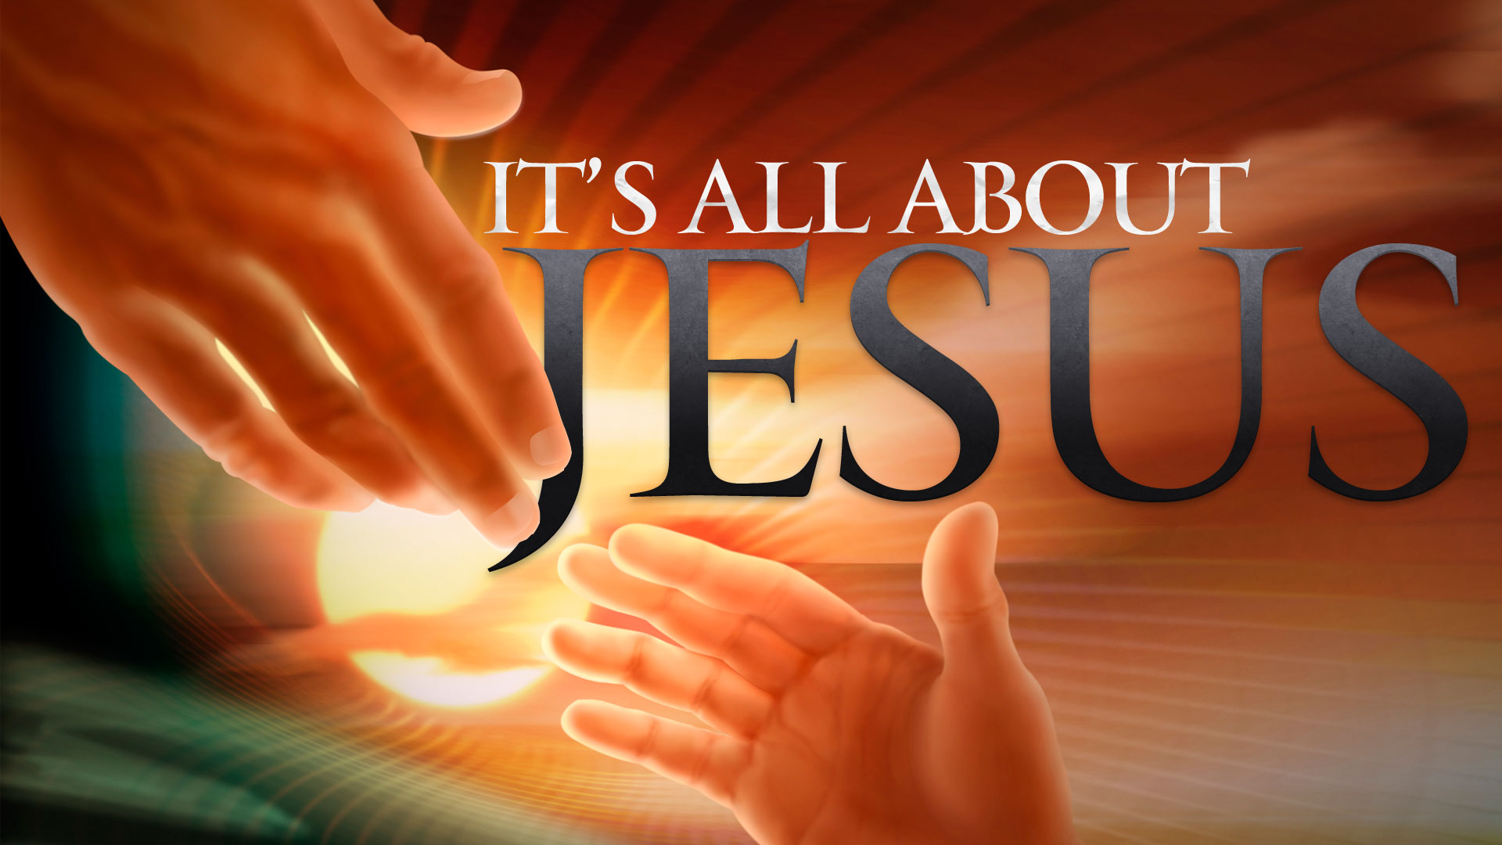

We Must Endure Hardship
By Pastor Fee Soliven
2 Timothy 2:1-8
Wednesday Evening
April 18, 2018

Slide 4
1 You therefore, my son, be strong in the grace that is in Christ Jesus.

Slide 5
2 And the things that you have heard from me among many witnesses, commit these to faithful men who will be able to teach others also.

Slide 6
3 You therefore must endure hardship as a good soldier of Jesus Christ.

Slide 7
4 No one engaged in warfare entangles himself with the affairs of this life, that he may please him who enlisted him as a soldier.

Slide 8
5 And also if anyone competes in athletics, he is not crowned unless he competes according to the rules.

Slide 9
6 The hard-working farmer must be first to partake of the crops.

Slide 10
7 Consider what I say, and may the Lord give you understanding in all things.

Slide 11
1 You therefore, my son, be strong in the grace that is in Christ Jesus.

Slide 12
Romans 1:16-17
16 For I am not ashamed of the gospel of Christ, for it is the power of God to salvation for everyone who believes, for the Jew first and also for the Greek. 17 For in it the righteousness of God is revealed from faith to faith; as it is written, "The just shall live by faith."

Slide 13
Mark 8:38
“For whoever is ashamed of Me and My words in this adulterous and sinful generation, of him the Son of Man also will be ashamed when He comes in the glory of His Father with the holy angels."

Slide 14
1 John 2:28-29
28 And now, little children, abide in Him, that when He appears, we may have confidence and not be ashamed before Him at His coming. 29 If you know that He is righteous, you know that everyone who practices righteousness is born of Him.

Slide 15
How can someone be strong with
God’s favor?

Slide 16
Philippians 4:13
“I can do all things through him who strengthens me”

Slide 17
Isaiah 41:10
“Fear not, for I am with you; be not dismayed, for I am your God; I will strengthen you, I will help you, I will uphold you with my righteous right hand”

Slide 18
Isaiah 40:31
“But they who wait for the Lord shall renew their strength; they shall mount up with wings like eagles; they shall run and not be weary; they shall walk and not faint”

Slide 19
2 And the things that you have heard from me among many witnesses, commit these to faithful men who will be able to teach others also.

Slide 20
Luke 16:10
“One who is faithful in a very little is also faithful in much, and one who is dishonest in a very little is also dishonest in much.”

Slide 21
Proverbs 28:20
“A faithful man will abound with blessings, but whoever hastens to be rich will not go unpunished.”

Slide 22
Proverbs 3:3
“Let not steadfast love and faithfulness forsake you; bind them around your neck; write them on the tablet of your heart.”

Slide 23
3 You therefore must endure hardship as a good soldier of Jesus Christ.

Slide 24
Acts 14:21-23
21 And when they had preached the gospel to that city and made many disciples, they returned to Lystra, Iconium, and Antioch, 22 strengthening the souls of the disciples, exhorting them to continue in the faith, and saying, "We must through many tribulations enter the kingdom of God."

Slide 25
23 So when they had appointed elders in every church, and prayed with fasting, they commended them to the Lord in whom they had believed.

Slide 26
Hebrews 13:23
“Know that our brother Timothy has been set free, with whom I shall see you if he comes shortly.”

Slide 27
1 Corinthians 9:7
“What soldier in the army has to pay his own expenses? And have you ever heard of a farmer who harvests his crop and doesn't have the right to eat some of it? What shepherd takes care of a flock of sheep and goats and isn't allowed to drink some of the milk?”

Slide 28
4 No one engaged in warfare entangles himself with the affairs of this life, that he may please him who enlisted him as a soldier.

Slide 29
Acts 5:29
But Peter and the apostles answered,
“We must obey God rather than men.”

Slide 30
1 Peter 5:6-11
6 Therefore humble yourselves under the mighty hand of God, that He may exalt you in due time, 7 casting all your care upon Him, for He cares for you. 8 Be sober, be vigilant; because your adversary the devil walks about like a roaring lion, seeking whom he may devour.

Slide 31
9 Resist him, steadfast in the faith, knowing that the same sufferings are experienced by your brotherhood in the world. 10 But may the God of all grace, who called us to His eternal glory by Christ Jesus, after you have suffered a while, perfect, establish, strengthen, and settle you. 11 To Him be the glory and the dominion forever and ever. Amen.

Slide 32
5 And also if anyone competes in athletics, he is not crowned unless he competes according to the rules.

Slide 33
Titus 1:10-16
10 For there are many insubordinate, both idle talkers and deceivers, especially those of the circumcision, 11 whose mouths must be stopped, who subvert whole households, teaching things which they ought not, for the sake of dishonest gain.

Slide 34
12 One of them, a prophet of their own, said, "Cretans are always liars, evil beasts, lazy gluttons." 13 This testimony is true. Therefore rebuke them sharply, that they may be sound in the faith, 14 not giving heed to Jewish fables and commandments of men who turn from the truth.

Slide 35
15 To the pure all things are pure, but to those who are defiled and unbelieving nothing is pure; but even their mind and conscience are defiled. 16 They profess to know God, but in works they deny Him, being abominable, disobedient, and disqualified for every good work.

Slide 36
6 The hard-working farmer must be first to partake of the crops.

Slide 37
1. The soldier must trust the commanding officer and desire to please him so that obeying the commander becomes central, even when difficulties are encountered. Pleasing Christ gives strength to endure hardship.

Slide 38
2. The athlete accepts the rules of the competition in order to complete the challenge of the game, including its difficulties.

Slide 39
3. The farmer works hard at plowing, planting, waiting, weeding, and harvesting, and is entitled to enjoy the results.

Slide 40
4. The soldier submits to the officer; the athlete to the code of the competition; the farmer to the laws of nature and agriculture. The believer submits to Jesus Christ. In him we have a gracious commanding officer: one who provides an example and directions for our course, and who rewards the hard and patient work of his servants.

Slide 41
7 Consider what I say, and may the Lord give you understanding in all things.

