Slide 1


Slide 2


Slide 3
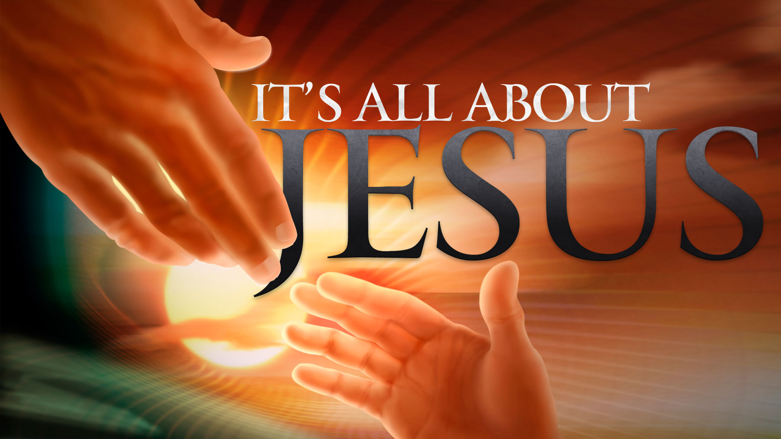

Never Be Ashamed of Our Lord Jesus Christ
By Pastor Fee Soliven
2 Timothy 2:8-13
Wednesday Evening
May 9, 2018

Slide 4
8 Remember that Jesus Christ, of the seed of David, was raised from the dead according to my gospel, 9 for which I suffer trouble as an evildoer, even to the point of chains; but the word of God is not chained.

Slide 5
10 Therefore I endure all things for the sake of the elect, that they also may obtain the salvation which is in Christ Jesus with eternal glory.

Slide 6
11 This is a faithful saying: For if we died with Him, We shall also live with Him. 12 If we endure, We shall also reign with Him. If we deny Him, He also will deny us. 13 If we are faithless, He remains faithful; He cannot deny Himself.

Slide 7
8 Remember that Jesus Christ, of the seed of David, was raised from the dead according to my gospel, 9 for which I suffer trouble as an evildoer, even to the point of chains; but the word of God is not chained.

Slide 8
Romans 1:1-4
1 Paul, a bondservant of Jesus Christ, called to be an apostle, separated to the gospel of God 2 which He promised before through His prophets in the Holy Scriptures, 3 concerning His Son Jesus Christ our Lord, who was born of the seed of David according to the flesh, 4 and declared to be the Son of God with power according to the Spirit of holiness, by the resurrection from the dead.

Slide 9
Acts 16:20-24
20 And they brought them to the magistrates, and said, “These men, being Jews, vexceedingly trouble our city; 21 and they teach customs which are not lawful for us, being Romans, to receive or observe.” 22 Then the multitude rose up together against them; and the magistrates tore off their clothes wand commanded them to be beaten with rods.

Slide 10
23 And when they had laid many stripes on them, they threw them into prison, commanding the jailer to keep them securely. 24 Having received such a charge, he put them into the inner prison and fastened their feet in the stocks.

Slide 11
Acts 2:24
But God raised Him from the dead, releasing Him from the agony of death, because it was impossible for Him to be held in its clutches.

Slide 12
Philippians 1:12-18
12 But I want you to know, brethren, that the things which happened to me have actually turned out for the furtherance of the gospel, 13 so that it has become evident to the whole palace guard, and to all the rest, that my chains are in Christ;

Slide 13
14 and most of the brethren in the Lord, having become confident by my chains, are much more bold to speak the word without fear. 15 Some indeed preach Christ even from envy and strife, and some also from good will: 16 The former preach Christ from selfish ambition, not sincerely, supposing to add affliction to my chains;

Slide 14
17 but the latter out of love, knowing that I am appointed for the defense of the gospel. 18 What then? Only that in every way, whether in pretense or in truth, Christ is preached; and in this I rejoice, yes, and will rejoice.

Slide 15
1 Thessalonians 3:1-4
1 Therefore, when we could no longer endure it, we thought it good to be left in Athens alone, 2 and sent Timothy, our brother and minister of God, and our fellow laborer in the gospel of Christ, to establish you and encourage you concerning your faith,

Slide 16
3 that no one should be shaken by these afflictions; for you yourselves know that we are appointed to this. 4 For, in fact, we told you before when we were with you that we would suffer tribulation, just as it happened, and you know.

Slide 17
10 Therefore I endure all things for the sake of the elect, that they also may obtain the salvation which is in Christ Jesus with eternal glory.

Slide 18
1 Thessalonians 1:2-7
2 We give thanks to God always for you all, making mention of you in our prayers, 3 remembering without ceasing your work of faith, labor of love, and patience of hope in our Lord Jesus Christ in the sight of our God and Father,

Slide 19
4 knowing, beloved brethren, your election by God. 5 For our gospel did not come to you in word only, but also in power, hand in the Holy Spirit and in much assurance, as you know what kind of men we were among you for your sake.

Slide 20
6 And you became followers of us and of the Lord, having received the word in much affliction, with joy of the Holy Spirit, 7 so that you became examples to all in Macedonia and Achaia who believe.

Slide 21
Colossians 3:12-17
12 Therefore, as the elect of God, holy and beloved, put on tender mercies, kindness, humility, meekness, longsuffering; 13 bearing with one another, and forgiving one another, if anyone has a complaint against another; even as Christ forgave you, so you also must do.

Slide 22
14 But above all these things put on love, which is the bond of perfection. 15 And let the peace of God rule in your hearts, to which also you were called in one body; and be thankful. 16 Let the word of Christ dwell in you richly in all wisdom, teaching and admonishing one another in psalms and hymns and spiritual songs, singing with grace in your hearts to the Lord.

Slide 23
17 And whatever you do in word or deed, do all in the name of the Lord Jesus, giving thanks to God the Father through Him.

Slide 24
11 This is a faithful saying: For if we died with Him, We shall also live with Him. 12 If we endure, We shall also reign with Him. If we deny Him, He also will deny us. 13 If we are faithless, He remains faithful; He cannot deny Himself.

Slide 25
1 Corinthians 15:20-28
20 But now Christ is risen from the dead, and has become the firstfruits of those who have fallen asleep. 21 For since by man came death, by Man also came the resurrection of the dead. 22 For as in Adam all die, even so in Christ all shall be made alive.

Slide 26
23 But each one in his own order: Christ the firstfruits, afterward those who are Christ's at His coming. 24 Then comes the end, when He delivers the kingdom to God the Father, when He puts an end to all rule and all authority and power. 25 For He must reign till He has put all enemies under His feet.

Slide 27
26 The last enemy that will be destroyed is death. 27 For "He has put all things under His feet." But when He says "all things are put under Him," it is evident that He who put all things under Him is excepted.

Slide 28
Revelation 3:21-22
21 To him who overcomes I will grant to sit with Me on My throne, as I also overcame and sat down with My Father on His throne. 22 He who has an ear, let him hear what the Spirit says to the churches." ' "

Slide 29
Revelation 5:10
“And have made us kings and priests to our God; And we shall reign on the earth."

Slide 30
Revelation 20:4-5
“And I saw thrones, and they sat on them, and judgment was committed to them. Then I saw the souls of those who had been beheaded for their witness to Jesus and for the word of God, who had not worshiped the beast or his image, and had not received his mark on their foreheads or on their hands. And they lived and reigned with Christ for a thousand years.”

Slide 31
Matthew 10:32-33
32 "Therefore whoever confesses Me before men, him I will also confess before My Father who is in heaven. 33 But whoever denies Me before men, him I will also deny before My Father who is in heaven.

Slide 32
Romans 1:16-17
16 For I am not ashamed of the gospel of Christ, for it is the power of God to salvation for everyone who believes, for the Jew first and also for the Greek. 17 For in it the righteousness of God is revealed from faith to faith; as it is written, "The just shall live by faith."

