Slide 1


Slide 2


Slide 3
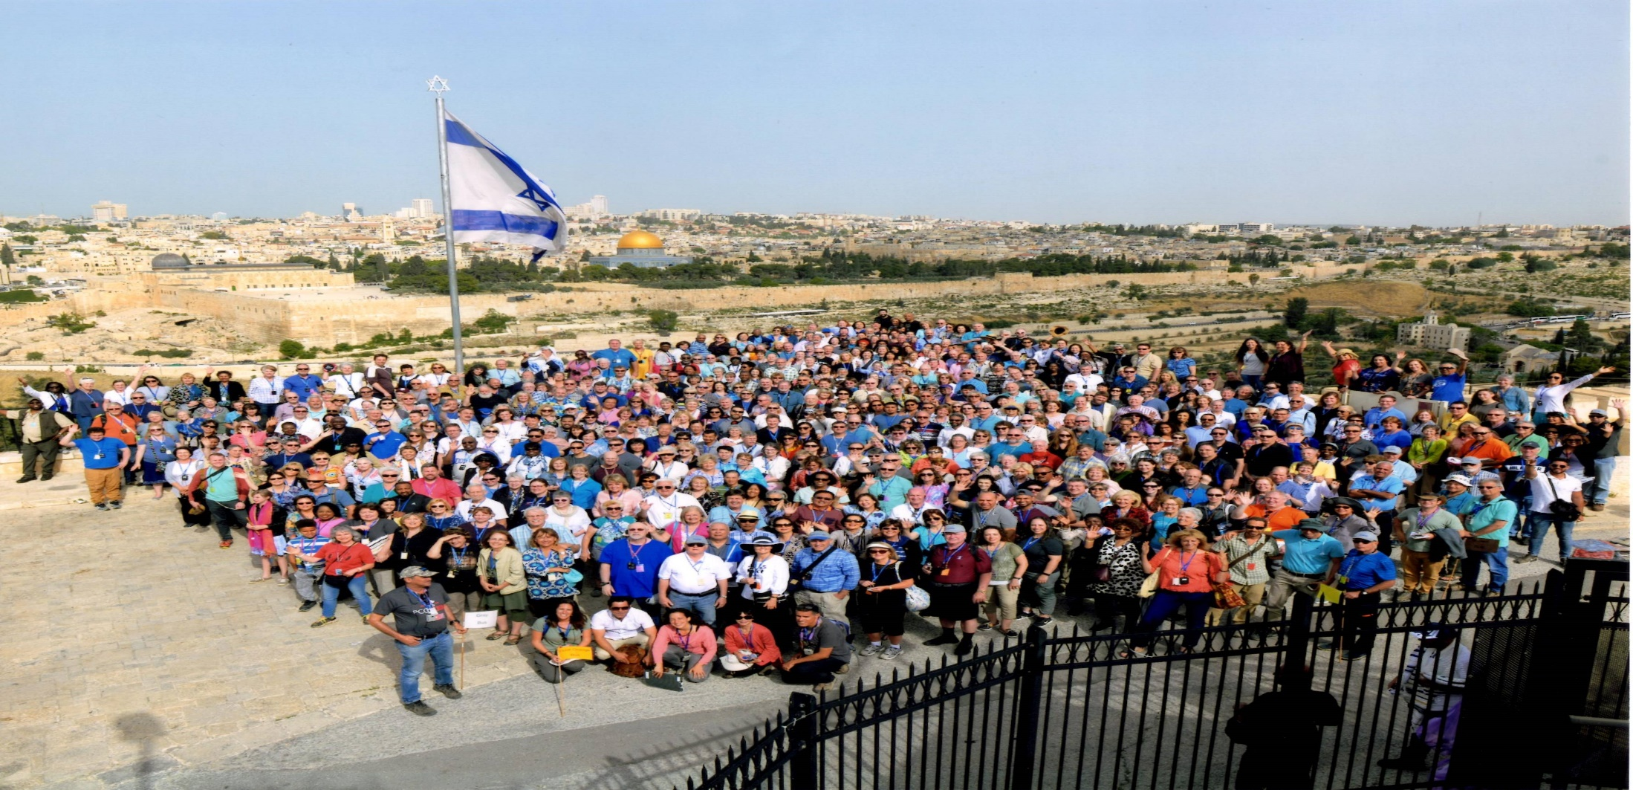

The Resurrected Dry Bones
By Pastor Fee Soliven
Ezekiel 37:4-6
Sunday Morning
May 6, 2018

Slide 4
Luke 22:39-43
39 Coming out, He went to the Mount of Olives, as He was accustomed, and His disciples also followed Him. 40 When He came to the place, He said to them, "Pray that you may not enter into temptation." 41 And He was withdrawn from them about a stone's throw, and He knelt down and prayed, 42 saying, "Father, if it is Your will, take this cup away from Me; nevertheless not My will, but Yours, be done."

Slide 5
Ezekiel 37:4-6
4 Then he said to me, "Prophesy to these bones and say to them, 'Dry bones, hear the word of the LORD! 5 This is what the Sovereign LORD says to these bones: I will make breath enter you, and you will come to life. 6 I will attach tendons to you and make flesh come upon you and cover you with skin; I will put breath in you, and you will come to life. Then you will know that I am the LORD.'"

Slide 6
The theme of our trip to Israel was the prophesy of the Dry Bones.

Slide 7
1. The promise to Moses on Mount Nebo The Land of Milk and Honey for the Children of Israel

Slide 8
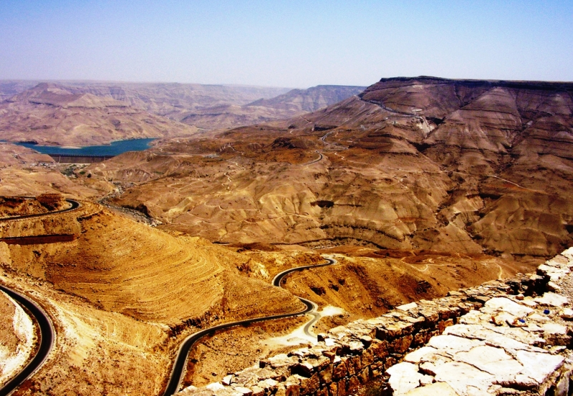
The apostle Paul is an inspiring example of someone who was down but not out.

Slide 9
Deuteronomy 34
1 Then Moses climbed Mount Nebo from the plains of Moab to the top of Pisgah, across from Jericho. There the LORD showed him the whole land--from Gilead to Dan, 2 all of Naphtali, the territory of Ephraim and Manasseh, all the land of Judah as far as the western sea,

Slide 10
3 the Negev and the whole region from the Valley of Jericho, the City of Palms, as far as Zoar. 4 Then the LORD said to him, "This is the land I promised on oath to Abraham, Isaac and Jacob when I said, 'I will give it to your descendants.' I have let you see it with your eyes, but you will not cross over into it." 5 And Moses the servant of the LORD died there in Moab, as the LORD had said.

Slide 11
6 He buried him in Moab, in the valley opposite Beth Peor, but to this day no one knows where his grave is. 7 Moses was a hundred and twenty years old when he died, yet his eyes were not weak nor his strength gone. 8 The Israelites grieved for Moses in the plains of Moab thirty days, until the time of weeping and mourning was over.

Slide 12
9 Now Joshua son of Nun was filled with the spirit of wisdom because Moses had laid his hands on him. So the Israelites listened to him and did what the LORD had commanded Moses. 10 Since then, no prophet has risen in Israel like Moses, whom the LORD knew face to face,

Slide 13
11 who did all those miraculous signs and wonders the LORD sent him to do in Egypt--to Pharaoh and to all his officials and to his whole land. 12 For no one has ever shown the mighty power or performed the awesome deeds that Moses did in the sight of all Israel.

Slide 14
2. Moses Left Specific Instructions to Avoid Destruction

Slide 15
Deuteronomy 28:1-14
1 If you fully obey the LORD your God and carefully follow all his commands I give you today, the LORD your God will set you high above all the nations on earth. 2 All these blessings will come upon you and accompany you if you obey the LORD your God:

Slide 16
3 You will be blessed in the city and blessed in the country. 4 The fruit of your womb will be blessed, and the crops of your land and the young of your livestock--the calves of your herds and the lambs of your flocks. 5 Your basket and your kneading trough will be blessed.

Slide 17
6 You will be blessed when you come in and blessed when you go out. 7 The LORD will grant that the enemies who rise up against you will be defeated before you. They will come at you from one direction but flee from you in seven. 8 The LORD will send a blessing on your barns and on everything you put your hand to. The LORD your God will bless you in the land he is giving you.

Slide 18
9 The LORD will establish you as his holy people, as he promised you on oath, if you keep the commands of the LORD your God and walk in his ways. 10 Then all the peoples on earth will see that you are called by the name of the LORD, and they will fear you.

Slide 19
11 The LORD will grant you abundant prosperity--in the fruit of your womb, the young of your livestock and the crops of your ground--in the land he swore to your forefathers to give you. 12 The LORD will open the heavens, the storehouse of his bounty, to send rain on your land in season and to bless all the work of your hands. You will lend to many nations but will borrow from none.

Slide 20
13 The LORD will make you the head, not the tail. If you pay attention to the commands of the LORD your God that I give you this day and carefully follow them, you will always be at the top, never at the bottom. 14 Do not turn aside from any of the commands I give you today, to the right or to the left, following other gods and serving them.

Slide 21
3. Israel’s Disobedience
was their Demise

Slide 22
Deuteronomy 28:15-20
15 However, if you do not obey the LORD your God and do not carefully follow all his commands and decrees I am giving you today, all these curses will come upon you and overtake you: 16 You will be cursed in the city and cursed in the country. 17 Your basket and your kneading trough will be cursed.

Slide 23
18 The fruit of your womb will be cursed, and the crops of your land, and the calves of your herds and the lambs of your flocks. 19 You will be cursed when you come in and cursed when you go out. 20 The LORD will send on you curses, confusion and rebuke in everything you put your hand to, until you are destroyed and come to sudden ruin because of the evil you have done in forsaking him.

Slide 24
Deuteronomy 28:25-27
25 The LORD will cause you to be defeated before your enemies. You will come at them from one direction but flee from them in seven, and you will become a thing of horror to all the kingdoms on earth. 26 Your carcasses will be food for all the birds of the air and the beasts of the earth, and there will be no one to frighten them away.

Slide 25
Deuteronomy 28:64-66
64 Then the LORD will scatter you among all nations, from one end of the earth to the other. There you will worship other gods--gods of wood and stone, which neither you nor your fathers have known. 65 Among those nations you will find no repose, no resting place for the sole of your foot. There the LORD will give you an anxious mind, eyes weary with longing, and a despairing heart. 66 You will live in constant suspense, filled with dread both night and day, never sure of your life.

Slide 26
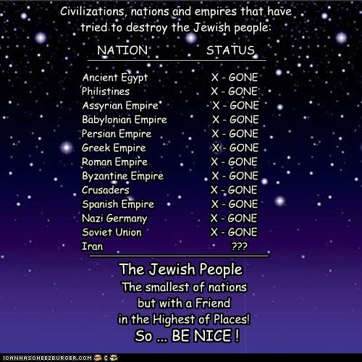
Luke 23:13-25
13 Then Pilate, when he had called together the chief priests, the rulers, and the people, 14 said to them, "You have brought this Man to me, as one who misleads the people. And indeed, having examined Him in your presence, I have found no fault in this Man concerning those things of which you accuse Him;

Slide 27
4. God Prophesied that He would Gather them Once Again after He Scattered Them

Slide 28
Isaiah 11:10-13
10 In that day the Root of Jesse will stand as a banner for the peoples; the nations will rally to him, and his place of rest will be glorious.

Slide 29
11 In that day the Lord will reach out his hand a second time to reclaim the remnant that is left of his people from Assyria, from Lower Egypt, from Upper Egypt, from Cush, from Elam, from Babylonia, from Hamath and from the islands of the sea.

Slide 30
12 He will raise a banner for the nations and gather the exiles of Israel; he will assemble the scattered people of Judah from the four quarters of the earth. 13 Ephraim's jealousy will vanish, and Judah's enemies will be cut off; Ephraim will not be jealous of Judah, nor Judah hostile toward Ephraim.

Slide 31
Isaiah 43:4-7
4 Since you are precious and honored in my sight, and because I love you, I will give men in exchange for you, and people in exchange for your life. 5 Do not be afraid, for I am with you; I will bring your children from the east and gather you from the west.

Slide 32
6 I will say to the north, 'Give them up!' and to the south, 'Do not hold them back.' Bring my sons from afar and my daughters from the ends of the earth--7 everyone who is called by my name, whom I created for my glory, whom I formed and made."

Slide 33
Ezekiel 37:4-6
4 Then he said to me, "Prophesy to these bones and say to them, 'Dry bones, hear the word of the LORD! 5 This is what the Sovereign LORD says to these bones: I will make breath enter you, and you will come to life. 6 I will attach tendons to you and make flesh come upon you and cover you with skin; I will put breath in you, and you will come to life. Then you will know that I am the LORD.'"

Slide 34
5. We too were Dead who
God Raised Up

Slide 35
Ephesians 2:1-10
1 And you He made alive, who were dead in trespasses and sins, 2 in which you once walked according to the course of this world, according to the prince of the power of the air, the spirit who now works in the sons of disobedience,

Slide 36
3 among whom also we all once conducted ourselves in the lusts of our flesh, fulfilling the desires of the flesh and of the mind, and were by nature children of wrath, just as the others. 4 But God, who is rich in mercy, because of His great love with which He loved us,

Slide 37
5 even when we were dead in trespasses, made us alive together with Christ (by grace you have been saved), 6 and raised us up together, and made us sit together in the heavenly places in Christ Jesus, 7 that in the ages to come He might show the exceeding riches of His grace in His kindness toward us in Christ Jesus.

Slide 38
8 For by grace you have been saved through faith, and that not of yourselves; it is the gift of God, 9 not of works, lest anyone should boast. 10 For we are His workmanship, created in Christ Jesus for good works, which God prepared beforehand that we should walk in them.

Slide 39
Romans 6:4-14
4 Therefore we were buried with Him through baptism into death, that just as Christ was raised from the dead by the glory of the Father, even so we also should walk in newness of life. 5 For if we have been united together in the likeness of His death, certainly we also shall be in the likeness of His resurrection,
.

Slide 40
6 knowing this, that our old man was crucified with Him, that the body of sin might be done away with, that we should no longer be slaves of sin. 7 For he who has died has been freed from sin. 8 Now if we died with Christ, we believe that we shall also live with Him,

Slide 41
9 knowing that Christ, having been raised from the dead, dies no more. Death no longer has dominion over Him. 10 For the death that He died, He died to sin once for all; but the life that He lives, He lives to God. 11 Likewise you also, reckon yourselves to be dead indeed to sin, but alive to God in Christ Jesus our Lord. 12 Therefore do not let sin reign in your mortal body, that you should obey it in its lusts.

Slide 42
13 And do not present your members as instruments of unrighteousness to sin, but present yourselves to God as being alive from the dead, and your members as instruments of righteousness to God. 14 For sin shall not have dominion over you, for you are not under law but under grace

Slide 43
6. Another Sign That Jesus Is Coming Back

Slide 44
Psalm 102:16-19
16 For the LORD shall build up Zion; He shall appear in His glory.
17 He shall regard the prayer of the destitute, And shall not despise their prayer.

Slide 45
18 This will be written for the generation to come, That a people yet to be created may praise the LORD. 19 For He looked down from the height of His sanctuary; From heaven the LORD viewed the earth…

Slide 46
Matthew 24:3-14
3 Now as He sat on the Mount of Olives, the disciples came to Him privately, saying, "Tell us, when will these things be? And what will be the sign of Your coming, and of the end of the age?"

Slide 47
4 And Jesus answered and said to them: "Take heed that no one deceives you. 5 For many will come in My name, saying, 'I am the Christ,' and will deceive many. 6 And you will hear of wars and rumors of wars. See that you are not troubled; for all these things must come to pass, but the end is not yet.

Slide 48
7 For nation will rise against nation, and kingdom against kingdom. And there will be famines, pestilences, and earthquakes in various places. 8 All these are the beginning of sorrows. 9 Then they will deliver you up to tribulation and kill you, and you will be hated by all nations for My name's sake.

Slide 49
10 And then many will be offended, will betray one another, and will hate one another. 11 Then many false prophets will rise up and deceive many. 12 And because lawlessness will abound, the love of many will grow cold. 13 But he who endures to the end shall be saved. 14 And this gospel of the kingdom will be preached in all the world as a witness to all the nations, and then the end will come.

Slide 50
7. How should we ought to live awaiting for His Arrival?

Slide 51
2 Peter 3:9-16
9 The Lord is not slack concerning His promise, as some count slackness, but is longsuffering toward us, not willing that any should perish but that all should come to repentance.

Slide 52
10 But the day of the Lord will come as a thief in the night, in which the heavens will pass away with a great noise, and the elements will melt with fervent heat; both the earth and the works that are in it will be burned up.

Slide 53
11 Therefore, since all these things will be dissolved, what manner of persons ought you to be in holy conduct and godliness, 12 looking for and hastening the coming of the day of God, because of which the heavens will be dissolved, being on fire, and the elements will melt with fervent heat?

Slide 54
13 Nevertheless we, according to His promise, look for new heavens and a new earth in which righteousness dwells. 14 Therefore, beloved, looking forward to these things, be diligent to be found by Him in peace, without spot and blameless;

Slide 55
15 and account that the longsuffering of our Lord is salvation--as also our beloved brother Paul, according to the wisdom given to him, has written to you…

