Slide 1


Slide 2


Slide 3
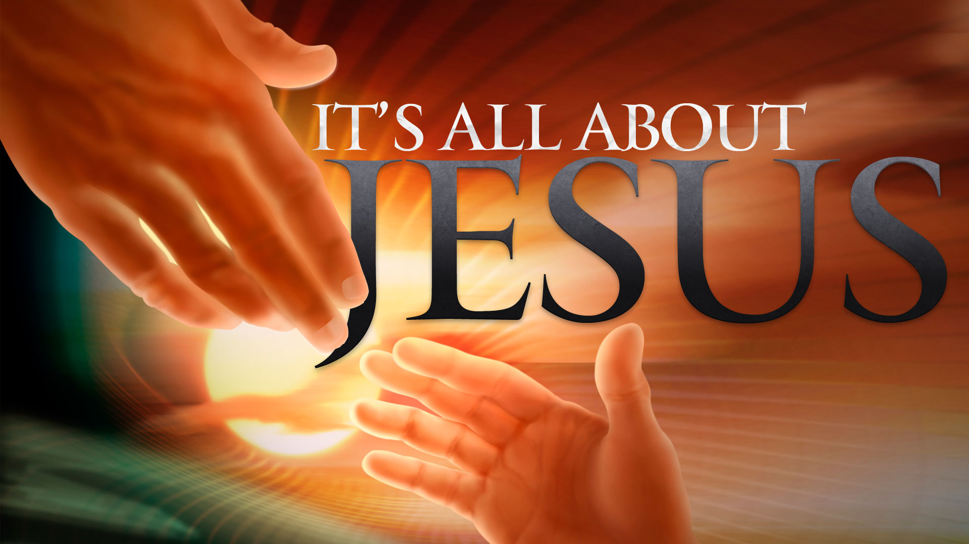

We Live in Perilous Times
By Pastor Fee Soliven
2 Timothy 3:1-5
Wednesday Evening
May 30, 2018

Slide 4
1 But know this, that in the last days perilous times will come:

Slide 5
2 For men will be lovers of themselves, lovers of money, boasters, proud, blasphemers, disobedient to parents, unthankful, unholy,

Slide 6
3 unloving, unforgiving, slanderers, without self-control, brutal, despisers of good,

Slide 7
4 traitors, headstrong, haughty, lovers of pleasure rather than lovers of God,

Slide 8
5 having a form of godliness but denying its power. And from such people turn away!

Slide 9
1 But know this, that in the last days perilous times will come:

Slide 10
Acts 2:17
17'And it shall come to pass in the last days, says God, That I will pour out of My Spirit on all flesh; Your sons and your daughters shall prophesy, Your young men shall see visions, Your old men shall dream dreams.

Slide 11
James 5:3
“Your gold and silver are corroded, and their corrosion will be a witness against you and will eat your flesh like fire. You have heaped up treasure in the last days”

Slide 12
2 Peter 3:3
“knowing this first: that scoffers will come in the last days, walking according to their own lusts”

Slide 13
2 For men will be lovers of themselves, lovers of money, boasters, proud, blasphemers, disobedient to parents, unthankful, unholy,

Slide 14
To be boastful and proud pictures a heart full of pride that manifests itself in outward boastfulness.

Slide 15
Scoffing at God means speaking disrespectfully of him.

Slide 16
Exodus 20:12
"Honor your father and your mother, that your days may be long upon the land which the LORD your God is giving you”

Slide 17
Acting in a way that shows them courtesy and respect.

Slide 18
“very difficult times follow”

Slide 19
Romans 1:18-23
18 For the wrath of God is revealed from heaven against all ungodliness and unrighteousness of men, who suppress the truth in unrighteousness,

Slide 20
19 because what may be known of God is manifest in them, for God has shown it to them. 20 For since the creation of the world His invisible attributes are clearly seen, being understood by the things that are made, even His eternal power and Godhead, so that they are without excuse,

Slide 21
21 because, although they knew God, they did not glorify Him as God, nor were thankful, but became futile in their thoughts, and their foolish hearts were darkened. 22 Professing to be wise, they became fools,

Slide 22
3 unloving, unforgiving, slanderers, without self-control, brutal, despisers of good,

Slide 23
Romans 1:18-23, 31
18 For the wrath of God is revealed from heaven against all ungodliness and unrighteousness of men, who suppress the truth in unrighteousness,

Slide 24
19 because what may be known of God is manifest in them, for God has shown it to them. 20 For since the creation of the world His invisible attributes are clearly seen, being understood by the things that are made, even His eternal power and Godhead, so that they are without excuse,

Slide 25
21 because, although they knew God, they did not glorify Him as God, nor were thankful, but became futile in their thoughts, and their foolish hearts were darkened. 22 Professing to be wise, they became fools

Slide 26
Romans 1:31-32
31 undiscerning, untrustworthy, unloving, unforgiving, unmerciful; 32 who, knowing the righteous judgment of God, that those who practice such things are worthy of death, not only do the same but also approve of those who practice them.

Slide 27
4 traitors, headstrong, haughty, lovers of pleasure rather than lovers of God,

Slide 28
Traitors - This word is used in the New Testament only here and in Luke 6:16; Acts 7:52. It means any one who betrays - whether it be a friend or his country. Treason has been in all ages regarded as one of the worst crimes that man can commit.

Slide 29
Luke 6:16
“Judas the son of James, and Judas Iscariot who also became a traitor”

Slide 30
Acts 7:52
“Which of the prophets did your fathers not persecute? And they killed those who foretold the coming of the Just One, of whom you now have become the betrayers and murderers”

Slide 31
Heady - The same word in Acts 19:36, is rendered rashly. It occurs only there and in this place in the New Testament.

Slide 32
Acts 19:36
“Therefore, since these things cannot be denied, you ought to be quiet and do nothing rashly”

Slide 33
High-minded - Literally, "puffed up;" compare the notes at 1 Timothy 3:6, where the same word is rendered "lifted up with pride." The meaning is, that they would be inflated with pride or self-conceit.

Slide 34
Lovers of pleasures more than
lovers of God
That is, of sensual pleasures, or vain amusements. This has been, and is, the characteristic of a great part of the world, and has often distinguished even many who profess religion.

Slide 35
Philippians 3:17-19
17 Brethren, join in following my example, and note those who so walk, as you have us for a pattern. 18 For many walk, of whom I have told you often, and now tell you even weeping, that they are the enemies of the cross of Christ: 19 whose end is destruction, whose god is their belly, and whose glory is in their shame--who set their mind on earthly things.

Slide 36
5 having a form of godliness but denying its power. And from such people turn away!

Slide 37
John 3:1-8
1 There was a man of the Pharisees named Nicodemus, a ruler of the Jews. 2 This man came to Jesus by night and said to Him, "Rabbi, we know that You are a teacher come from God; for no one can do these signs that You do unless God is with him."

Slide 38
3 Jesus answered and said to him, "Most assuredly, I say to you, unless one is born again, he cannot see the kingdom of God." 4 Nicodemus said to Him, "How can a man be born when he is old? Can he enter a second time into his mother's womb and be born?"

Slide 39
5 Jesus answered, "Most assuredly, I say to you, unless one is born of water and the Spirit, he cannot enter the kingdom of God. 6 That which is born of the flesh is flesh, and that which is born of the Spirit is spirit. 7 Do not marvel that I said to you, 'You must be born again.'

