Slide 1


Slide 2


Slide 3
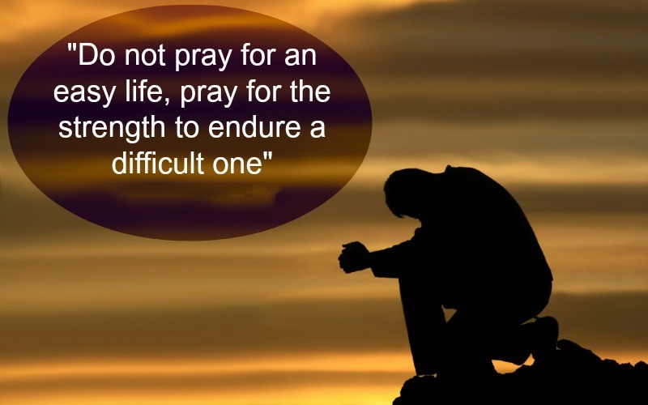

God Strengthen Me to Endure
By Pastor Fee Soliven
Ephesians 4:1-6
Sunday Morning
June 10, 2018

Slide 4
1 I, therefore, the prisoner of the Lord, beseech you to walk worthy of the calling with which you were called, 2 with all lowliness and gentleness, with longsuffering, bearing with one another in love, 3 endeavoring to keep the unity of the Spirit in the bond of peace. 4 There is one body and one Spirit, just as you were called in one hope of your calling; 5 one Lord, one faith, one baptism; 6 one God and Father of all, who is above all, and through all, and in you all.

Slide 5
A Common Misconception of Christian People

Slide 6
If we possess enough Faith, we will automatically find Supernatural escape from every problem, sickness, or trial.

Slide 7
Walking with God is a
"VOCATION" not a "VACATION"!

Slide 8
Ephesians 4:1
1 I therefore, the prisoner of the Lord, beseech you that ye walk worthy of the vocation wherewith ye are called…

Slide 9
Vocation
specialized training, intense training (GREEK - klesis, kletos: high calling, heavenly calling, holy calling to a particular task.)

Slide 10
Hebrews 6:13-15
13 For when God made a promise to Abraham, because He could swear by no one greater, He swore by Himself, 14 saying, "Surely blessing I will bless you, and multiplying I will multiply you." 15 And so, after he had patiently endured, he obtained the promise.

Slide 11
Endure
The Greek word for Endure is Hupophero" - - to bear up courageously under stress, suffering…

Slide 12
Matthew 10:23
“And you will be hated by all for My name's sake. But he who endures to the end will be saved”

Slide 13
Mark 13:13
“And you will be hated by all men for My name's sake. But he who endures to the end shall be saved”

Slide 14
Romans 12:12
“rejoicing in hope, patient in tribulation, continuing steadfastly in prayer”

Slide 15
2 Corinthians 6:4
“But as servants of God we commend ourselves in every way: by great endurance, in afflictions, hardships, calamities”…

Slide 16
WHAT DOES IT MEAN TO ENDURE?

Slide 17
Daniel 3:8-29
8 Therefore at that time certain Chaldeans came forward and accused the Jews. 9 They spoke and said to King Nebuchadnezzar, "O king, live forever! 10 You, O king, have made a decree that everyone who hears the sound of the horn, flute, harp, lyre, and psaltery, in symphony with all kinds of music, shall fall down and worship the gold image;

Slide 18
11 and whoever does not fall down and worship shall be cast into the midst of a burning fiery furnace. 12 There are certain Jews whom you have set over the affairs of the province of Babylon: Shadrach, Meshach, and Abed-nego; these men, O king, have not paid due regard to you. They do not serve your gods or worship the gold image which you have set up."

Slide 19
13 Then Nebuchadnezzar, in rage and fury, gave the command to bring Shadrach, Meshach, and Abed-nego. So they brought these men before the king. 14 Nebuchadnezzar spoke, saying to them, "Is it true, Shadrach, Meshach, and Abed-nego, that you do not serve my gods or worship the gold image which I have set up?

Slide 20
15 Now if you are ready at the time you hear the sound of the horn, flute, harp, lyre, and psaltery, in symphony with all kinds of music, and you fall down and worship the image which I have made, good! But if you do not worship, you shall be cast immediately into the midst of a burning fiery furnace. And who is the god who will deliver you from my hands?"

Slide 21
16 Shadrach, Meshach, and Abed-nego answered and said to the king, "O Nebuchadnezzar, we have no need to answer you in this matter. 17 If that is the case, our God whom we serve is able to deliver us from the burning fiery furnace, and He will deliver us from your hand, O king.

Slide 22
18 But if not, let it be known to you, O king, that we do not serve your gods, nor will we worship the gold image which you have set up." 19 Then Nebuchadnezzar was full of fury, and the expression on his face changed toward Shadrach, Meshach, and Abed-nego. He spoke and commanded that they heat the furnace seven times more than it was usually heated.

Slide 23
20 And he commanded certain mighty men of valor who were in his army to bind Shadrach, Meshach, and Abed-nego, and cast them into the burning fiery furnace. 21 Then these men were bound in their coats, their trousers, their turbans, and their other garments, and were cast into the midst of the burning fiery furnace.

Slide 24
22 Therefore, because the king's command was urgent, and the furnace exceedingly hot, the flame of the fire killed those men who took up Shadrach, Meshach, and Abed-nego. 23 And these three men, Shadrach, Meshach, and Abed-nego, fell down bound into the midst of the burning fiery furnace.

Slide 25
24 Then King Nebuchadnezzar was astonished; and he rose in haste and spoke, saying to his counselors, "Did we not cast three men bound into the midst of the fire?" They answered and said to the king, "True, O king." 25 "Look!" he answered, "I see four men loose, walking in the midst of the fire; and they are not hurt, and the form of the fourth is like the Son of God."

Slide 26
26 Then Nebuchadnezzar went near the mouth of the burning fiery furnace and spoke, saying, "Shadrach, Meshach, and Abed-nego, servants of the Most High God, come out, and come here." Then Shadrach, Meshach, and Abed-nego came from the midst of the fire.

Slide 27
27 And the satraps, administrators, governors, and the king's counselors gathered together, and they saw these men on whose bodies the fire had no power; the hair of their head was not singed nor were their garments affected, and the smell of fire was not on them.

Slide 28
28 Nebuchadnezzar spoke, saying, "Blessed be the God of Shadrach, Meshach, and Abed-nego, who sent His Angel and delivered His servants who trusted in Him, and they have frustrated the king's word, and yielded their bodies, that they should not serve nor worship any god except their own God!

Slide 29
GOD DELIVERED THEM
"IN THE FIRE"
AND NOT
"FROM THE FIRE!"

Slide 30
SOME THINGS WE COULD BE CALLED UPON IN THIS
LIFE TO "ENDURE"

Slide 31
1. Persecution

Slide 32
2 Thessalonians 1:4
“Therefore, among God's churches we boast about your perseverance and faith in all the persecutions and trials you are enduring”

Slide 33
2 Timothy 3:11-12
10 But you have carefully followed my doctrine, manner of life, purpose, faith, longsuffering, love, perseverance, 11 persecutions, afflictions, which happened to me at Antioch, at Iconium, at Lystra--what persecutions I endured. And out of them all the Lord delivered me.

Slide 34
12 Yes, and all who desire to live godly in Christ Jesus will suffer persecution. 13 But evil men and impostors will grow worse and worse, deceiving and being deceived.

Slide 35
2. Affliction

Slide 36
2 Timothy 4:5
“But you be watchful in all things, endure afflictions, do the work of an evangelist, fulfill your ministry”

Slide 37
1 Thessalonians 1:6
“And you became followers of us and of the Lord, having received the word in much affliction, with joy of the Holy Spirit”

Slide 38
James 5:10-11
10 My brethren, take the prophets, who spoke in the name of the Lord, as an example of suffering and patience. 11 Indeed we count them blessed who endure. You have heard of the perseverance of Job and seen the end intended by the Lord--that the Lord is very compassionate and merciful.

Slide 39
3. Hardship

Slide 40
2 Timothy 2:1-3
1 You therefore, my son, be strong in the grace that is in Christ Jesus. 2 And the things that you have heard from me among many witnesses, commit these to faithful men who will be able to teach others also. 3 You therefore must endure hardship as a good soldier of Jesus Christ.

Slide 41
4. Grief

Slide 42
1 Peter 2:19-21
19 For this is commendable, if because of conscience toward God one endures grief, suffering wrongfully. 20 For what credit is it if, when you are beaten for your faults, you take it patiently? But when you do good and suffer, if you take it patiently, this is commendable before God. 21 For to this you were called, because Christ also suffered for us, leaving us an example, that you should follow His steps:

Slide 43
5. Chastening

Slide 44
Hebrews 12:5-8
5 And you have forgotten the exhortation which speaks to you as to sons: "My son, do not despise the chastening of the LORD, Nor be discouraged when you are rebuked by Him; 6 For whom the LORD loves He chastens, And scourges every son whom He receives."

Slide 45
7 If you endure chastening, God deals with you as with sons; for what son is there whom a father does not chasten? 8 But if you are without chastening, of which all have become partakers, then you are illegitimate and not sons.

Slide 46
6. Temptation
An enticement to evil
and
A test or trial

Slide 47
James 1:12
“Blessed is the man who endures temptation; for when he has been approved, he will receive the crown of life which the Lord has promised to those who love Him”

Slide 48
Luke 9:23
“Then He said to them all, "If anyone desires to come after Me, let him deny himself, and take up his cross daily, and follow Me.”

Slide 49
1. We must deny ourselves.
2. We must take up our cross daily.
3. We must follow Jesus Christ.

Slide 50
Galatians 6:14
“But God forbid that I should boast except in the cross of our Lord Jesus Christ, by whom the world has been crucified to me, and I to the world.

Slide 51
Those that endure to the
end will be saved

Slide 52
Matthew 10:22
“And you will be hated by all for My name's sake. But he who endures to the end will be saved.”

Slide 53
Ezekiel 22:14
“Can your heart endure, or can your hands remain strong, in the days when I shall deal with you? I, the LORD, have spoken, and will do it”

Slide 54
1 Corinthian 13:7
“ love bears all things, believes all things, hopes all things, endures all things”

