Slide 1


Slide 2


Slide 3
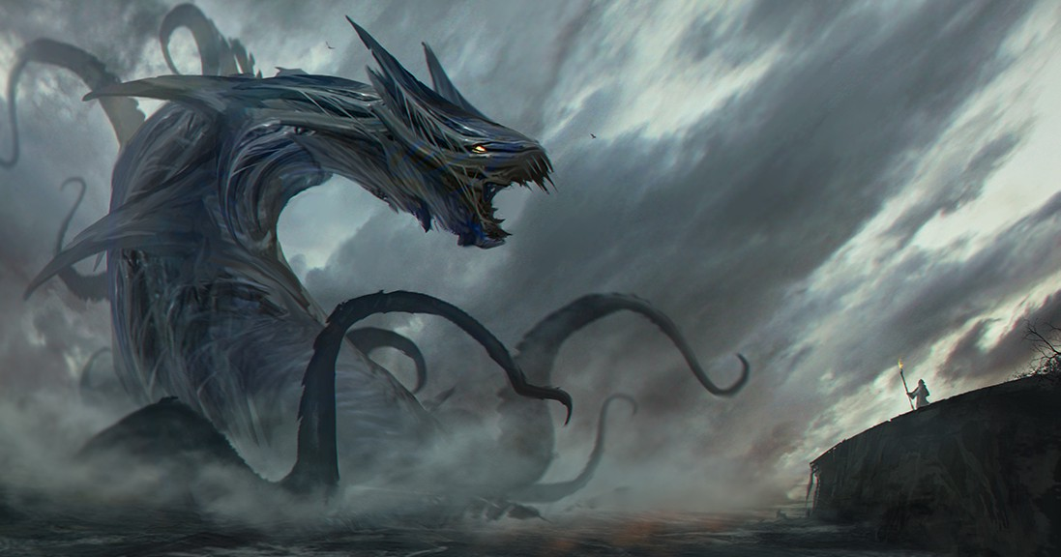

The Leviathan Spirit
By Pastor Fee Soliven
Ephesians 6:10-13
Sunday Morning
June 3, 2018

Slide 4
10 Finally, my brethren, be strong in the Lord and in the power of His might. 11 Put on the whole armor of God, that you may be able to stand against the wiles of the devil. 12 For we do not wrestle against flesh and blood, but against principalities, against powers, against the rulers of the darkness of this age, against spiritual hosts of wickedness in the heavenly places. 13 Therefore take up the whole armor of God, that you may be able to withstand in the evil day, and having done all, to stand.

Slide 5
Ephesians 6:12
“For we do not wrestle against flesh and blood, but against principalities, against powers, against the rulers of the darkness of this age, against spiritual hosts of wickedness in the heavenly places”

Slide 6
Leviathan Spirit

Slide 7
How many of you throughout your lives have seen marriages destroyed, friendships destroyed, parent child relationships destroyed, relationships through bloodline destroyed, ministries split and destroyed, Pastors and their ministry staff destroyed etc.?

Slide 8
Isaiah 27:1 NLT
“In that day the Lord will take his terrible, swift sword and punish Leviathan, the swiftly moving serpent, the coiling, writing serpent. He will kill the dragon of the sea”

Slide 9
Revelation 12:9 ESV
And the great dragon was thrown down, that ancient serpent, who is called the devil and Satan, the deceiver of the whole world—he was thrown down to the earth, and his angels were thrown down with him.

Slide 10
Job 41:1-4
1 "Can you draw out Leviathan with a hook, Or snare his tongue with a line which you lower? 2 Can you put a reed through his nose, Or pierce his jaw with a hook? 3 Will he make many supplications to you? Will he speak softly to you? 4 Will he make a covenant with you? Will you take him as a servant forever?

Slide 11
Attacks from the Leviathan Spirit and Our Counter Attack

Slide 12
Attacks:
Attitudes Connected to the Leviathan Spirit

Slide 13
1. Condescending attitudes toward others in the body.
2. Independent, attitude not willing to die to self
3. Self -Glory
4. Self-Confidence not including God
5. Lack of time in God’s presence

Slide 14
6. Critical and condemning attitudes and thoughts
7. Boasting over achievements and revelation
8. Dishonor of authority
9. Desiring to be served
10. Desire for reputation

Slide 15
11. Desiring to control others
12. Use of position of authority or gift to fulfill selfish ambition and vision
13. Mocking or coming against Deliverance and/or Deliverance ministries

Slide 16
Counter Attack:
By living in humility

Slide 17
James 4:10
"Humble yourselves in the sight of the Lord and he will lift you up."

Slide 18
Attacks:
A Lying Tongue
lies, gossip, accusation, criticism, faultfinding, slander

Slide 19
Counter Attack:
Walk and Live in Truth

Slide 20
Isaiah 54:17
“No weapon formed against you shall prosper, And every tongue which rises against you in judgment You shall condemn. This is the heritage of the servants of the LORD, And their righteousness is from Me," Says the LORD.

Slide 21
Attacks:
Miscommunication

Slide 22
It wants to get between you and the revelation of God and distort the word of the Lord. It will seek to hide from you true revelation and confuse the true meanings of things. It wants to get between your conversation and your hearing then distort or mutter what someone is really saying. It wants to come between friends, ministry and even
children and parents.

Slide 23
Counter Attack:
“Leviathan I bind you in
Jesus’ Name”

Slide 24
God Exposes Leviathan

Slide 25
Job 41:1-2
1 “Can you draw out Leviathan with a hook, or snare his tongue with a line which you lower? 2 Can you put a reed through his nose, or pierce his jaw with a hook? ​

Slide 26
Job 41:3-4
3 Will he make many supplications to you? Will he speak softly to you? Will he make a covenant with you? 4 Will you take him as a servant forever?

Slide 27
Job 41:8-10
8 Lay your hand on him; remember the battle–never do it again! 9 Indeed, any hope of overcoming him is false; shall one not be overwhelmed at the sight of him? 10 No one is so fierce that he would dare stir him up.

Slide 28
Proverbs 6:12-19
12 A worthless person, a wicked man, Walks with a perverse mouth; 13 He winks with his eyes, He shuffles his feet, He points with his fingers; 14 Perversity is in his heart, He devises evil continually, He sows discord.

Slide 29
15 Therefore his calamity shall come suddenly; Suddenly he shall be broken without remedy. 16 These six things the LORD hates, Yes, seven are an abomination to Him: 17 A proud look, A lying tongue, Hands that shed innocent blood,

Slide 30
18 A heart that devises wicked plans, Feet that are swift in running to evil, 19 A false witness who speaks lies, And one who sows discord among brethren.

Slide 31
Titus 3:9-11
9 But avoid foolish controversies, genealogies, dissensions, and quarrels about the law, for they are unprofitable and worthless. 10 As for a person who stirs up division, after warning him once and then twice, have nothing more to do with him, 11 knowing that such a person is warped and sinful; he is self-condemned.

Slide 32
1 John 3:8
“Whoever makes a practice of sinning is of the devil, for the devil has been sinning from the beginning. The reason the Son of God appeared was to destroy the works of the devil.”

Slide 33
John 8:44
“You are of your father the devil, and your will is to do your father's desires. He was a murderer from the beginning, and has nothing to do with the truth, because there is no truth in him. When he lies, he speaks out of his own character, for he is a liar and the father of lies.”

Slide 34
The unbelievers, the progressive liberal left wingers, most of our government, the shadow government known as the deep state are pawns and prey to this Leviathan spirit that cannot be battled in the natural sense!

Slide 35
Our Only Lethal Counter Attack is Prayer Through the Holy Ghost!

Slide 36
2 Corinthians 10:3-6
3 For though we walk in the flesh, we do not war according to the flesh. 4 For the weapons of our warfare are not carnal but mighty in God for pulling down strongholds, 5 casting down arguments and every high thing that exalts itself against the knowledge of God, bringing every thought into captivity to the obedience of Christ, 6 and being ready to punish all disobedience when your obedience is fulfilled.

Slide 37
James 4:7
“Submit yourselves therefore to God. Resist the devil, and he will flee from you”

Slide 38
Ephesians 4:27
“And give no opportunity to the devil”

Slide 39
Ephesians 6:10-18
10 Finally, my brethren, be strong in the Lord and in the power of His might. 11 Put on the whole armor of God, that you may be able to stand against the wiles of the devil.

Slide 40
12 For we do not wrestle against flesh and blood, but against principalities, against powers, against the rulers of the darkness of this age, against spiritual hosts of wickedness in the heavenly places. 13 Therefore take up the whole armor of God, that you may be able to withstand in the evil day, and having done all, to stand.

Slide 41
14 Stand therefore, having girded your waist with truth, having put on the breastplate of righteousness, 15 and having shod your feet with the preparation of the gospel of peace; 16 above all, taking the shield of faith with which you will be able to quench all the fiery darts of the wicked one.

Slide 42
17 And take the helmet of salvation, and the sword of the Spirit, which is the word of God; 18 praying always with all prayer and supplication in the Spirit, being watchful to this end with all perseverance and supplication for all the saints

