Slide 1


Slide 2
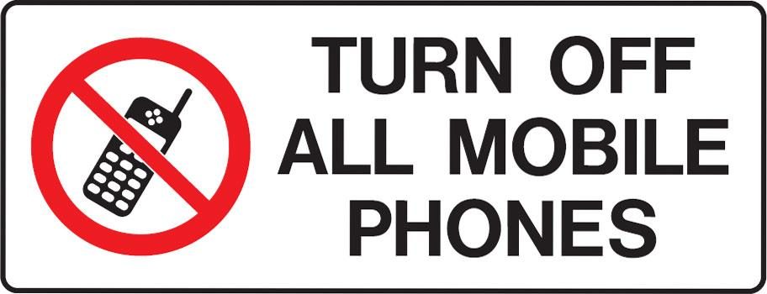

Slide 3
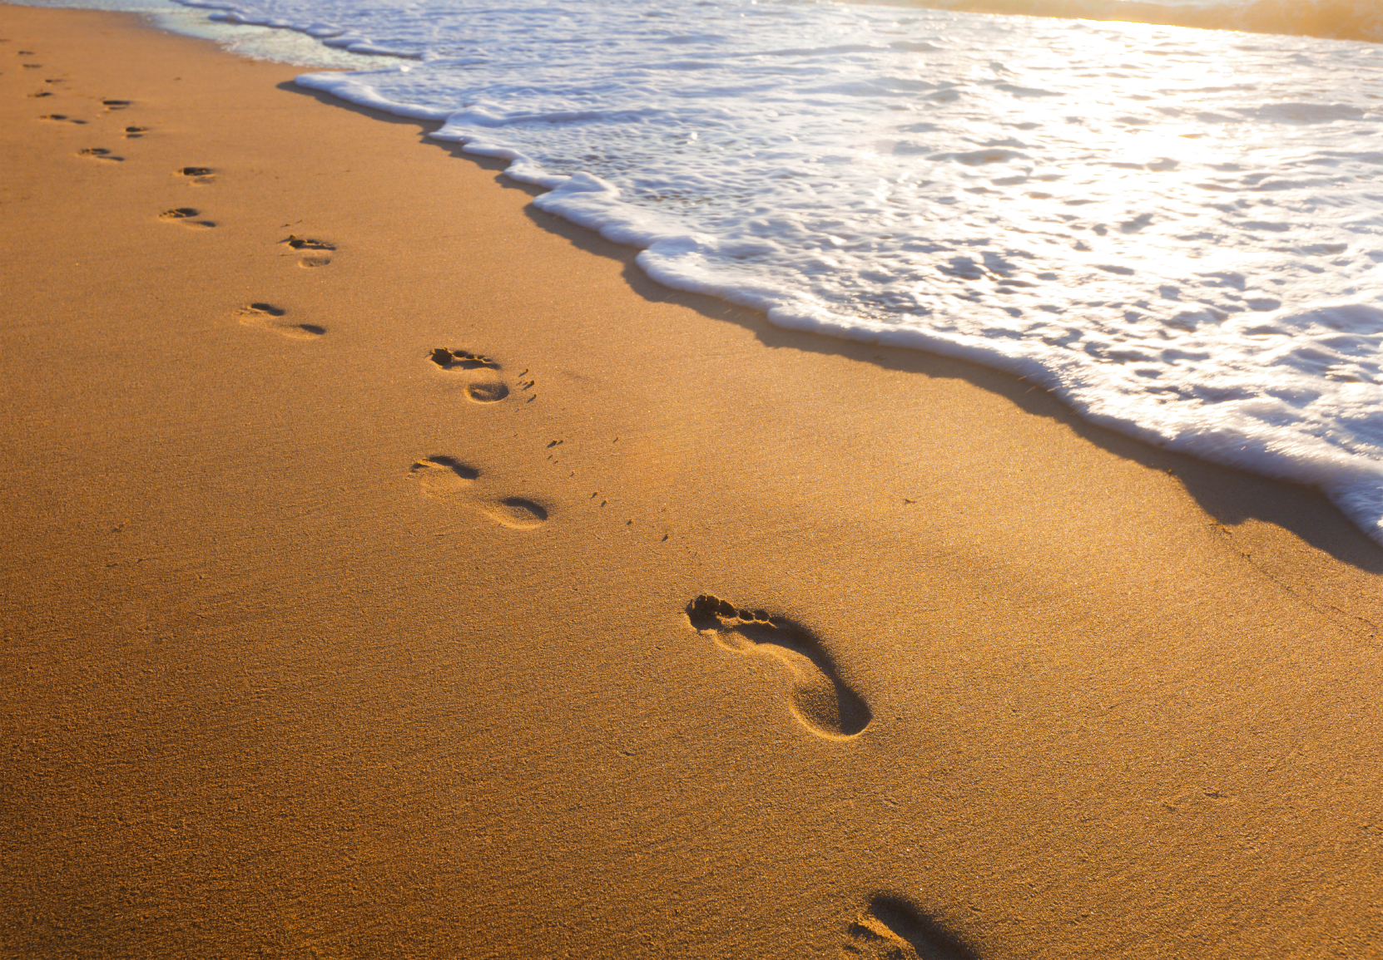

Help Me to See You Lord
by Pastor Fee Soliven
James 1:2-6
Sunday Morning
July 29, 2018

Slide 4
James 1:2-6
2 My brethren, count it all joy when you fall into various trials, 3 knowing that the testing of your faith produces patience. 4 But let patience have its perfect work, that you may be perfect and complete, lacking nothing. 5 If any of you lacks wisdom, let him ask of God, who gives to all liberally and without reproach, and it will be given to him. 6 But let him ask in faith, with no doubting, for he who doubts is like a wave of the sea driven and tossed by the wind.

Slide 5
When we’re facing a difficult decision or situation, it’s important that we distinguish between a trial and a temptation

Slide 6
Titus 3:1 ESV
“Remind them to be submissive to rulers and authorities, to be obedient, to be ready for every good work…”

Slide 7
John 14:15 ESV
“If you love me, you will keep my commandments”

Slide 8
Acts 5:29
“But Peter and the apostles answered, “We must obey God rather than men”

Slide 9
The Lord tested Abraham’s faith

Slide 10
Genesis 22:1-19
1 Now it came to pass after these things that God tested Abraham, and said to him, "Abraham!" And he said, "Here I am." 2 And He said, "Take now your son, your only son Isaac, whom you love, and go to the land of Moriah, and offer him there as a burnt offering on one of the mountains of which I shall tell you."

Slide 11
3 So Abraham rose early in the morning and saddled his donkey, and took two of his young men with him, and Isaac his son; and he split the wood for the burnt offering, and arose and went to the place of which God had told him. 4 Then on the third day Abraham lifted his eyes and saw the place afar off. 5 And Abraham said to his young men, "Stay here with the donkey; the lad and I will go yonder and worship, and we will come back to you."

Slide 12
6 So Abraham took the wood of the burnt offering and laid it on Isaac his son; and he took the fire in his hand, and a knife, and the two of them went together. 7 But Isaac spoke to Abraham his father and said, "My father!" And he said, "Here I am, my son." Then he said, "Look, the fire and the wood, but where is the lamb for a burnt offering?" 8 And Abraham said, "My son, God will provide for Himself the lamb for a burnt offering." So the two of them went together.

Slide 13
9 Then they came to the place of which God had told him. And Abraham built an altar there and placed the wood in order; and he bound Isaac his son and laid him on the altar, upon the wood. 10 And Abraham stretched out his hand and took the knife to slay his son. 11 But the Angel of the LORD called to him from heaven and said, "Abraham, Abraham!" And he said, "Here I am."

Slide 14
12 And He said, "Do not lay your hand on the lad, or do anything to him; for now I know that you fear God, since you have not withheld your son, your only son, from Me." 13 Then Abraham lifted his eyes and looked, and there behind him was a ram caught in a thicket by its horns. So Abraham went and took the ram, and offered it up for a burnt offering instead of his son.

Slide 15
14 And Abraham called the name of the place, The-Lord-Will-Provide; as it is said to this day, "In the Mount of The LORD it shall be provided." 15 Then the Angel of the LORD called to Abraham a second time out of heaven, 16 and said: "By Myself I have sworn, says the LORD, because you have done this thing, and have not withheld your son, your only son—

Slide 16
17 blessing I will bless you, and in multiplying I will multiply your descendants as the stars of the heaven and as the sand which is on the seashore; and your descendants shall possess the gate of their enemies. 18 In your seed all the nations of the earth shall be blessed, because you have obeyed My voice." 19 So Abraham returned to his young men, and they rose and went together to Beersheba; and Abraham dwelt at Beersheba.

Slide 17
Genesis 22:2
“Take now your son, your only son, whom you love, Isaac, and go to the land of Moriah, and offer him there as a burnt offering on one of the mountains of which I will tell you”

Slide 18
Genesis 22:3
“So Abraham rose early in the morning and saddled his donkey, and took two of his young men with him and Isaac his son; and he split wood for the burnt offering, and arose and went to the place of which God had told him”

Slide 19
Genesis 12:2-3
“I will make you a great nation, and I will bless you, and make your name great; and so you shall be a blessing; and I will bless those who bless you, and the one who curses you I will curse. And in you all the families of the earth shall be blessed”

Slide 20
How could all this come to pass if Isaac was dead?

Slide 21
Our lack of understanding of why God tells us to do something is never an acceptable excuse for not doing it

Slide 22
Genesis 22:4-5
“On the third day Abraham raised his eyes and saw the place from a distance. Abraham said to his young men, ‘Stay here with the donkey, and I and the lad will go over there; and we will worship and return to you.’”

Slide 23
Hebrews 11:17-19
17 By faith Abraham, when he was tested, offered up Isaac, and he who had received the promises offered up his only begotten son, 18 of whom it was said, "In Isaac your seed shall be called," 19 concluding that God was able to raise him up, even from the dead, from which he also received him in a figurative sense.

Slide 24
There is just as much power and authority behind God’s promises to us as there was to Abraham

Slide 25
2 Timothy 3:16-17
16 All Scripture is breathed out by God and profitable for teaching, for reproof, for correction, and for training in righteousness, 17 that the man of God may be competent, equipped for every good work.

Slide 26
Ephesians 2:10
“For we are his workmanship, created in Christ Jesus for good works, which God prepared beforehand, that we should walk in them”

Slide 27
Genesis 2:6
“Abraham took the wood of the burnt offering and laid it on Isaac his son, and he took in his hand the fire and the knife. So the two of them walked on together”

Slide 28
Genesis 2:8
“God will provide for Himself the lamb for the burnt offering, my son”

Slide 29
Abraham is proven faithful

Slide 30
Genesis 22:9
“Then they came to the place of which God had told him. And Abraham built an altar there and placed the wood in order; and he bound Isaac his son and laid him on the altar, upon the wood”

Slide 31
Genesis 22:12
“Now I know that you fear God, since you have not withheld your son, your only son, from Me”

Slide 32
1. What similarities do you see between Abraham’s willingness to sacrifice his son and God’s sacrifice of His Son for us?

Slide 33
2. Are you reluctant to obey the Lord in some area of your life?

Slide 34
3. What will obedience cost you?

Slide 35
4. What will disobedience cost you?

Slide 36
5. Is the Lord asking you to surrender someone or something to Him?

Slide 37
6. What do you think would happen if you obeyed?

Slide 38
7. How does Abraham’s story encourage you to trust God?

