Slide 1


Slide 2


Slide 3
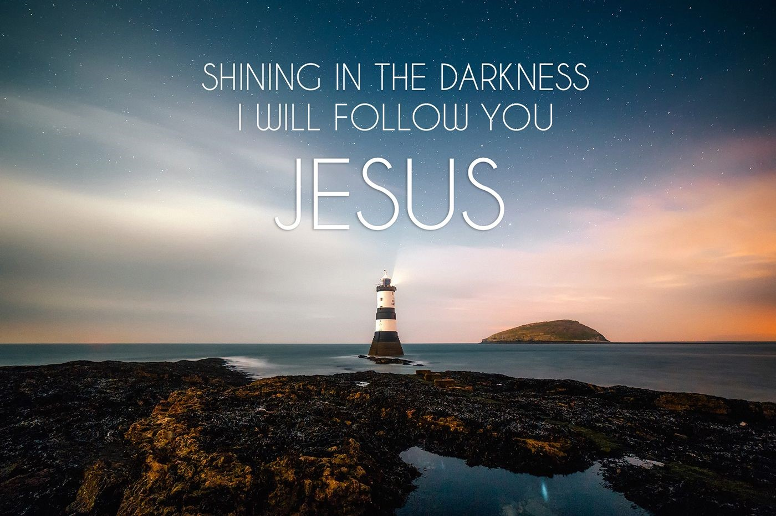

Jesus Help Me Follow You
by Pastor Fee Soliven
Proverbs 3:5-6
Sunday Morning
July 1, 2018

Slide 4
Proverbs 3:5-6
5 Trust in the LORD with all your heart, And lean not on your own understanding; 6 In all your ways acknowledge Him, And He shall direct your paths.

Slide 5
Life is really just one continuous series of decisions, but we are not left to figure all this out by ourselves.

Slide 6
Proverbs 15:2-3
2 The tongue of the wise uses knowledge rightly, But the mouth of fools pours forth foolishness. 3 The eyes of the LORD are in every place, Keeping watch on the evil and the good.

Slide 7
1 Kings 12:1-11
1 And Rehoboam went to Shechem, for all Israel had gone to Shechem to make him king. 2 So it happened, when Jeroboam the son of Nebat heard it (he was still in Egypt, for he had fled from the presence of King Solomon and had been dwelling in Egypt), 3 that they sent and called him. Then Jeroboam and the whole assembly of Israel came and spoke to Rehoboam, saying,

Slide 8
4 "Your father made our yoke heavy; now therefore, lighten the burdensome service of your father, and his heavy yoke which he put on us, and we will serve you." 5 So he said to them, "Depart for three days, then come back to me." And the people departed. 6 Then King Rehoboam consulted the elders who stood before his father Solomon while he still lived, and he said, "How do you advise me to answer these people?"

Slide 9
7 And they spoke to him, saying, "If you will be a servant to these people today, and serve them, and answer them, and speak good words to them, then they will be your servants forever." 8 But he rejected the advice which the elders had given him, and consulted the young men who had grown up with him, who stood before him.

Slide 10
9 And he said to them, "What advice do you give? How should we answer this people who have spoken to me, saying, 'Lighten the yoke which your father put on us'?" 10 Then the young men who had grown up with him spoke to him, saying, "Thus you should speak to this people who have spoken to you, saying, 'Your father made our yoke heavy, but you make it lighter on us'--thus you shall say to them: 'My little finger shall be thicker than my father's waist!

Slide 11
11 And now, whereas my father put a heavy yoke on you, I will add to your yoke; my father chastised you with whips, but I will chastise you with scourges!' "

Slide 12
How do we detect bad counsel?

Slide 13
1. Unwise counselors make little or no mention of God or His Word

Slide 14
2. There will be an absence of prayer

Slide 15
3. They may display a subtle defensiveness about using Scripture for guidance

Slide 16
4. They may suggest actions that are not scriptural

Slide 17
5. Unwise counselors may be very critical of Christian leaders or godly people

Slide 18
6. They suggest reading material that ignores God’s Word

Slide 19
7. Sometimes counselors give advice according to what they think we want to hear

Slide 20
8. An advisor may seek to control the one counseled

Slide 21
9. Some counselors may seek to create a sense of dependency on them

Slide 22
10. Avoid counselors with an ungodly lifestyle

Slide 23
11. Some advisors may want to give us an out

Slide 24
12. Some counselors are seeking our approval

Slide 25
13. Some people counsel in a way that is profitable for themselves

Slide 26
14. Sometimes a counselor may become inappropriately involved with the counselee

Slide 27
15. A counselor may unload on the person seeking help

Slide 28
16. We should not go to an unbeliever for godly counsel

Slide 29
What are the consequences of going to an ungodly counselor?

Slide 30
We might make the wrong decision.

Slide 31
We might be deceived

Slide 32
2 Peter 2:1-10
1 But there were also false prophets among the people, even as there will be false teachers among you, who will secretly bring in destructive heresies, even denying the Lord who bought them, and bring on themselves swift destruction.

Slide 33
2 And many will follow their destructive ways, because of whom the way of truth will be blasphemed. 3 By covetousness they will exploit you with deceptive words; for a long time their judgment has not been idle, and their destruction does not slumber. 4 For if God did not spare the angels who sinned, but cast them down to hell and delivered them into chains of darkness, to be reserved for judgment;

Slide 34
5 and did not spare the ancient world, but saved Noah, one of eight people, a preacher of righteousness, bringing in the flood on the world of the ungodly; 6 and turning the cities of Sodom and Gomorrah into ashes, condemned them to destruction, making them an example to those who afterward would live ungodly;

Slide 35
7 and delivered righteous Lot, who was oppressed by the filthy conduct of the wicked 8(for that righteous man, dwelling among them, tormented his righteous soul from day to day by seeing and hearing their lawless deeds)-- 9 then the Lord knows how to deliver the godly out of temptations and to reserve the unjust under punishment for the day of judgment,

Slide 36
10 and especially those who walk according to the flesh in the lust of uncleanness and despise authority. They are presumptuous, self-willed. They are not afraid to speak evil of dignitaries,

Slide 37
We could be controlled by the counselor.

Slide 38
It may cost us financially.

Slide 39
It could separate friends.

Slide 40
It may injure our marriage.

Slide 41
We could turn away from trusting God and turn to trusting a person.

Slide 42
We might be encouraged to make decisions that violate God’s Word.

Slide 43
We may be led astray and lead someone else astray also.

Slide 44
Psalm 1:1-6
1 Blessed is the man Who walks not in the counsel of the ungodly, Nor stands in the path of sinners, Nor sits in the seat of the scornful; 2 But his delight is in the law of the LORD, And in His law he meditates day and night.

Slide 45
3 He shall be like a tree Planted by the rivers of water, That brings forth its fruit in its season, Whose leaf also shall not wither; And whatever he does shall prosper. 4 The ungodly are not so, But are like the chaff which the wind drives away.

Slide 46
5 Therefore the ungodly shall not stand in the judgment, Nor sinners in the congregation of the righteous. 6 For the LORD knows the way of the righteous, But the way of the ungodly shall perish.

Slide 47
Isaiah 9:6
“For unto us a Child is born, Unto us a Son is given; And the government will be upon His shoulder. And His name will be called Wonderful, Counselor, Mighty God, Everlasting Father, Prince of Peace”

Slide 48
1 John 2:1-8
(Living Bible Translation)
1 My little children, I am telling you this so that you will stay away from sin. But if you sin, there is someone to plead for you before the Father. His name is Jesus Christ, the one who is all that is good and who pleases God completely.

Slide 49
2 He is the one who took God's wrath against our sins upon himself and brought us into fellowship with God; and he is the forgiveness for our sins, and not only ours but all the world's. 3 And how can we be sure that we belong to him? By looking within ourselves: are we really trying to do what he wants us to?

Slide 50
4 Someone may say, "I am a Christian; I am on my way to heaven; I belong to Christ." But if he doesn't do what Christ tells him to, he is a liar. 5 But those who do what Christ tells them to will learn to love God more and more. That is the way to know whether or not you are a Christian.

Slide 51
6 Anyone who says he is a Christian should live as Christ did. 7 Dear brothers, I am not writing out a new rule for you to obey, for it is an old one you have always had, right from the start. You have heard it all before. 8 Yet it is always new, and works for you just as it did for Christ; and as we obey this commandment, to love one another, the darkness in our lives disappears and the new light of life in Christ shines in.
1

Slide 52
1. When you talk to someone about your problems, what are you truly seeking? Support? Sympathy? Agreement? Direction? God’s viewpoint?

Slide 53
2. What criteria do you use for choosing a counselor?

Slide 54
3. How important is it to you that the advice is shaped by the Word of God?

Slide 55
4. When trouble strikes, do you know where to find God’s answer in His Word?

Slide 56
5. What can you do now to ensure that you will be familiar enough with Scripture to know what He desires?

