Slide 1


Slide 2


Slide 3
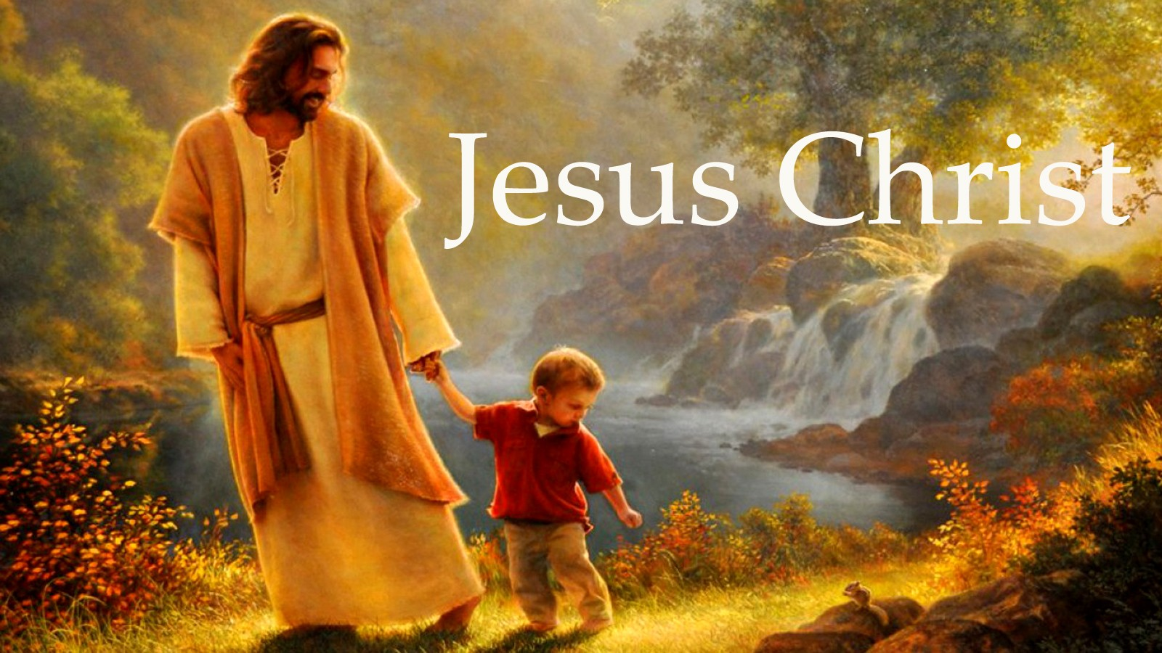

Lead Me and Teach Me Lord
by Pastor Fee Soliven
Psalm 25:1-5
Sunday Morning
July 22, 2018

Slide 4
Psalm 25:1-5
1 To You, O LORD, I lift up my soul. 2 O my God, I trust in You; Let me not be ashamed; Let not my enemies triumph over me. 3 Indeed, let no one who waits on You be ashamed; Let those be ashamed who deal treacherously without cause. 4 Show me Your ways, O LORD; Teach me Your paths. 5 Lead me in Your truth and teach me, For You are the God of my salvation; On You I wait all the day.

Slide 5
Learning to listen to the Lord is an important lesson for all of us!

Slide 6
Jeremiah 29:11-13
11 For I know the thoughts that I think toward you, says the LORD, thoughts of peace and not of evil, to give you a future and a hope. 12 Then you will call upon Me and go and pray to Me, and I will listen to you. 13 And you will seek Me and find Me, when you search for Me with all your heart.

Slide 7
Genesis 12:1-3
“Go forth from your country, and from your relatives and from your father’s house, to the land which I will show you; and I will make you a great nation, and I will bless you, and make your name great; and so you shall be a blessing; and I will bless those who bless you, and the one who curses you I will curse, and in you all the families of the earth shall be blessed.”

Slide 8
God’s directions were very clear, but Abraham didn’t follow them fully.

Slide 9
Genesis 13:1-13
1 Then Abram went up from Egypt, he and his wife and all that he had, and Lot with him, to the South. 2 Abram was very rich in livestock, in silver, and in gold. 3 And he went on his journey from the South as far as Bethel, to the place where his tent had been at the beginning, between Bethel and Ai,

Slide 10
4 to the place of the altar which he had made there at first. And there Abram called on the name of the LORD. 5 Lot also, who went with Abram, had flocks and herds and tents. 6 Now the land was not able to support them, that they might dwell together, for their possessions were so great that they could not dwell together.

Slide 11
7 And there was strife between the herdsmen of Abram's livestock and the herdsmen of Lot's livestock. The Canaanites and the Perizzites then dwelt in the land. 8 So Abram said to Lot, "Please let there be no strife between you and me, and between my herdsmen and your herdsmen; for we are brethren.

Slide 12
9 Is not the whole land before you? Please separate from me. If you take the left, then I will go to the right; or, if you go to the right, then I will go to the left." 10 And Lot lifted his eyes and saw all the plain of Jordan, that it was well watered everywhere (before the LORD destroyed Sodom and Gomorrah) like the garden of the LORD, like the land of Egypt as you go toward Zoar.

Slide 13
11 Then Lot chose for himself all the plain of Jordan, and Lot journeyed east. And they separated from each other. 12 Abram dwelt in the land of Canaan, and Lot dwelt in the cities of the plain and pitched his tent even as far as Sodom. 13 But the men of Sodom were exceedingly wicked and sinful against the LORD.

Slide 14
Genesis 16:1-16
1 Now Sarai, Abram's wife, had borne him no children. And she had an Egyptian maidservant whose name was Hagar. 2 So Sarai said to Abram, "See now, the LORD has restrained me from bearing children. Please, go in to my maid; perhaps I shall obtain children by her." And Abram heeded the voice of Sarai.

Slide 15
3 Then Sarai, Abram's wife, took Hagar her maid, the Egyptian, and gave her to her husband Abram to be his wife, after Abram had dwelt ten years in the land of Canaan. 4 So he went in to Hagar, and she conceived. And when she saw that she had conceived, her mistress became despised in her eyes.

Slide 16
5 Then Sarai said to Abram, "My wrong be upon you! I gave my maid into your embrace; and when she saw that she had conceived, I became despised in her eyes. The LORD judge between you and me." 6 So Abram said to Sarai, "Indeed your maid is in your hand; do to her as you please." And when Sarai dealt harshly with her, she fled from her presence.

Slide 17
7 Now the Angel of the LORD found her by a spring of water in the wilderness, by the spring on the way to Shur. 8 And He said, "Hagar, Sarai's maid, where have you come from, and where are you going?" She said, "I am fleeing from the presence of my mistress Sarai." 9 The Angel of the LORD said to her, "Return to your mistress, and submit yourself under her hand."

Slide 18
10 Then the Angel of the LORD said to her, "I will multiply your descendants exceedingly, so that they shall not be counted for multitude." 11 And the Angel of the LORD said to her: "Behold, you are with child, And you shall bear a son. You shall call his name Ishmael, Because the LORD has heard your affliction.

Slide 19
12 He shall be a wild man; His hand shall be against every man, And every man's hand against him. And he shall dwell in the presence of all his brethren." 13 Then she called the name of the LORD who spoke to her, You-Are-the-God-Who-Sees; for she said, "Have I also here seen Him who sees me?"

Slide 20
14 Therefore the well was called Beer Lahai Roi; observe, it is between Kadesh and Bered. 15 So Hagar bore Abram a son; and Abram named his son, whom Hagar bore, Ishmael. 16 Abram was eighty-six years old when Hagar bore Ishmael to Abram.

Slide 21
There’s always danger when we are listening to the wrong voices

Slide 22
John 10:27-30
27 My sheep hear My voice, and I know them, and they follow Me. 28 And I give them eternal life, and they shall never perish; neither shall anyone snatch them out of My hand. 29 My Father, who has given them to Me, is greater than all; and no one is able to snatch them out of My Father's hand. 30 I and My Father are one."

Slide 23
Genesis 21:1-5
1 And the LORD visited Sarah as He had said, and the LORD did for Sarah as He had spoken. 2 For Sarah conceived and bore Abraham a son in his old age, at the set time of which God had spoken to him. 3 And Abraham called the name of his son who was born to him--whom Sarah bore to him--Isaac.

Slide 24
4 Then Abraham circumcised his son Isaac when he was eight days old, as God had commanded him. 5 Now Abraham was one hundred years old when his son Isaac was born to him.

Slide 25
What causes us to get ahead of God?

Slide 26
1. We listen to other people instead of the Lord.

Slide 27
2. We are deceived by appearances rather than making choices based on the will of God.

Slide 28
3. We become impatient and impose a time limit on the Lord.

Slide 29
4. We are afraid of failure or the possibility that we’ll miss out on something if we don’t act now.

Slide 30
1 Samuel 15:22-23
(The Living Bible Translation)
22 Samuel replied, "Has the Lord as much pleasure in your burnt offerings and sacrifices as in your obedience? Obedience is far better than sacrifice. He is much more interested in your listening to him than in your offering the fat of rams to him.

Slide 31
23 For rebellion is as bad as the sin of witchcraft, and stubbornness is as bad as worshiping idols. And now because you have rejected the word of Jehovah, he has rejected you from being king."

Slide 32
5. The problem could be unbelief

Slide 33
Hebrews 11:6
“But without faith it is impossible to please Him, for he who comes to God must believe that He is, and that He is a rewarder of those who diligently seek Him”

Slide 34
What is the penalty for not waiting for God?

Slide 35
1. We deny ourselves His best

Slide 36
2. We delay God’s purpose in our life

Slide 37
3. We experience disharmony

Slide 38
5. We suffer great disappointments

Slide 39
6. Somewhere along the way we can expect defeat and possibly destruction

Slide 40
1. Have you ever jumped ahead of God?

Slide 41
2. If so, what caused you to become impatient?

Slide 42
3. What happened as a result?

Slide 43
4. What have you learned about God’s timing both from His Word and through your experiences of either obedience or impatience?

Slide 44
5. How will these lessons guard you against getting ahead of Him in the future?

