Slide 1


Slide 2


Slide 3


Come After Me
By Pastor Fee Soliven
Mark 1:14-22
Wednesday Evening
August 1, 2018

Slide 4
14 Now after John was put in prison, Jesus came to Galilee, preaching the gospel of the kingdom of God,

Slide 5
15 and saying, "The time is fulfilled, and the kingdom of God is at hand. Repent, and believe in the gospel."

Slide 6
16 And as He walked by the Sea of Galilee, He saw Simon and Andrew his brother casting a net into the sea; for they were fishermen.

Slide 7
17 Then Jesus said to them, "Come after Me, and I will make you become fishers of men."

Slide 8
18 And immediately they left their nets and followed Him.

Slide 9
19 When He had gone a little farther from there, He saw James the son of Zebedee, and John his brother, who also were in the boat mending their nets.

Slide 10
20 And immediately He called them, and they left their father Zebedee in the boat with the hired servants, and went after Him.

Slide 11
21 Then they went into Capernaum, and immediately on the Sabbath He entered the synagogue and taught.

Slide 12
22 And they were astonished at His teaching, for He taught them as one having authority, and not as the scribes.

Slide 13
14 Now after John was put in prison, Jesus came to Galilee, preaching the gospel of the kingdom of God,

Slide 14
Matthew 14:1-12
1 At that time Herod the tetrarch heard the report about Jesus 2 and said to his servants, "This is John the Baptist; he is risen from the dead, and therefore these powers are at work in him." 3 For Herod had laid hold of John and bound him, and put him in prison for the sake of Herodias, his brother Philip's wife.

Slide 15
4 Because John had said to him, "It is not lawful for you to have her." 5 And although he wanted to put him to death, he feared the multitude, because they counted him as a prophet. 6 But when Herod's birthday was celebrated, the daughter of Herodias danced before them and pleased Herod. 7 Therefore he promised with an oath to give her whatever she might ask. 8 So she, having been prompted by her mother, said, "Give me John the Baptist's head here on a platter."

Slide 16
9 And the king was sorry; nevertheless, because of the oaths and because of those who sat with him, he commanded it to be given to her. 10 So he sent and had John beheaded in prison. 11 And his head was brought on a platter and given to the girl, and she brought it to her mother. 12 Then his disciples came and took away the body and buried it, and went and told Jesus.

Slide 17
15 and saying, "The time is fulfilled, and the kingdom of God is at hand. Repent, and believe in the gospel."

Slide 18
Matthew 3:2
and saying, "Repent, for the kingdom of heaven is near."

Slide 19
Matthew 4:17
From that time on Jesus began to preach, "Repent, for the kingdom of heaven is near."

Slide 20
Acts 2:38
Peter replied, "Repent and be baptized, every one of you, in the name of Jesus Christ for the forgiveness of your sins, and you will receive the gift of the Holy Spirit.

Slide 21
Acts 20:21
testifying to Jews and Greeks alike about repentance to God and faith in our Lord Jesus.

Slide 22
Galatians 4:4
But when the time had fully come, God sent His Son, born of a woman, born under the Law,

Slide 23
Ephesians 1:10
as a plan for the fullness of time, to bring all things in heaven and on earth together in Christ.

Slide 24
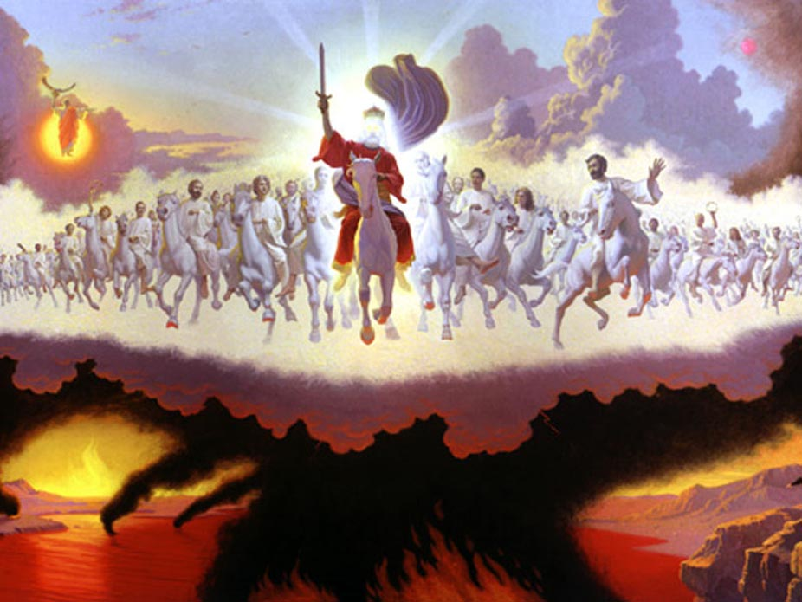
(3) to inaugurate his public ministry to bring the message of salvation to all people;

Slide 25
16 And as He walked by the Sea of Galilee, He saw Simon and Andrew his brother casting a net into the sea; for they were fishermen.

Slide 26
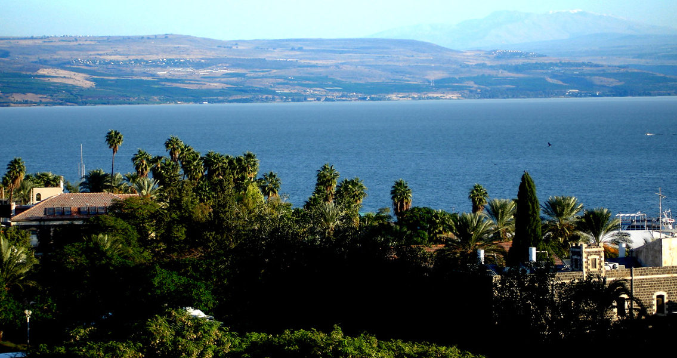
(5) to give us an example to follow

Slide 27
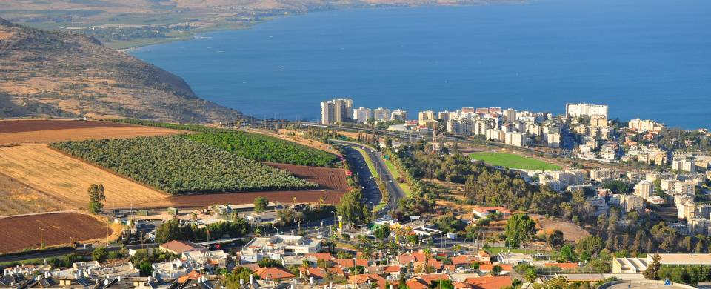
10 And immediately, coming up from the water, He saw the heavens parting and the Spirit descending upon Him like a dove.

Slide 28
John 1:35-39
35 Again, the next day, John stood with two of his disciples. 36 And looking at Jesus as He walked, he said, "Behold the Lamb of God!" 37 The two disciples heard him speak, and they followed Jesus.

Slide 29
38 Then Jesus turned, and seeing them following, said to them, "What do you seek?" They said to Him, "Rabbi" (which is to say, when translated, Teacher), "where are You staying?" 39 He said to them, "Come and see." They came and saw where He was staying, and remained with Him that day (now it was about the tenth hour).

Slide 30
John 1:42
“And he brought him to Jesus. Now when Jesus looked at him, He said, "You are Simon the son of Jonah. You shall be called Cephas" (which is translated, A Stone).”

Slide 31
17 Then Jesus said to them, "Come after Me, and I will make you become fishers of men."

Slide 32
Luke 9:23
“Then he said to them all: “Whoever wants to be my disciple must deny themselves and take up their cross daily and follow me.”

Slide 33
Luke 14:25-26
25 “Large crowds were traveling with Jesus, and turning to them he said: 26 “If anyone comes to me and does not hate father and mother, wife and children, brothers and sisters–yes, even their own life–such a person cannot be my disciple.”

Slide 34
Matthew 10:37
“Anyone who loves their father or mother more than me is not worthy of me; anyone who loves their son or daughter more than me is not worthy of me.”

Slide 35
Matthew 10:38
“Whoever does not take up their cross and follow me is not worthy of me.”

Slide 36
18 And immediately they left their nets and followed Him.

Slide 37
Luke 14:33
“So likewise, whoever of you does not forsake all that he has cannot be My disciple”

Slide 38
Luke 18:18-23
18 Now a certain ruler asked Him, saying, "Good Teacher, what shall I do to inherit eternal life?" 19 So Jesus said to him, "Why do you call Me good? No one is good but One, that is, God. 20 You know the commandments: 'Do not commit adultery,' 'Do not murder,' 'Do not steal,' 'Do not bear false witness,' 'Honor your father and your mother.' "

Slide 39
21 And he said, "All these I have kept from my youth." 22 So when Jesus heard these things, He said to him, "You still lack one thing. Sell all that you have and distribute to the poor, and you will have treasure in heaven; and come, follow Me." 23 But when he heard this, he became very sorrowful, for he was very rich.

Slide 40
19 When He had gone a little farther from there, He saw James the son of Zebedee, and John his brother, who also were in the boat mending their nets.

Slide 41
Luke 5:10
and so also were James and John, the sons of Zebedee, who were partners with Simon. And Jesus said to Simon, "Do not be afraid. From now on you will catch men."

Slide 42
20 And immediately He called them, and they left their father Zebedee in the boat with the hired servants, and went after Him.

Slide 43
Matthew 10:37
“Anyone who loves their father or mother more than me is not worthy of me; anyone who loves their son or daughter more than me is not worthy of me.”

Slide 44
21 Then they went into Capernaum, and immediately on the Sabbath He entered the synagogue and taught.

Slide 45
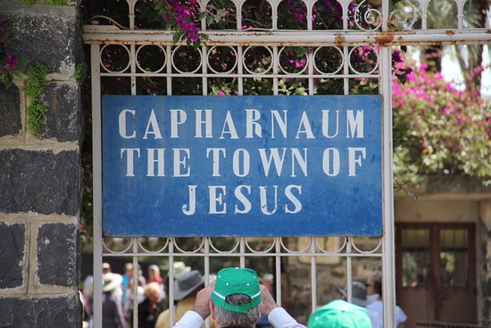
Ephesians 1:10
as a plan for the fullness of time, to bring all things in heaven and on earth together in Christ.

Slide 46
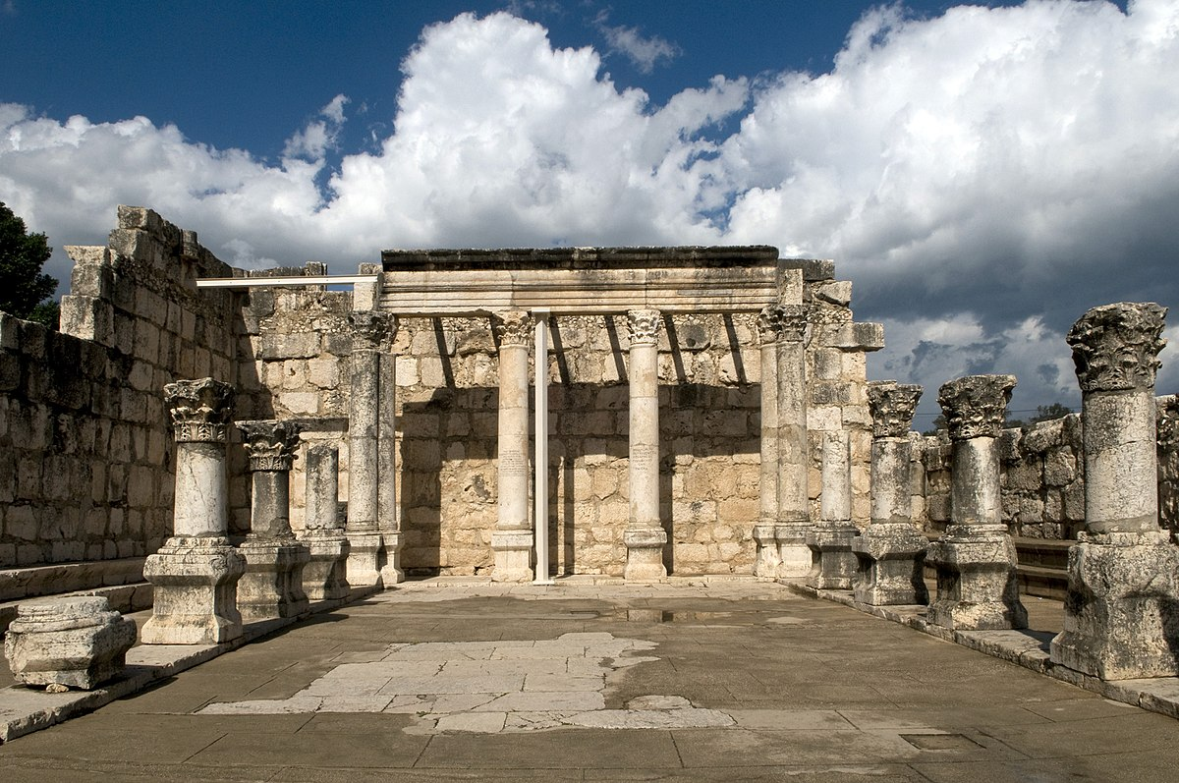
Acts 20:21
testifying to Jews and Greeks alike about repentance to God and faith in our Lord Jesus.

Slide 47
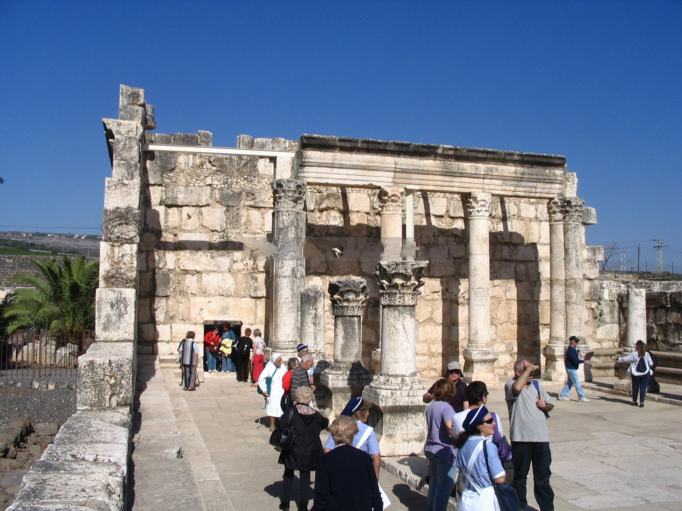
Galatians 4:4
But when the time had fully come, God sent His Son, born of a woman, born under the Law,

Slide 48
Matthew 4:12-16
12 Now when Jesus heard that John had been put in prison, He departed to Galilee. 13 And leaving Nazareth, He came and dwelt in Capernaum, which is by the sea, in the regions of Zebulun and Naphtali

Slide 49
Matthew 11:20-24
20 Then He began to rebuke the cities in which most of His mighty works had been done, because they did not repent: 21 "Woe to you, Chorazin! Woe to you, Bethsaida! For if the mighty works which were done in you had been done in Tyre and Sidon, they would have repented long ago in sackcloth and ashes.

Slide 50
22 But I say to you, it will be more tolerable for Tyre and Sidon in the day of judgment than for you. 23 And you, Capernaum, who are exalted to heaven, will be brought down to Hades; for if the mighty works which were done in you had been done in Sodom, it would have remained until this day. 24 But I say to you that it shall be more tolerable for the land of Sodom in the day of judgment than for you."

Slide 51
22 And they were astonished at His teaching, for He taught them as one having authority, and not as the scribes.

