Slide 1


Slide 2


Slide 3
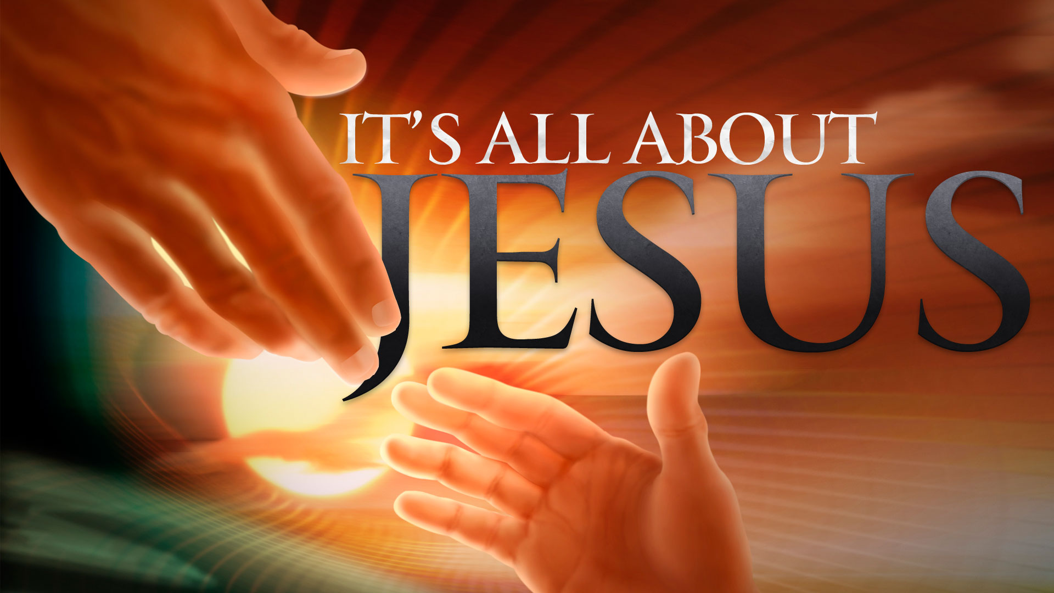

Jesus Called Sinners to Repent
by Pastor Fee Soliven
Mark 2:13-17
Wednesday Evening
August 29, 2018

Slide 4
13 Then He went out again by the sea; and all the multitude came to Him, and He taught them.

Slide 5
14 As He passed by, He saw Levi the son of Alphaeus sitting at the tax office. And He said to him, "Follow Me." So he arose and followed Him.

Slide 6
15 Now it happened, as He was dining in Levi's house, that many tax collectors and sinners also sat together with Jesus and His disciples; for there were many, and they followed Him.

Slide 7
16 And when the scribes and Pharisees saw Him eating with the tax collectors and sinners, they said to His disciples, "How is it that He eats and drinks with tax collectors and sinners?"

Slide 8
17 When Jesus heard it, He said to them, "Those who are well have no need of a physician, but those who are sick. I did not come to call the righteous, but sinners, to repentance."

Slide 9
13 Then He went out again by the sea; and all the multitude came to Him, and He taught them.

Slide 10
Matthew 5:1-12
1 And seeing the multitudes, He went up on a mountain, and when He was seated His disciples came to Him. 2 Then He opened His mouth and taught them, saying: 3 "Blessed are the poor in spirit, For theirs is the kingdom of heaven.

Slide 11
4 Blessed are those who mourn, For they shall be comforted.

Slide 12
5 Blessed are the meek, For they shall inherit the earth.

Slide 13
6 Blessed are those who hunger and thirst for righteousness, For they shall be filled.

Slide 14
7 Blessed are the merciful, For they shall obtain mercy. 8 Blessed are the pure in heart, For they shall see God.

Slide 15
9 Blessed are the peacemakers, For they shall be called sons of God.

Slide 16
10 Blessed are those who are persecuted for righteousness' sake, For theirs is the kingdom of heaven.

Slide 17
11 "Blessed are you when they revile and persecute you, and say all kinds of evil against you falsely for My sake.

Slide 18
12 Rejoice and be exceedingly glad, for great is your reward in heaven, for so they persecuted the prophets who were before you.

Slide 19
14 As He passed by, He saw Levi the son of Alphaeus sitting at the tax office. And He said to him, "Follow Me." So he arose and followed Him.

Slide 20
15 Now it happened, as He was dining in Levi's house, that many tax collectors and sinners also sat together with Jesus and His disciples; for there were many, and they followed Him.

Slide 21
16 And when the scribes and Pharisees saw Him eating with the tax collectors and sinners, they said to His disciples, "How is it that He eats and drinks with tax collectors and sinners?"

Slide 22
Matthew 23:25-39
25 Woe to you, scribes and Pharisees, hypocrites! For you cleanse the outside of the cup and dish, but inside they are full of extortion and self-indulgence. 26 Blind Pharisee, first cleanse the inside of the cup and dish, that the outside of them may be clean also.

Slide 23
27 Woe to you, scribes and Pharisees, hypocrites! For you are like whitewashed tombs which indeed appear beautiful outwardly, but inside are full of dead men's bones and all uncleanness. 28 Even so you also outwardly appear righteous to men, but inside you are full of hypocrisy and lawlessness. 29 Woe to you, scribes and Pharisees, hypocrites! Because you build the tombs of the prophets and adorn the monuments of the righteous,

Slide 24
30 and say, 'If we had lived in the days of our fathers, we would not have been partakers with them in the blood of the prophets.' 31 "Therefore you are witnesses against yourselves that you are sons of those who murdered the prophets. 32 Fill up, then, the measure of your fathers' guilt. 33 Serpents, brood of vipers! How can you escape the condemnation of hell?

Slide 25
17 When Jesus heard it, He said to them, "Those who are well have no need of a physician, but those who are sick. I did not come to call the righteous, but sinners, to repentance."

Slide 26
John 3:17-21
17 For God did not send His Son into the world to condemn the world, but that the world through Him might be saved. 18 He who believes in Him is not condemned; but he who does not believe is condemned already, because he has not believed in the name of the only begotten Son of God.

Slide 27
19 And this is the condemnation, that the light has come into the world, and men loved darkness rather than light, because their deeds were evil. 20 For everyone practicing evil hates the light and does not come to the light, lest his deeds should be exposed. 21 But he who does the truth comes to the light, that his deeds may be clearly seen, that they have been done in God."

