Slide 1


Slide 2


Slide 3


Jesus is Willing to Heal You
by Pastor Fee Soliven
Mark 1:32-45
Wednesday Evening
August 15, 2018

Slide 4
32 Now at evening, when the sun had set, they brought to Him all who were sick and those who were demon-possessed. 33 And the whole city was gathered together at the door.

Slide 5
34 Then He healed many who were sick with various diseases, and cast out many demons; and He did not allow the demons to speak, because they knew Him.

Slide 6
35 Now in the morning, having risen a long while before daylight, He went out and departed to a solitary place; and there He prayed.

Slide 7
36 And Simon and those who were with Him searched for Him. 37 When they found Him, they said to Him, "Everyone is looking for You." 38 But He said to them, "Let us go into the next towns, that I may preach there also, because for this purpose I have come forth."

Slide 8
39 And He was preaching in their synagogues throughout all Galilee, and casting out demons.

Slide 9
40 Then a leper came to Him, imploring Him, kneeling down to Him and saying to Him, "If You are willing, You can make me clean."

Slide 10
41 And Jesus, moved with compassion, put out His hand and touched him, and said to him, "I am willing; be cleansed."

Slide 11
42 As soon as He had spoken, immediately the leprosy left him, and he was cleansed.

Slide 12
43 And He strictly warned him and sent him away at once, 44 and said to him, "See that you say nothing to anyone; but go your way, show yourself to the priest, and offer for your cleansing those things which Moses commanded, as a testimony to them."

Slide 13
45 But he went out and began to proclaim it freely, and to spread the matter, so that Jesus could no longer openly enter the city, but was outside in deserted places; and they came to Him from every quarter.

Slide 14
32 Now at evening, when the sun had set, they brought to Him all who were sick and those who were demon-possessed. 33 And the whole city was gathered together at the door.

Slide 15
34 Then He healed many who were sick with various diseases, and cast out many demons; and He did not allow the demons to speak, because they knew Him.

Slide 16
Luke 8:26-33
26 Then they sailed to the country of the Gadarenes, which is opposite Galilee. 27 And when He stepped out on the land, there met Him a certain man from the city who had demons for a long time. And he wore no clothes, nor did he live in a house but in the tombs.

Slide 17
28 When he saw Jesus, he cried out, fell down before Him, and with a loud voice said, "What have I to do with You, Jesus, Son of the Most High God? I beg You, do not torment me!" 29 For He had commanded the unclean spirit to come out of the man. For it had often seized him, and he was kept under guard, bound with chains and shackles; and he broke the bonds and was driven by the demon into the wilderness.

Slide 18
30 Jesus asked him, saying, "What is your name?" And he said, "Legion," because many demons had entered him. 31 And they begged Him that He would not command them to go out into the abyss. 32 Now a herd of many swine was feeding there on the mountain. And they begged Him that He would permit them to enter them. And He permitted them. 33 Then the demons went out of the man and entered the swine, and the herd ran violently down the steep place into the lake and drowned.

Slide 19
35 Now in the morning, having risen a long while before daylight, He went out and departed to a solitary place; and there He prayed.

Slide 20
1. After the successful ministry in Capernaum with the healing of many sick and demon-possessed people;
2. After the miracle of feeding more than five thousand people
3. In Gethsemane, just prior to his arrest, trial, and crucifixion

Slide 21
36 And Simon and those who were with Him searched for Him. 37 When they found Him, they said to Him, "Everyone is looking for You." 38 But He said to them, "Let us go into the next towns, that I may preach there also, because for this purpose I have come forth."

Slide 22
Romans 10:14-15
14 How then shall they call on Him in whom they have not believed? And how shall they believe in Him of whom they have not heard? And how shall they hear without a preacher? 15 And how shall they preach unless they are sent? As it is written: "How beautiful are the feet of those who preach the gospel of peace, Who bring glad tidings of good things!"

Slide 23
39 And He was preaching in their synagogues throughout all Galilee, and casting out demons.

Slide 24
Galilee, Samaria, and Judea

Slide 25
Romans 10:14-15
14 How then shall they call on Him in whom they have not believed? And how shall they believe in Him of whom they have not heard? And how shall they hear without a preacher? 15 And how shall they preach unless they are sent? As it is written: "How beautiful are the feet of those who preach the gospel of peace, Who bring glad tidings of good things!"

Slide 26
Can a Christian be demon-possessed?

Slide 27
1 Samuel 16:14
"The Spirit of the Lord had departed from Saul, and an evil spirit tormented him…”

Slide 28
Luke 22:3-6
3 Then Satan entered Judas, surnamed Iscariot, who was numbered among the twelve. 4 So he went his way and conferred with the chief priests and captains, how he might betray Him to them. 5 And they were glad, and agreed to give him money. 6 So he promised and sought opportunity to betray Him to them in the absence of the multitude.

Slide 29
Acts 5:1-5
1 But a certain man named Ananias, with Sapphira his wife, sold a possession. 2 And he kept back part of the proceeds, his wife also being aware of it, and brought a certain part and laid it at the apostles' feet. 3 But Peter said, "Ananias, why has Satan filled your heart to lie to the Holy Spirit and keep back part of the price of the land for yourself?

Slide 30
4 While it remained, was it not your own? And after it was sold, was it not in your own control? Why have you conceived this thing in your heart? You have not lied to men but to God." 5 Then Ananias, hearing these words, fell down and breathed his last. So great fear came upon all those who heard these things.

Slide 31
Colossians 1:12-14
13 He has delivered us from the power of darkness and conveyed us into the kingdom of the Son of His love, 14 in whom we have redemption through His blood, the forgiveness of sins.

Slide 32
1 John 4:4-6
4 You are of God, little children, and have overcome them, because He who is in you is greater than he who is in the world. 5 They are of the world. Therefore they speak as of the world, and the world hears them. 6 We are of God. He who knows God hears us; he who is not of God does not hear us. By this we know the spirit of truth and the spirit of error.

Slide 33
Romans 8:38-39
"For I am convinced that neither death nor life, neither angels nor demons, neither the present nor the future, nor any powers, neither height nor depth, nor anything else in all creation, will be able to separate us from the love of God that is in Christ Jesus our Lord"

Slide 34
40 Then a leper came to Him, imploring Him, kneeling down to Him and saying to Him, "If You are willing, You can make me clean."

Slide 35
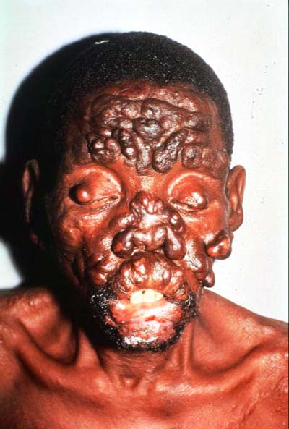
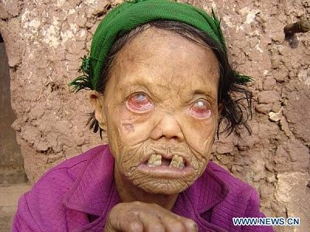
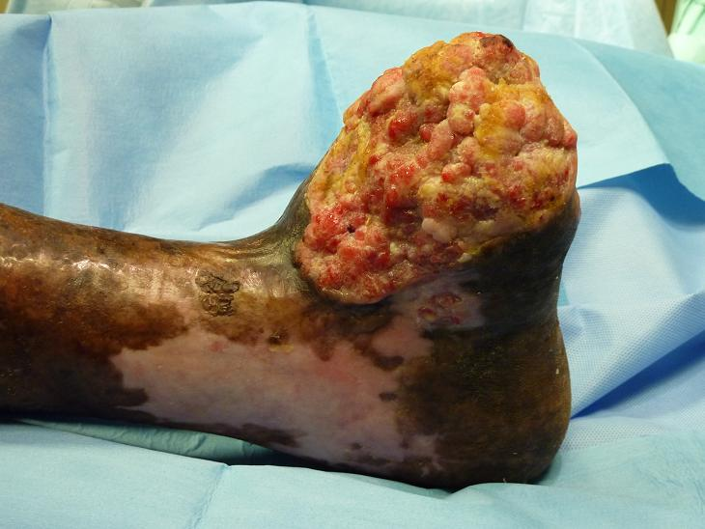
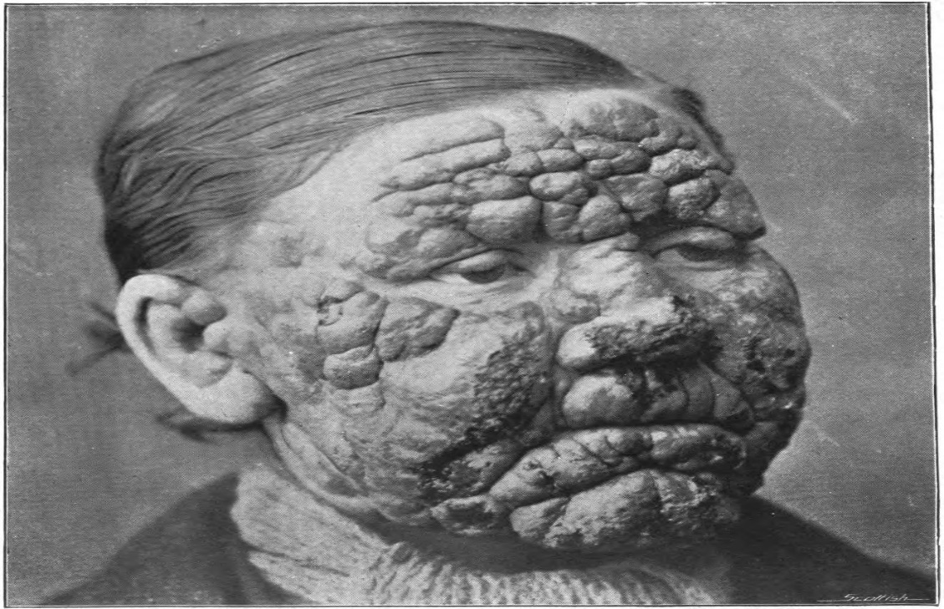
32 Now at evening, when the sun had set, they brought to Him all who were sick and those who were demon-possessed. 33 And the whole city was gathered together at the door.

Slide 36
41 And Jesus, moved with compassion, put out His hand and touched him, and said to him, "I am willing; be cleansed."

Slide 37
42 As soon as He had spoken, immediately the leprosy left him, and he was cleansed.

Slide 38
Leviticus 5:3
“Or if he touches human uncleanness-- whatever uncleanness with which a man may be defiled, and he is unaware of it-- when he realizes it, then he shall be guilty”

Slide 39
Numbers 5:1-3
1 And the LORD spoke to Moses, saying: 2 "Command the children of Israel that they put out of the camp every leper, everyone who has a discharge, and whoever becomes defiled by a corpse. 3 You shall put out both male and female; you shall put them outside the camp, that they may not defile their camps in the midst of which I dwell."

Slide 40
43 And He strictly warned him and sent him away at once, 44 and said to him, "See that you say nothing to anyone; but go your way, show yourself to the priest, and offer for your cleansing those things which Moses commanded, as a testimony to them."

Slide 41
“Don’t talk to anyone along the way.”

Slide 42
John 2:24-25
24 But Jesus did not commit Himself to them, because He knew all men, 25 and had no need that anyone should testify of man, for He knew what was in man.

Slide 43
45 But he went out and began to proclaim it freely, and to spread the matter, so that Jesus could no longer openly enter the city, but was outside in deserted places; and they came to Him from every quarter.

