Slide 1


Slide 2


Slide 3
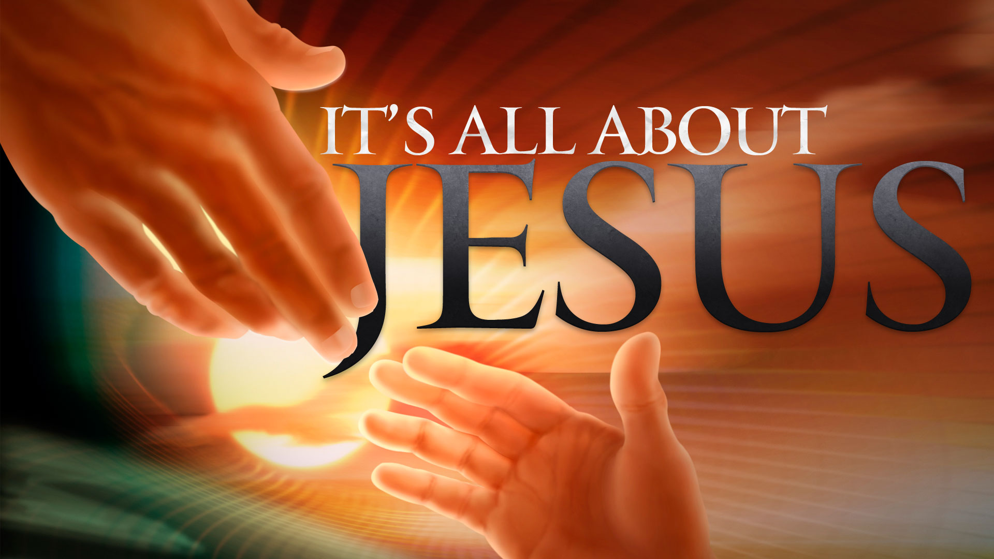

It’s About Relationship Not Ritual
by Pastor Fee Soliven
Mark 2:18-28
Wednesday Evening
September 5, 2018

Slide 4
18 The disciples of John and of the Pharisees were fasting. Then they came and said to Him, "Why do the disciples of John and of the Pharisees fast, but Your disciples do not fast?"

Slide 5
19 And Jesus said to them, "Can the friends of the bridegroom fast while the bridegroom is with them? As long as they have the bridegroom with them they cannot fast.

Slide 6
20 But the days will come when the bridegroom will be taken away from them, and then they will fast in those days.

Slide 7
21 No one sews a piece of unshrunk cloth on an old garment; or else the new piece pulls away from the old, and the tear is made worse.

Slide 8
22 And no one puts new wine into old wineskins; or else the new wine bursts the wineskins, the wine is spilled, and the wineskins are ruined. But new wine must be put into new wineskins."

Slide 9
23 Now it happened that He went through the grain-fields on the Sabbath; and as they went His disciples began to pluck the heads of grain. 24 And the Pharisees said to Him, "Look, why do they do what is not lawful on the Sabbath?"

Slide 10
25 But He said to them, "Have you never read what David did when he was in need and hungry, he and those with him: 26 how he went into the house of God in the days of Abiathar the high priest, and ate the showbread, which is not lawful to eat, except for the priests, and also gave some to those who were with him?"

Slide 11
27 And He said to them, "The Sabbath was made for man, and not man for the Sabbath.

Slide 12
28 Therefore the Son of Man is also Lord of the Sabbath."

Slide 13
18 The disciples of John and of the Pharisees were fasting. Then they came and said to Him, "Why do the disciples of John and of the Pharisees fast, but Your disciples do not fast?"

Slide 14
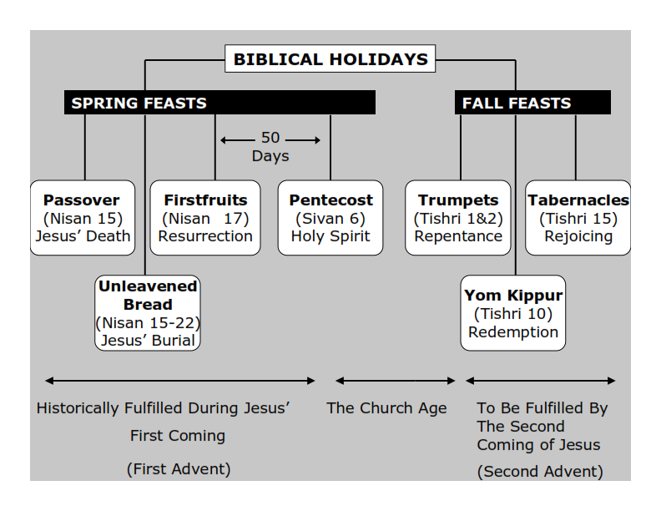
Philippians 3:20-21
20 For our citizenship is in heaven, from which we also eagerly wait for the Savior, the Lord Jesus Christ, 21 who will transform our lowly body that it may be conformed to His glorious body, according to the working by which He is able even to subdue all things to Himself.

Slide 15
Leviticus 16:29
"This shall be a statute forever for you: In the seventh month, on the tenth day of the month, you shall afflict your souls, and do no work at all, whether a native of your own country or a stranger who dwells among you.”

Slide 16
Luke 18:9-14
9 Also He spoke this parable to some who trusted in themselves that they were righteous, and despised others: 10 Two men went up to the temple to pray, one a Pharisee and the other a tax collector. 11 The Pharisee stood and prayed thus with himself, 'God, I thank You that I am not like other men--extortioners, unjust, adulterers, or even as this tax collector.

Slide 17
12 I fast twice a week; I give tithes of all that I possess.' 13 And the tax collector, standing afar off, would not so much as raise his eyes to heaven, but beat his breast, saying, 'God, be merciful to me a sinner!' 14 I tell you, this man went down to his house justified rather than the other; for everyone who exalts himself will be humbled, and he who humbles himself will be exalted."

Slide 18
19 And Jesus said to them, "Can the friends of the bridegroom fast while the bridegroom is with them? As long as they have the bridegroom with them they cannot fast.

Slide 19
Luke 4:1-2
1 Then Jesus, being filled with the Holy Spirit, returned from the Jordan and was led by the Spirit into the wilderness, 2 being tempted for forty days by the devil. And in those days He ate nothing, and afterward, when they had ended, He was hungry.

Slide 20
20 But the days will come when the bridegroom will be taken away from them, and then they will fast in those days.

Slide 21
Ephesians 5:25-27
25 Husbands, love your wives, just as Christ also loved the church and gave Himself for her, 26 that He might sanctify and cleanse her with the washing of water by the word, 27 that He might present her to Himself a glorious church, not having spot or wrinkle or any such thing, but that she should be holy and without blemish.

Slide 22
2 Corinthians 11:2
“For I am jealous for you with godly jealousy. For I have betrothed you to one husband, that I may present you as a chaste virgin to Christ.”

Slide 23
Revelation 19:7-9
7 Let us be glad and rejoice and give Him glory, for the marriage of the Lamb has come, and His wife has made herself ready." 8 And to her it was granted to be arrayed in fine linen, clean and bright, for the fine linen is the righteous acts of the saints. 9 Then he said to me, "Write: 'Blessed are those who are called to the marriage supper of the Lamb!' " And he said to me, "These are the true sayings of God."

Slide 24
21 No one sews a piece of unshrunk cloth on an old garment; or else the new piece pulls away from the old, and the tear is made worse.

Slide 25
2 Corinthians 5:17-18
17 Therefore, if anyone is in Christ, he is a new creation; old things have passed away; behold, all things have become new. 18 Now all things are of God, who has reconciled us to Himself through Jesus Christ, and has given us the ministry of reconciliation…

Slide 26
22 And no one puts new wine into old wineskins; or else the new wine bursts the wineskins, the wine is spilled, and the wineskins are ruined. But new wine must be put into new wineskins."

Slide 27
Romans 6:6-9
6 knowing this, that our old man was crucified with Him, that the body of sin might be done away with, that we should no longer be slaves of sin. 7 For he who has died has been freed from sin. 8 Now if we died with Christ, we believe that we shall also live with Him, 9 knowing that Christ, having been raised from the dead, dies no more. Death no longer has dominion over Him.

Slide 28
23 Now it happened that He went through the grain-fields on the Sabbath; and as they went His disciples began to pluck the heads of grain. 24 And the Pharisees said to Him, "Look, why do they do what is not lawful on the Sabbath?"

Slide 29
Matthew 12:9-14 (Living Bible Version)
9 Then he went over to the synagogue 10 and noticed there a man with a deformed hand. The Pharisees asked Jesus, "Is it legal to work by healing on the Sabbath day?" (They were, of course, hoping he would say yes, so they could arrest him!)

Slide 30
11 This was his answer: "If you had just one sheep, and it fell into a well on the Sabbath, would you work to rescue it that day? Of course you would. 12 And how much more valuable is a person than a sheep! Yes, it is right to do good on the Sabbath."

Slide 31
13 Then he said to the man, "Stretch out your arm." And as he did, his hand became normal, just like the other one! 14 Then the Pharisees called a meeting to plot Jesus' arrest and death.

Slide 32
25 But He said to them, "Have you never read what David did when he was in need and hungry, he and those with him: 26 how he went into the house of God in the days of Abiathar the high priest, and ate the showbread, which is not lawful to eat, except for the priests, and also gave some to those who were with him?"

Slide 33
1 Samuel 21:1-6
1 David went to the city of Nob to see Ahimelech, the priest. Ahimelech trembled when he saw him. "Why are you alone?" he asked. "Why is no one with you?" 2 "The king has sent me on a private matter," David lied. "He told me not to tell anybody why I am here. I have told my men where to meet me later.

Slide 34
3 Now, what is there to eat? Give me five loaves of bread or anything else you can." 4 "We don't have any regular bread," the priest replied, "but there is the holy bread, which I guess you can have if only your young men have not slept with any women for awhile."

Slide 35
5 "Rest assured," David replied. "I never let my men run wild when they are on an expedition, and since they stay clean even on ordinary trips, how much more so on this one!" 6 So, since there was no other food available, the priest gave him the holy bread-the Bread of the Presence that was placed before the Lord in the Tabernacle. It had just been replaced that day with fresh bread.

Slide 36
“If you condemn me, you must also condemn David.”

Slide 37
27 And He said to them, "The Sabbath was made for man, and not man for the Sabbath.

Slide 38
Genesis 2:1-3
1 Now at last the heavens and earth were successfully completed, with all that they contained. 2 So on the seventh day, having finished his task, God ceased from this work he had been doing, 3 and God blessed the seventh day and declared it holy, because it was the day when he ceased this work of creation.

Slide 39
28 Therefore the Son of Man is also Lord of the Sabbath."

Slide 40
Who created the Sabbath?

Slide 41
Colossians 2:16-17
16 So let no one judge you in food or in drink, or regarding a festival or a new moon or sabbaths, 17 which are a shadow of things to come, but the substance is of Christ.

