Slide 3
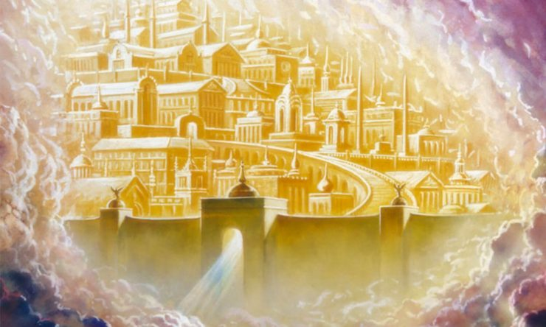
Jesus Thank You for my Treasures
By Pastor Fee Soliven
Matthew 5:10-12
Sunday Morning
September 30, 2018

Slide 4
Matthew 5:10-12
10 Blessed are those who are persecuted for righteousness' sake, For theirs is the kingdom of heaven. 11 "Blessed are you when they revile and persecute you, and say all kinds of evil against you falsely for My sake. 12 Rejoice and be exceedingly glad, for great is your reward in heaven, for so they persecuted the prophets who were before you.

Slide 5
What Difference Does a Future Heaven Make in My Life Today?

Slide 6
Colossians 3:1–2
1 Keep seeking the things above, where Christ is, seated at the right hand of God. 2 Set your mind on the things above, not on the things that are on earth.

Slide 7
“Place called Heaven.”

Slide 8
The Bible never belittles human disappointment . . . but it does add one key word: temporary. What we feel now, we will not always feel. Our disappointment is itself a sign, an aching, a hunger for something better. And faith is, in the end, a kind of homesickness—for a home we have never visited but have never once stopped longing for.

Slide 9
John 14:2-3
2 In My Father's house are many mansions; if it were not so, I would have told you. I go to prepare a place for you. 3 And if I go and prepare a place for you, I will come again and receive you to Myself; that where I am, there you may be also.

Slide 10
The Inevitability of Death

Slide 11
“One out of every One Dies.”

Slide 12
Hebrews 9:27-28
27 And as it is appointed for men to die once, but after this the judgment, 28 so Christ was offered once to bear the sins of many. To those who eagerly wait for Him He will appear a second time, apart from sin, for salvation.

Slide 13
Ecclesiastes 9:12
“For man also does not know his time: Like fish taken in a cruel net, Like birds caught in a snare, So the sons of men are snared in an evil time, When it falls suddenly upon them.”

Slide 14
Genesis 27:2
“I am old and I do not know the day of my death”

Slide 15
Luke 12:16-21
16 Then He spoke a parable to them, saying: "The ground of a certain rich man yielded plentifully. 17 And he thought within himself, saying, 'What shall I do, since I have no room to store my crops?' 18 So he said, 'I will do this: I will pull down my barns and build greater, and there I will store all my crops and my goods.

Slide 16
19 And I will say to my soul, "Soul, you have many goods laid up for many years; take your ease; eat, drink, and be merry." ' 20 But God said to him, 'Fool! This night your soul will be required of you; then whose will those things be which you have provided?' 21 So is he who lays up treasure for himself, and is not rich toward God."

Slide 17
The Benefits of Being
“Heavenly Minded”

Slide 18
1. Focusing on Heaven Reminds Us of the Brevity of Our Earthly Life

Slide 19
.___________>
Life on Earth ----- Eternity

Slide 20
James 4:13-15
13 Come now, you who say, "Today or tomorrow we will go to such and such a city, spend a year there, buy and sell, and make a profit"; 14 whereas you do not know what will happen tomorrow. For what is your life? It is even a vapor that appears for a little time and then vanishes away.

Slide 21
1 Peter 1:24
because "All flesh is as grass, And all the glory of man as the flower of the grass. The grass withers, And its flower falls away,

Slide 22
2. Focusing on Heaven Prepares Us for the Certainty of Judgment

Slide 23
“Everybody Is Going to Heaven” may be a popular song but it’s also a horrendous lie.

Slide 24
Matthew 7:13-14
13 "Enter by the narrow gate; for wide is the gate and broad is the way that leads to destruction, and there are many who go in by it. 14 Because narrow is the gate and difficult is the way which leads to life, and there are few who find it.

Slide 25
Isaiah 53:6
“All we like sheep have gone astray; We have turned, every one, to his own way; And the LORD has laid on Him the iniquity of us all.”

Slide 26
John 14:6
Jesus said to him, "I am the way, the truth, and the life. No one comes to the Father except through Me.”

Slide 27
Revelation 20:11-15
11 Then I saw a great white throne and Him who sat on it, from whose face the earth and the heaven fled away. And there was found no place for them.

Slide 28
12 And I saw the dead, small and great, standing before God, and books were opened. And another book was opened, which is the Book of Life. And the dead were judged according to their works, by the things which were written in the books. 13 The sea gave up the dead who were in it, and Death and Hades delivered up the dead who were in them. And they were judged, each one according to his works.

Slide 29
14 Then Death and Hades were cast into the lake of fire. This is the second death. 15 And anyone not found written in the Book of Life was cast into the lake of fire.

Slide 30
2 Corinthians 5:10-11
10 For we must all appear before the judgment seat of Christ, that each one may receive the things done in the body, according to what he has done, whether good or bad. 11 Knowing, therefore, the terror of the Lord, we persuade men; but we are well known to God, and I also trust are well known in your consciences.

Slide 31
3. Focusing on Heaven Motivates Us to Live Pure Lives

Slide 32
1 Corinthians 3:13
“each one's work will become clear; for the Day will declare it, because it will be revealed by fire; and the fire will test each one's work, of what sort it is.”

Slide 33
4. Our Heavenly Rewards

Slide 34
1. The Imperishable Crown

Slide 35
1 Corinthians 9:24-25
24 “Do you not know that those who run in a race all run, but one receives the prize? Run in such a way that you may obtain it. 25 And everyone who competes for the prize is temperate [disciplined] in all things. Now they do it to obtain a perishable crown, but we for an imperishable crown”

Slide 36
Matthew 6:19
“where moth and rust destroy, and where thieves break in and steal”

Slide 37
2. The Crown of Rejoicing

Slide 38
1 Thessalonians 2:19
“For what is our hope, or joy, or crown of rejoicing? Is it not even you in the presence of our Lord Jesus Christ at His coming?”

Slide 39
Philippians 4:4
“rejoice always in the Lord” for all the bountiful blessings our gracious God has showered upon us.”

Slide 40
3. The Crown of Righteousness

Slide 41
2 Timothy 4:8
“Finally, there is laid up for me the crown of righteousness, which the Lord, the righteous Judge, will give to me on that Day, and not to me only but also to all who have loved His appearing.”

Slide 42
4. The Crown of Glory

Slide 43
1 Peter 5:4
“And when the Chief Shepherd appears, you will receive the crown of glory that does not fade away.”

Slide 44
Acts 7:55-56
55 But he, being full of the Holy Spirit, gazed into heaven and saw the glory of God, and Jesus standing at the right hand of God, 56 and said, "Look! I see the heavens opened and the Son of Man standing at the right hand of God!"

Slide 45
5. The Crown of Life

Slide 46
Revelation 2:10
“Do not fear any of those things which you are about to suffer. Indeed, the devil is about to throw some of you into prison, that you may be tested, and you will have tribulation ten days. Be faithful until death, and I will give you the crown of life.”

Slide 47
John 10:10
“I have come that they may have life and that they may have it more abundantly”

Slide 48
Key to Receiving your rewards

Slide 49
1 Corinthians 3:5-15
5 Who then is Paul, and who is Apollos, but ministers through whom you believed, as the Lord gave to each one? 6 I planted, Apollos watered, but God gave the increase. 7 So then neither he who plants is anything, nor he who waters, but God who gives the increase.

Slide 50
8 Now he who plants and he who waters are one, and each one will receive his own reward according to his own labor. 9 For we are God's fellow workers; you are God's field, you are God's building. 10 According to the grace of God which was given to me, as a wise master builder I have laid the foundation, and another builds on it. But let each one take heed how he builds on it.

Slide 51
11 For no other foundation can anyone lay than that which is laid, which is Jesus Christ. 12 Now if anyone builds on this foundation with gold, silver, precious stones, wood, hay, straw, 13 each one's work will become clear; for the Day will declare it, because it will be revealed by fire; and the fire will test each one's work, of what sort it is.

Slide 52
14 If anyone's work which he has built on it endures, he will receive a reward. 15 If anyone's work is burned, he will suffer loss; but he himself will be saved, yet so as through fire.

Slide 53
1. Is it your desire to see Jesus face to face?

Slide 54
2. When Jesus comes back will you have a heart of rejoicing to see Him or will you be ashamed of His appearing?

Slide 55
3. Have you stored up treasure in heaven that will last forever?

Slide 56
4. Is your treasure Gold, Silver, Bronze or Hay, Wood and Stubble?

