Slide 1


Slide 2


Slide 3
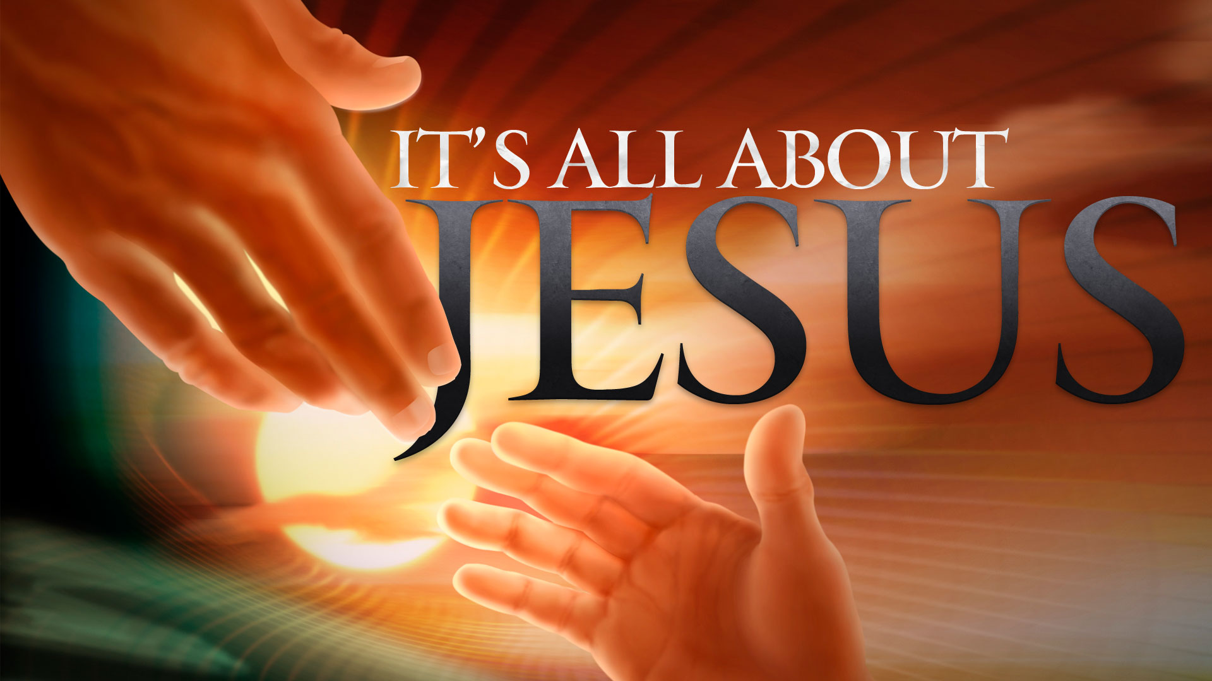

The Enemies of Jesus
by Pastor Fee Soliven
Mark 3:1-12
Wednesday Evening
September 12, 2018

Slide 4
1 And He entered the synagogue again, and a man was there who had a withered hand. 2 So they watched Him closely, whether He would heal him on the Sabbath, so that they might accuse Him.

Slide 5
3 And He said to the man who had the withered hand, "Step forward."

Slide 6
4 Then He said to them, "Is it lawful on the Sabbath to do good or to do evil, to save life or to kill?" But they kept silent.

Slide 7
5 And when He had looked around at them with anger, being grieved by the hardness of their hearts, He said to the man, "Stretch out your hand." And he stretched it out, and his hand was restored as whole as the other.

Slide 8
6 Then the Pharisees went out and immediately plotted with the Herodians against Him, how they might destroy Him.

Slide 9
7 But Jesus withdrew with His disciples to the sea. And a great multitude from Galilee followed Him, and from Judea
8 and Jerusalem and Idumea and beyond the Jordan; and those from Tyre and Sidon, a great multitude, when they heard how many things He was doing, came to Him.

Slide 10
9 So He told His disciples that a small boat should be kept ready for Him because of the multitude, lest they should crush Him. 10 For He healed many, so that as many as had afflictions pressed about Him to touch Him.

Slide 11
11 And the unclean spirits, whenever they saw Him, fell down before Him and cried out, saying, "You are the Son of God." 12 But He sternly warned them that they should not make Him known.

Slide 12
1 And He entered the synagogue again, and a man was there who had a withered hand. 2 So they watched Him closely, whether He would heal him on the Sabbath, so that they might accuse Him.

Slide 13
Luke 6:6
“Now it happened on another Sabbath, also, that He entered the synagogue and taught. And a man was there whose right hand was withered.”

Slide 14
Philippians 3:17-20
17 Brethren, join in following my example, and note those who so walk, as you have us for a pattern. 18 For many walk, of whom I have told you often, and now tell you even weeping, that they are the enemies of the cross of Christ: 19 whose end is destruction, whose god is their belly, and whose glory is in their shame--who set their mind on earthly things.

Slide 15
Romans 5:10-11
10 For if when we were enemies we were reconciled to God through the death of His Son, much more, having been reconciled, we shall be saved by His life. 11 And not only that, but we also rejoice in God through our Lord Jesus Christ, through whom we have now received the reconciliation.

Slide 16
Exodus 31:14
14 You shall keep the Sabbath, therefore, for it is holy to you. Everyone who profanes it shall surely be put to death; for whoever does any work on it, that person shall be cut off from among his peoples.

Slide 17
3 And He said to the man who had the withered hand, "Step forward."

Slide 18
4 Then He said to them, "Is it lawful on the Sabbath to do good or to do evil, to save life or to kill?" But they kept silent.

Slide 19
“Is it legal to do good deeds on the Sabbath, or is it a day for doing harm?”

Slide 20
Matthew 12:10-14
10 And behold, there was a man who had a withered hand. And they asked Him, saying, "Is it lawful to heal on the Sabbath?"--that they might accuse Him. 11 Then He said to them, "What man is there among you who has one sheep, and if it falls into a pit on the Sabbath, will not lay hold of it and lift it out?

Slide 21
12 Of how much more value then is a man than a sheep? Therefore it is lawful to do good on the Sabbath." 13 Then He said to the man, "Stretch out your hand." And he stretched it out, and it was restored as whole as the other. 14 Then the Pharisees went out and plotted against Him, how they might destroy Him.

Slide 22
Exodus 31:14
“You shall keep the Sabbath, therefore, for it is holy to you. Everyone who profanes it shall surely be put to death; for whoever does any work on it, that person shall be cut off from among his people.”

Slide 23
5 And when He had looked around at them with anger, being grieved by the hardness of their hearts, He said to the man, "Stretch out your hand." And he stretched it out, and his hand was restored as whole as the other.

Slide 24
2 Corinthians 4:3-4
3 But even if our gospel is veiled, it is veiled to those who are perishing, 4 whose minds the god of this age has blinded, who do not believe, lest the light of the gospel of the glory of Christ, who is the image of God, should shine on them.

Slide 25
6 Then the Pharisees went out and immediately plotted with the Herodians against Him, how they might destroy Him.

Slide 26
1. You shall have no other gods before Me.
2. You shall make no idols.
3. You shall not take the name of the Lord your God in vain.
4. Keep the Sabbath day holy.
5. Honor your father and your mother.
6. You shall not murder.
7. You shall not commit adultery.
8. You shall not steal.
9. You shall not bear false witness against your neighbor.
10. You shall not covet.

Slide 27
7 But Jesus withdrew with His disciples to the sea. And a great multitude from Galilee followed Him, and from Judea
8 and Jerusalem and Idumea and beyond the Jordan; and those from Tyre and Sidon, a great multitude, when they heard how many things He was doing, came to Him.

Slide 28
9 So He told His disciples that a small boat should be kept ready for Him because of the multitude, lest they should crush Him. 10 For He healed many, so that as many as had afflictions pressed about Him to touch Him.

Slide 29
John 21:24-25
24 This is the disciple who testifies of these things, and wrote these things; and we know that his testimony is true. 25 And there are also many other things that Jesus did, which if they were written one by one, I suppose that even the world itself could not contain the books that would be written. Amen.

Slide 30
11 And the unclean spirits, whenever they saw Him, fell down before Him and cried out, saying, "You are the Son of God." 12 But He sternly warned them that they should not make Him known.

Slide 31
“You are the Son of God!”

Slide 32
James 2:19
“You believe that there is one God. You do well. Even the demons believe--and tremble”

