Slide 1
“For the Joy of the Lord is your Strength”
Nehemiah 8:10

Slide 3
The Feast of Tabernacles
by Pastor Fee Soliven
Revelation 21:1-5
Sunday Morning
September 23, 2018

Slide 4
Revelation 21:1-5
1 Now I saw a new heaven and a new earth, for the first heaven and the first earth had passed away. Also there was no more sea. 2 Then I, John, saw the holy city, New Jerusalem, coming down out of heaven from God, prepared as a bride adorned for her husband.

Slide 5
3 And I heard a loud voice from heaven saying, "Behold, the tabernacle of God is with men, and He will dwell with them, and they shall be His people. God Himself will be with them and be their God. 4 And God will wipe away every tear from their eyes; there shall be no more death, nor sorrow, nor crying. There shall be no more pain, for the former things have passed away."

Slide 6
Zechariah 12:10-11
10 "And I will pour on the house of David and on the inhabitants of Jerusalem the Spirit of grace and supplication; then they will look on Me whom they have pierced; they will mourn for Him as one mourns for his only son, and grieve for Him as one grieves for a firstborn. 11 In that day there shall be a great mourning in Jerusalem, like the mourning at Hadad Rimmon in the plain of Megiddo.

Slide 7
Revelation 1:4-8
4 John, to the seven churches which are in Asia: Grace to you and peace from Him who is and who was and who is to come, and from the seven Spirits who are before His throne, 5 and from Jesus Christ, the faithful witness, the firstborn from the dead, and the ruler over the kings of the earth. To Him who loved us and washed us from our sins in His own blood,

Slide 8
6 and has made us kings and priests to His God and Father, to Him be glory and dominion forever and ever. Amen. 7 Behold, He is coming with clouds, and every eye will see Him, even they who pierced Him. And all the tribes of the earth will mourn because of Him. Even so, Amen. 8 I am the Alpha and the Omega, the Beginning and the End," says the Lord, "who is and who was and who is to come, the Almighty."

Slide 9
Leviticus 23:2
And the LORD spoke to Moses, saying, Speak to the children of Israel, and say to them, Concerning the Feasts of the LORD, which you shall proclaim to be holy convocations, even these are my feasts.

Slide 10
The Hebrew word for Feasts is also MOED meaning appointed times.
The Hebrew word for convocation is MIQRA meaning a dress rehearsal.

Slide 11
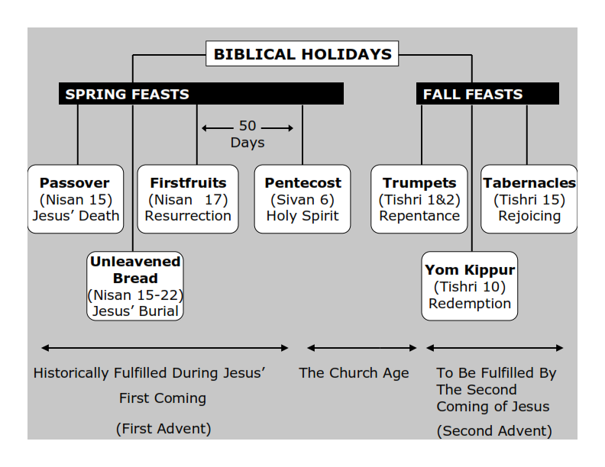
Psalm 139:16 (Amplified Bible)
Your eyes saw my unformed substance, and in Your book all the days [of my life] were written before ever they took shape, when as yet there was none of them.

Slide 12
Feast of Trumpets :
REPENTANCE
Feast of Yom Kippur: REDEMPTION
Feast of Tabernacles: REJOICING

Slide 13
Leviticus 23:39-43
39'Also on the fifteenth day of the seventh month, when you have gathered in the fruit of the land, you shall keep the feast of the LORD for seven days; on the first day there shall be a sabbath-rest, and on the eighth day a sabbath-rest. 40 And you shall take for yourselves on the first day the fruit of beautiful trees, branches of palm trees, the boughs of leafy trees, and willows of the brook; and you shall rejoice before the LORD your God for seven days.

Slide 14
41 You shall keep it as a feast to the LORD for seven days in the year. It shall be a statute forever in your generations. You shall celebrate it in the seventh month. 42 You shall dwell in booths for seven days. All who are native Israelites shall dwell in booths, 43 that your generations may know that I made the children of Israel dwell in booths when I brought them out of the land of Egypt: I am the LORD your God.' "

Slide 15
The Origin of Sukkot

Slide 16
Sukkot hearkens back to times in ancient Israel when Jews would build huts near the edges of their fields during the harvest season. One of these dwellings was called a "sukkah" and "sukkot" is the plural form of this Hebrew word.

Slide 17
These dwellings not only provided shade but allowed the workers to maximize the amount of time they spent in the fields, harvesting their food more quickly as a result.

Slide 18
Sukkot is also related to the way the Jewish people lived while wandering in the desert for 40 years (Leviticus 23:42-43). As they moved from one place to another they built tents or booths, called sukkot, that gave them temporary shelter in the desert.

Slide 19
Hence, the sukkot (booths) that Jews build during the holiday of Sukkot are reminders both of Israel's agricultural history and of the Israelite exodus from Egypt.

Slide 20
Genesis 3:6-8
6 So when the woman saw that the tree was good for food, that it was pleasant to the eyes, and a tree desirable to make one wise, she took of its fruit and ate. She also gave to her husband with her, and he ate.

Slide 21
7 Then the eyes of both of them were opened, and they knew that they were naked; and they sewed fig leaves together and made themselves coverings. 8 And they heard the sound of the LORD God walking in the garden in the cool of the day, and Adam and his wife hid themselves from the presence of the LORD God among the trees of the garden.

Slide 22
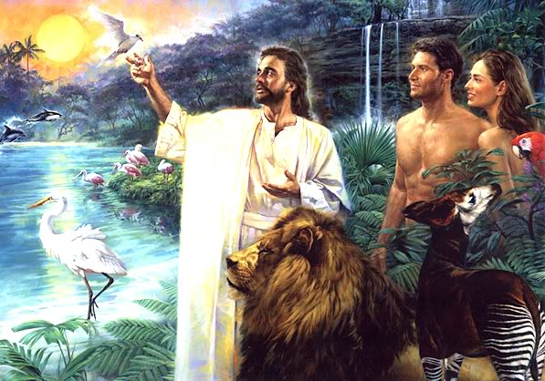
cloud of incense may cover the mercy seat that is on the Testimony, lest he die. 14 He shall take some of the blood of the bull and sprinkle it with his finger on the mercy seat on the east side; and before the mercy seat he shall sprinkle some of the blood with his finger seven times.

Slide 23
Exodus 25:8-9
8 And let them make Me a sanctuary, that I may dwell among them. 9 According to all that I show you, that is, the pattern of the tabernacle and the pattern of all its furnishings, just so you shall make it.

Slide 24
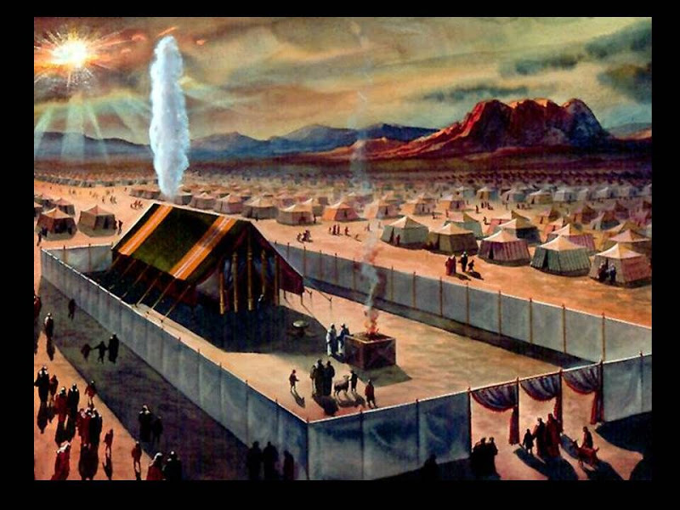
Place, because of the uncleanness of the children of Israel, and because of their transgressions, for all their sins; and so he shall do for the tabernacle of meeting which remains among them in the midst of their uncleanness.

Slide 25
John 1:14-15
14 And the Word became flesh and dwelt among us, and we beheld His glory, the glory as of the only begotten of the Father, full of grace and truth.

Slide 26
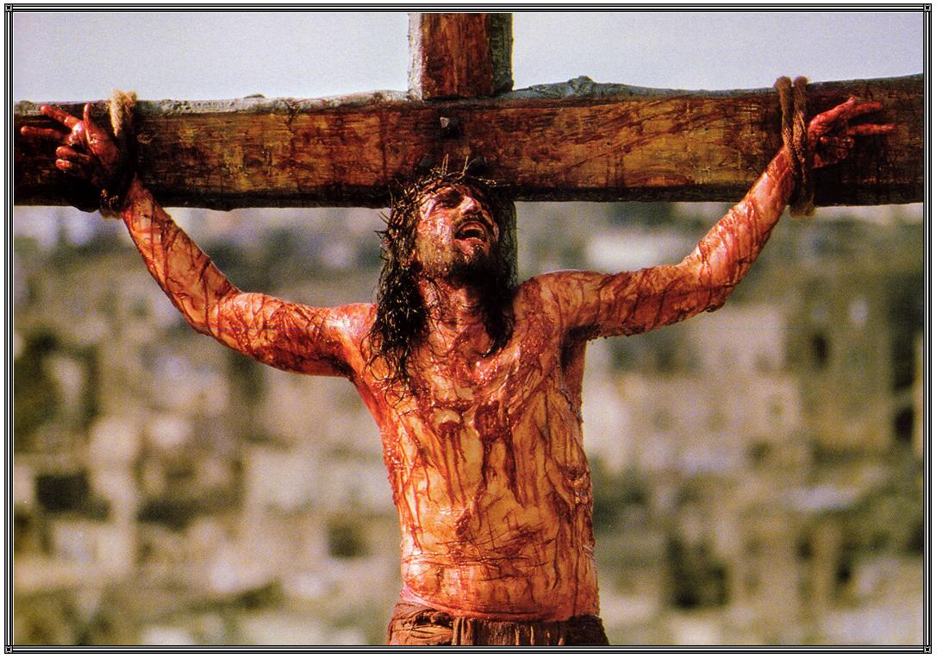
4 And the smoke of the incense, with the prayers of the saints, ascended before God from the angel's hand. 5 Then the angel took the censer, filled it with fire from the altar, and threw it to the earth. And there were noises, thunderings, lightnings, and an earthquake.

Slide 27
Revelation 21:3
"And I heard a loud voice from heaven saying, "Behold, the tabernacle of God is with men, and He will dwell with them, and they shall be His people. God Himself will be with them and be their God"

Slide 28
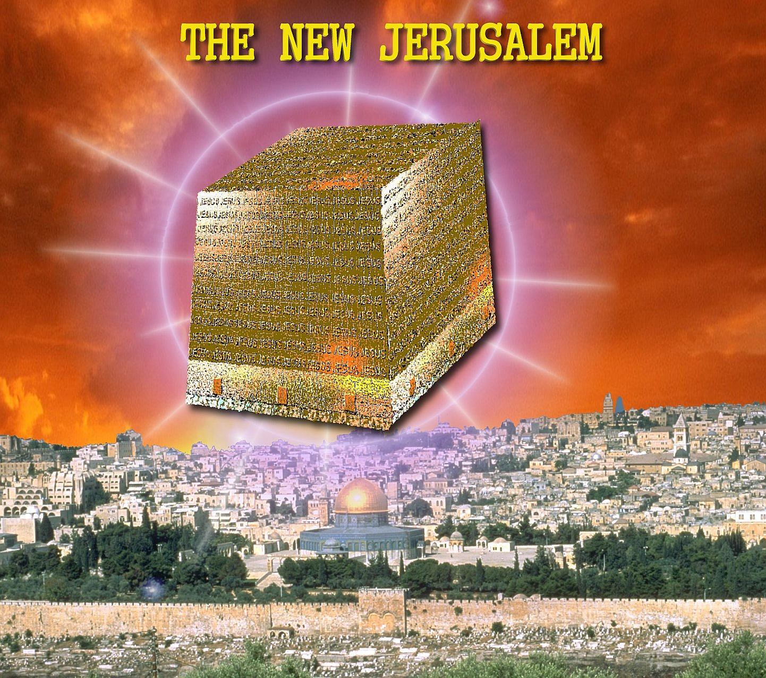
Revelation 6:9-11
9 When He opened the fifth seal, I saw under the altar the souls of those who had been slain for the word of God and for the testimony which they held. 10 And they cried with a loud voice, saying, "How long, O Lord, holy and true, until

Slide 29
Zechariah 14:4
And in that day His feet will stand on the Mount of Olives, Which faces Jerusalem on the east. And the Mount of Olives shall be split in two, From east to west, Making a very large valley; Half of the mountain shall move toward the north And half of it toward the south.

Slide 30
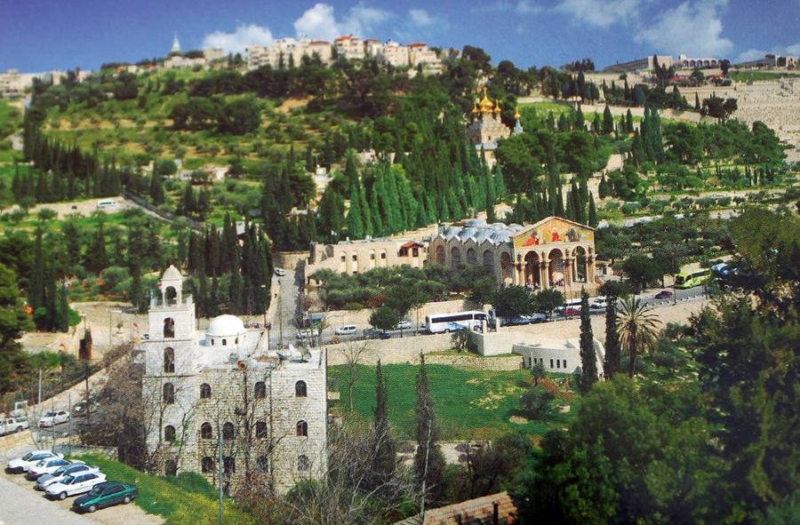
Isaiah 63:1-4
(New Living Translation)
1 Who is this who comes from Edom, from the city of Bozrah, with his clothing stained red? Who is this in royal robes, marching in his great strength? “It is I, the Lord, announcing your salvation! It is I, the Lord, who has the power to save

Slide 31
Zechariah 14:16
And it shall come to pass that everyone who is left of all the nations which came against Jerusalem shall go up from year to year to worship the King, the LORD of hosts, and to keep the Feast of Tabernacles.

Slide 32
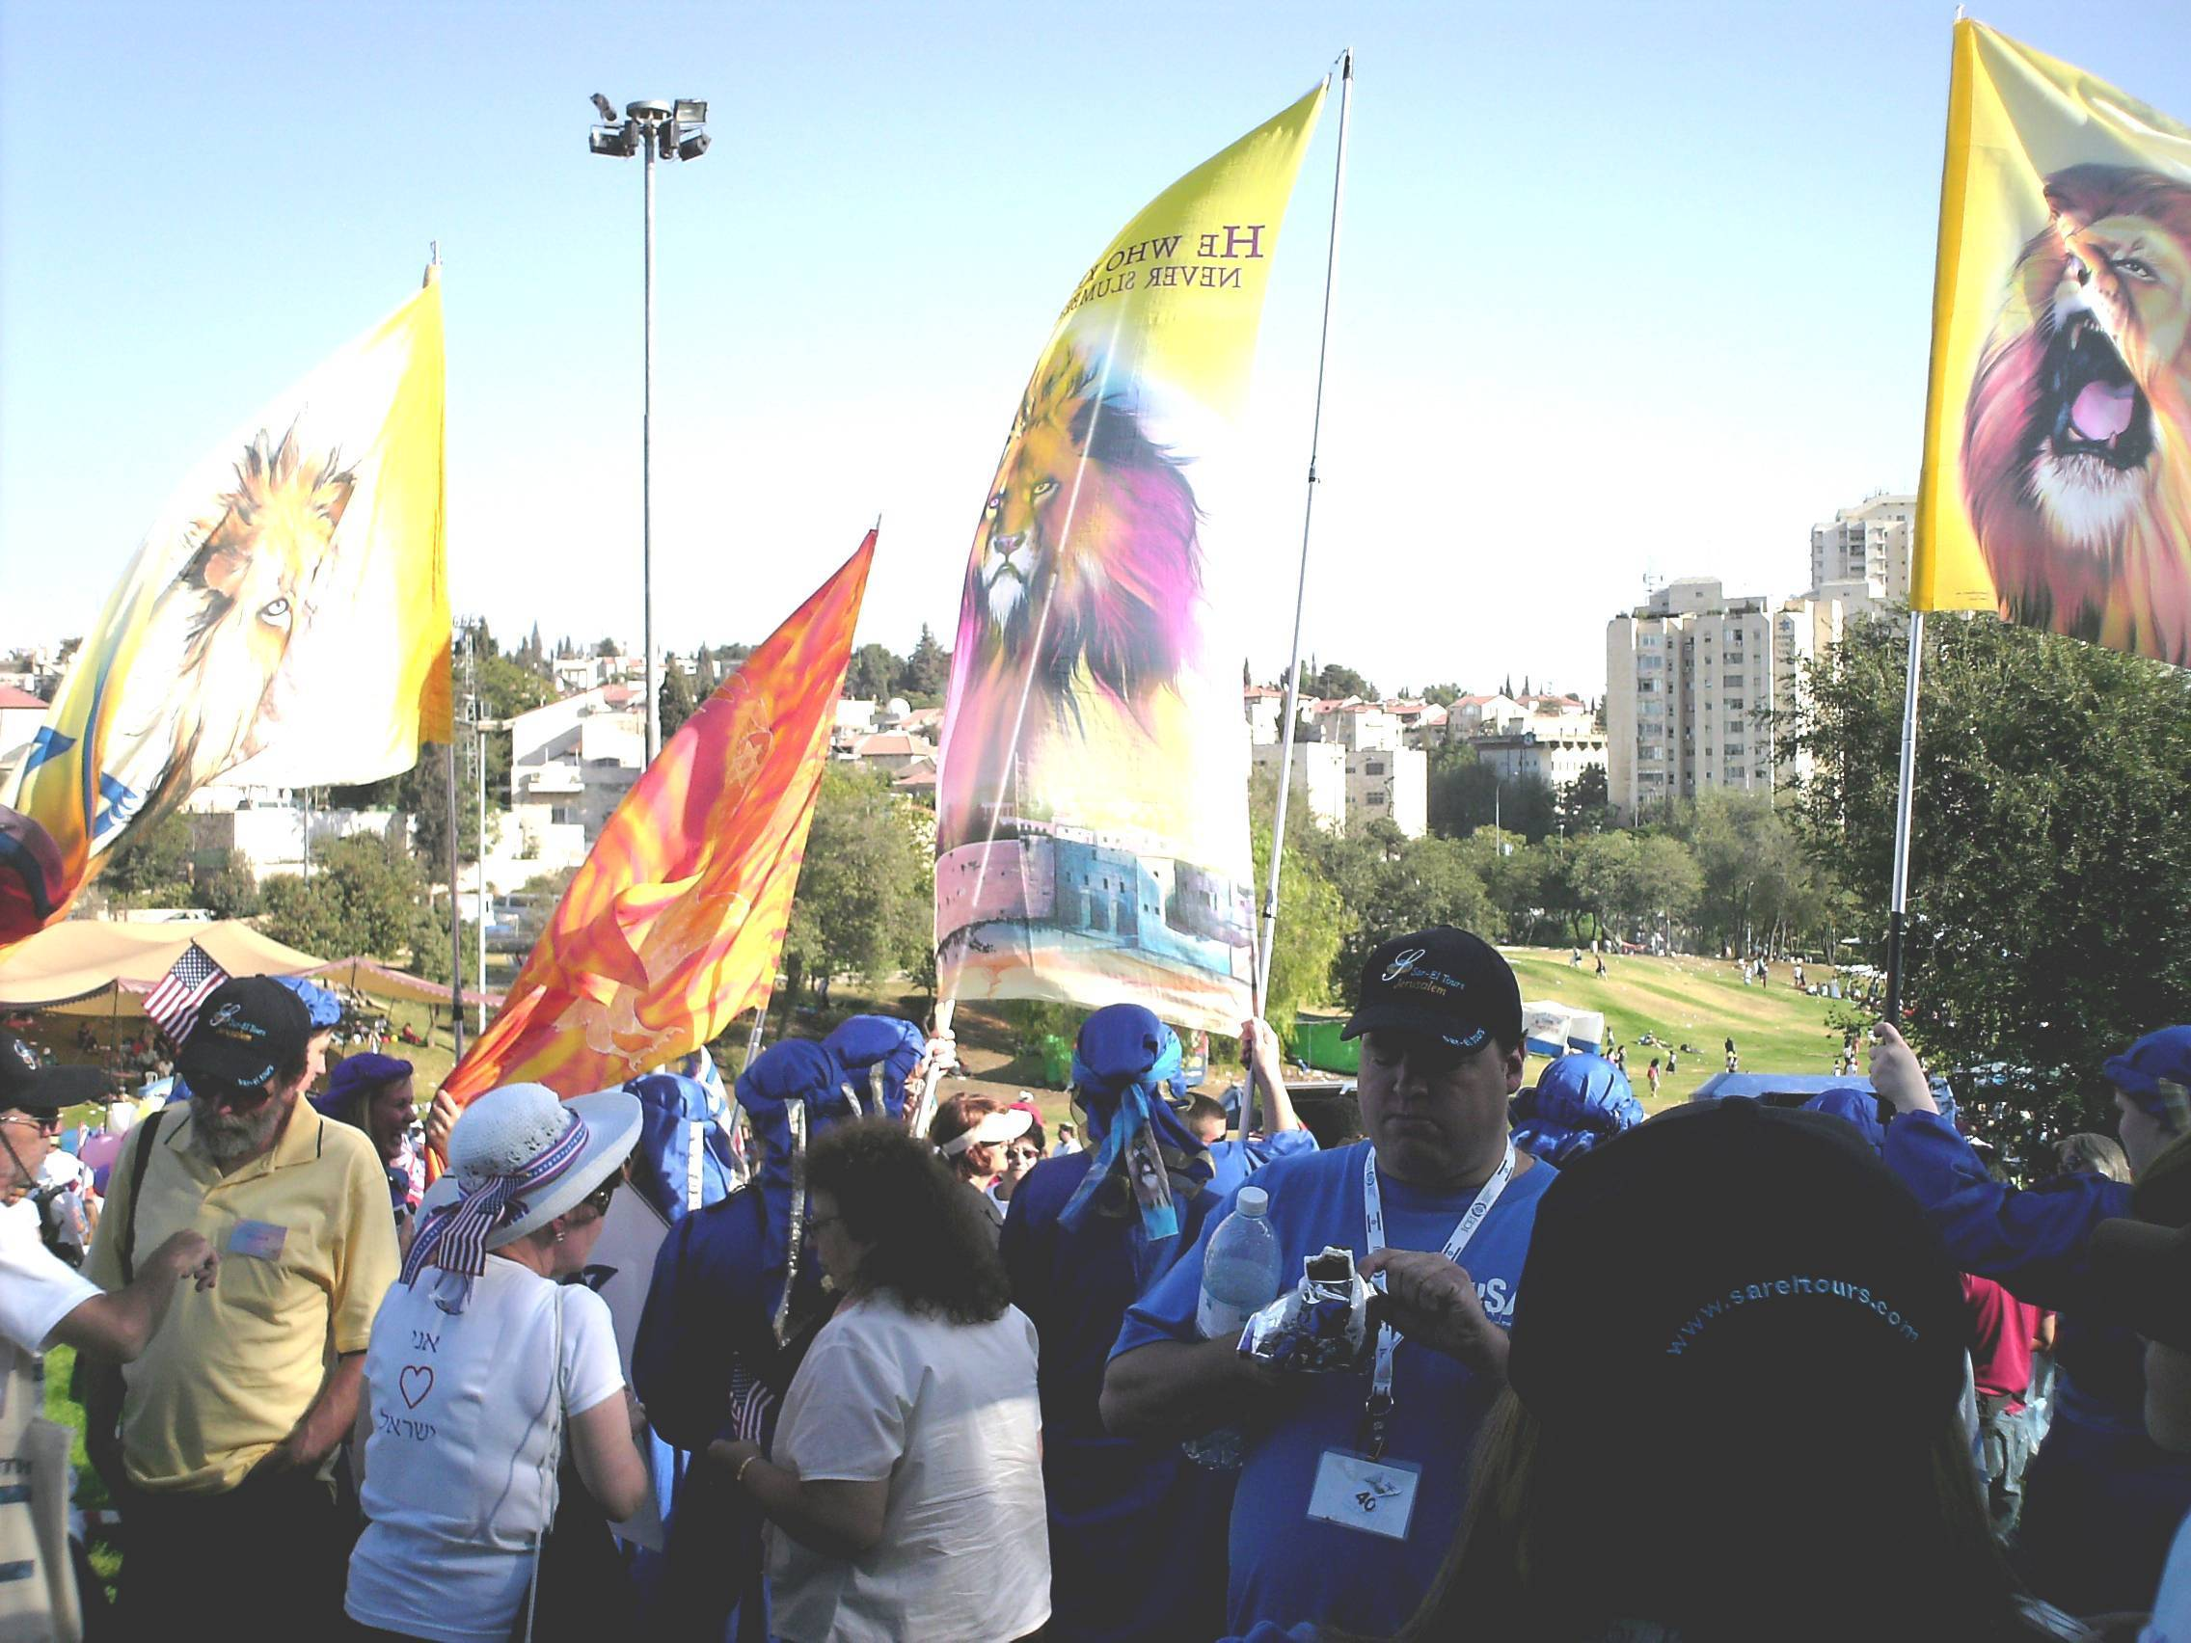
Isaiah 63:1-4
(New Living Translation)
1 Who is this who comes from Edom, from the city of Bozrah, with his clothing stained red? Who is this in royal robes, marching in his great strength? “It is I, the Lord, announcing your salvation! It is I, the Lord, who has the power to save

Slide 33
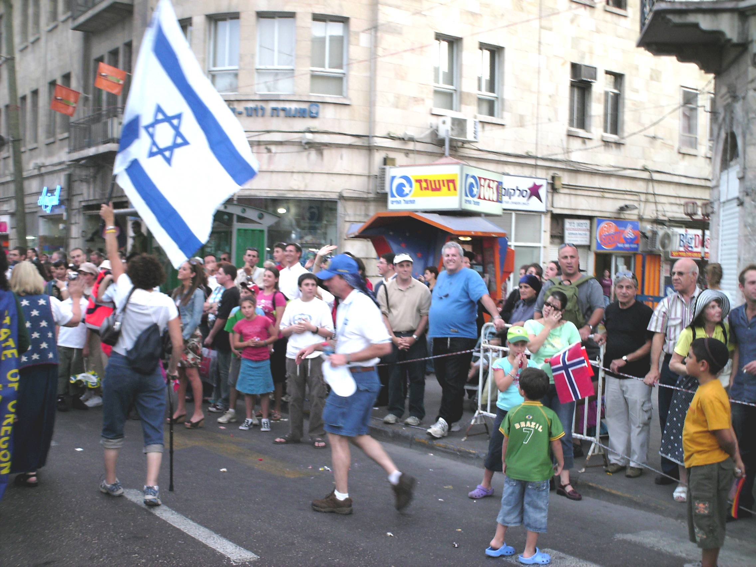
Isaiah 63:1-4
(New Living Translation)
1 Who is this who comes from Edom, from the city of Bozrah, with his clothing stained red? Who is this in royal robes, marching in his great strength? “It is I, the Lord, announcing your salvation! It is I, the Lord, who has the power to save

Slide 34
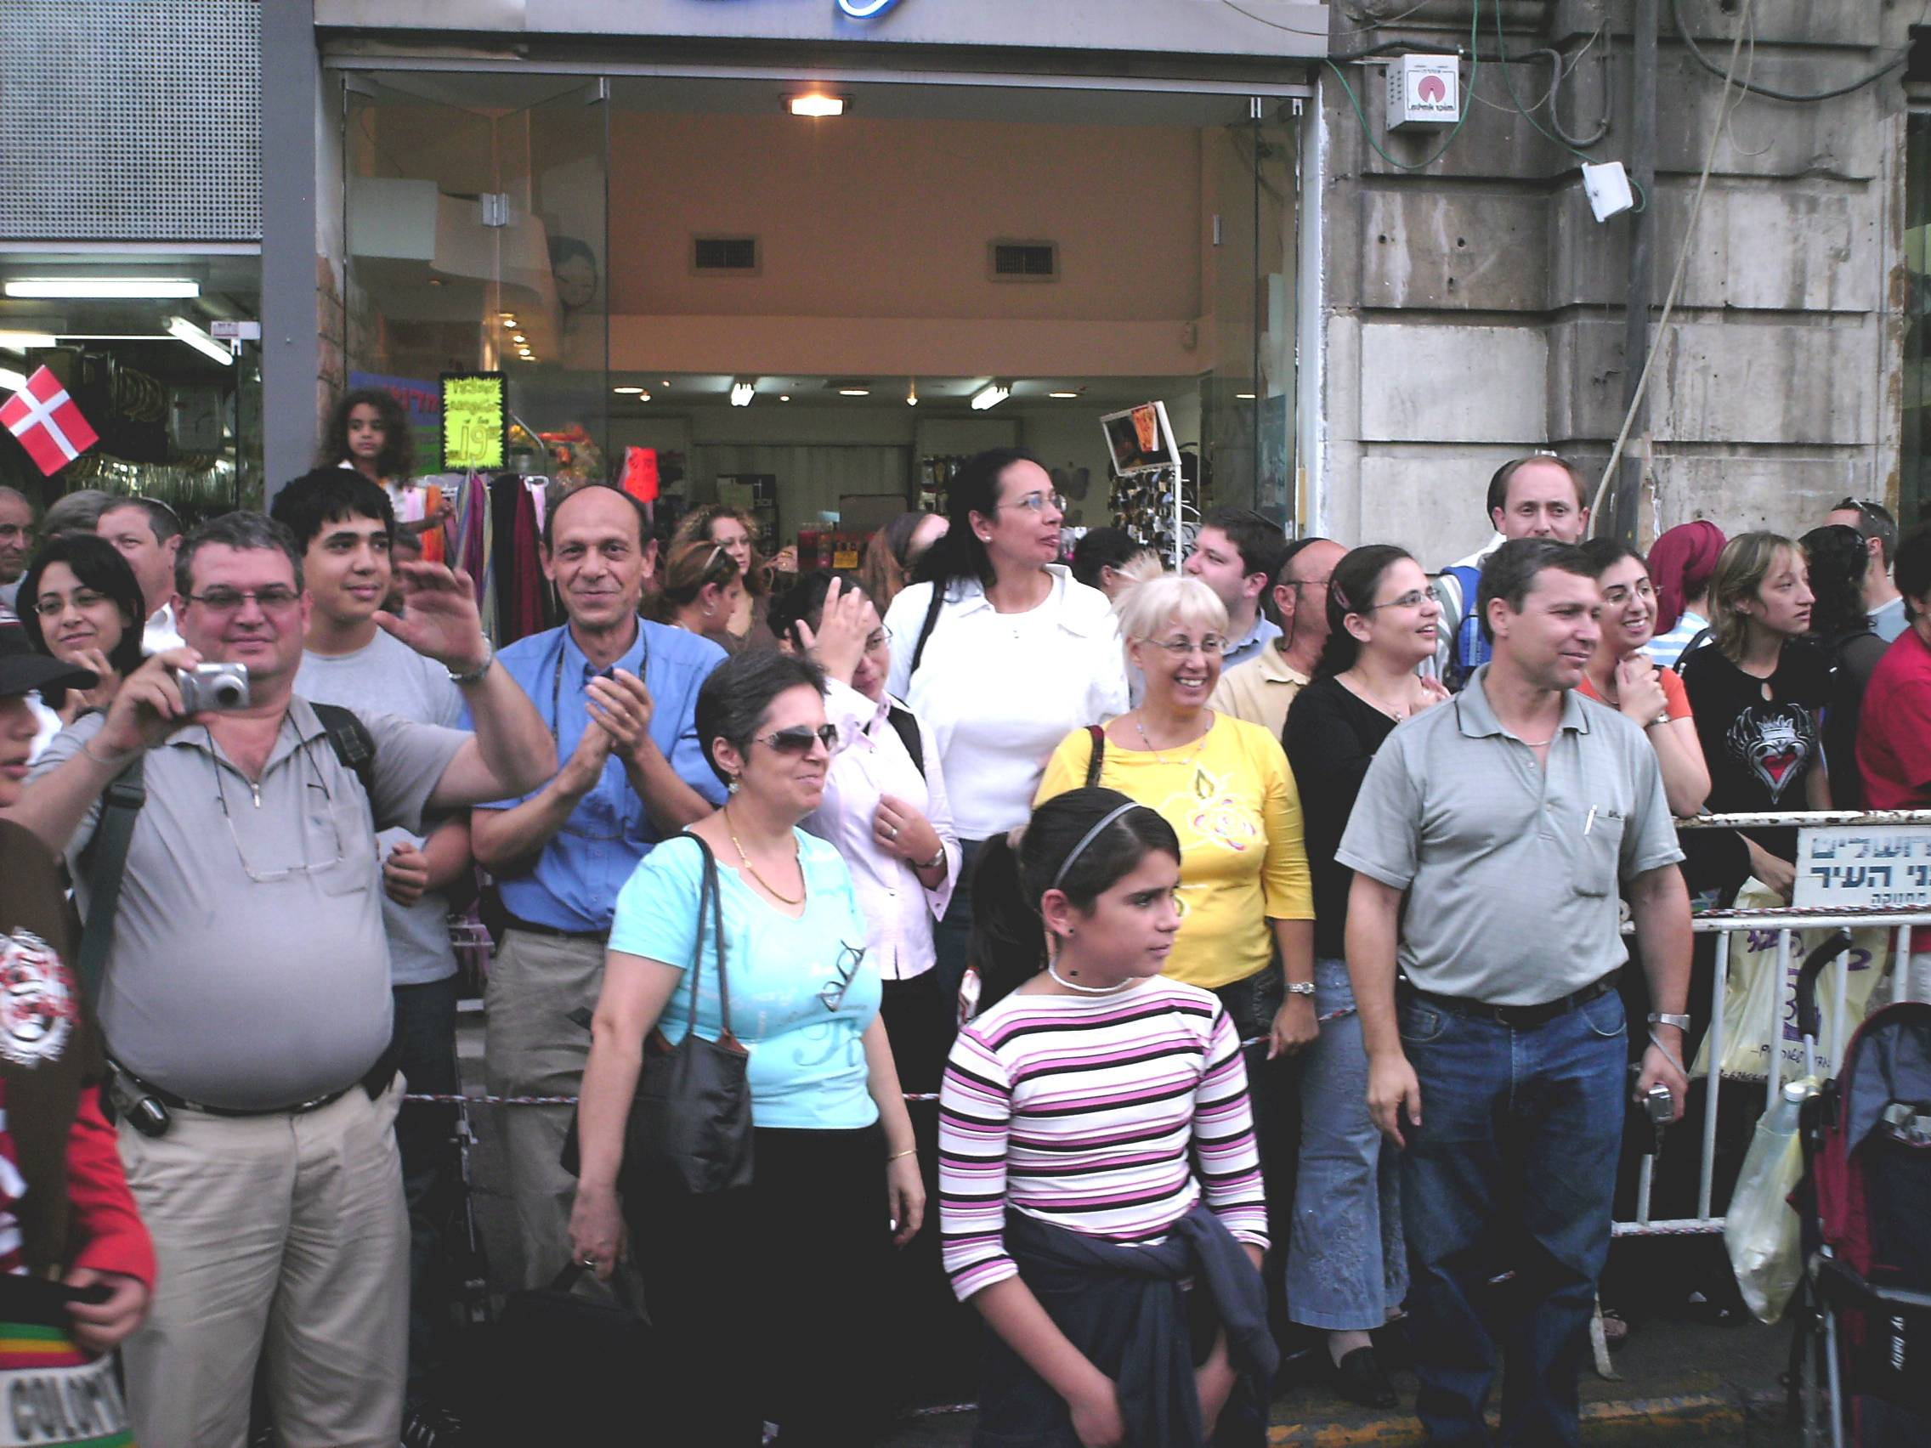
Isaiah 63:1-4
(New Living Translation)
1 Who is this who comes from Edom, from the city of Bozrah, with his clothing stained red? Who is this in royal robes, marching in his great strength? “It is I, the Lord, announcing your salvation! It is I, the Lord, who has the power to save

Slide 35
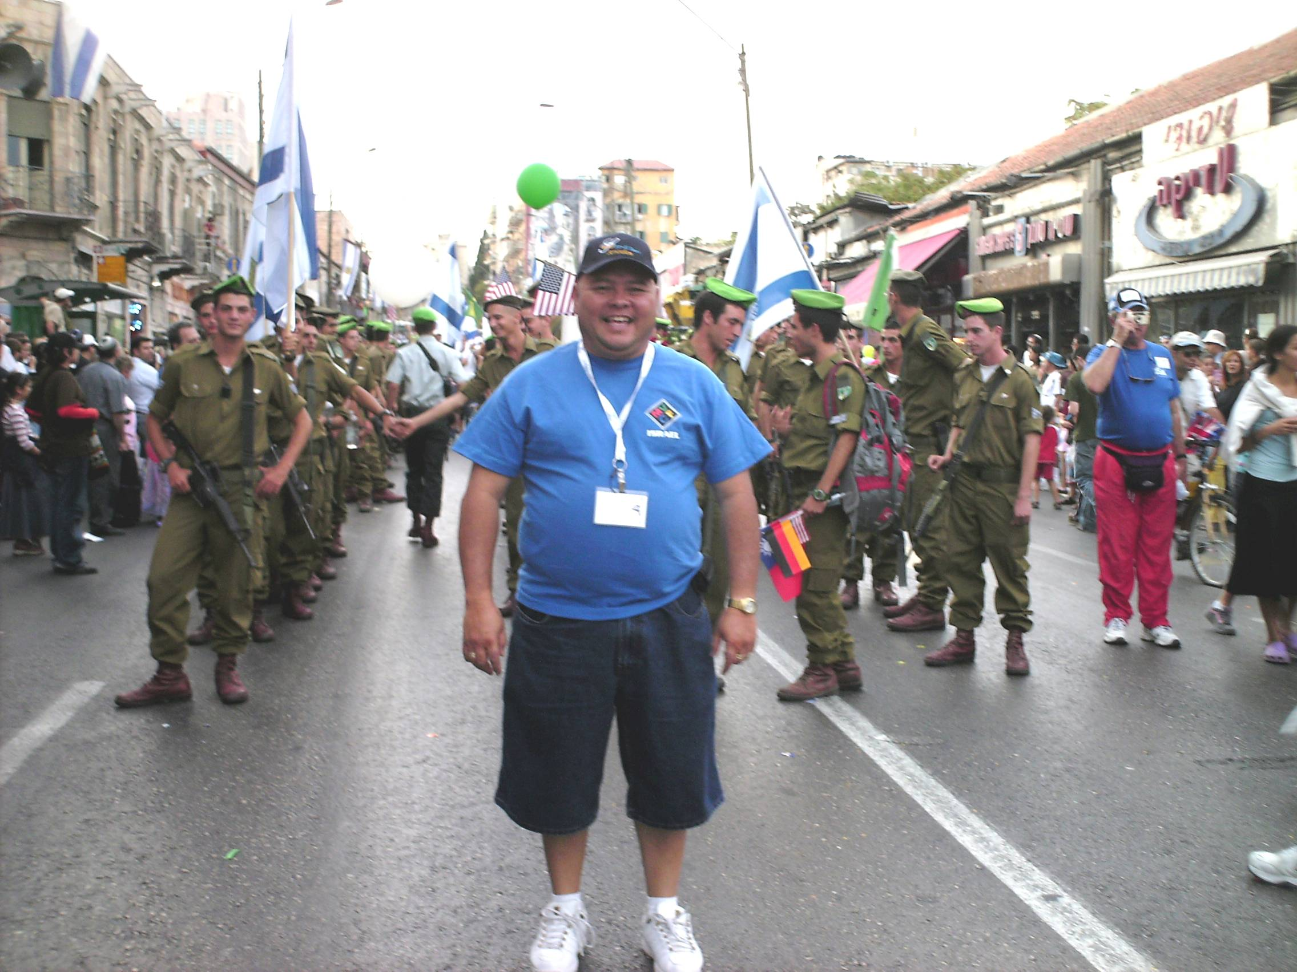
Isaiah 63:1-4
(New Living Translation)
1 Who is this who comes from Edom, from the city of Bozrah, with his clothing stained red? Who is this in royal robes, marching in his great strength? “It is I, the Lord, announcing your salvation! It is I, the Lord, who has the power to save

Slide 36
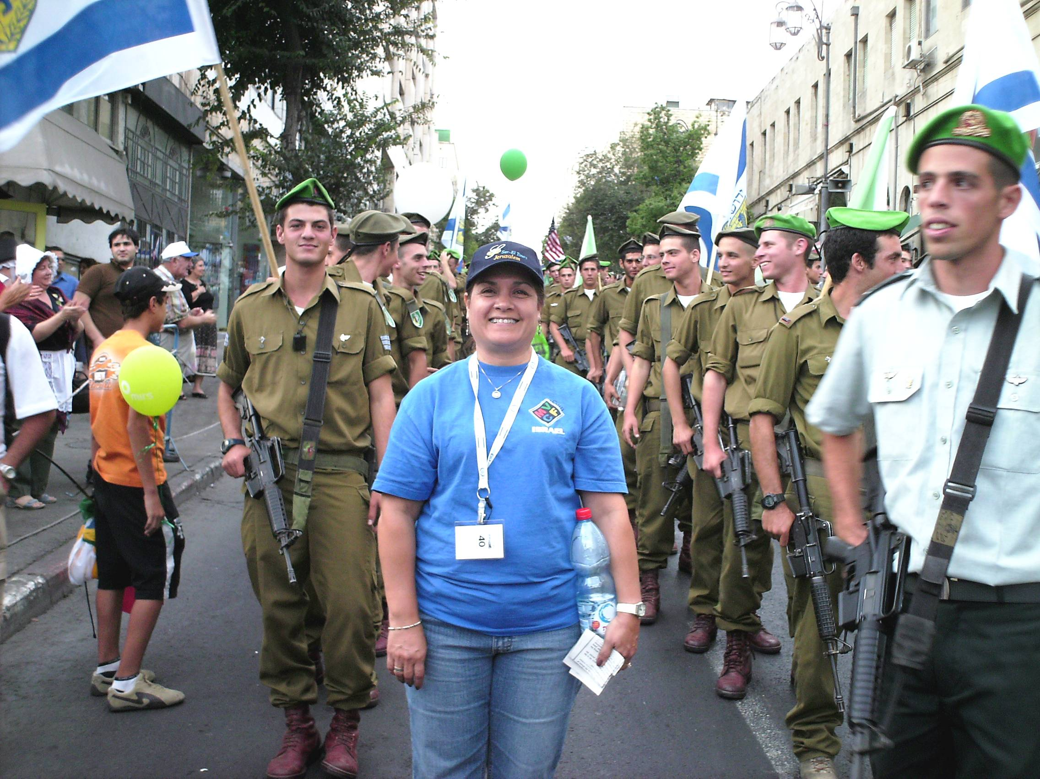
Isaiah 63:1-4
(New Living Translation)
1 Who is this who comes from Edom, from the city of Bozrah, with his clothing stained red? Who is this in royal robes, marching in his great strength? “It is I, the Lord, announcing your salvation! It is I, the Lord, who has the power to save

Slide 37
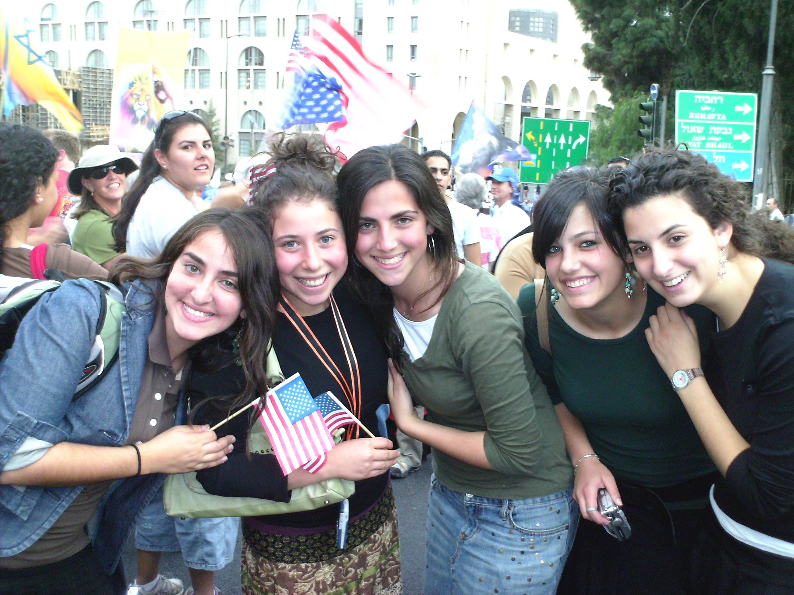
Isaiah 63:1-4
(New Living Translation)
1 Who is this who comes from Edom, from the city of Bozrah, with his clothing stained red? Who is this in royal robes, marching in his great strength? “It is I, the Lord, announcing your salvation! It is I, the Lord, who has the power to save

Slide 38
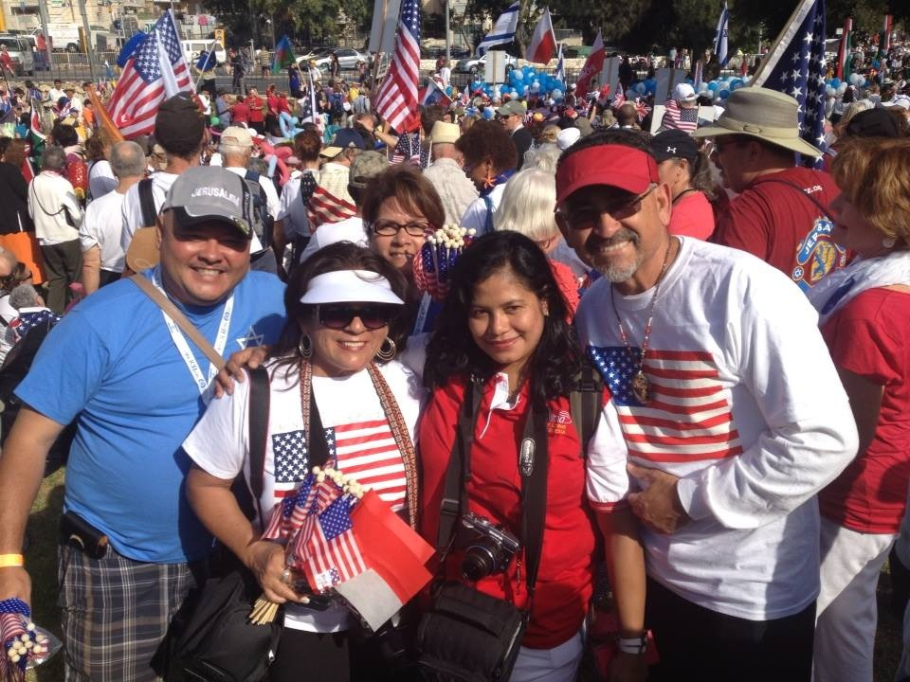
Isaiah 63:1-4
(New Living Translation)
1 Who is this who comes from Edom, from the city of Bozrah, with his clothing stained red? Who is this in royal robes, marching in his great strength? “It is I, the Lord, announcing your salvation! It is I, the Lord, who has the power to save

Slide 39
Zechariah 14:17-19
17 And it shall be that whichever of the families of the earth do not come up to Jerusalem to worship the King, the LORD of hosts, on them there will be no rain. 18 If the family of Egypt will not come up and enter in, they shall have no rain; they shall receive the plague with which the LORD strikes the nations who do not come up to keep the Feast of Tabernacles.

Slide 40
19 This shall be the punishment of Egypt and the punishment of all the nations that do not come up to keep the Feast of Tabernacles.

Slide 41
2 Corinthians 5:1-8
1 For we know that if our earthly house, this tent, is destroyed, we have a building from God, a house not made with hands, eternal in the heavens. 2 For in this we groan, earnestly desiring to be clothed with our habitation which is from heaven, 3 if indeed, having been clothed, we shall not be found naked. 4 For we who are in this tent groan, being burdened, not because we want to be unclothed, but further clothed, that mortality may be swallowed up by life.

Slide 42
5 Now He who has prepared us for this very thing is God, who also has given us the Spirit as a guarantee. 6 So we are always confident, knowing that while we are at home in the body we are absent from the Lord. 7 For we walk by faith, not by sight. 8 We are confident, yes, well pleased rather to be absent from the body and to be present with the Lord.

Slide 43
2 Peter 1:13-14
13 Yes, I think it is right, as long as I am in this tent, to stir you up by reminding you, 14 knowing that shortly I must put off my tent, just as our Lord Jesus Christ showed me.

Slide 44
Hebrews 11:8-10
8 By faith Abraham obeyed when he was called to go out to the place which he would receive as an inheritance. And he went out, not knowing where he was going. 9 By faith he dwelt in the land of promise as in a foreign country, dwelling in tents with Isaac and Jacob, the heirs with him of the same promise; 10 for he waited for the city which has foundations, whose builder and maker is God.

Slide 45
Deuteronomy 32:8-9
When the Most High divided their inheritance to the nations, When He separated the sons of Adam, He set the boundaries of the peoples According to the number of the children of Israel. 9 For the LORD's portion is His people; Jacob is the place of His inheritance.

Slide 46
Genesis 10:32
"These were the families of the sons of Noah, according to their generations, in their nations; and from these the nations were divided on the earth after the flood”

Slide 47
Numbers 29:39-40
39'These things you shall present to the LORD at your appointed feasts (besides your vowed offerings and your freewill offerings) as your burnt offerings and your grain offerings, as your drink offerings and your peace offerings.' " 40 So Moses told the children of Israel everything, just as the LORD commanded Moses.

Slide 48
Exodus 19:5-6
5 Now therefore, if you will indeed obey My voice and keep My covenant, then you shall be a special treasure to Me above all people; for all the earth is Mine. 6 And you shall be to Me a kingdom of priests and a holy nation.' These are the words which you shall speak to the children of Israel."

Slide 49
1 Peter 2:9-10
9 But you are a chosen generation, a royal priesthood, a holy nation, His own special people, that you may proclaim the praises of Him who called you out of darkness into His marvelous light; 10 who once were not a people but are now the people of God, who had not obtained mercy but now have obtained mercy.

Slide 50
Exodus 23:16-17
16 and the Feast of Harvest, the firstfruits of your labors which you have sown in the field; and the Feast of Ingathering at the end of the year, when you have gathered in the fruit of your labors from the field.

Slide 51
Revelation 14:15-19
(King James Version)
15 And another angel came out of the temple, crying with a loud voice to him that sat on the cloud, Thrust in thy sickle, and reap: for the time is come for thee to reap; for the harvest of the earth is ripe.

Slide 52
16 And he that sat on the cloud thrust in his sickle on the earth; and the earth was reaped. 17 And another angel came out of the temple which is in heaven, he also having a sharp sickle. 18 And another angel came out from the altar, which had power over fire; and cried with a loud cry to him that had the sharp sickle, saying, Thrust in thy sharp sickle, and gather the clusters of the vine of the earth; for her grapes are fully ripe.

Slide 53
19 And the angel thrust in his sickle into the earth, and gathered the vine of the earth, and cast it into the great winepress of the wrath of God.

Slide 54
John 7:1-2
1 After these things Jesus walked in Galilee; for He did not want to walk in Judea, because the Jews sought to kill Him. 2 Now the Jews' Feast of Tabernacles was at hand.

Slide 55
John 7:37-39
37 On the last day, that great day of the feast, Jesus stood and cried out, saying, "If anyone thirsts, let him come to Me and drink. 38 He who believes in Me, as the Scripture has said, out of his heart will flow rivers of living water.”

Slide 56
39 But this He spoke concerning the Spirit, whom those believing in Him would receive; for the Holy Spirit was not yet given, because Jesus was not yet glorified.

Slide 57
Isaiah 12:2-6
2 Behold, God is my salvation, I will trust and not be afraid; 'For YAH, the LORD, is my strength and song; He also has become my salvation.'" 3 Therefore with joy you will draw water From the wells of salvation. 4 And in that day you will say: "Praise the LORD, call upon His name; Declare His deeds among the peoples,
Make mention that His name is exalted.

Slide 58
5 Sing to the LORD, For He has done excellent things; This is known in all the earth. 6 Cry out and shout, O inhabitant of Zion, For great is the Holy One of Israel in your midst!"

Slide 59
Zechariah 14:4
And in that day His feet will stand on the Mount of Olives, Which faces Jerusalem on the east. And the Mount of Olives shall be split in two, From east to west, Making a very large valley; Half of the mountain shall move toward the north And half of it toward the south.

Slide 60
Revelation 21:1-5
1 Now I saw a new heaven and a new earth, for the first heaven and the first earth had passed away. Also there was no more sea. 2 Then I, John, saw the holy city, New Jerusalem, coming down out of heaven from God, prepared as a bride adorned for her husband.

Slide 61
3 And I heard a loud voice from heaven saying, "Behold, the tabernacle of God is with men, and He will dwell with them, and they shall be His people. God Himself will be with them and be their God. 4 And God will wipe away every tear from their eyes; there shall be no more death, nor sorrow, nor crying. There shall be no more pain, for the former things have passed away."

Slide 62
“For the Joy of the Lord is your Strength”
Nehemiah 8:10

