Slide 1


Slide 2


Slide 3
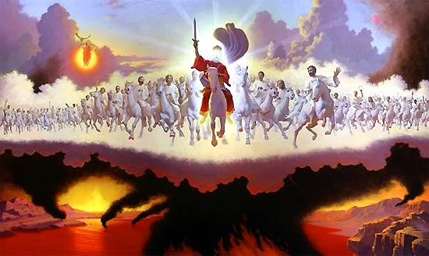

The Feast of Yom Kippur
by Pastor Fee Soliven
Jude 14-15
Sunday Morning
September 16, 2018

Slide 4
Jude 14-15
14 Now Enoch, the seventh from Adam, prophesied about these men also, saying, "Behold, the Lord comes with ten thousands of His saints, 15 to execute judgment on all, to convict all who are ungodly among them of all their ungodly deeds which they have committed in an ungodly way, and of all the harsh things which ungodly sinners have spoken against Him."

Slide 5
Leviticus 23:2
And the LORD spoke to Moses, saying, Speak to the children of Israel, and say to them, Concerning the Feasts of the LORD, which you shall proclaim to be holy convocations, even these are my feasts.

Slide 6
The Hebrew word for Feasts is also MOED meaning appointed times.
The Hebrew word for convocation is MIQRA meaning a dress rehearsal.

Slide 7
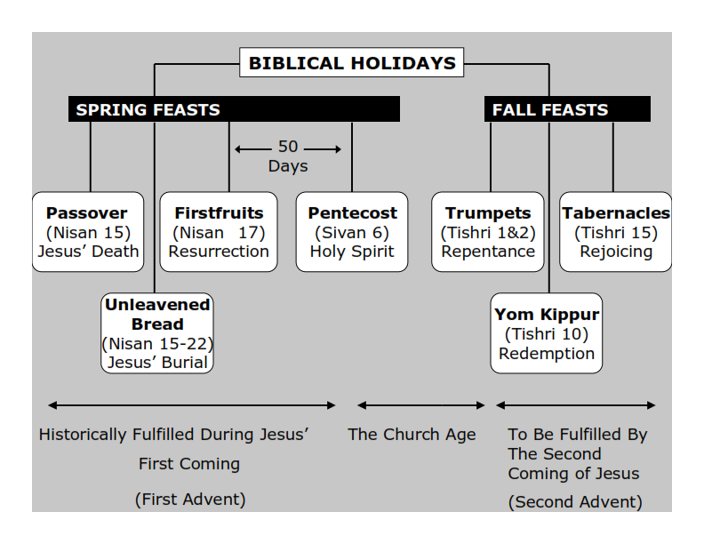
Psalm 139:16 (Amplified Bible)
Your eyes saw my unformed substance, and in Your book all the days [of my life] were written before ever they took shape, when as yet there was none of them.

Slide 8
Feast of Trumpets : REPENTANCE
Feast of Yom Kippur: REDEMPTION
Feast of Tabernacles: REJOICING

Slide 9
Leviticus 23:26-27
26 And the LORD spoke to Moses, saying: 27 "Also the tenth day of this seventh month shall be the Day of Atonement. It shall be a holy convocation for you; you shall afflict your souls, and offer an offering made by fire to the LORD.

Slide 10
The 10th day on the seventh month is Tishri 10, 5777 which is on our calendar for this year is October 12, 2016

Slide 11
The word atonement comes from the Hebrew word Kaphar which means to cover. Think in terms of a credit card which covers the expense you’ve incurred until the real payment can be made.

Slide 12
John 1:29
“The next day John saw Jesus coming toward him, and said, "Behold! The Lamb of God who takes away the sin of the world!”

Slide 13
Hebrews 10:4-10
4 For it is not possible that the blood of bulls and goats could take away sins. 5 Therefore, when He came into the world, He said: "Sacrifice and offering You did not desire, But a body You have prepared for Me.

Slide 14
6 In burnt offerings and sacrifices for sin You had no pleasure. 7 Then I said, 'Behold, I have come--In the volume of the book it is written of Me--To do Your will, O God.' " 8 Previously saying, "Sacrifice and offering, burnt offerings, and offerings for sin You did not desire, nor had pleasure in them" (which are offered according to the law),

Slide 15
9 then He said, "Behold, I have come to do Your will, O God." He takes away the first that He may establish the second. 10 By that will we have been sanctified through the offering of the body of Jesus Christ once for all.

Slide 16
2 Peter 3:13
"Nevertheless we, according to His promise, look for new heavens and a new earth in which righteousness dwells"

Slide 17
Leviticus 16:3-6
3 Thus Aaron shall come into the Holy Place: with the blood of a young bull as a sin offering, and of a ram as a burnt offering. 4 He shall put the holy linen tunic and the linen trousers on his body; he shall be girded with a linen sash, and with the linen turban he shall be attired. These are holy garments. Therefore he shall wash his body in water, and put them on.

Slide 18
5 And he shall take from the congregation of the children of Israel two kids of the goats as a sin offering, and one ram as a burnt offering. 6 "Aaron shall offer the bull as a sin offering, which is for himself, and make atonement for himself and for his house. 7 He shall take the two goats and present them before the LORD at the door of the tabernacle of meeting.

Slide 19
Leviticus 16:33
33 then he shall make atonement for the Holy Sanctuary, and he shall make atonement for the tabernacle of meeting and for the altar, and he shall make atonement for the priests and for all the people of the assembly.

Slide 20
Psalm 141:2
"Let my prayer be set before You as incense, The lifting up of my hands as the evening sacrifice"

Slide 21
Leviticus 16:12-17
12 Then he shall take a censer full of burning coals of fire from the altar before the LORD, with his hands full of sweet incense beaten fine, and bring it inside the veil. 13 And he shall put the incense on the fire before the LORD, that the cloud of incense may cover the mercy seat that is on the Testimony, lest he die.

Slide 22
14 He shall take some of the blood of the bull and sprinkle it with his finger on the mercy seat on the east side; and before the mercy seat he shall sprinkle some of the blood with his finger seven times. 15 "Then he shall kill the goat of the sin offering, which is for the people, bring its blood inside the veil, do with that blood as he did with the blood of the bull, and sprinkle it on the mercy seat and before the mercy seat.

Slide 23
16 So he shall make atonement for the Holy Place, because of the uncleanness of the children of Israel, and because of their transgressions, for all their sins; and so he shall do for the tabernacle of meeting which remains among them in the midst of their uncleanness.

Slide 24
Revelation 8:3-6
3 Then another angel, having a golden censer, came and stood at the altar. And he was given much incense, that he should offer it with the prayers of all the saints upon the golden altar which was before the throne.

Slide 25
4 And the smoke of the incense, with the prayers of the saints, ascended before God from the angel's hand. 5 Then the angel took the censer, filled it with fire from the altar, and threw it to the earth. And there were noises, thunderings, lightnings, and an earthquake.

Slide 26
6 So the seven angels who had the seven trumpets prepared themselves to sound.

Slide 27
Revelation 6:9-11
9 When He opened the fifth seal, I saw under the altar the souls of those who had been slain for the word of God and for the testimony which they held. 10 And they cried with a loud voice, saying, "How long, O Lord, holy and true, until You judge and avenge our blood on those who dwell on the earth?"

Slide 28
11 Then a white robe was given to each of them; and it was said to them that they should rest a little while longer, until both the number of their fellow servants and their brethren, who would be killed as they were, was completed.

Slide 29
Isaiah 63:1-4
(New Living Translation)
1 Who is this who comes from Edom, from the city of Bozrah, with his clothing stained red? Who is this in royal robes, marching in his great strength? “It is I, the Lord, announcing your salvation! It is I, the Lord, who has the power to save!” 2 Why are your clothes so red, as if you have been treading out grapes?

Slide 30
3 “I have been treading the winepress alone; no one was there to help me. In my anger I have trampled my enemies as if they were grapes. In my fury I have trampled my foes. Their blood has stained my clothes. 4 For the time has come for me to avenge my people, to ransom them from their oppressors.

Slide 31
Revelation 19:2
"For true and righteous are His judgments, because He has judged the great harlot who corrupted the earth with her fornication; and He has avenged on her the blood of His servants shed by her."

Slide 32
Revelation 19:13-16
13 He was clothed with a robe dipped in blood, and His name is called The Word of God. 14 And the armies in heaven, clothed in fine linen, white and clean, followed Him on white horses.

Slide 33
15 Now out of His mouth goes a sharp sword, that with it He should strike the nations. And He Himself will rule them with a rod of iron. He Himself treads the winepress of the fierceness and wrath of Almighty God. 16 And He has on His robe and on His thigh a name written: KING OF KINGS AND LORD OF LORDS.

Slide 34
Leviticus 16:16-18
16 So he shall make atonement for the Holy Place, because of the uncleanness of the children of Israel, and because of their transgressions, for all their sins; and so he shall do for the tabernacle of meeting which remains among them in the midst of their uncleanness.

Slide 35
17 There shall be no man in the tabernacle of meeting when he goes in to make atonement in the Holy Place, until he comes out, that he may make atonement for himself, for his household, and for all the assembly of Israel.

Slide 36
Revelation 15:8
"The temple was filled with smoke from the glory of God and from His power, and no one was able to enter the temple till the seven plagues of the seven angels were completed"

Slide 37
Zechariah 14:1-4
1 Behold, the day of the LORD is coming, And your spoil will be divided in your midst. 2 For I will gather all the nations to battle against Jerusalem; The city shall be taken, The houses rifled, And the women ravished. Half of the city shall go into captivity, But the remnant of the people shall not be cut off from the city.

Slide 38
3 Then the LORD will go forth And fight against those nations, As He fights in the day of battle. 4 And in that day His feet will stand on the Mount of Olives, Which faces Jerusalem on the east. And the Mount of Olives shall be split in two, From east to west, Making a very large valley; Half of the mountain shall move toward the north And half of it toward the south.

Slide 39
Revelation 1:7-8
7 Behold, He is coming with clouds, and every eye will see Him, even they who pierced Him. And all the tribes of the earth will mourn because of Him. Even so, Amen. 8 I am the Alpha and the Omega, the Beginning and the End," says the Lord, "who is and who was and who is to come, the Almighty."

Slide 40
Revelation 19:11
11 Now I saw heaven opened, and behold, a white horse. And He who sat on him was called Faithful and True, and in righteousness He judges and makes war.

Slide 41
Joel 3:9-17
9 Proclaim this among the nations:"Prepare for war! Wake up the mighty men, Let all the men of war draw near, Let them come up. 10 Beat your plowshares into swords And your pruning hooks into spears; Let the weak say, 'I am strong.' “

Slide 42
11 Assemble and come, all you nations, And gather together all around. Cause Your mighty ones to go down there, O LORD. 12 "Let the nations be wakened, and come up to the Valley of Jehoshaphat; For there I will sit to judge all the surrounding nations.

Slide 43
13 Put in the sickle, for the harvest is ripe. Come, go down; For the winepress is full, The vats overflow--For their wickedness is great." 14 Multitudes, multitudes in the valley of decision! For the day of the LORD is near in the valley of decision. 15 The sun and moon will grow dark, And the stars will diminish their brightness.

Slide 44
16 The LORD also will roar from Zion, And utter His voice from Jerusalem; The heavens and earth will shake; But the LORD will be a shelter for His people, And the strength of the children of Israel.

Slide 45
17 "So you shall know that I am the LORD your God, Dwelling in Zion My holy mountain. Then Jerusalem shall be holy, And no aliens shall ever pass through her again."

Slide 46
Zephaniah 1:14-15
14 The great day of the LORD is near; It is near and hastens quickly. The noise of the day of the LORD is bitter; There the mighty men shall cry out. 15 That day is a day of wrath, A day of trouble and distress, A day of devastation and desolation, A day of darkness and gloominess, A day of clouds and thick darkness...

Slide 47
2 Peter 3:3-13
3 knowing this first: that scoffers will come in the last days, walking according to their own lusts, 4 and saying, "Where is the promise of His coming? For since the fathers fell asleep, all things continue as they were from the beginning of creation."

Slide 48
5 For this they willfully forget: that by the word of God the heavens were of old, and the earth standing out of water and in the water, 6 by which the world that then existed perished, being flooded with water. 7 But the heavens and the earth which are now preserved by the same word, are reserved for fire until the day of judgment and perdition of ungodly men.

Slide 49
8 But, beloved, do not forget this one thing, that with the Lord one day is as a thousand years, and a thousand years as one day. 9 The Lord is not slack concerning His promise, as some count slackness, but is longsuffering toward us, not willing that any should perish but that all should come to repentance.

Slide 50
10 But the day of the Lord will come as a thief in the night, in which the heavens will pass away with a great noise, and the elements will melt with fervent heat; both the earth and the works that are in it will be burned up. 11 Therefore, since all these things will be dissolved, what manner of persons ought you to be in holy conduct and godliness,

Slide 51
12 looking for and hastening the coming of the day of God, because of which the heavens will be dissolved, being on fire, and the elements will melt with fervent heat? 13 Nevertheless we, according to His promise, look for new heavens and a new earth in which righteousness dwells.

Slide 52
Hosea 5:14-15
14 For I will be like a lion to Ephraim, And like a young lion to the house of Judah. I, even I, will tear them and go away; I will take them away, and no one shall rescue. 15 I will return again to My place Till they acknowledge their offense. Then they will seek My face; In their affliction they will earnestly seek Me."

Slide 53
Hosea 6:1-3
1 Come, and let us return to the LORD; For He has torn, but He will heal us; He has stricken, but He will bind us up. 2 After two days He will revive us; On the third day He will raise us up, That we may live in His sight. 3 Let us know, Let us pursue the knowledge of the LORD. His going forth is established as the morning; He will come to us like the rain, Like the latter and former rain to the earth.

Slide 54
Revelation 21:2-8
3 And I heard a loud voice from heaven saying, "Behold, the tabernacle of God is with men, and He will dwell with them, and they shall be His people. God Himself will be with them and be their God.

Slide 55
4 And God will wipe away every tear from their eyes; there shall be no more death, nor sorrow, nor crying. There shall be no more pain, for the former things have passed away." 5 Then He who sat on the throne said, "Behold, I make all things new." And He said to me, "Write, for these words are true and faithful."

Slide 56
6 And He said to me, "It is done! I am the Alpha and the Omega, the Beginning and the End. I will give of the fountain of the water of life freely to him who thirsts. 7 He who overcomes shall inherit all things, and I will be his God and he shall be My son.

Slide 57
8 But the cowardly, unbelieving, abominable, murderers, sexually immoral, sorcerers, idolaters, and all liars shall have their part in the lake which burns with fire and brimstone, which is the second death."

