Slide 3
Is Your House United or Divided?
by Pastor Fee Soliven
Mark 3:20-31
Wednesday Evening
October 3, 2018

Slide 4
20 Then the multitude came together again, so that they could not so much as eat bread.

Slide 5
21 But when His own people heard about this, they went out to lay hold of Him, for they said, "He is out of His mind."

Slide 6
22 And the scribes who came down from Jerusalem said, "He has Beelzebub," and, "By the ruler of the demons He casts out demons."

Slide 7
23 So He called them to Himself and said to them in parables: "How can Satan cast out Satan? 24 If a kingdom is divided against itself, that kingdom cannot stand. 25 And if a house is divided against itself, that house cannot stand. 26 And if Satan has risen up against himself, and is divided, he cannot stand, but has an end.

Slide 8
27 No one can enter a strong man's house and plunder his goods, unless he first binds the strong man. And then he will plunder his house.

Slide 9
28 "Assuredly, I say to you, all sins will be forgiven the sons of men, and whatever blasphemies they may utter; 29 but he who blasphemes against the Holy Spirit never has forgiveness, but is subject to eternal condemnation"—30 because they said, "He has an unclean spirit."

Slide 10
31 Then His brothers and His mother came, and standing outside they sent to Him, calling Him. 32 And a multitude was sitting around Him; and they said to Him, "Look, Your mother and Your brothers are outside seeking You." 33 But He answered them, saying, "Who is My mother, or My brothers?"

Slide 11
34 And He looked around in a circle at those who sat about Him, and said, "Here are My mother and My brothers! 35 For whoever does the will of God is My brother and My sister and mother."

Slide 12
20 Then the multitude came together again, so that they could not so much as eat bread.

Slide 13
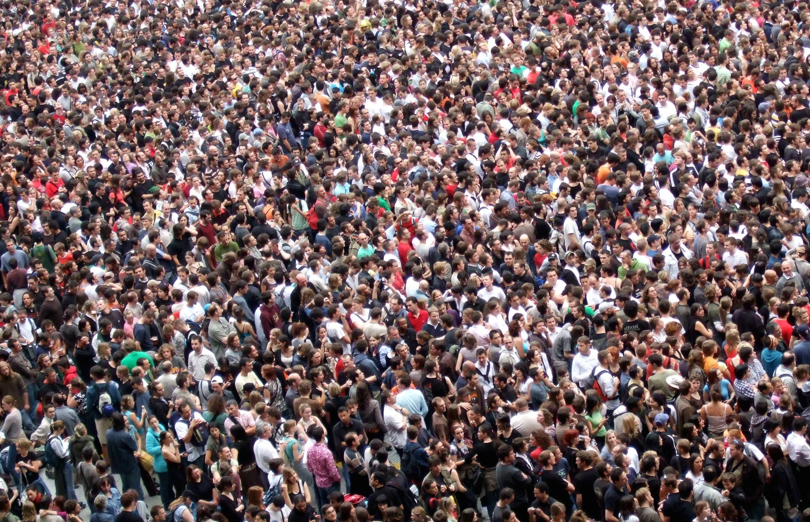
18 "If the world hates you, you know that it hated Me before it hated you. 19 If you were of the world, the world would love its own. Yet because you are not of the world, but I chose you out of the world, therefore the world hates you.

Slide 14
21 But when His own people heard about this, they went out to lay hold of Him, for they said, "He is out of His mind."

Slide 15
John 7:5
“For even His brothers did not believe in Him.

Slide 16
Acts 4:4
“However, many of those who heard the word believed; and the number of the men came to be about five thousand.”

Slide 17
22 And the scribes who came down from Jerusalem said, "He has Beelzebub," and, "By the ruler of the demons He casts out demons."

Slide 18
Beelzebub is the Greek form of the name Baal-zebub, a pagan Philistine god worshiped in the ancient Philistine city of Ekron during the Old Testament times.

Slide 19
2 Kings 1:1-2
1 Moab rebelled against Israel after the death of Ahab. 2 Now Ahaziah fell through the lattice of his upper room in Samaria, and was injured; so he sent messengers and said to them, "Go, inquire of Baal-Zebub, the god of Ekron, whether I shall recover from this injury

Slide 20
23 So He called them to Himself and said to them in parables: "How can Satan cast out Satan? 24 If a kingdom is divided against itself, that kingdom cannot stand. 25 And if a house is divided against itself, that house cannot stand. 26 And if Satan has risen up against himself, and is divided, he cannot stand, but has an end.

Slide 21
Why would Satan work against himself?

Slide 22
1 Corinthians 1:10
Now I plead with you, brethren, by the name of our Lord Jesus Christ, that you all speak the same thing, and that there be no divisions among you, but that you be perfectly joined together in the same mind and in the same judgment.

Slide 23
Romans 16:17-18
17 Now I urge you, brethren, note those who cause divisions and offenses, contrary to the doctrine which you learned, and avoid them. 18 For those who are such do not serve our Lord Jesus Christ, but their own belly, and by smooth words and flattering speech deceive the hearts of the simple.

Slide 24
Psalm 133:1
“How good and pleasant it is when God’s people live together in unity!”

Slide 25
27 No one can enter a strong man's house and plunder his goods, unless he first binds the strong man. And then he will plunder his house.

Slide 26
Revelation 20:10
“The devil, who deceived them, was cast into the lake of fire and brimstone where the beast and the false prophet are. And they will be tormented day and night forever and ever.”

Slide 27
28 "Assuredly, I say to you, all sins will be forgiven the sons of men, and whatever blasphemies they may utter; 29 but he who blasphemes against the Holy Spirit never has forgiveness, but is subject to eternal condemnation"—30 because they said, "He has an unclean spirit."

Slide 28
Acts 2:38-39
38 Then Peter said to them, "Repent, and let every one of you be baptized in the name of Jesus Christ for the remission of sins; and you shall receive the gift of the Holy Spirit. 39 For the promise is to you and to your children, and to all who are afar off, as many as the Lord our God will call."

Slide 29
Matthew 12:31-32
31 "Therefore I say to you, every sin and blasphemy will be forgiven men, but the blasphemy against the Spirit will not be forgiven men. 32 Anyone who speaks a word against the Son of Man, it will be forgiven him; but whoever speaks against the Holy Spirit, it will not be forgiven him, either in this age or in the age to come.

Slide 30
31 Then His brothers and His mother came, and standing outside they sent to Him, calling Him. 32 And a multitude was sitting around Him; and they said to Him, "Look, Your mother and Your brothers are outside seeking You." 33 But He answered them, saying, "Who is My mother, or My brothers?"

Slide 31
34 And He looked around in a circle at those who sat about Him, and said, "Here are My mother and My brothers! 35 For whoever does the will of God is My brother and My sister and mother."

Slide 32
Matthew 15:1-9
1 Then the scribes and Pharisees who were from Jerusalem came to Jesus, saying, 2 "Why do Your disciples transgress the tradition of the elders? For they do not wash their hands when they eat bread."

Slide 33
3 He answered and said to them, "Why do you also transgress the commandment of God because of your tradition? 4 For God commanded, saying, 'Honor your father and your mother'; and, 'He who curses father or mother, let him be put to death.' 5 But you say, 'Whoever says to his father or mother, "Whatever profit you might have received from me is a gift to God"—

Slide 34
6 then he need not honor his father or mother.' Thus you have made the commandment of God of no effect by your tradition. 7 Hypocrites! Well did Isaiah prophesy about you, saying: 8'These people draw near to Me with their mouth, And honor Me with their lips, But their heart is far from Me. 9 And in vain they worship Me, Teaching as doctrines the commandments of men.' "

Slide 35
John 19:25-27
25 Now there stood by the cross of Jesus His mother, and His mother's sister, Mary the wife of Clopas, and Mary Magdalene. 26 When Jesus therefore saw His mother, and the disciple whom He loved standing by, He said to His mother, "Woman, behold your son!" 27 Then He said to the disciple, "Behold your mother!" And from that hour that disciple took her to his own home.

Slide 36
Acts 1:14
“These all continued with one accord in prayer and supplication, with the women and Mary the mother of Jesus, and with His brothers.”

