Slide 1


Slide 2


Slide 3


Let Your Lamp Shine Bright
by Pastor Fee Soliven
Mark 4:21-29
Wednesday Evening
October 17, 2018

Slide 4
21 And He said to them, "Is a lamp brought to be put under a basket or under a bed? Is it not to be set on a lampstand?

Slide 5
22 For there is nothing hidden which will not be revealed, nor has anything been kept secret but that it should come to light.

Slide 6
23 If anyone has ears to hear,
let him hear."

Slide 7
24 Then He said to them, "Take heed what you hear. With the same measure you use, it will be measured to you; and to you who hear, more will be given.

Slide 8
25 For whoever has, to him more will be given; but whoever does not have, even what he has will be taken away from him."

Slide 9
26 And He said, "The kingdom of God is as if a man should scatter seed on the ground, 27 and should sleep by night and rise by day, and the seed should sprout and grow, he himself does not know how. 28 For the earth yields crops by itself: first the blade, then the head, after that the full grain in the head.

Slide 10
29 But when the grain ripens, immediately he puts in the sickle, because the harvest has come."

Slide 11
21 And He said to them, "Is a lamp brought to be put under a basket or under a bed? Is it not to be set on a lampstand?

Slide 12
Matthew 5:13-16
13 "You are the salt of the earth; but if the salt loses its flavor, how shall it be seasoned? It is then good for nothing but to be thrown out and trampled underfoot by men. 14 You are the light of the world. A city that is set on a hill cannot be hidden.

Slide 13
15 Nor do they light a lamp and put it under a basket, but on a lampstand, and it gives light to all who are in the house. 16 Let your light so shine before men, that they may see your good works and glorify your Father in heaven.

Slide 14
22 For there is nothing hidden which will not be revealed, nor has anything been kept secret but that it should come to light.

Slide 15
Romans 16:25-27
25 Now to Him who is able to establish you according to my gospel and the preaching of Jesus Christ, according to the revelation of the mystery kept secret since the world began 26 but now has been made manifest, and by the prophetic Scriptures has been made known to all nations, according to the commandment of the everlasting God, for obedience to the faith-- 27 to God, alone wise, be glory through Jesus Christ forever. Amen.

Slide 16
23 If anyone has ears to hear, let him hear."

Slide 17
Revelation 2:7
“He who has an ear, let him hear what the Spirit says to the churches. To him who overcomes I will give to eat from the tree of life, which is in the midst of the Paradise of God." '

Slide 18
24 Then He said to them, "Take heed what you hear. With the same measure you use, it will be measured to you; and to you who hear, more will be given.

Slide 19
Matthew 7:1-6
1 "Judge not, that you be not judged. 2 For with what judgment you judge, you will be judged; and with the measure you use, it will be measured back to you. 3 And why do you look at the speck in your brother's eye, but do not consider the plank in your own eye? 4 Or how can you say to your brother, 'Let me remove the speck from your eye'; and look, a plank is in your own eye?

Slide 20
5 Hypocrite! First remove the plank from your own eye, and then you will see clearly to remove the speck out of your brother's eye. 6 Do not give what is holy to the dogs; nor cast your pearls before swine, lest they trample them under their feet, and turn and tear you in pieces.

Slide 21
25 For whoever has, to him more will be given; but whoever does not have, even what he has will be taken away from him."

Slide 22
Luke 8:18
Pay attention, therefore, to how you listen. Whoever has will be given more, but whoever does not have, even what he thinks he has will be taken away from him."

Slide 23
26 And He said, "The kingdom of God is as if a man should scatter seed on the ground, 27 and should sleep by night and rise by day, and the seed should sprout and grow, he himself does not know how. 28 For the earth yields crops by itself: first the blade, then the head, after that the full grain in the head.

Slide 24
2 Peter 3:17-18
17 You therefore, beloved, since you know this beforehand, beware lest you also fall from your own steadfastness, being led away with the error of the wicked; 18 but grow in the grace and knowledge of our Lord and Savior Jesus Christ. To Him be the glory both now and forever. Amen.

Slide 25
29 But when the grain ripens, immediately he puts in the sickle, because the harvest has come."

Slide 26
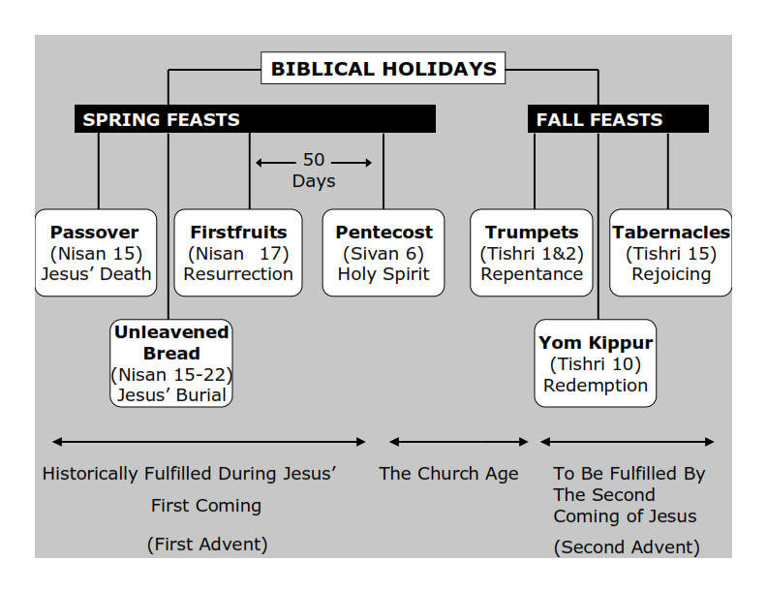
Webster’s Dictionary defines the word tribulation as: 1. grievous trouble; severe trial or suffering. 2. an instance of this; an affliction, trouble, etc.

Slide 27
2 Corinthians 6:1-2
1 We then, as workers together with Him also plead with you not to receive the grace of God in vain. 2 For He says: "In an acceptable time I have heard you, And in the day of salvation I have helped you." Behold, now is the accepted time; behold, now is the day of salvation.

Slide 28
Matthew 4:12-17
12 Now when Jesus heard that John had been put in prison, He departed to Galilee. 13 And leaving Nazareth, He came and dwelt in Capernaum, which is by the sea, in the regions of Zebulun and Naphtali, 14 that it might be fulfilled which was spoken by Isaiah the prophet, saying:

Slide 29
15 "The land of Zebulun and the land of Naphtali, By the way of the sea, beyond the Jordan, Galilee of the Gentiles: 16 The people who sat in darkness have seen a great light, And upon those who sat in the region and shadow of death
Light has dawned."

Slide 30
17 From that time Jesus began to preach and to say, "Repent, for the kingdom of heaven is at hand."

