Slide 3
Sowing and Reaping
by Pastor Fee Soliven
Mark 4:1-20
Wednesday Evening
October 10, 2018

Slide 4
1 And again He began to teach by the sea. And a great multitude was gathered to Him, so that He got into a boat and sat in it on the sea; and the whole multitude was on the land facing the sea.

Slide 5
2 Then He taught them many things by parables, and said to them in His teaching: 3 "Listen! Behold, a sower went out to sow.”

Slide 6
4 And it happened, as he sowed, that some seed fell by the wayside; and the birds of the air came and devoured it. 5 Some fell on stony ground, where it did not have much earth; and immediately it sprang up because it had no depth of earth. 6 But when the sun was up it was scorched, and because it had no root it withered away. 7 And some seed fell among thorns; and the thorns grew up and choked it, and it yielded no crop.

Slide 7
8 But other seed fell on good ground and yielded a crop that sprang up, increased and produced: some thirtyfold, some sixty, and some a hundred." 9 And He said to them, "He who has ears to hear, let him hear!"

Slide 8
10 But when He was alone, those around Him with the twelve asked Him about the parable.

Slide 9
11 And He said to them, "To you it has been given to know the mystery of the kingdom of God; but to those who are outside, all things come in parables,

Slide 10
12 so that 'Seeing they may see and not perceive, And hearing they may hear and not understand; Lest they should turn, And their sins be forgiven them.' "

Slide 11
13 And He said to them, "Do you not understand this parable? How then will you understand all the parables?

Slide 12
14 The sower sows the word.

Slide 13
15 And these are the ones by the wayside where the word is sown. When they hear, Satan comes immediately and takes away the word that was sown in their hearts.

Slide 14
16 These likewise are the ones sown on stony ground who, when they hear the word, immediately receive it with gladness; 17 and they have no root in themselves, and so endure only for a time. Afterward, when tribulation or persecution arises for the word's sake, immediately they stumble.

Slide 15
18 Now these are the ones sown among thorns; they are the ones who hear the word, 19 and the cares of this world, the deceitfulness of riches, and the desires for other things entering in choke the word, and it becomes unfruitful.

Slide 16
20 But these are the ones sown on good ground, those who hear the word, accept it, and bear fruit: some thirtyfold, some sixty, and some a hundred."

Slide 17
1 And again He began to teach by the sea. And a great multitude was gathered to Him, so that He got into a boat and sat in it on the sea; and the whole multitude was on the land facing the sea.

Slide 18
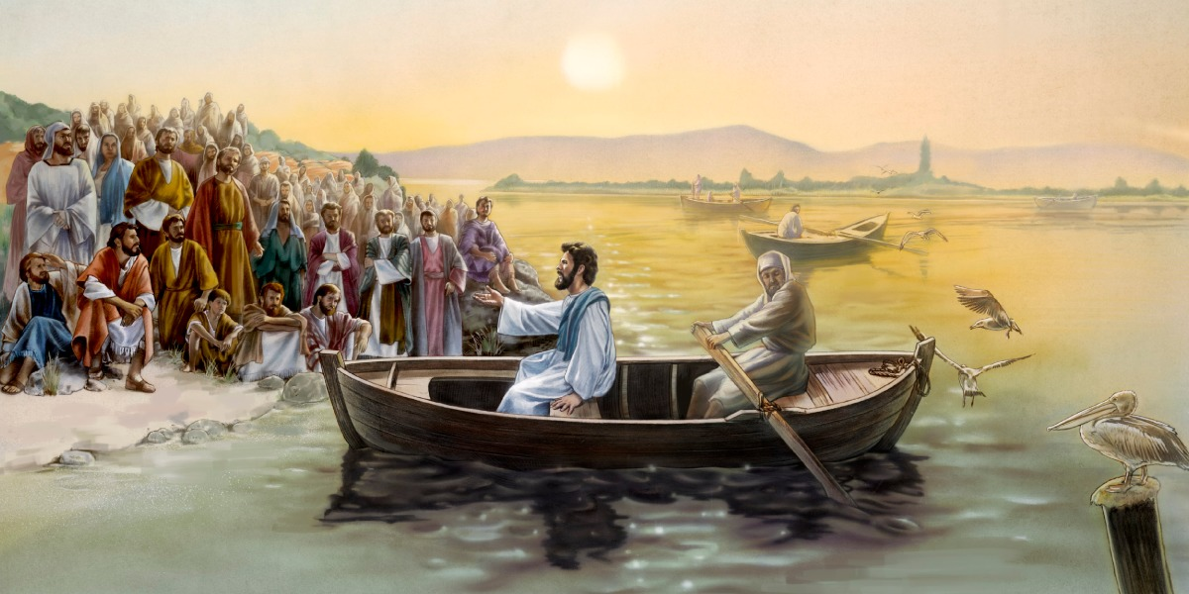
21 But when His own people heard about this, they went out to lay hold of Him, for they said, "He is out of His mind."

Slide 19
2 Then He taught them many things by parables, and said to them in His teaching: 3 "Listen! Behold, a sower went out to sow.

Slide 20
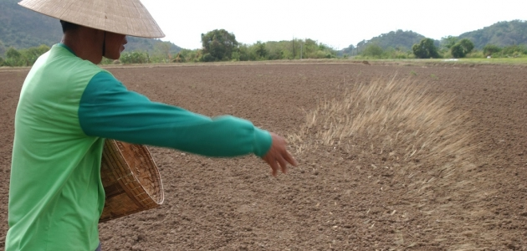
23 So He called them to Himself and said to them in parables: "How can Satan cast out Satan? 24 If a kingdom is divided against itself, that kingdom cannot stand. 25 And if a house is divided against itself, that house cannot stand. 26 And if Satan has risen up against himself, and is divided, he cannot stand, but has an end.

Slide 21
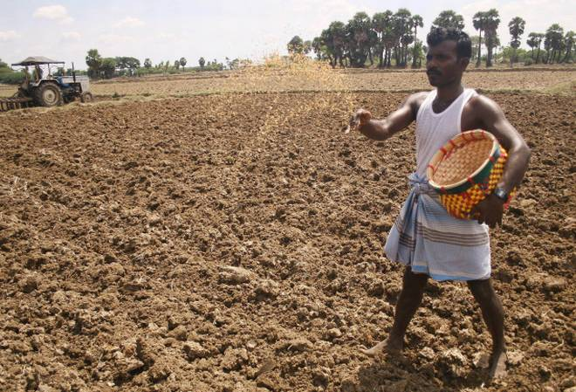
27 No one can enter a strong man's house and plunder his goods, unless he first binds the strong man. And then he will plunder his house.

Slide 22
4 And it happened, as he sowed, that some seed fell by the wayside; and the birds of the air came and devoured it. 5 Some fell on stony ground, where it did not have much earth; and immediately it sprang up because it had no depth of earth. 6 But when the sun was up it was scorched, and because it had no root it withered away. 7 And some seed fell among thorns; and the thorns grew up and choked it, and it yielded no crop.

Slide 23
8 But other seed fell on good ground and yielded a crop that sprang up, increased and produced: some thirtyfold, some sixty, and some a hundred." 9 And He said to them, "He who has ears to hear, let him hear!"

Slide 24
10 But when He was alone, those around Him with the twelve asked Him about the parable.

Slide 25
11 And He said to them, "To you it has been given to know the mystery of the kingdom of God; but to those who are outside, all things come in parables,

Slide 26
Romans 16:25-26
25 Now to Him who is able to establish you according to my gospel and the preaching of Jesus Christ, according to the revelation of the mystery kept secret since the world began 26 but now has been made manifest, and by the prophetic Scriptures has been made known to all nations, according to the commandment of the everlasting God, for obedience to the faith--

Slide 27
12 so that 'Seeing they may see and not perceive, And hearing they may hear and not understand; Lest they should turn, And their sins be forgiven them.' "

Slide 28
Isaiah 6:9
And He said, "Go, and tell this people: 'Keep on hearing, but do not understand; Keep on seeing, but do not perceive.'

Slide 29
13 And He said to them, "Do you not understand this parable? How then will you understand all the parables?

Slide 30
14 The sower sows the word.

Slide 31
Matthew 13:37
He answered and said to them: "He who sows the good seed is the Son of Man.”

Slide 32
15 And these are the ones by the wayside where the word is sown. When they hear, Satan comes immediately and takes away the word that was sown in their hearts.

Slide 33
2 Corinthians 4:3-4
3 And even if our gospel is veiled, it is veiled to those who are perishing. 4 The god of this age has blinded the minds of unbelievers, so that they cannot see the light of the gospel of the glory of Christ, who is the image of God.

Slide 34
16 These likewise are the ones sown on stony ground who, when they hear the word, immediately receive it with gladness; 17 and they have no root in themselves, and so endure only for a time. Afterward, when tribulation or persecution arises for the word's sake, immediately they stumble.

Slide 35
18 Now these are the ones sown among thorns; they are the ones who hear the word, 19 and the cares of this world, the deceitfulness of riches, and the desires for other things entering in choke the word, and it becomes unfruitful.

Slide 36
20 But these are the ones sown on good ground, those who hear the word, accept it, and bear fruit: some thirtyfold, some sixty, and some a hundred."

Slide 37
1 Samuel 13:14
“But now your kingdom shall not continue. The LORD has sought for Himself a man after His own heart, and the LORD has commanded him to be commander over His people, because you have not kept what the LORD commanded you."

