Slide 1


Slide 2


Slide 3
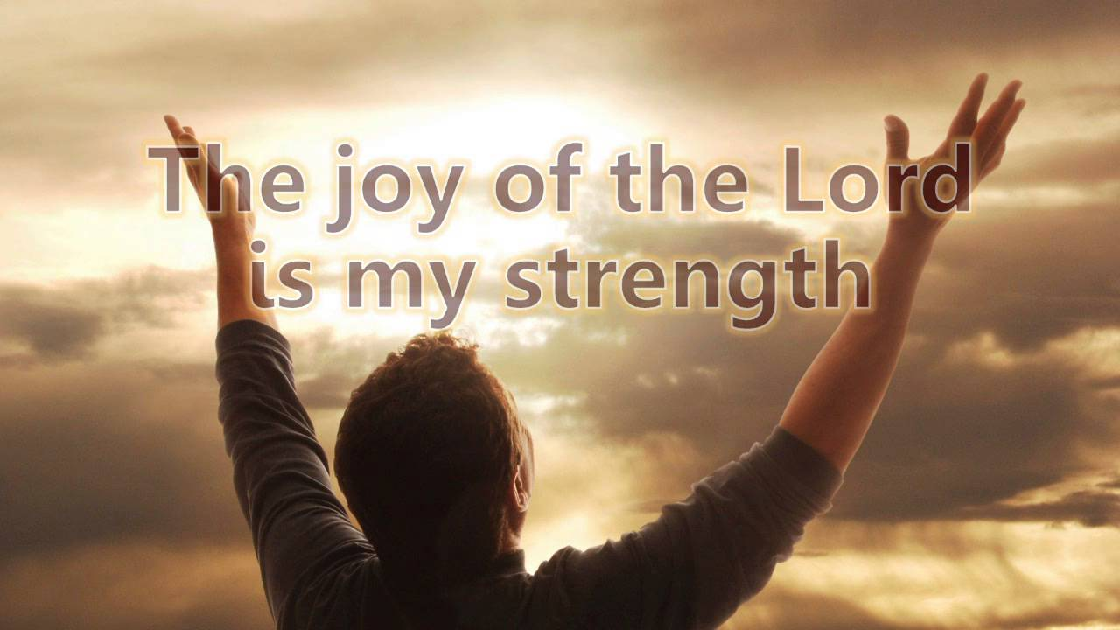

The Joy of the Lord
By Pastor Fee Soliven
Philippians 4:1-4
Sunday Morning
October 14, 2018

Slide 4
Philippians 4:1-4
1 Therefore, my beloved and longed-for brethren, my joy and crown, so stand fast in the Lord, beloved. 2 I implore Euodia and I implore Syntyche to be of the same mind in the Lord. 3 And I urge you also, true companion, help these women who labored with me in the gospel, with Clement also, and the rest of my fellow workers, whose names are in the Book of Life. 4 Rejoice in the Lord always. Again I will say, rejoice!

Slide 5
How do your circumstances affect you?

Slide 6
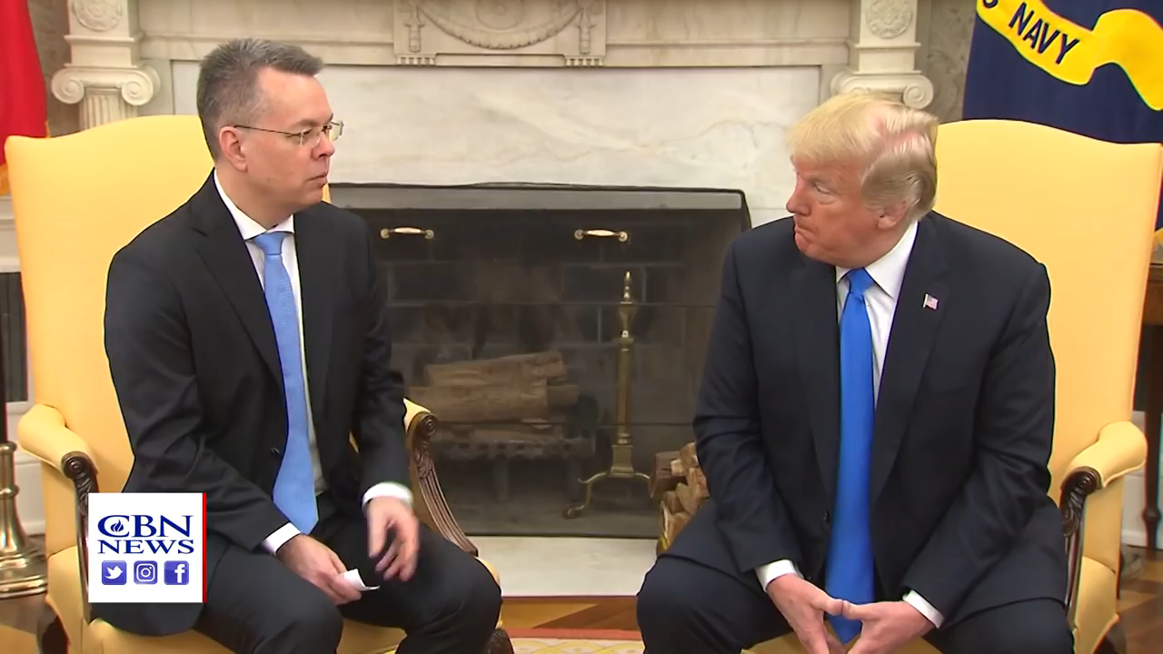
How do your circumstances affect you?

Slide 7
When you are going through difficulties, pain, or disappointment, do these experiences change your conduct or disposition?

Slide 8
Are you one person when life is running smoothly, but a different one when you are visited by hardship and suffering?

Slide 9
John 15:9-11
9 "As the Father loved Me, I also have loved you; abide in My love. 10 If you keep My commandments, you will abide in My love, just as I have kept My Father's commandments and abide in His love. 11 These things I have spoken to you, that My joy may remain in you, and that your joy may be full.

Slide 10
Philippians 4:4
“Rejoice in the Lord always; again, I will say, rejoice!”

Slide 11
There is a difference between Happiness and Joy

Slide 12
Happiness depends upon good circumstances, but joy depends on a relationship

Slide 13
Ephesians 1:9-14
9 having made known to us the mystery of His will, according to His good pleasure which He purposed in Himself, 10 that in the dispensation of the fullness of the times He might gather together in one all things in Christ, both which are in heaven and which are on earth--in Him. 11 In Him also we have obtained an inheritance, being predestined according to the purpose of Him who works all things according to the counsel of His will,

Slide 14
12 that we who first trusted in Christ should be to the praise of His glory. 13 In Him you also trusted, after you heard the word of truth, the gospel of your salvation; in whom also, having believed, you were sealed with the Holy Spirit of promise, 14 who is the guarantee of our inheritance until the redemption of the purchased possession, to the praise of His glory.

Slide 15
We should not allow our Circumstances to determine our Disposition

Slide 16
1 Peter 5:7-8
7 casting all your care upon Him, for He cares for you. 8 Be sober, be vigilant; because your adversary the devil walks about like a roaring lion, seeking whom he may devour.

Slide 17
1 Peter 4:14
“If you are insulted because of the name of Christ, you are blessed, for the Spirit of glory and of God rests on you.”

Slide 18
1 Peter 3:16-17
16 Do what is right; then if men speak against you, calling you evil names, they will become ashamed of themselves for falsely accusing you when you have only done what is good. 17 Remember, if God wants you to suffer, it is better to suffer for doing good than for doing wrong!

Slide 19
Something is missing in
Paul’s letter

Slide 20
Romans 1:16-17
16 For I am not ashamed of the gospel of Christ, for it is the power of God to salvation for everyone who believes, for the Jew first and also for the Greek. 17 For in it the righteousness of God is revealed from faith to faith; as it is written, "The just shall live by faith."

Slide 21
The source of Paul’s Joy was his relationship with Jesus

Slide 22
James 1:2-4
2 My brethren, count it all joy when you fall into various trials, 3 knowing that the testing of your faith produces patience. 4 But let patience have its perfect work, that you may be perfect and complete, lacking nothing.

Slide 23
This kind of Joy is a Spiritual Gift

Slide 24
Galatians 5:22-24
22 But the fruit of the Spirit is love, joy, peace, longsuffering, kindness, goodness, faithfulness, 23 gentleness, self-control. Against such there is no law. 24 And those who are Christ's have crucified the flesh with its passions and desires.

Slide 25
Isaiah 59:2
“But your iniquities have separated you from your God; And your sins have hidden His face from you, So that He will not hear.”

Slide 26
James 4:17
“Therefore, to him who knows to do good and does not do it, to him it is sin.”

Slide 27
Happiness is based on Conditions, but Joy is based on a Relationship

Slide 28
Proverbs 17:22
“A joyful heart is good medicine, But a broken spirit dries up the bones.”

Slide 29
Philippians 3:13-15
13 Brethren, I do not count myself to have apprehended; but one thing I do, forgetting those things which are behind and reaching forward to those things which are ahead, 14 I press toward the goal for the prize of the upward call of God in Christ Jesus. 15 Therefore let us, as many as are mature, have this mind; and if in anything you think otherwise, God will reveal even this to you.

Slide 30
We can Rejoice when we’re
Hurting because

Slide 31
God walks through it with us
Hebrews 13:5
For He Himself has said, "I will never leave you nor forsake you."

Slide 32
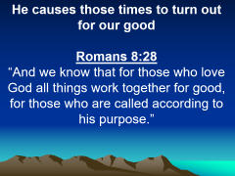

The Lord is in control of
our circumstances
Isaiah 41:10
“Fear not, for I am with you; be not dismayed, for I am your God; I will strengthen you, I will help you, I will uphold you with my righteous right hand”

Slide 33
He causes those times to turn out for our good
Romans 8:28
“And we know that for those who love God all things work together for good, for those who are called according to his purpose.”

Slide 34
There is nothing that can separate
us from His love
Romans 8:38-39
38 For I am persuaded that neither death nor life, nor angels nor principalities nor powers, nor things present nor things to come, 39 nor height nor depth, nor any other created thing, shall be able to separate us from the love of God which is in Christ Jesus our Lord.

Slide 35
We can thank God for what
He is doing in us
2 Corinthians 13:5-6
5 Examine yourselves as to whether you are in the faith. Test yourselves. Do you not know yourselves, that Jesus Christ is in you?--unless indeed you are disqualified. 6 But I trust that you will know that we are not disqualified.

Slide 36
To gain the right Perspective of Joy in the midst of Pain, consider what Peter says…

Slide 37
1 Peter 1:3-8
3 Blessed be the God and Father of our Lord Jesus Christ, who according to His abundant mercy has begotten us again to a living hope through the resurrection of Jesus Christ from the dead, 4 to an inheritance incorruptible and undefiled and that does not fade away, reserved in heaven for you, 5 who are kept by the power of God through faith for salvation ready to be revealed in the last time.

Slide 38
6 In this you greatly rejoice, though now for a little while, if need be, you have been grieved by various trials, 7 that the genuineness of your faith, being much more precious than gold that perishes, though it is tested by fire, may be found to praise, honor, and glory at the revelation of Jesus Christ, 8 whom having not seen you love. Though now you do not see Him, yet believing, you rejoice with joy inexpressible and full of glory…

Slide 39
1. What evidence is there in your life that you have the joy of Christ?

Slide 40
2. How consistently is it expressed in your disposition in hard times?

Slide 41
3. What are some of the reasons you can rejoice in your relationship with Jesus, even when your circumstances give you no apparent reason to do so?

