Slide 1


Slide 2


Slide 3


Christians Must Always Give Thanks
By Pastor Fee Soliven
Psalm 105:1-6
Sunday Morning
November 18, 2018

Slide 4
Psalm 105:1-6
1 Oh, give thanks to the LORD! Call upon His name; Make known His deeds among the peoples! 2 Sing to Him, sing psalms to Him; Talk of all His wondrous works! 3 Glory in His holy name; Let the hearts of those rejoice who seek the LORD! 4 Seek the LORD and His strength; Seek His face evermore! 5 Remember His marvelous works which He has done, His wonders, and the judgments of His mouth, 6 O seed of Abraham His servant, You children of Jacob, His chosen ones!

Slide 5
"What should be the focus of Christians on Thanksgiving?"

Slide 6
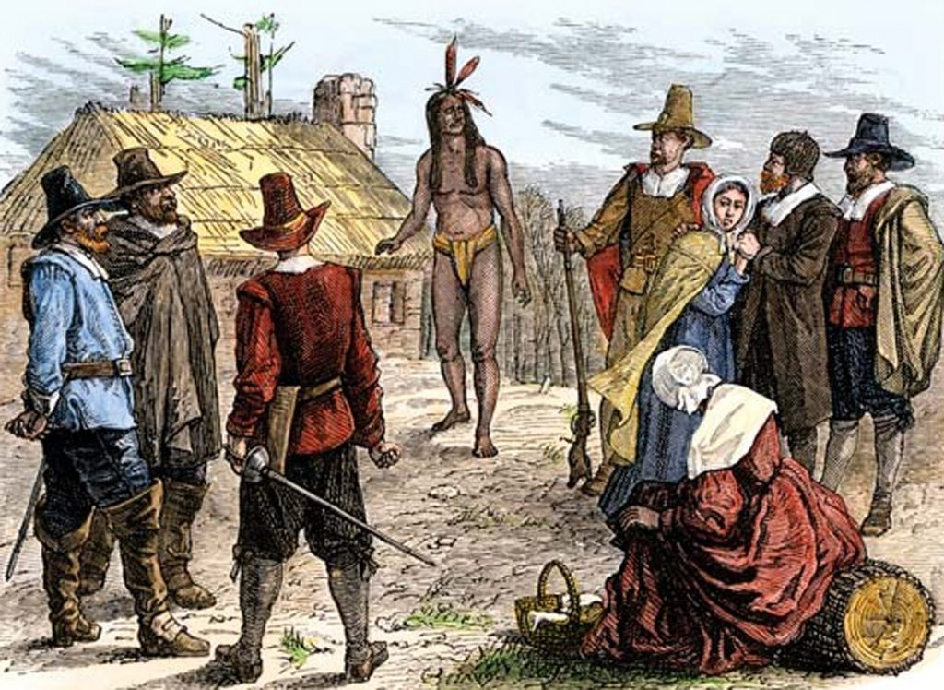
Psalm 92:1-5
1 It is good to give thanks to the LORD, And to sing praises to Your name, O Most High; 2 To declare Your lovingkindness in the morning, And Your faithfulness every night, 3 On an instrument of ten strings, On the lute, And on the harp, With harmonious sound.

Slide 7
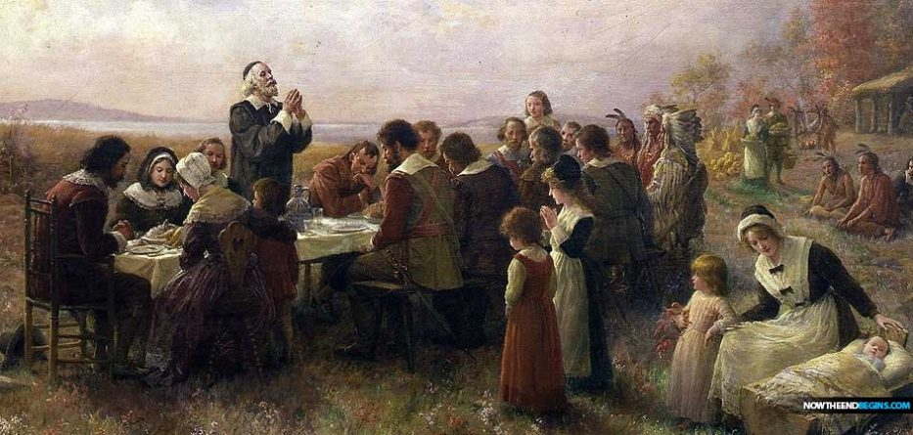
Psalm 92:1-5
1 It is good to give thanks to the LORD, And to sing praises to Your name, O Most High; 2 To declare Your lovingkindness in the morning, And Your faithfulness every night, 3 On an instrument of ten strings, On the lute, And on the harp, With harmonious sound.

Slide 8
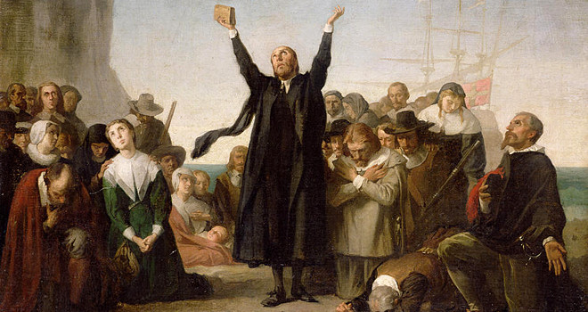
Psalm 92:1-5
1 It is good to give thanks to the LORD, And to sing praises to Your name, O Most High; 2 To declare Your lovingkindness in the morning, And Your faithfulness every night, 3 On an instrument of ten strings, On the lute, And on the harp, With harmonious sound.

Slide 9
President Abraham Lincoln officially set aside the last Thursday of November, in 1863, “as a day of thanksgiving and praise to our beneficent Father.” In 1941, Congress ruled that after 1941, the fourth Thursday of November be observed as Thanksgiving Day and be a legal holiday.

Slide 10
What comes to mind when you think about Thanksgiving Day?

Slide 11
Gratitude to God not only Honors Him, but it is Good for Us

Slide 12
Psalm 92:1
“It is good to give thanks to the LORD, And to sing praises to Your name, O Most High”

Slide 13
1. God is Holy
2. Man is Sinful
3. Obedience is Essential

Slide 14
Leviticus 22:29-33
29 And when you offer a sacrifice of thanksgiving to the LORD, offer it of your own free will. 30 On the same day it shall be eaten; you shall leave none of it until morning: I am the LORD. 31 "Therefore you shall keep My commandments, and perform them: I am the LORD.

Slide 15
32 You shall not profane My holy name, but I will be hallowed among the children of Israel. I am the LORD who sanctifies you, 33 who brought you out of the land of Egypt, to be your God: I am the LORD."

Slide 16
Should we do less than the Hebrews giving thanks to God every morning and evening in recognition of Him as the source of everything we have?

Slide 17
How can we follow the example taught by the daily sacrifice of thanksgiving?

Slide 18
A grateful heart keeps our minds focused on the Lord.

Slide 19
Gratitude Honors God

Slide 20
Psalm 50:23
“But true praise is a worthy sacrifice; this really honors me. Those who walk my paths will receive salvation from the Lord.”

Slide 21
Thankfulness is expressed in a Variety of Ways

Slide 22
A Spirit of Thanksgiving is the result of remembering all God has done for us.

Slide 23
God chose us before the
foundation of the world
Ephesians 1:4
“just as He chose us in Him before the foundation of the world”

Slide 24
We are indwelt and sealed by the Holy Spirit
2 Timothy 1:14
“That good thing which was committed to you, keep by the Holy Spirit who dwells in us.”

Slide 25
We are Eternally Secure
2 Corinthians 1:21-22
21 Now He who establishes us with you in Christ and has anointed us is God, 22 who also has sealed us and given us the Spirit in our hearts as a guarantee.

Slide 26
We have been given
gifts of the Spirit
1 Corinthians 12:28
“And God has appointed in the church, first apostles, second prophets, third teachers, then miracles, then gifts of healings, helps, administrations, various kinds of tongues.”

Slide 27
We have an intimate
relationship with the Lord
John 15:4
“Abide in me, and I in you. As the branch cannot bear fruit of itself, except it abide in the vine; no more can ye, except ye abide in me.”

Slide 28
We have the peace of
God in our hearts
Philippians 4:7
“and the peace of God, which surpasses all understanding, will guard your hearts and minds through Christ Jesus.”

Slide 29
The Lord loves us Unconditionally
Romans 8:38-39
38 For I am persuaded that neither death nor life, nor angels nor principalities nor powers, nor things present nor things to come, 39 nor height nor depth, nor any other created thing, shall be able to separate us from the love of God which is in Christ Jesus our Lord.

Slide 30
We’re never distant from God because we always live in
His presence
Hebrews 13:5
“For He Himself has said, "I will never leave you nor forsake you."

Slide 31
The Lord provides for Our Needs
Philippians 4:19
“And my God shall supply all your need according to His riches in glory by Christ Jesus.”

Slide 32
We have His divine Protection
Each Day
Psalm 34:7
“For the angel of the LORD is a guard; he surrounds and defends all who fear him.”

Slide 33
We have the Promise of a
Bodily Resurrection

Slide 34
1 Corinthians 15:51-53
51 But I am telling you this strange and wonderful secret: we shall not all die, but we shall all be given new bodies! 52 It will all happen in a moment, in the twinkling of an eye, when the last trumpet is blown. For there will be a trumpet blast from the sky, and all the Christians who have died will suddenly become alive, with new bodies that will never, never die; and then we who are still alive shall suddenly have new bodies too.

Slide 35
53 For our earthly bodies, the ones we have now that can die, must be transformed into heavenly bodies that cannot perish but will live forever.

Slide 36
We have the Blessing of God’s Atonement through Christ and total Forgiveness of Our Sins
Ephesians 1:7
“In him we have redemption through his blood, the forgiveness of sins, in accordance with the riches of God's grace”

Slide 37
We have an Eternal Home in Heaven and the Promise of the Resurrection
Philippians 3:20-21
20 For our citizenship is in heaven, from which we also eagerly wait for the Savior, the Lord Jesus Christ, 21 who will transform our lowly body that it may be conformed to His glorious body, according to the working by which He is able even to subdue all things to Himself.

Slide 38
We’ve been given the Word of God, the source of all
Knowledge and Understanding
Colossians 1:9
“For this reason we also, since the day we heard it, do not cease to pray for you, and to ask that you may be filled with the knowledge of His will in all wisdom and spiritual understanding”

Slide 39
True, heartfelt, daily thanksgiving has a powerful impact on our lives.

Slide 40
Results of Gratitude and Thankfulness
1. God Removes Anxiety
2. Praise and Gratitude drive out fretting and worry, it Keeps our focus on the Lord, the situation may not change, but our attitude will
3. Energizes us physically, mentally, emotionally, and Spiritually.

Slide 41
1. How can you make gratitude a daily practice in your life?

Slide 42
2. What effect does thankfulness have on your thoughts, attitudes, words, and actions?

Slide 43
3. The time we most need to thank the Lord is when we feel the least grateful.

Slide 44
4. What keeps you from thanking God in the midst of hardship or pain?

Slide 45
5. What can you do to increase your trust in Him so gratitude will be your first response?

