Slide 1


Slide 2


Slide 3
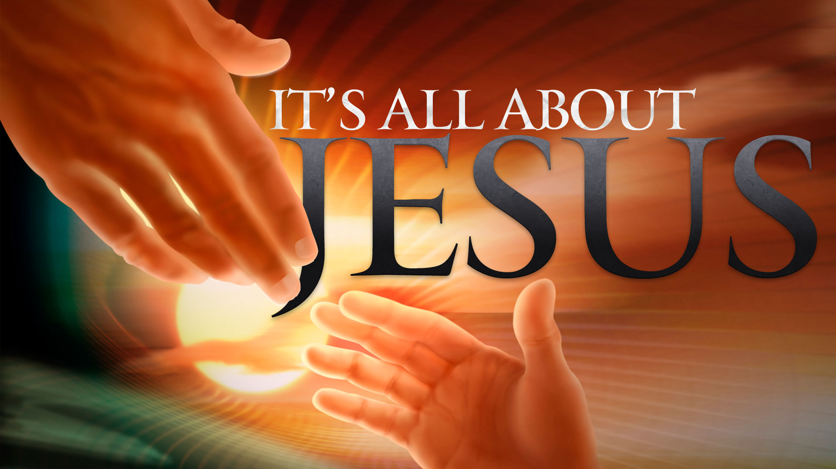

Deliverance Through Repentance
by Pastor Fee Soliven
Mark 6:1-13
Wednesday Evening
November 28, 2018

Slide 4
1 Then He went out from there and came to His own country, and His disciples followed Him. 2 And when the Sabbath had come, He began to teach in the synagogue. And many hearing Him were astonished, saying, "Where did this Man get these things? And what wisdom is this which is given to Him, that such mighty works are performed by His hands!

Slide 5
3 Is this not the carpenter, the Son of Mary, and brother of James, Joses, Judas, and Simon? And are not His sisters here with us?" And they were offended at Him. 4 But Jesus said to them, "A prophet is not without honor except in his own country, among his own relatives, and in his own house." 5 Now He could do no mighty work there, except that He laid His hands on a few sick people and healed them.

Slide 6
6 And He marveled because of their unbelief. Then He went about the villages in a circuit, teaching. 7 And He called the twelve to Himself, and began to send them out two by two, and gave them power over unclean spirits. 8 He commanded them to take nothing for the journey except a staff--no bag, no bread, no copper in their money belts-- 9 but to wear sandals, and not to put on two tunics.

Slide 7
10 Also He said to them, "In whatever place you enter a house, stay there till you depart from that place. 11 And whoever will not receive you nor hear you, when you depart from there, shake off the dust under your feet as a testimony against them. Assuredly, I say to you, it will be more tolerable for Sodom and Gomorrah in the day of judgment than for that city!"

Slide 8
12 So they went out and preached that people should repent. 13 And they cast out many demons, and anointed with oil many who were sick, and healed them.

Slide 9
1 Then He went out from there and came to His own country, and His disciples followed Him.

Slide 10
Micah 5:2
"But you, Bethlehem Ephrathah, Though you are little among the thousands of Judah, Yet out of you shall come forth to Me The One to be Ruler in Israel, Whose goings forth are from of old, From everlasting."

Slide 11
Luke 2:39-40
39 So when they had performed all things according to the law of the Lord, they returned to Galilee, to their own city, Nazareth. 40 And the Child grew and became strong in spirit, filled with wisdom; and the grace of God was upon Him.

Slide 12
2 And when the Sabbath had come, He began to teach in the synagogue. And many hearing Him were astonished, saying, "Where did this Man get these things? And what wisdom is this which is given to Him, that such mighty works are performed by His hands!

Slide 13
Ephesians 1:17-19
17 that the God of our Lord Jesus Christ, the Father of glory, may give to you the spirit of wisdom and revelation in the knowledge of Him, 18 the eyes of your understanding being enlightened; that you may know what is the hope of His calling, what are the riches of the glory of His inheritance in the saints…

Slide 14
3 Is this not the carpenter, the Son of Mary, and brother of James, Joses, Judas, and Simon? And are not His sisters here with us?" And they were offended at Him.

Slide 15
Luke 1:26-31
26 Now in the sixth month the angel Gabriel was sent by God to a city of Galilee named Nazareth, 27 to a virgin betrothed to a man whose name was Joseph, of the house of David. The virgin's name was Mary. 28 And having come in, the angel said to her, "Rejoice, highly favored one, the Lord is with you; blessed are you among women!"

Slide 16
29 But when she saw him, she was troubled at his saying, and considered what manner of greeting this was. 30 Then the angel said to her, "Do not be afraid, Mary, for you have found favor with God. 31 And behold, you will conceive in your womb and bring forth a Son, and shall call His name JESUS.

Slide 17
4 But Jesus said to them, "A prophet is not without honor except in his own country, among his own relatives, and in his own house."

Slide 18
Jeremiah 12:5-6
5 "If you have run with the footmen, and they have wearied you, Then how can you contend with horses? And if in the land of peace, In which you trusted, they wearied you, Then how will you do in the floodplain of the Jordan?

Slide 19
6 For even your brothers, the house of your father, Even they have dealt treacherously with you; Yes, they have called a multitude after you. Do not believe them, Even though they speak smooth words to you.

Slide 20
Acts 1:14
“These all continued with one accord in prayer and supplication, with the women and Mary the mother of Jesus, and with His brothers”

Slide 21
5 Now He could do no mighty work there, except that He laid His hands on a few sick people and healed them. 6 And He marveled because of their unbelief. Then He went about the villages in a circuit, teaching.

Slide 22
Hebrews 11:6
“But without faith it is impossible to please Him, for he who comes to God must believe that He is, and that He is a rewarder of those who diligently seek Him”

Slide 23
7 And He called the twelve to Himself, and began to send them out two by two, and gave them power over unclean spirits.

Slide 24
Luke 10:1-2
1 After these things the Lord appointed seventy others also, and sent them two by two before His face into every city and place where He Himself was about to go. 2 Then He said to them, "The harvest truly is great, but the laborers are few; therefore pray the Lord of the harvest to send out laborers into His harvest.

Slide 25
Matthew 10:1
“And when He had called His twelve disciples to Him, He gave them power over unclean spirits, to cast them out, and to heal all kinds of sickness and all kinds of disease”

Slide 26
8 He commanded them to take nothing for the journey except a staff--no bag, no bread, no copper in their money belts-- 9 but to wear sandals, and not to put on two tunics.

Slide 27
10 Also He said to them, "In whatever place you enter a house, stay there till you depart from that place.

Slide 28
1. It clearly showed that the Messiah had not come to offer wealth to his followers
2. It forced the disciples to rely on God’s power and not on their own provision
3. It involved the villagers and made them more eager to hear the message.

Slide 29
11 And whoever will not receive you nor hear you, when you depart from there, shake off the dust under your feet as a testimony against them. Assuredly, I say to you, it will be more tolerable for Sodom and Gomorrah in the day of judgment than for that city!"

Slide 30
Mark 6:11 (New Life Version)
11 Whoever does not take you in or listen to you, when you leave there, shake the dust off your feet. By doing that, you will speak against them. For sure, I tell you, it will be easier for the cities of Sodom and Gomorrah on the day men stand before God and are judged than for that city.”

Slide 31
12 So they went out and preached that people should repent. 13 And they cast out many demons, and anointed with oil many who were sick, and healed them.

