Slide 1


Slide 2


Slide 3


Jesus Our Deliverer
by Pastor Fee Soliven
Mark 5:1-20
Wednesday Evening
November 7, 2018

Slide 4
1 Then they came to the other side of the sea, to the country of the Gadarenes.

Slide 5
2 And when He had come out of the boat, immediately there met Him out of the tombs a man with an unclean spirit,

Slide 6
3 who had his dwelling among the tombs; and no one could bind him, not even with chains, 4 because he had often been bound with shackles and chains. And the chains had been pulled apart by him, and the shackles broken in pieces; neither could anyone tame him.

Slide 7
5 And always, night and day, he was in the mountains and in the tombs, crying out and cutting himself with stones.

Slide 8
6 When he saw Jesus from afar, he ran and worshiped Him.

Slide 9
7 And he cried out with a loud voice and said, "What have I to do with You, Jesus, Son of the Most High God? I implore You by God that You do not torment me."

Slide 10
8 For He said to him, "Come out of the man, unclean spirit!“ 9 Then He asked him, "What is your name?" And he answered, saying, "My name is Legion; for we are many."

Slide 11
10 Also he begged Him earnestly that He would not send them out of the country.

Slide 12
11 Now a large herd of swine was feeding there near the mountains.

Slide 13
12 So all the demons begged Him, saying, "Send us to the swine, that we may enter them."

Slide 14
13 And at once Jesus gave them permission. Then the unclean spirits went out and entered the swine (there were about two thousand); and the herd ran violently down the steep place into the sea, and drowned in the sea.

Slide 15
14 So those who fed the swine fled, and they told it in the city and in the country. And they went out to see what it was that had happened. 15 Then they came to Jesus, and saw the one who had been demon-possessed and had the legion, sitting and clothed and in his right mind. And they were afraid. 16 And those who saw it told them how it happened to him who had been demon-possessed, and about the swine. 17 Then they began to plead with Him to depart from their region.

Slide 16
18 And when He got into the boat, he who had been demon-possessed begged Him that he might be with Him. 19 However, Jesus did not permit him, but said to him, "Go home to your friends, and tell them what great things the Lord has done for you, and how He has had compassion on you."

Slide 17
20 And he departed and began to proclaim in Decapolis all that Jesus had done for him; and all marveled.

Slide 18
1 Then they came to the other side of the sea, to the country of the Gadarenes.

Slide 19
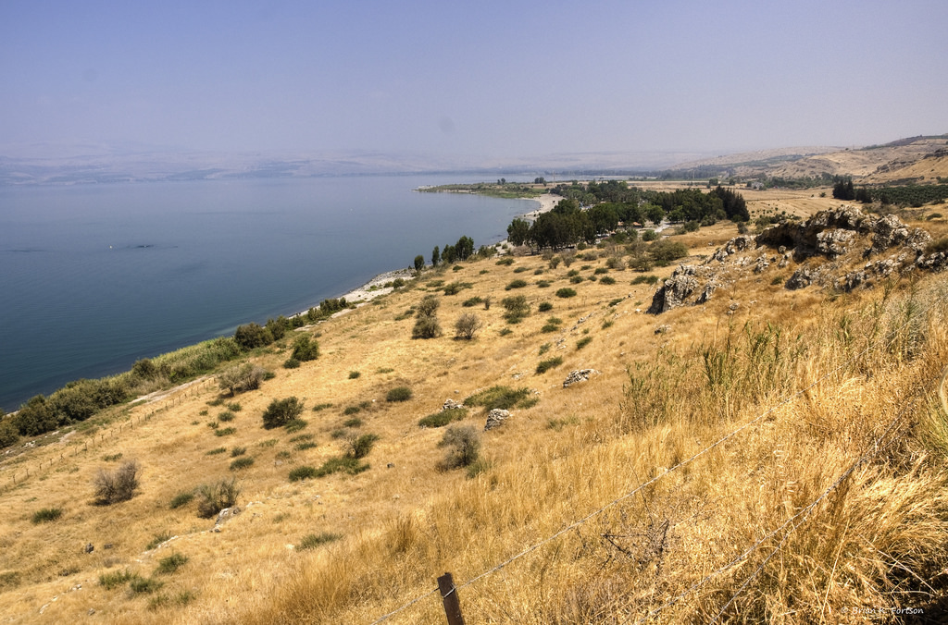
Acts 1:8
“But you shall receive power when the Holy Spirit has come upon you; and you shall be witnesses to Me in Jerusalem, and in all Judea and Samaria, and to the end of the earth."

Slide 20
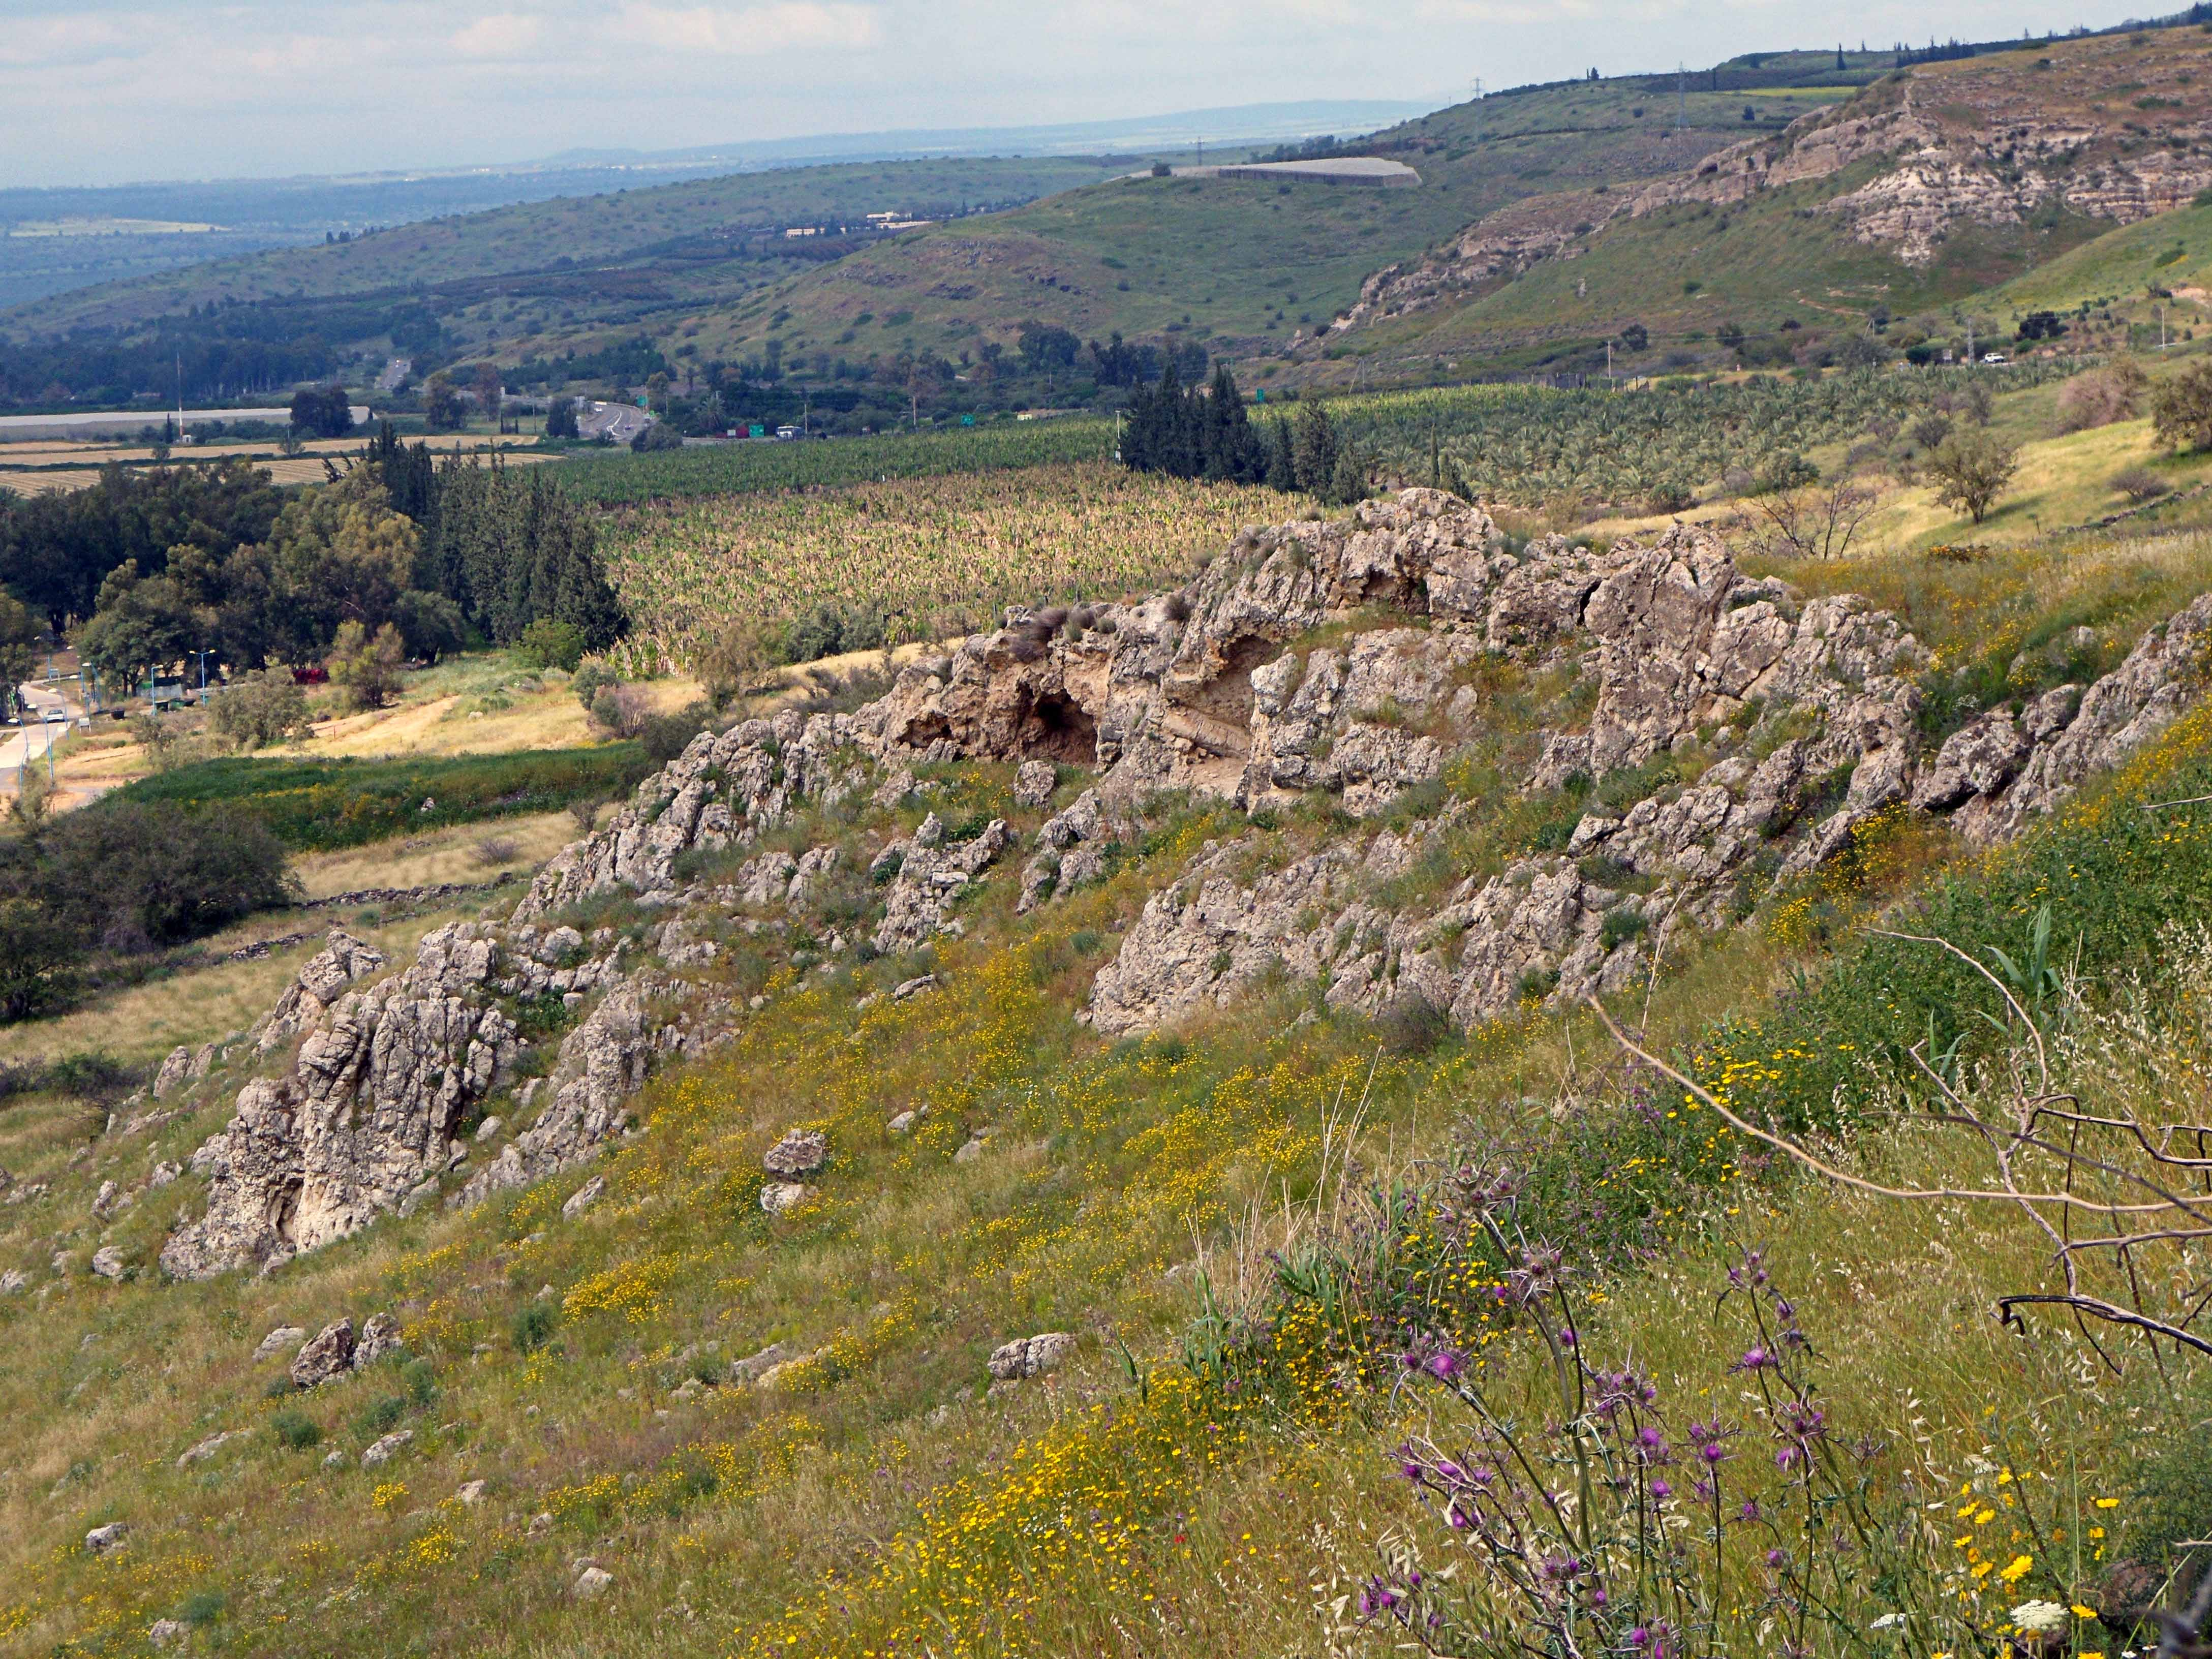
Acts 17:5-6
5 But the Jews who were not persuaded, becoming envious, took some of the evil men from the marketplace, and gathering a mob, set all the city in an uproar and attacked the house of Jason, and sought to bring them out to the people. 6 But when they did not find them, they dragged Jason and some brethren to the rulers of the city, crying out, "These who have turned the world upside down have come here too.

Slide 21
2 And when He had come out of the boat, immediately there met Him out of the tombs a man with an unclean spirit,

Slide 22
Luke 7:18-21
18 Then the disciples of John reported to him concerning all these things. 19 And John, calling two of his disciples to him, sent them to Jesus, saying, "Are You the Coming One, or do we look for another?" 20 When the men had come to Him, they said, "John the Baptist has sent us to You, saying, 'Are You the Coming One, or do we look for another?' " 21 And that very hour He cured many of infirmities, afflictions, and evil spirits; and to many blind He gave sight.

Slide 23
Acts 19:11-17
11 Now God worked unusual miracles by the hands of Paul, 12 so that even handkerchiefs or aprons were brought from his body to the sick, and the diseases left them and the evil spirits went out of them. 13 Then some of the itinerant Jewish exorcists took it upon themselves to call the name of the Lord Jesus over those who had evil spirits, saying, "We exorcise you by the Jesus whom Paul preaches."

Slide 24
14 Also there were seven sons of Sceva, a Jewish chief priest, who did so. 15 And the evil spirit answered and said, "Jesus I know, and Paul I know; but who are you?" 16 Then the man in whom the evil spirit was leaped on them, overpowered them, and prevailed against them, so that they fled out of that house naked and wounded.

Slide 25
3 who had his dwelling among the tombs; and no one could bind him, not even with chains, 4 because he had often been bound with shackles and chains. And the chains had been pulled apart by him, and the shackles broken in pieces; neither could anyone tame him.

Slide 26
5 And always, night and day, he was in the mountains and in the tombs, crying out and cutting himself with stones.

Slide 27
6 When he saw Jesus from afar, he ran and worshiped Him.

Slide 28
James 2:19
“You believe that there is one God. You do well. Even the demons believe--and tremble!”

Slide 29
7 And he cried out with a loud voice and said, "What have I to do with You, Jesus, Son of the Most High God? I implore You by God that You do not torment me."

Slide 30
Revelation 20:10
“The devil, who deceived them, was cast into the lake of fire and brimstone where the beast and the false prophet are. And they will be tormented day and night forever and ever.”

Slide 31
8 For He said to him, "Come out of the man, unclean spirit!“ 9 Then He asked him, "What is your name?" And he answered, saying, "My name is Legion; for we are many."

Slide 32
10 Also he begged Him earnestly that He would not send them out of the country.

Slide 33
Luke 8:30-31
30 Jesus asked him, saying, "What is your name?" And he said, "Legion," because many demons had entered him. 31 And they begged Him that He would not command them to go out into the abyss.

Slide 34
Why didn’t Jesus just destroy these demons—or send them away?

Slide 35
Revelation 21:3-8
3 And I heard a loud voice from heaven saying, "Behold, the tabernacle of God is with men, and He will dwell with them, and they shall be His people. God Himself will be with them and be their God. 4 And God will wipe away every tear from their eyes; there shall be no more death, nor sorrow, nor crying. There shall be no more pain, for the former things have passed away."

Slide 36
5 Then He who sat on the throne said, "Behold, I make all things new." And He said to me, "Write, for these words are true and faithful." 6 And He said to me, "It is done! I am the Alpha and the Omega, the Beginning and the End. I will give of the fountain of the water of life freely to him who thirsts.

Slide 37
7 He who overcomes shall inherit all things, and I will be his God and he shall be My son. 8 But the cowardly, unbelieving, abominable, murderers, sexually immoral, sorcerers, idolaters, and all liars shall have their part in the lake which burns with fire and brimstone, which is the second death."

Slide 38
11 Now a large herd of swine was feeding there near the mountains.

Slide 39
Leviticus 11:6-8
6 the hare, because it chews the cud but does not have cloven hooves, is unclean to you; 7 and the swine, though it divides the hoof, having cloven hooves, yet does not chew the cud, is unclean to you. 8 Their flesh you shall not eat, and their carcasses you shall not touch. They are unclean to you.

Slide 40
12 So all the demons begged Him, saying, "Send us to the swine, that we may enter them."

Slide 41
13 And at once Jesus gave them permission. Then the unclean spirits went out and entered the swine (there were about two thousand); and the herd ran violently down the steep place into the sea, and drowned in the sea.

Slide 42
14 So those who fed the swine fled, and they told it in the city and in the country. And they went out to see what it was that had happened. 15 Then they came to Jesus, and saw the one who had been demon-possessed and had the legion, sitting and clothed and in his right mind. And they were afraid. 16 And those who saw it told them how it happened to him who had been demon-possessed, and about the swine. 17 Then they began to plead with Him to depart from their region.

Slide 43
18 And when He got into the boat, he who had been demon-possessed begged Him that he might be with Him. 19 However, Jesus did not permit him, but said to him, "Go home to your friends, and tell them what great things the Lord has done for you, and how He has had compassion on you."

Slide 44
20 And he departed and began to proclaim in Decapolis all that Jesus had done for him; and all marveled.

Slide 45
Matthew 4:23-25
23 And Jesus went about all Galilee, teaching in their synagogues, preaching the gospel of the kingdom, and healing all kinds of sickness and all kinds of disease among the people.

Slide 46
24 Then His fame went throughout all Syria; and they brought to Him all sick people who were afflicted with various diseases and torments, and those who were demon-possessed, epileptics, and paralytics; and He healed them. 25 Great multitudes followed Him--from Galilee, and from Decapolis, Jerusalem, Judea, and beyond the Jordan.

