Slide 1


Slide 2


Slide 3
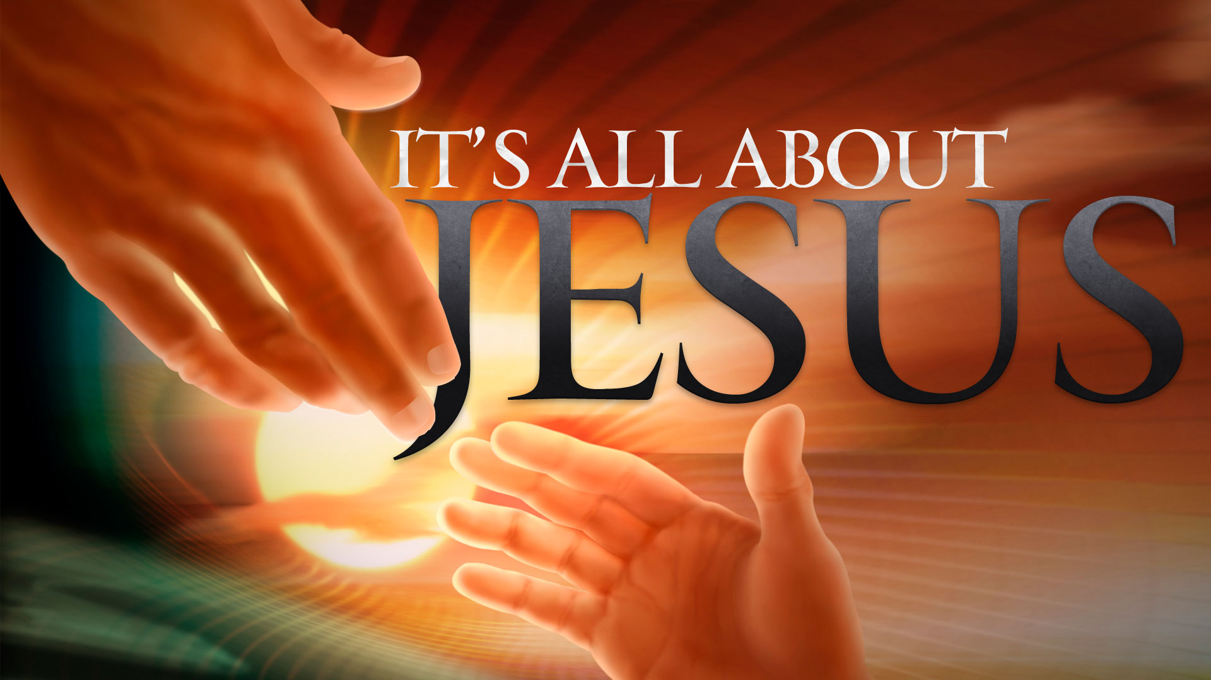

Oh Ye Of Little Faith
by Pastor Fee Soliven
Mark 4:30-41
Wednesday Evening
October 31, 2018

Slide 4
30 Then He said, "To what shall we liken the kingdom of God? Or with what parable shall we picture it?

Slide 5
31 It is like a mustard seed which, when it is sown on the ground, is smaller than all the seeds on earth; 32 but when it is sown, it grows up and becomes greater than all herbs, and shoots out large branches, so that the birds of the air may nest under its shade."

Slide 6
33 And with many such parables He spoke the word to them as they were able to hear it. 34 But without a parable He did not speak to them. And when they were alone, He explained all things to His disciples.

Slide 7
35 On the same day, when evening had come, He said to them, "Let us cross over to the other side."

Slide 8
36 Now when they had left the multitude, they took Him along in the boat as He was. And other little boats were also with Him.

Slide 9
37 And a great windstorm arose, and the waves beat into the boat, so that it was already filling.

Slide 10
38 But He was in the stern, asleep on a pillow. And they awoke Him and said to Him, "Teacher, do You not care that we are perishing?"

Slide 11
39 Then He arose and rebuked the wind, and said to the sea, "Peace, be still!" And the wind ceased and there was a great calm.

Slide 12
40 But He said to them, "Why are you so fearful? How is it that you have no faith?"

Slide 13
41 And they feared exceedingly, and said to one another, "Who can this be, that even the wind and the sea obey Him!"

Slide 14
30 Then He said, "To what shall we liken the kingdom of God? Or with what parable shall we picture it?

Slide 15
31 It is like a mustard seed which, when it is sown on the ground, is smaller than all the seeds on earth; 32 but when it is sown, it grows up and becomes greater than all herbs, and shoots out large branches, so that the birds of the air may nest under its shade."

Slide 16
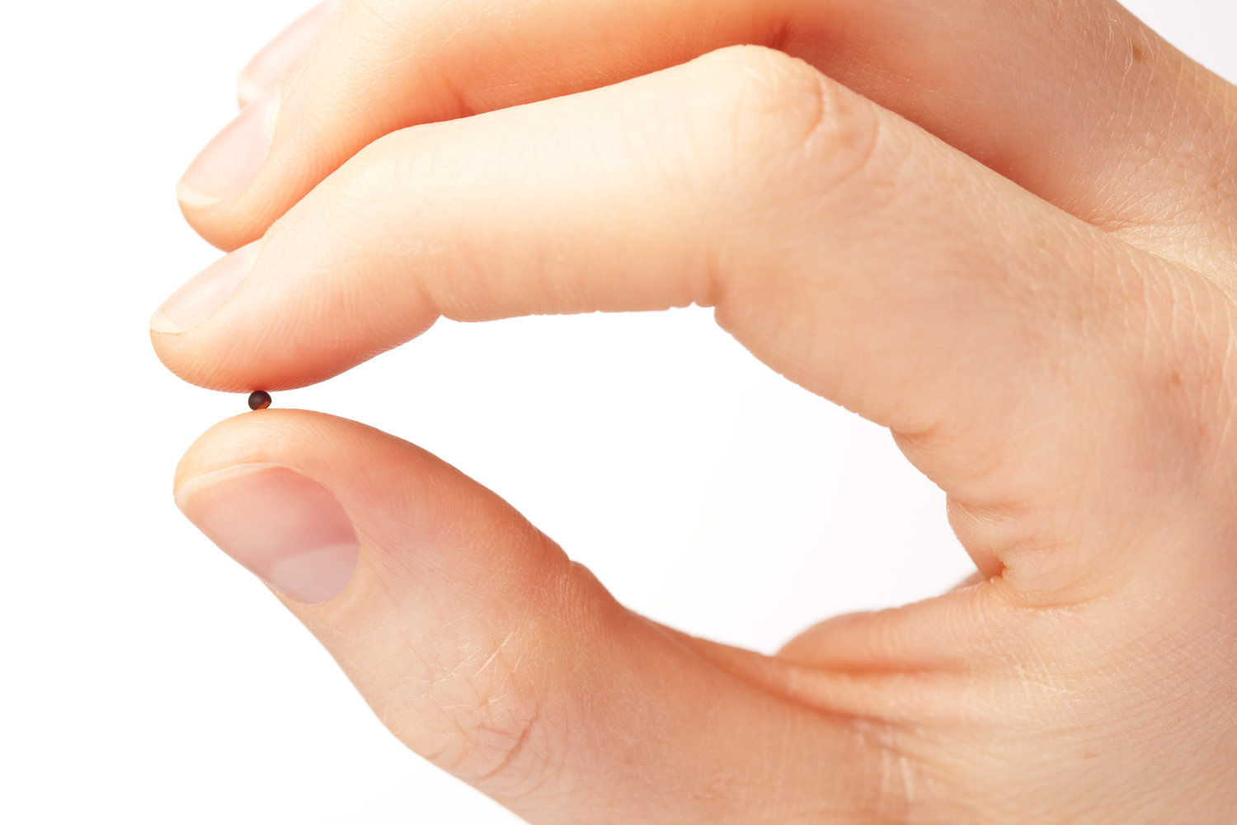
23 If anyone has ears to hear, let him hear."

Slide 17
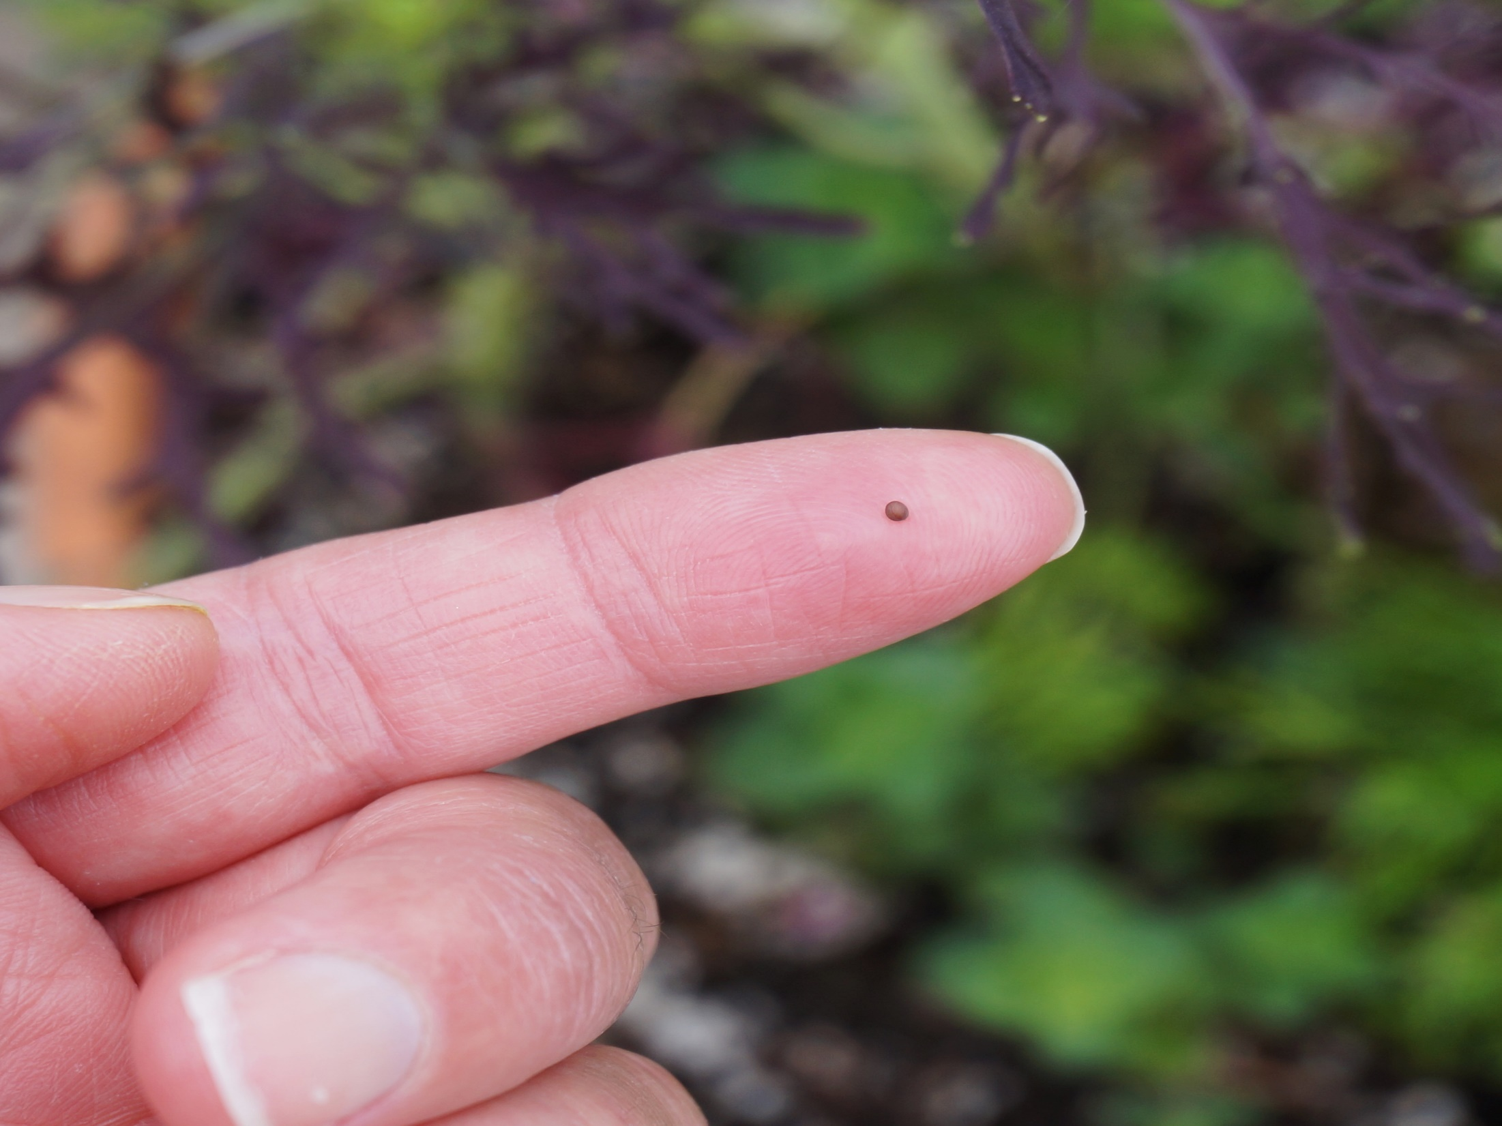
Revelation 2:7
“He who has an ear, let him hear what the Spirit says to the churches. To him who overcomes I will give to eat from the tree of life, which is in the midst of the Paradise of God." '

Slide 18
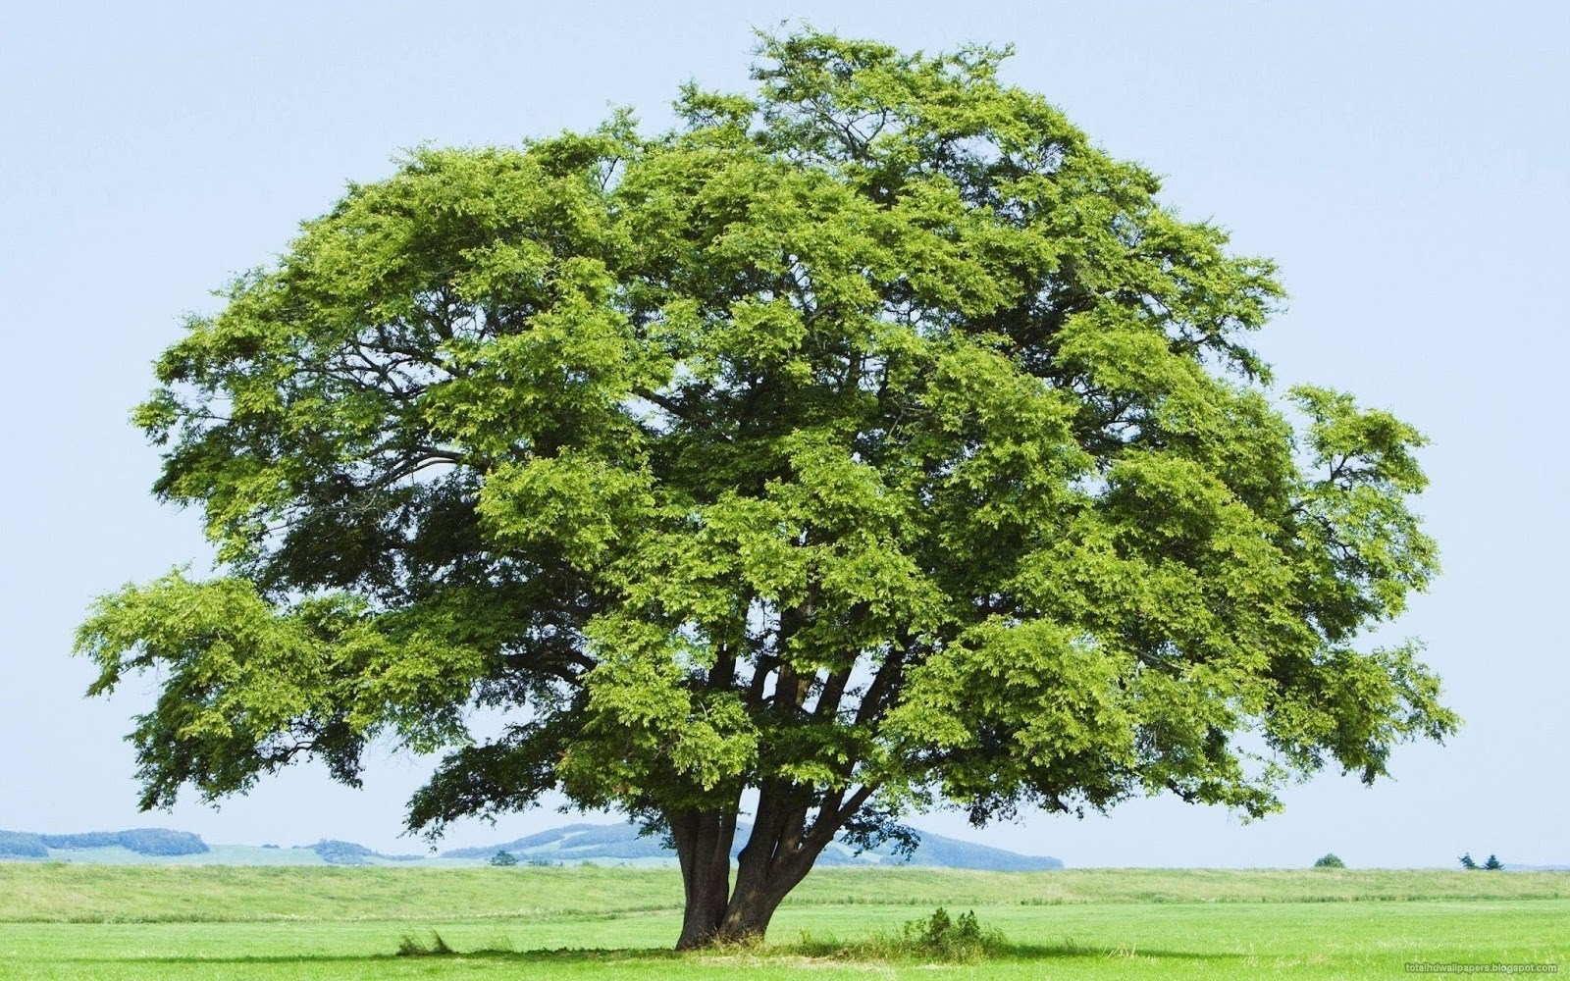
24 Then He said to them, "Take heed what you hear. With the same measure you use, it will be measured to you; and to you who hear, more will be given.

Slide 19
Acts 1:8
“But you shall receive power when the Holy Spirit has come upon you; and you shall be witnesses to Me in Jerusalem, and in all Judea and Samaria, and to the end of the earth."

Slide 20
Acts 17:5-6
5 But the Jews who were not persuaded, becoming envious, took some of the evil men from the marketplace, and gathering a mob, set all the city in an uproar and attacked the house of Jason, and sought to bring them out to the people. 6 But when they did not find them, they dragged Jason and some brethren to the rulers of the city, crying out, "These who have turned the world upside down have come here too.

Slide 21
33 And with many such parables He spoke the word to them as they were able to hear it. 34 But without a parable He did not speak to them. And when they were alone, He explained all things to His disciples.

Slide 22
Colossians 1:24-29
24 I now rejoice in my sufferings for you, and fill up in my flesh what is lacking in the afflictions of Christ, for the sake of His body, which is the church, 25 of which I became a minister according to the stewardship from God which was given to me for you, to fulfill the word of God, 26 the mystery which has been hidden from ages and from generations, but now has been revealed to His saints.

Slide 23
27 To them God willed to make known what are the riches of the glory of this mystery among the Gentiles: which is Christ in you, the hope of glory. 28 Him we preach, warning every man and teaching every man in all wisdom, that we may present every man perfect in Christ Jesus. 29 To this end I also labor, striving according to His working which works in me mightily.

Slide 24
35 On the same day, when evening had come, He said to them, "Let us cross over to the other side."

Slide 25
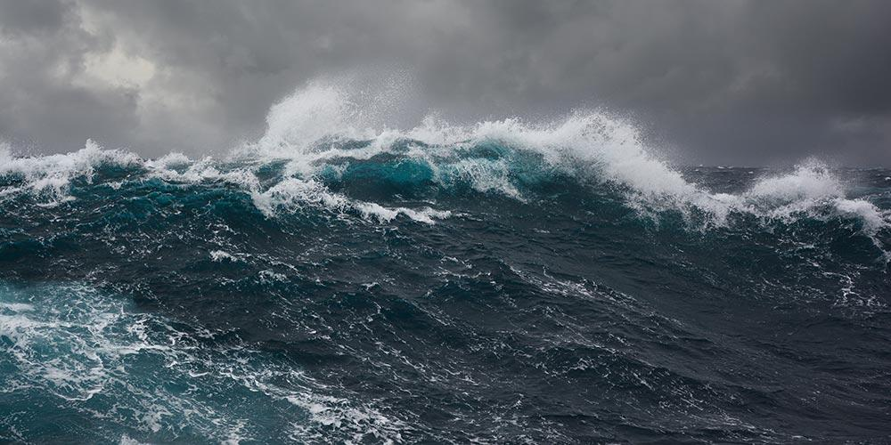
29 But when the grain ripens, immediately he puts in the sickle, because the harvest has come."

Slide 26
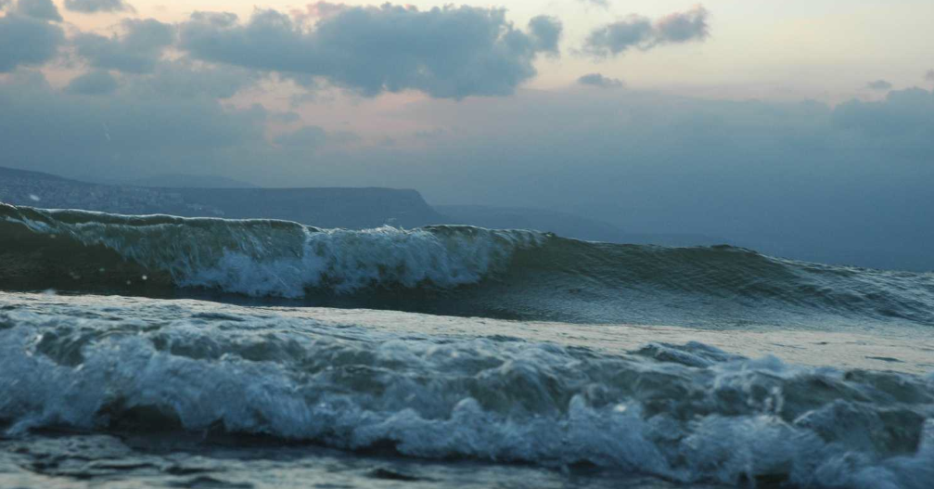
Webster’s Dictionary defines the word tribulation as: 1. grievous trouble; severe trial or suffering. 2. an instance of this; an affliction, trouble, etc.

Slide 27
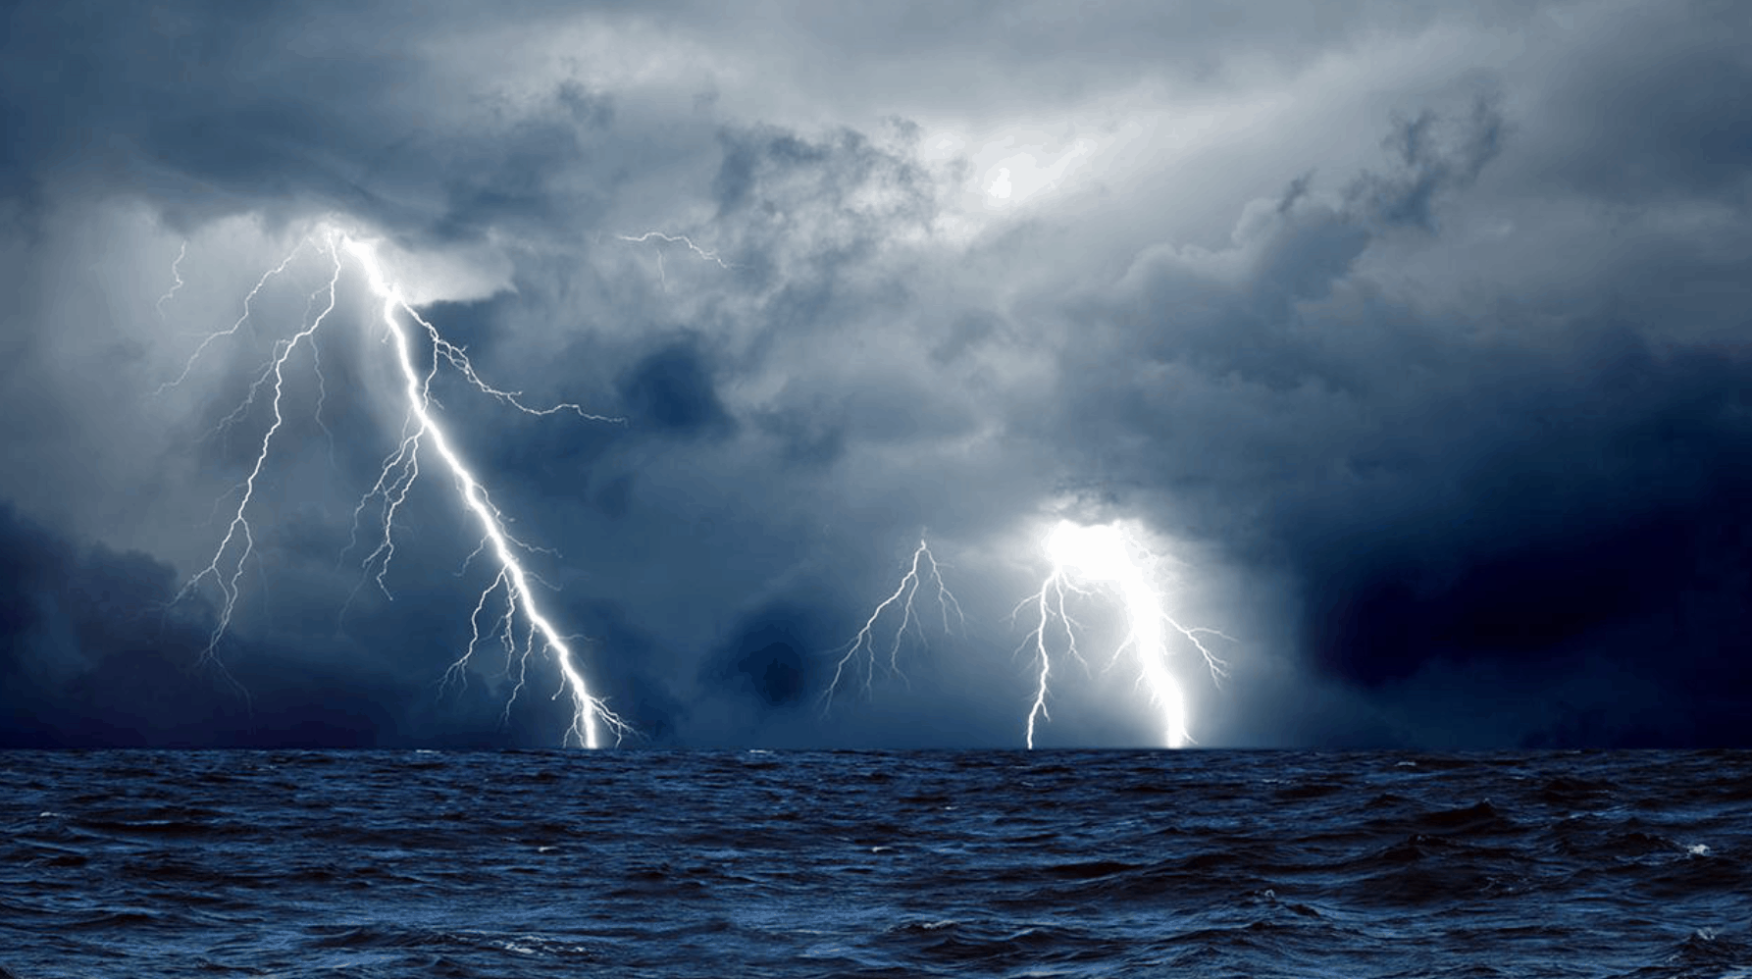
2 Corinthians 6:1-2
1 We then, as workers together with Him also plead with you not to receive the grace of God in vain. 2 For He says: "In an acceptable time I have heard you, And in the day of salvation I have helped you." Behold, now is the accepted time; behold, now is the day of salvation.

Slide 28
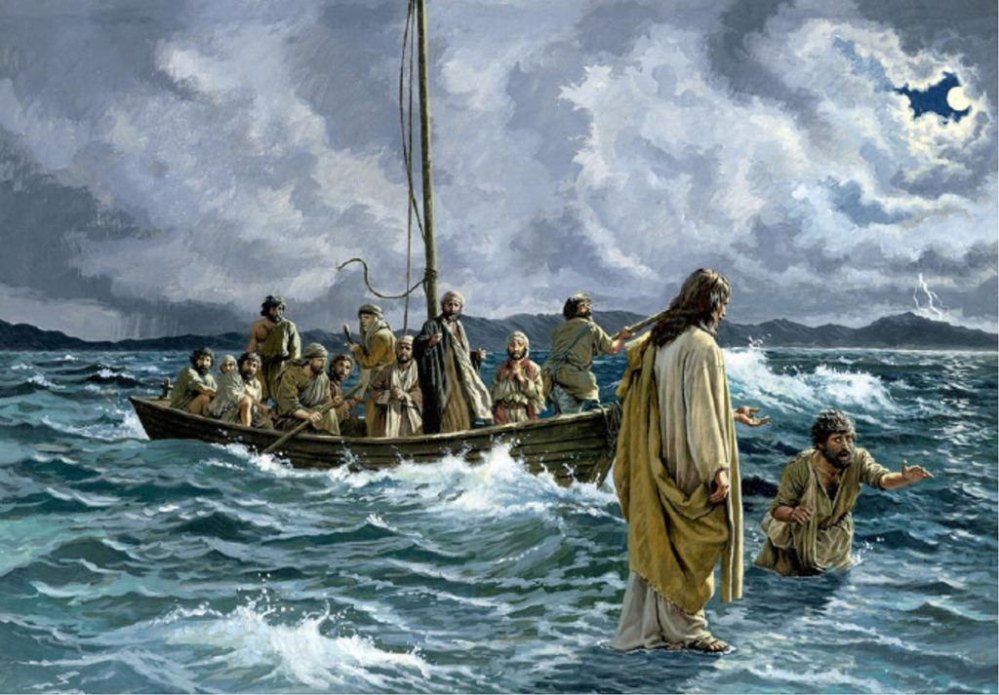
Matthew 4:12-17
12 Now when Jesus heard that John had been put in prison, He departed to Galilee. 13 And leaving Nazareth, He came and dwelt in Capernaum, which is by the sea, in the regions of Zebulun and Naphtali, 14 that it might be fulfilled which was spoken by Isaiah the prophet, saying:

Slide 29
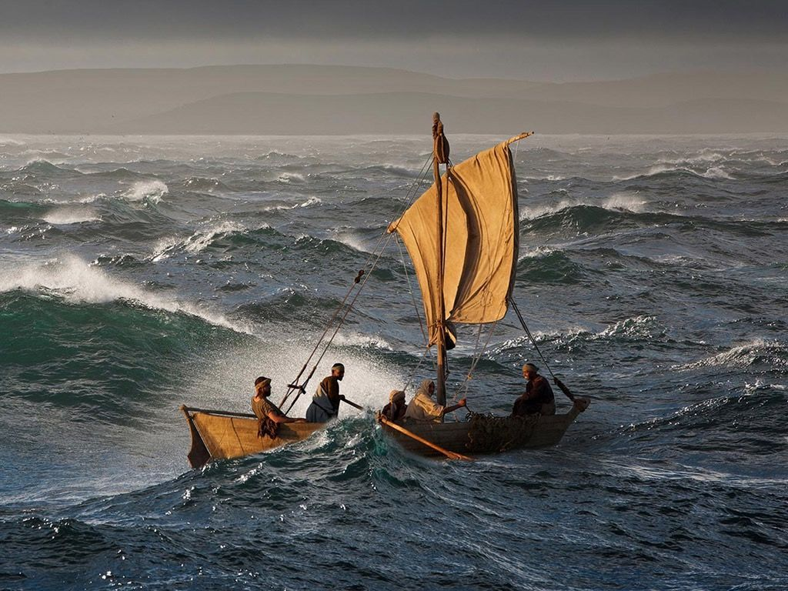
15 "The land of Zebulun and the land of Naphtali, By the way of the sea, beyond the Jordan, Galilee of the Gentiles: 16 The people who sat in darkness have seen a great light, And upon those who sat in the region and shadow of death
Light has dawned."

Slide 30
36 Now when they had left the multitude, they took Him along in the boat as He was. And other little boats were also with Him.

Slide 31
37 And a great windstorm arose, and the waves beat into the boat, so that it was already filling.

Slide 32
38 But He was in the stern, asleep on a pillow. And they awoke Him and said to Him, "Teacher, do You not care that we are perishing?"

Slide 33
John 16:32-33
32 Indeed the hour is coming, yes, has now come, that you will be scattered, each to his own, and will leave Me alone. And yet I am not alone, because the Father is with Me. 33 These things I have spoken to you, that in Me you may have peace. In the world you will have tribulation; but be of good cheer, I have overcome the world."

Slide 34
Romans 12:9-12
9 Let love be without hypocrisy. Abhor what is evil. Cling to what is good. 10 Be kindly affectionate to one another with brotherly love, in honor giving preference to one another; 11 not lagging in diligence, fervent in spirit, serving the Lord; 12 rejoicing in hope, patient in tribulation, continuing steadfastly in prayer…

Slide 35
2 Corinthians 1:3-6
3 What a wonderful God we have-he is the Father of our Lord Jesus Christ, the source of every mercy, and the one who so wonderfully comforts and strengthens us in our hardships and trials. And why does he do this? So that when others are troubled, needing our sympathy and encouragement, we can pass on to them this same help and comfort God has given us.

Slide 36
5 You can be sure that the more we undergo sufferings for Christ, the more he will shower us with his comfort and encouragement. 6 We are in deep trouble for bringing you God's comfort and salvation. But in our trouble God has comforted us-and this, too, to help you: to show you from our personal experience how God will tenderly comfort you when you undergo these same sufferings. He will give you the strength to endure.

Slide 37
Hebrews 13:5-6
5 Let your conduct be without covetousness; be content with such things as you have. For He Himself has said, "I will never leave you nor forsake you." 6 So we may boldly say: "The LORD is my helper; I will not fear. What can man do to me?"

Slide 38
39 Then He arose and rebuked the wind, and said to the sea, "Peace, be still!" And the wind ceased and there was a great calm.

Slide 39
Matthew 28:16-18
16 Then the eleven disciples went away into Galilee, to the mountain which Jesus had appointed for them. 17 When they saw Him, they worshiped Him; but some doubted. 18 And Jesus came and spoke to them, saying, "All authority has been given to Me in heaven and on earth.

Slide 40
2 Peter 1:2-4
2 Grace and peace be multiplied to you in the knowledge of God and of Jesus our Lord, 3 as His divine power has given to us all things that pertain to life and godliness, through the knowledge of Him who called us by glory and virtue, 4 by which have been given to us exceedingly great and precious promises, that through these you may be partakers of the divine nature, having escaped the corruption that is in the world through lust.

Slide 41
40 But He said to them, "Why are you so fearful? How is it that you have no faith?"

Slide 42
2 Timothy 1:7
“For God has not given us a spirit of fear, but of power and of love and of a sound mind”

Slide 43
Galatians 2:20
“I have been crucified with Christ; it is no longer I who live, but Christ lives in me; and the life which I now live in the flesh I live by faith in the Son of God, who loved me and gave Himself for me.”

Slide 44
1 Timothy 3:16
“And without controversy great is the mystery of godliness: God was manifested in the flesh, Justified in the Spirit, Seen by angels, Preached among the Gentiles, Believed on in the world, Received up in glory.”

Slide 45
41 And they feared exceedingly, and said to one another, "Who can this be, that even the wind and the sea obey Him!"

