Slide 1


Slide 2
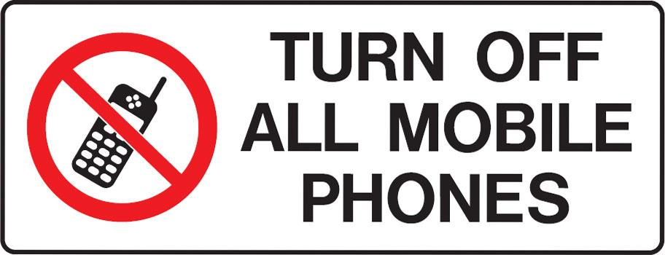

Slide 3


The Kindness of Our Savior
By Pastor Fee Soliven
Titus 3:4-7
Sunday Morning
November 11, 2018

Slide 4
Titus 3:4-7
4 But when the kindness and the love of God our Savior toward man appeared, 5 not by works of righteousness which we have done, but according to His mercy He saved us, through the washing of regeneration and renewing of the Holy Spirit, 6 whom He poured out on us abundantly through Jesus Christ our Savior, 7 that having been justified by His grace we should become heirs according to the hope of eternal life.

Slide 5
Do you think you are a kind person?

Slide 6
Would those who are closest to you agree with your assessment?

Slide 7
Proverbs 11:17
“A man who is kind benefits himself, but a cruel man hurts himself.”

Slide 8
Galatians 5:22-23
“But the fruit of the Spirit is love, joy, peace, patience, kindness, goodness, faithfulness, gentleness, self control.”

Slide 9
Ephesians 4:32
“Be kind to one another, tender-hearted, forgiving each other, just as God in Christ also has forgiven you.”

Slide 10
Colossians 3:12
“So, as those who have been chosen of God, holy and beloved, put on a heart of compassion, kindness, humility, gentleness and patience.”

Slide 11
Luke 6:35
“But love your enemies, and do good, and lend, expecting nothing in return, and your reward will be great, and you will be sons of the Most High, for he is kind to the ungrateful and the evil.”

Slide 12
Proverbs 11:17
“A man who is kind benefits himself, but a cruel man hurts himself.”

Slide 13
Mark 10:46-52
46 Now they came to Jericho. As He went out of Jericho with His disciples and a great multitude, blind Bartimaeus, the son of Timaeus, sat by the road begging. 47 And when he heard that it was Jesus of Nazareth, he began to cry out and say, "Jesus, Son of David, have mercy on me!"

Slide 14
48 Then many warned him to be quiet; but he cried out all the more, "Son of David, have mercy on me!" 49 So Jesus stood still and commanded him to be called. Then they called the blind man, saying to him, "Be of good cheer. Rise, He is calling you." 50 And throwing aside his garment, he rose and came to Jesus.

Slide 15
51 So Jesus answered and said to him, "What do you want Me to do for you?" The blind man said to Him, "Rabboni, that I may receive my sight." 52 Then Jesus said to him, "Go your way; your faith has made you well." And immediately he received his sight and followed Jesus on the road.

Slide 16
God shows kindness to all Mankind

Slide 17
Titus 3:4-6
4 “But when the kindness of God our Savior and His love for mankind appeared, He saved us, 5 not on the basis of deeds which we have done in righteousness, but according to His mercy, by the washing of regeneration and renewing by the Holy Spirit, 6 whom He poured out upon us richly through Jesus Christ our Savior.”

Slide 18
Romans 2:4
Or do you despise the riches of His goodness, forbearance, and longsuffering, not knowing that the goodness of God leads you to repentance?

Slide 19
Expressions of God’s Kindness

Slide 20
1. He Pardons us from our Sin

Slide 21
Ephesians 2:8-9
8 For by grace you have been saved through faith, and that not of yourselves; it is the gift of God, 9 not of works, lest anyone should boast.

Slide 22
2. He provides for our Needs

Slide 23
Philippians 4:19
“And my God shall supply all your need according to His riches in glory by Christ Jesus.”

Slide 24
3. In times of danger, He often protects Us

Slide 25
Psalm 91:11
“For He shall give His angels charge over you, To keep you in all your ways.”

Slide 26
4. Every answered Prayer is an act of kindness on God’s Part

Slide 27
John 14:13
“And whatever you ask in My name, that I will do, that the Father may be glorified in the Son.”

Slide 28
5. He Gives us the gift of Eternal Life

Slide 29
John 10:27-30
27 My sheep hear My voice, and I know them, and they follow Me. 28 And I give them eternal life, and they shall never perish; neither shall anyone snatch them out of My hand. 29 My Father, who has given them to Me, is greater than all; and no one is able to snatch them out of My Father's hand. 30 I and My Father are one."

Slide 30
6. God keeps every Promise He makes

Slide 31
2 Corinthians 1:20-22
20 For all the promises of God in Him are Yes, and in Him Amen, to the glory of God through us. 21 Now He who establishes us with you in Christ and has anointed us is God, 22 who also has sealed us and given us the Spirit in our hearts as a guarantee.

Slide 32
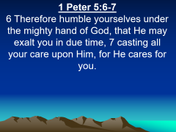

7. He is Personally involved in our Lives

Slide 33
1 Peter 5:6-7
6 Therefore humble yourselves under the mighty hand of God, that He may exalt you in due time, 7 casting all your care upon Him, for He cares for you.

Slide 34
8. We have the Promise of His presence with Us

Slide 35
Hebrews 13:5
“For He Himself has said, ‘I will never desert you, nor will I ever forsake you.’”

Slide 36
Proverbs 19:22
“What is desirable in a man is his kindness.”

Slide 37
Proverbs 3:3
“Do not let kindness and truth leave you; bind them around your neck, write them on the tablet of your heart.”

Slide 38
Zechariah 7:9
“Thus has the LORD of hosts said, ‘Dispense true justice and practice kindness and compassion each to his brother.’”

Slide 39
1 Peter 2:3
“If you have tasted the kindness of the Lord.”

Slide 40
1. Are your interactions with your family kind?

Slide 41
2. Why is the home often the most difficult place to practice kindness?

Slide 42
3. What would your home look like if everyone was kind to one another?

