Slide 1


Slide 2


Slide 3


Wonder Working Power of Jesus
by Pastor Fee Soliven
Mark 5:21-43
Wednesday Evening
November 14, 2018

Slide 4
21 Now when Jesus had crossed over again by boat to the other side, a great multitude gathered to Him; and He was by the sea. 22 And behold, one of the rulers of the synagogue came, Jairus by name. And when he saw Him, he fell at His feet 23 and begged Him earnestly, saying, "My little daughter lies at the point of death. Come and lay Your hands on her, that she may be healed, and she will live."

Slide 5
24 So Jesus went with him, and a great multitude followed Him and thronged Him. 25 Now a certain woman had a flow of blood for twelve years, 26 and had suffered many things from many physicians. She had spent all that she had and was no better, but rather grew worse. 27 When she heard about Jesus, she came behind Him in the crowd and touched His garment;

Slide 6
28 for she said, "If only I may touch His clothes, I shall be made well." 29 Immediately the fountain of her blood was dried up, and she felt in her body that she was healed of the affliction. 30 And Jesus, immediately knowing in Himself that power had gone out of Him, turned around in the crowd and said, "Who touched My clothes?"

Slide 7
31 But His disciples said to Him, "You see the multitude thronging You, and You say, 'Who touched Me?' " 32 And He looked around to see her who had done this thing. 33 But the woman, fearing and trembling, knowing what had happened to her, came and fell down before Him and told Him the whole truth.

Slide 8
34 And He said to her, "Daughter, your faith has made you well. Go in peace, and be healed of your affliction." 35 While He was still speaking, some came from the ruler of the synagogue's house who said, "Your daughter is dead. Why trouble the Teacher any further?" 36 As soon as Jesus heard the word that was spoken, He said to the ruler of the synagogue, "Do not be afraid; only believe."

Slide 9
37 And He permitted no one to follow Him except Peter, James, and John the brother of James. 38 Then He came to the house of the ruler of the synagogue, and saw a tumult and those who wept and wailed loudly. 39 When He came in, He said to them, "Why make this commotion and weep? The child is not dead, but sleeping." 40 And they ridiculed Him. But when He had put them all outside, He took the father and the mother of the child, and those who were with Him, and entered where the child was lying.

Slide 10
41 Then He took the child by the hand, and said to her, "Talitha, cumi," which is translated, "Little girl, I say to you, arise." 42 Immediately the girl arose and walked, for she was twelve years of age. And they were overcome with great amazement. 43 But He commanded them strictly that no one should know it, and said that something should be given her to eat.

Slide 11
21 Now when Jesus had crossed over again by boat to the other side, a great multitude gathered to Him; and He was by the sea.

Slide 12
22 And behold, one of the rulers of the synagogue came, Jairus by name. And when he saw Him, he fell at His feet 23 and begged Him earnestly, saying, "My little daughter lies at the point of death. Come and lay Your hands on her, that she may be healed, and she will live." 24 So Jesus went with him, and a great multitude followed Him and thronged Him.

Slide 13
25 Now a certain woman had a flow of blood for twelve years, 26 and had suffered many things from many physicians. She had spent all that she had and was no better, but rather grew worse.

Slide 14
Leviticus 15:25-27
25'If a woman has a discharge of blood for many days, other than at the time of her customary impurity, or if it runs beyond her usual time of impurity, all the days of her unclean discharge shall be as the days of her customary impurity. She shall be unclean.

Slide 15
26 Every bed on which she lies all the days of her discharge shall be to her as the bed of her impurity; and whatever she sits on shall be unclean, as the uncleanness of her impurity. 27 Whoever touches those things shall be unclean; he shall wash his clothes and bathe in water, and be unclean until evening.

Slide 16
27 When she heard about Jesus, she came behind Him in the crowd and touched His garment; 28 for she said, "If only I may touch His clothes, I shall be made well."

Slide 17
Acts 19:11-12
11 Now God worked unusual miracles by the hands of Paul, 12 so that even handkerchiefs or aprons were brought from his body to the sick, and the diseases left them and the evil spirits went out of them.

Slide 18
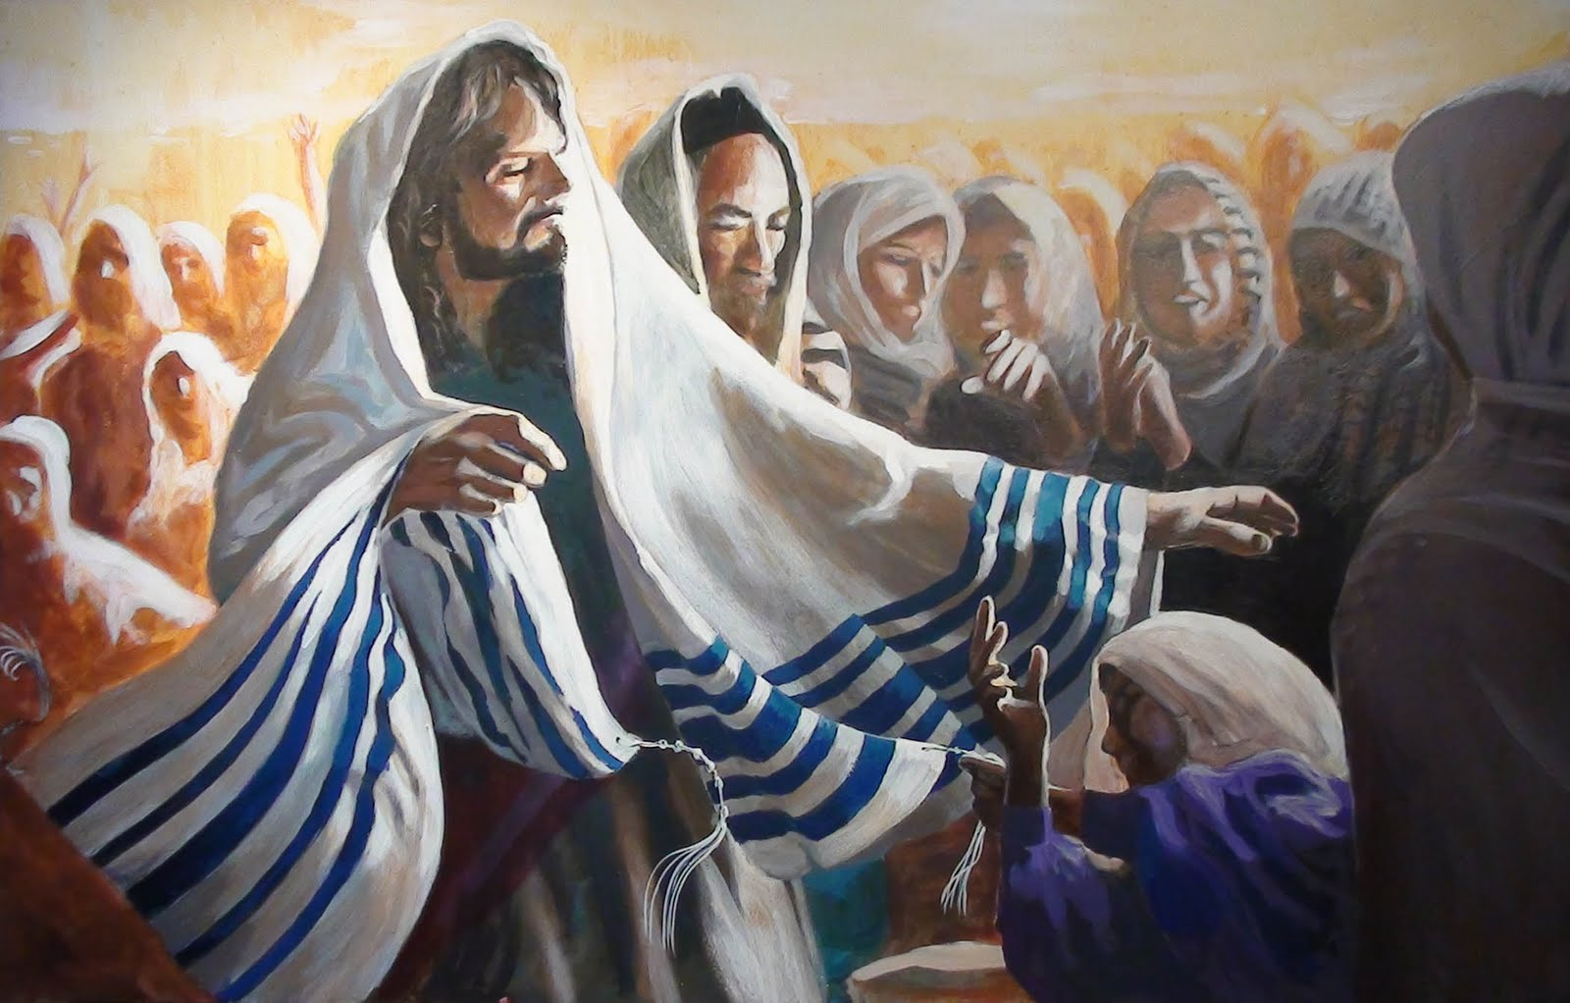
1 Then they came to the other side of the sea, to the country of the Gadarenes.

Slide 19
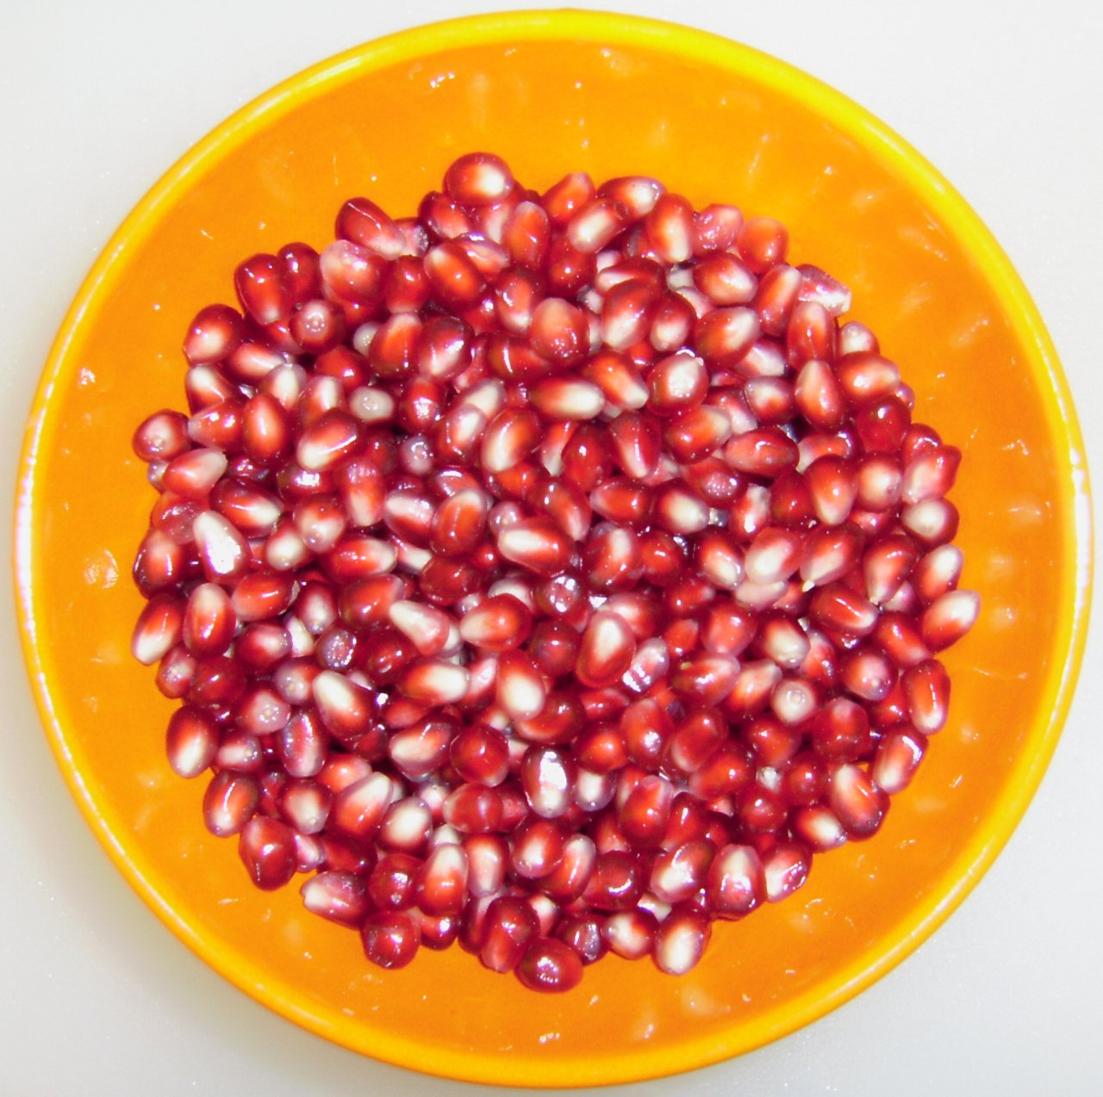
Acts 1:8
“But you shall receive power when the Holy Spirit has come upon you; and you shall be witnesses to Me in Jerusalem, and in all Judea and Samaria, and to the end of the earth."

Slide 20
29 Immediately the fountain of her blood was dried up, and she felt in her body that she was healed of the affliction.

Slide 21
30 And Jesus, immediately knowing in Himself that power had gone out of Him, turned around in the crowd and said, "Who touched My clothes?"

Slide 22
Hebrews 11:6
But without faith it is impossible to please Him, for he who comes to God must believe that He is, and that He is a rewarder of those who diligently seek Him.

Slide 23
31 But His disciples said to Him, "You see the multitude thronging You, and You say, 'Who touched Me?' "

Slide 24
32 And He looked around to see her who had done this thing.

Slide 25
33 But the woman, fearing and trembling, knowing what had happened to her, came and fell down before Him and told Him the whole truth.

Slide 26
34 And He said to her, "Daughter, your faith has made you well. Go in peace, and be healed of your affliction."

Slide 27
35 While He was still speaking, some came from the ruler of the synagogue's house who said, "Your daughter is dead. Why trouble the Teacher any further?"

Slide 28
36 As soon as Jesus heard the word that was spoken, He said to the ruler of the synagogue, "Do not be afraid; only believe."

Slide 29
John 11:25-26
25 Jesus said to her, "I am the resurrection and the life. He who believes in Me, though he may die, he shall live. 26 And whoever lives and believes in Me shall never die. Do you believe this?"

Slide 30
37 And He permitted no one to follow Him except Peter, James, and John the brother of James.

Slide 31
What would Jesus do next?

Slide 32
38 Then He came to the house of the ruler of the synagogue, and saw a tumult and those who wept and wailed loudly.

Slide 33
39 When He came in, He said to them, "Why make this commotion and weep? The child is not dead, but sleeping."

Slide 34
40 And they ridiculed Him. But when He had put them all outside, He took the father and the mother of the child, and those who were with Him, and entered where the child was lying.

Slide 35
41 Then He took the child by the hand, and said to her, "Talitha, cumi," which is translated, "Little girl, I say to you, arise."

Slide 36
42 Immediately the girl arose and walked, for she was twelve years of age. And they were overcome with great amazement.

Slide 37
Luke 7:11-17
11 Now it happened, the day after, that He went into a city called Nain; and many of His disciples went with Him, and a large crowd. 12 And when He came near the gate of the city, behold, a dead man was being carried out, the only son of his mother; and she was a widow. And a large crowd from the city was with her.

Slide 38
13 When the Lord saw her, He had compassion on her and said to her, "Do not weep." 14 Then He came and touched the open coffin, and those who carried him stood still. And He said, "Young man, I say to you, arise." 15 So he who was dead sat up and began to speak. And He presented him to his mother.

Slide 39
16 Then fear came upon all, and they glorified God, saying, "A great prophet has risen up among us"; and, "God has visited His people." 17 And this report about Him went throughout all Judea and all the surrounding region.

Slide 40
43 But He commanded them strictly that no one should know it, and said that something should be given her to eat.

