Slide 1


Slide 2


Slide 3
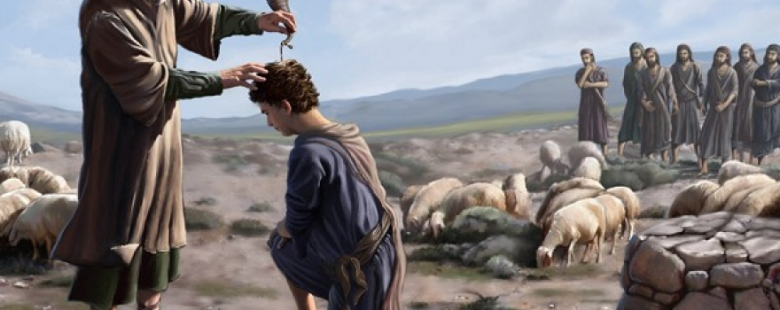


A Life Submitted Unto God
By Pastor Fee Soliven
Luke 22:39-42
Sunday Morning
December 2, 2018

Slide 4
Luke 22:39-42
39 Coming out, He went to the Mount of Olives, as He was accustomed, and His disciples also followed Him. 40 When He came to the place, He said to them, "Pray that you may not enter into temptation." 41 And He was withdrawn from them about a stone's throw, and He knelt down and prayed, 42 saying, "Father, if it is Your will, take this cup away from Me; nevertheless not My will, but Yours, be done."

Slide 5
To the best of your knowledge, are you fully surrendered to
Jesus Christ?

Slide 6
Galatians 2:20
“I have been crucified with Christ; it is no longer I who live, but Christ lives in me; and the life which I now live in the flesh I live by faith in the Son of God, who loved me and gave Himself for me.”

Slide 7
A Surrendered Life
Begins at Salvation

Slide 8
1 John 4:15-16
15 Whoever confesses that Jesus is the Son of God, God abides in him, and he in God. 16 And we have known and believed the love that God has for us. God is love, and he who abides in love abides in God, and God in him.

Slide 9
1 Corinthians 6:19-20
19 Or do you not know that your body is the temple of the Holy Spirit who is in you, whom you have from God, and you are not your own? 20 For you were bought at a price; therefore glorify God in your body and in your spirit, which are God's.

Slide 10
Full Surrender is God’s Perfect
Will for our Lives

Slide 11
1. Selfish Motives

Slide 12
1 John 5:14-15
14 Now this is the confidence that we have in Him, that if we ask anything according to His will, He hears us. 15 And if we know that He hears us, whatever we ask, we know that we have the petitions that we have asked of Him.

Slide 13
“According to his God’s Will”

Slide 14
2. Turning Away from Scripture

Slide 15
Proverbs 28:9
“One who turns away his ear from hearing the law, Even his prayer is an abomination”

Slide 16
3. Unforgiving Hearts

Slide 17
Mark 11:25-26
25 "And whenever you stand praying, if you have anything against anyone, forgive him, that your Father in heaven may also forgive you your trespasses. 26 But if you do not forgive, neither will your Father in heaven forgive your trespasses."

Slide 18
4. Family Discord

Slide 19
1 Peter 3:7-9
7 Husbands, likewise, dwell with them with understanding, giving honor to the wife, as to the weaker vessel, and as being heirs together of the grace of life, that your prayers may not be hindered.

Slide 20
8 Finally, all of you be of one mind, having compassion for one another; love as brothers, be tenderhearted, be courteous; 9 not returning evil for evil or reviling for reviling, but on the contrary blessing, knowing that you were called to this, that you may inherit a blessing.

Slide 21
5. Unconfessed Sin

Slide 22
Psalm 66:18
“If I regard iniquity in my heart, The Lord will not hear”

Slide 23
6. Doubt

Slide 24
James 1:5-8
5 If any of you lacks wisdom, let him ask of God, who gives to all liberally and without reproach, and it will be given to him. 6 But let him ask in faith, with no doubting, for he who doubts is like a wave of the sea driven and tossed by the wind.

Slide 25
7 For let not that man suppose that he will receive anything from the Lord; 8 he is a double-minded man, unstable in all his ways.

Slide 26
Jesus Christ is the Perfect Example of Full Surrender

Slide 27
Luke 22:42
saying, "Father, if it is Your will, take this cup away from Me; nevertheless not My will, but Yours, be done."

Slide 28
This is the same kind of attitude we should have not my will
but Yours be done.

Slide 29
Philippians 2:5
“Let this mind be in you which was also in Christ Jesus”

Slide 30
What does it mean to Yield Ourselves to God?

Slide 31
1 John 1:9
“If we confess our sins, He is faithful and just to forgive us our sins and to cleanse us from all unrighteousness.”

Slide 32
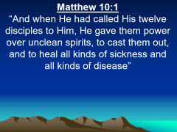

What would happen if we Gave Ourselves Fully to God?

Slide 33
Matthew 10:1
“And when He had called His twelve disciples to Him, He gave them power over unclean spirits, to cast them out, and to heal all kinds of sickness and all kinds of disease”

Slide 34
How would God respond if we Yielded Ourselves to Him?

Slide 35
Psalm 84:11
“For the LORD God is a sun and shield; The LORD will give grace and glory; No good thing will He withhold From those who walk uprightly.”

Slide 36
Romans 8:15-17
15 For you did not receive the spirit of bondage again to fear, but you received the Spirit of adoption by whom we cry out, "Abba, Father." 16 The Spirit Himself bears witness with our spirit that we are children of God, 17 and if children, then heirs--heirs of God and joint heirs with Christ, if indeed we suffer with Him, that we may also be glorified together.

Slide 37
What is hindering total surrender?

Slide 38
Is it a Person, a Possession, a Way of Life, a Habit?

Slide 39
What changes do we need to make?

Slide 40
1. We must stop rationalizing and excusing our lack of submission to God

Slide 41
2. Trust God

Slide 42
3. Remember that the safest place to be is in subjection to Him

Slide 43
4. Surrender today, tomorrow, and every day because it’s a lifelong practice that will continue until we meet the Lord in heaven

