Slide 1


Slide 2


Slide 3
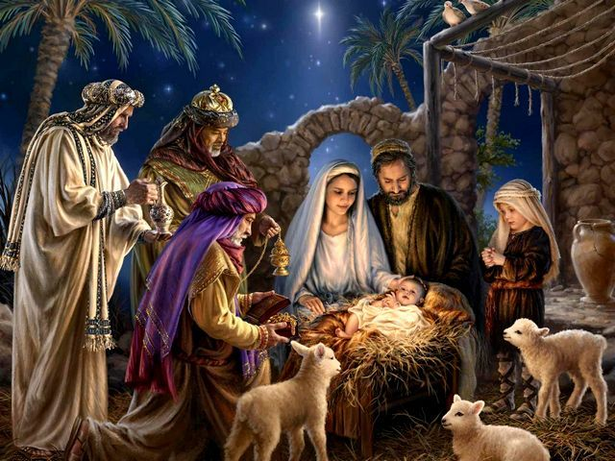

Immanuel God with Us
By Pastor Fee Soliven
Matthew 1:20-23
Sunday Morning
December 23, 2018

Slide 4
Matthew 1:20-23
20 …"Joseph, son of David, do not be afraid to take to you Mary your wife, for that which is conceived in her is of the Holy Spirit. 21 And she will bring forth a Son, and you shall call His name JESUS, for He will save His people from their sins." 22 So all this was done that it might be fulfilled which was spoken by the Lord through the prophet, saying: 23 "Behold, the virgin shall be with child, and bear a Son, and they shall call His name Immanuel," which is translated, "God with us."

Slide 5
Although many people celebrate Christmas each year, relatively few of them understand exactly what happened two thousand years ago or who the baby born that night was!

Slide 6
The Angelic Messenger

Slide 7
Luke 2:8-12
8 Now there were in the same country shepherds living out in the fields, keeping watch over their flock by night. 9 And behold, an angel of the Lord stood before them, and the glory of the Lord shone around them, and they were greatly afraid.

Slide 8
10 Then the angel said to them, "Do not be afraid, for behold, I bring you good tidings of great joy which will be to all people. 11 For there is born to you this day in the city of David a Savior, who is Christ the Lord.

Slide 9
1 Peter 1:8
“And though you have not seen Him, you love Him, and though you do not see Him now, but believe in Him, you greatly rejoice with joy inexpressible and full of glory”

Slide 10
Luke 2:13
“a multitude of the heavenly host praising God”

Slide 11
The Christmas Announcement

Slide 12
Luke 2:11
“For today in the city of David there has been born for you a Savior, who is Christ the Lord”

Slide 13
Savior

Slide 14
1 Peter 1:18-20
18 knowing that you were not redeemed with corruptible things, like silver or gold, from your aimless conduct received by tradition from your fathers, 19 but with the precious blood of Christ, as of a lamb without blemish and without spot. 20 He indeed was foreordained before the foundation of the world, but was manifest in these last times for you…

Slide 15
Ephesians 1:7-8
“In Him we have redemption through His blood, the forgiveness of our trespasses, according to the riches of His grace which He lavished on us.”

Slide 16
Colossians 1:13-14
13 He has delivered us from the power of darkness and conveyed us into the kingdom of the Son of His love, 14 in whom we have redemption through His blood, the forgiveness of sins.

Slide 17
Son of God

Slide 18
Colossians 2:9-10
9 For in Him dwells all the fullness of the Godhead bodily; 10 and you are complete in Him, who is the head of all principality and power.

Slide 19
Luke 24:47-49
47 and that repentance and remission of sins should be preached in His name to all nations, beginning at Jerusalem. 48 And you are witnesses of these things. 49 Behold, I send the Promise of My Father upon you; but tarry in the city of Jerusalem until you are endued with power from on high."

Slide 20
“Power from on High”

Slide 21
Christ

Slide 22
Colossians 2:3
“in whom are hidden all the treasures of wisdom and knowledge”

Slide 23
Hebrews 9:11-14
11 But Christ came as High Priest of the good things to come, with the greater and more perfect tabernacle not made with hands, that is, not of this creation. 12 Not with the blood of goats and calves, but with His own blood He entered the Most Holy Place once for all, having obtained eternal redemption.

Slide 24
13 For if the blood of bulls and goats and the ashes of a heifer, sprinkling the unclean, sanctifies for the purifying of the flesh, 14 how much more shall the blood of Christ, who through the eternal Spirit offered Himself without spot to God, cleanse your conscience from dead works to serve the living God?

Slide 25
Lord

Slide 26
John 8:18-19
18 I am One who bears witness of Myself, and the Father who sent Me bears witness of Me." 19 Then they said to Him, "Where is Your Father?" Jesus answered, "You know neither Me nor My Father. If you had known Me, you would have known My Father also."

Slide 27
John 10:27-30
27 My sheep hear My voice, and I know them, and they follow Me. 28 And I give them eternal life, and they shall never perish; neither shall anyone snatch them out of My hand. 29 My Father, who has given them to Me, is greater than all; and no one is able to snatch them out of My Father's hand. 30 I and My Father are one."

Slide 28
Romans 10:9-10
9 “If you confess with your mouth Jesus as Lord, and believe in your heart that God raised Him from the dead, you will be saved; 10 for with the heart a person believes, resulting in righteousness, and with the mouth he confesses, resulting in salvation.”

Slide 29
1 Peter 1:3-5
3 Blessed be the God and Father of our Lord Jesus Christ, who according to His abundant mercy has begotten us again to a living hope through the resurrection of Jesus Christ from the dead, 4 to an inheritance incorruptible and undefiled and that does not fade away, reserved in heaven for you, 5 who are kept by the power of God through faith for salvation ready to be revealed in the last time.

Slide 30
God the Father

Slide 31
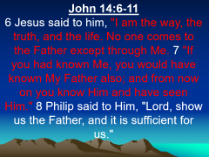

John 3:16
“For God so loved the world, that He gave His only begotten Son, that whoever believes in Him shall not perish, but have eternal life”

Slide 32
John 14:6-11
6 Jesus said to him, "I am the way, the truth, and the life. No one comes to the Father except through Me. 7 "If you had known Me, you would have known My Father also; and from now on you know Him and have seen Him." 8 Philip said to Him, "Lord, show us the Father, and it is sufficient for us."

Slide 33
9 Jesus said to him, "Have I been with you so long, and yet you have not known Me, Philip? He who has seen Me has seen the Father; so how can you say, 'Show us the Father'? 10 Do you not believe that I am in the Father, and the Father in Me? The words that I speak to you I do not speak on My own authority; but the Father who dwells in Me does the works. 11 Believe Me that I am in the Father and the Father in Me, or else believe Me for the sake of the works themselves.

Slide 34
God the Holy Spirit

Slide 35
1. Leads You to Truth

Slide 36
John 16:14
“However, when He, the Spirit of truth, has come, He will guide you into all truth; for He will not speak on His own authority, but whatever He hears He will speak; and He will tell you things to come.”

Slide 37
2. Gives You Power from Heaven

Slide 38
Acts 1:8
“But you shall receive power when the Holy Spirit has come upon you; and you shall be witnesses to Me in Jerusalem, and in all Judea and Samaria, and to the end of the earth."

Slide 39
3. Gives You a Second Birth

Slide 40
John 3:5-8
5 Jesus answered, "Most assuredly, I say to you, unless one is born of water and the Spirit, he cannot enter the kingdom of God. 6 That which is born of the flesh is flesh, and that which is born of the Spirit is spirit.

Slide 41
7 Do not marvel that I said to you, 'You must be born again.' 8 "The wind blows where it wishes, and you hear the sound of it, but cannot tell where it comes from and where it goes. So is everyone who is born of the Spirit."

Slide 42
4. Lives Inside of You Forever

Slide 43
Romans 8:9-11
9 But you are not in the flesh but in the Spirit, if indeed the Spirit of God dwells in you. Now if anyone does not have the Spirit of Christ, he is not His. 10 And if Christ is in you, the body is dead because of sin, but the Spirit is life because of righteousness.

Slide 44
11 But if the Spirit of Him who raised Jesus from the dead dwells in you, He who raised Christ from the dead will also give life to your mortal bodies through His Spirit who dwells in you.

Slide 45
1 Peter 1:22-23
22 Since you have purified your souls in obeying the truth through the Spirit in sincere love of the brethren, love one another fervently with a pure heart, 23 having been born again, not of corruptible seed but incorruptible, through the word of God which lives and abides forever…

Slide 46
1. How does understanding the names and titles given to Jesus help you better comprehend who the baby in the manger was?

Slide 47
2. How would you explain Christmas to someone who knows little or nothing about the true meaning of the Christmas Season?

